Slide 1
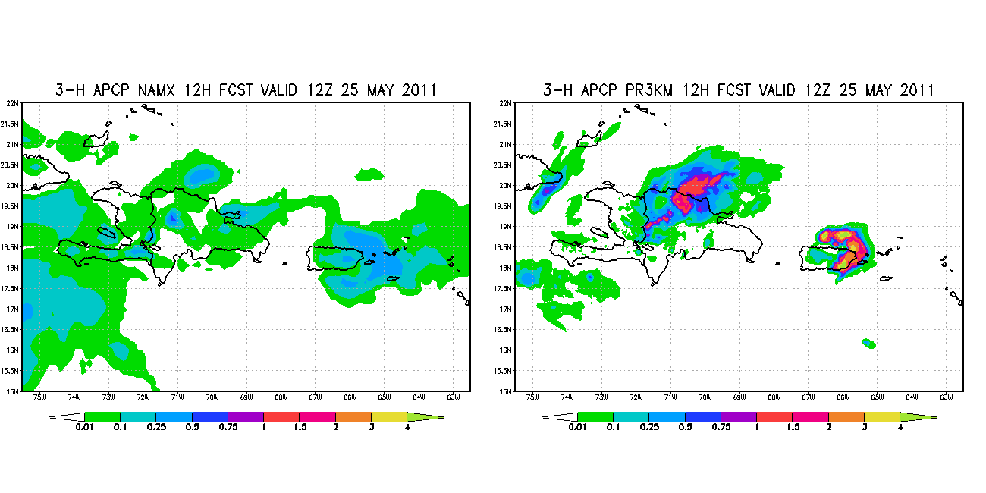
NAM 12 km vs 3 km HRW
Valid Wed. May 25 at 12z

