Slide 1
Dispersion Modeling Support at the NOAA /NWS
National Centers for Environmental Prediction (NCEP) and OAR/Air Resources Lab (ARL)
Jeff McQueen, Geoff DiMego,
Caterina Tassone, Geoff Manikin and Joe Carr
Roland Draxler, Barbara Stunder and Glenn Rolph
(NOAA/ARL)
November 1, 2011

Slide 2
Operational Meteorological and Dispersion Model Support
Progress towards:
  WMO Regional Specialized Meteorological Center support
    Run at NCEP 24/7 by Senior Duty Met (SDM)
  Homeland Security support
    1.3 km nest
  Volcanic Ash, dust, smoke regional and global capability
Probabilistic Prediction
  High Resolution Meteorological Ensembles
Evaluation Techniques
  Concentration Evaluation
Lessons Learned

Slide 3


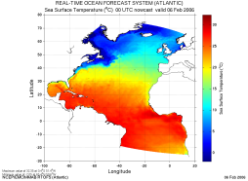


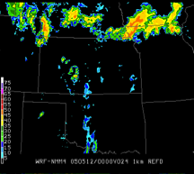
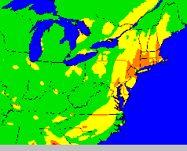

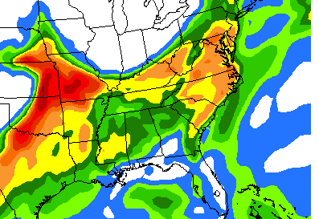
NOAA’s Model Production Suite
Climate
CFSv2
Oceans
HYCOM
WAVEWATCH III
NOS
PORTS
GLOFS
Coupled
Hurricane GFDL
HWRF
MOM4
Chesapeake
Tampa
Delaware
ADCIRC
3.5B Obs/Day
Satellites + Radar
99.9%
Global
Forecast
System
Regional NAM
NEMS NMM
Dispersion
ARL/HYSPLIT RSMC, Volc Ash
Regional
DA
Global Data
Assimilation
Severe Weather
WRF NMM/ARW
Workstation WRF
Short-Range
Ensemble Forecast
North American Ensemble Forecast System
Regional
DA
WRF: ARW, NMM
ETA, RSM
Air Quality
GFS, Canadian Global Model
NAM/CMAQ, smoke, dust
Forecast
Rapid Update
for Aviation
3
NOAH Land Surface Model

Slide 4
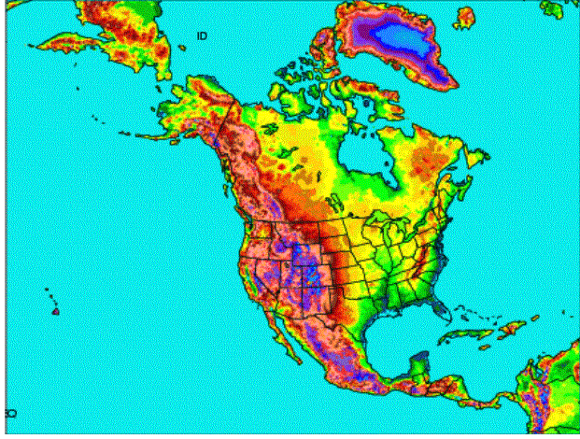
Oct 2011 NAM Upgrade
New NAM
NEMS based NMMB
B-grid replaces E-grid
Parent remains 12 km to 84 hr
Multiple Nests Run to 60 hr
  4 km CONUS nest
  6 km Alaska nest
  3 km HI & PR nests
Single locatable ~1.33-1.5 km FireWeather/IMET/DHS run to 36hr
Current NAM
WRF-NMM (E-grid)
GSI analysis
4/Day = 6 hr update
Forecasts to 84 hours
12 km horizontal
12 hr pre-forecast assimilation period with 3hr updates (catch-up)

Slide 5
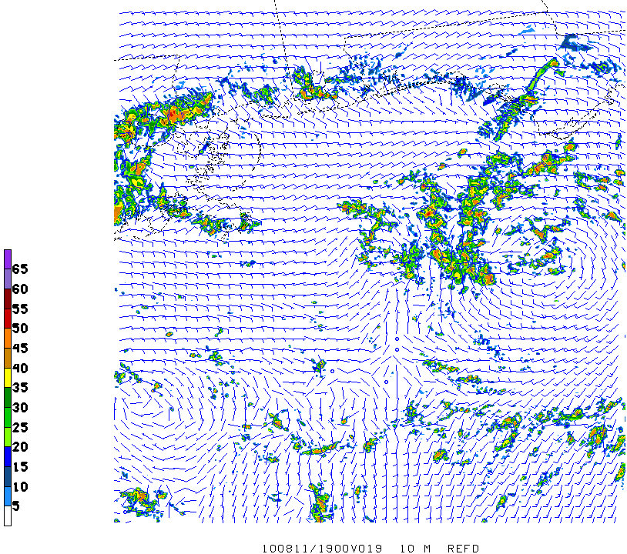
Gulf Spill 1.33 km NEMS/NMMB nest
Tropical Depression 5
19Z 11 August
1000 m REFD, 10 m winds

Slide 6
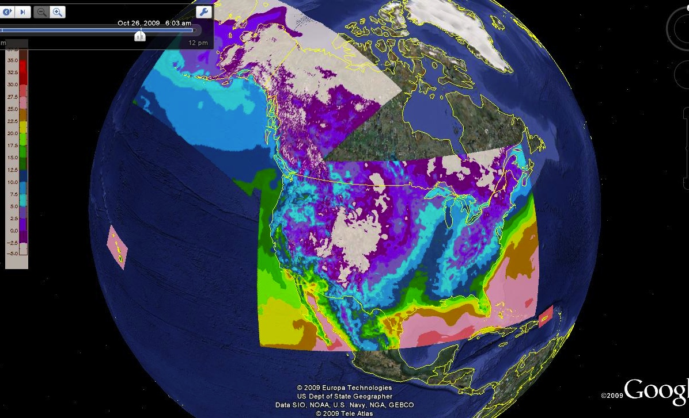
Google Map of 4 RTMA Domains
Real-time Mesoscale Analysis
Courtesy of Yan Zheng University of Utah
Real Time Mesoscale Analysis
Analyzed every hour on the NWS’ NDFD grids
10 m wind + est. anal. uncertainty
2m Temperature + est.anal.unc.
2m dew point + est.anal.unc.
Sfc pressure + est.anal.uncertainty
1 hr precip (Stage 2)
GOES Eff. Cloud Amount, PBLH

Slide 7
U.S. Dispersion Modeling Response
Center | Dispersion model | Meteorological model | Downscaled Mesoscale model
Interagency Modeling and Atmospheric Advisory Center (IMAAC) | National Atmospheric Radiation Advisory Center (NARAC) | GFS 35 km | WRF-ARW 5 km
NOAA/RSMC | HYSPLIT | GFS 35 km
DOD/Defense Threats Reduction Agency | HPAC-SCIPUFF | GFS 35 km | WRF 4 km

Slide 8
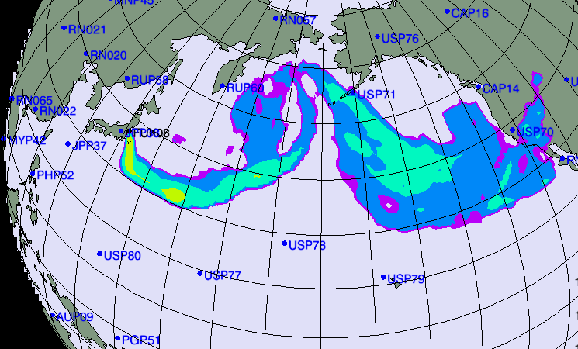

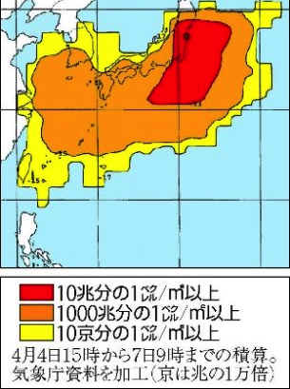
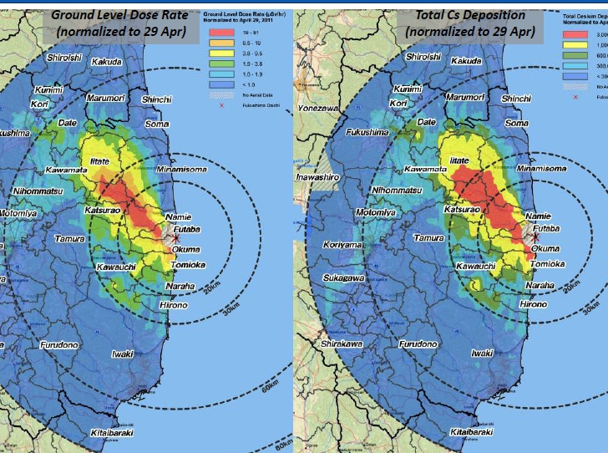
IAEA Long Range Transport Plume
New York Times March 16, 2011
JMA estimate

Slide 9
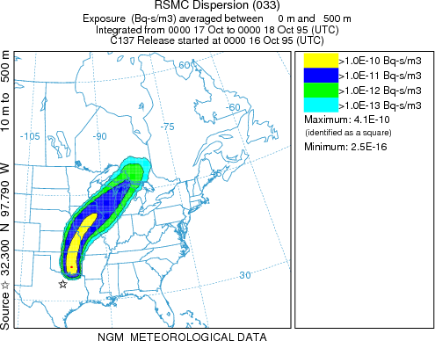
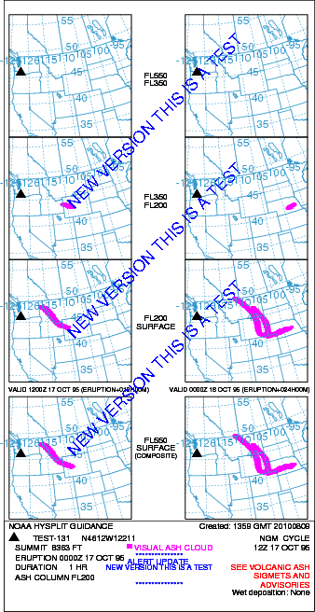
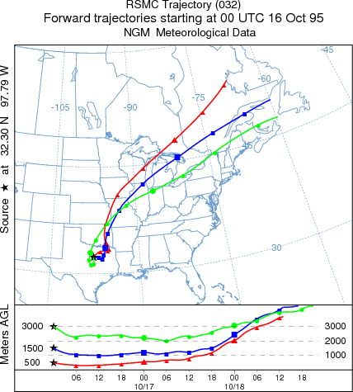
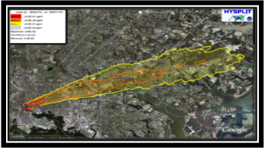
Operational HYSPLIT
  Volcano, RSMC, smoke, dust
HLS

Slide 10
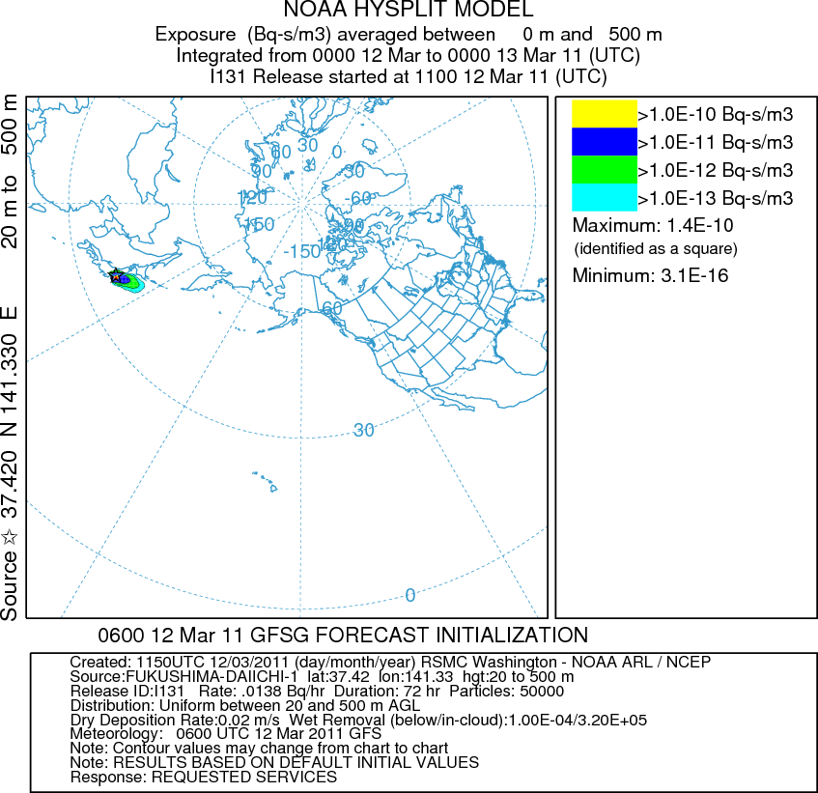
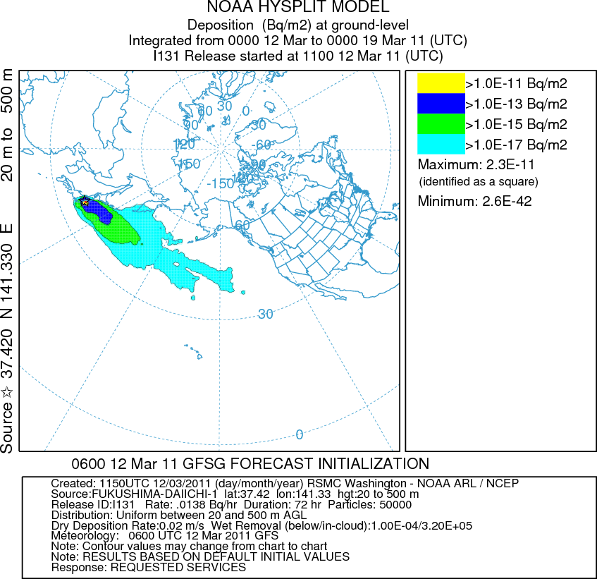
RSMC Washington Initial Response

Slide 11
RSMC-Washington response to Fukushima

Slide 12
RSMC-Washington response to Fukushima

Slide 13
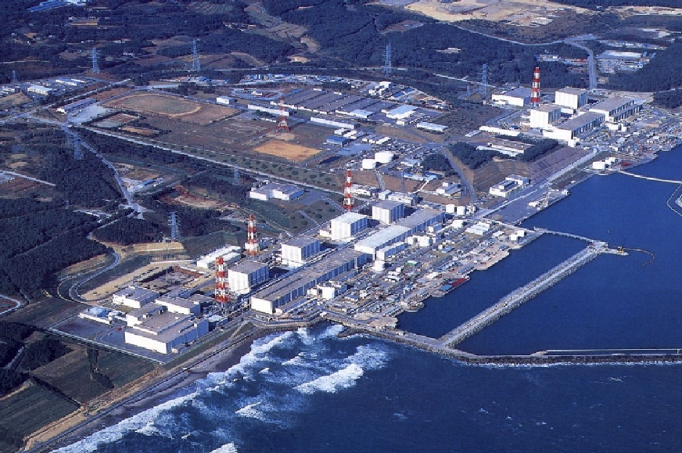

Slide 14
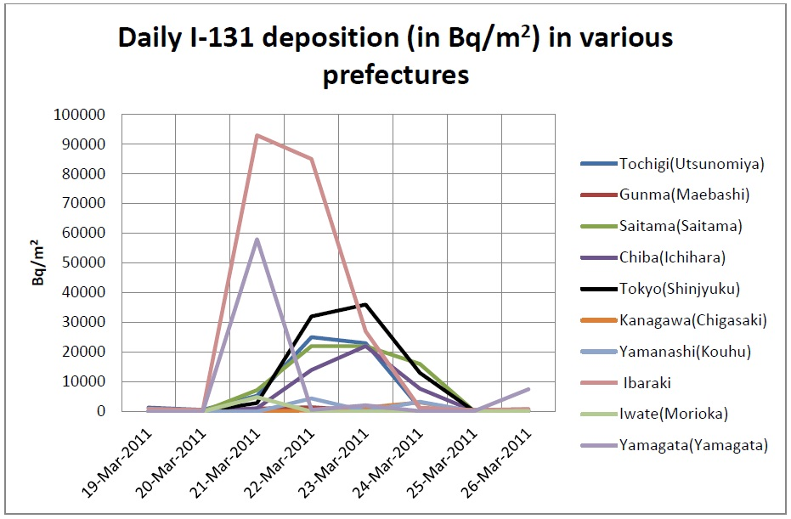
Monitoring Data available from web

Slide 15
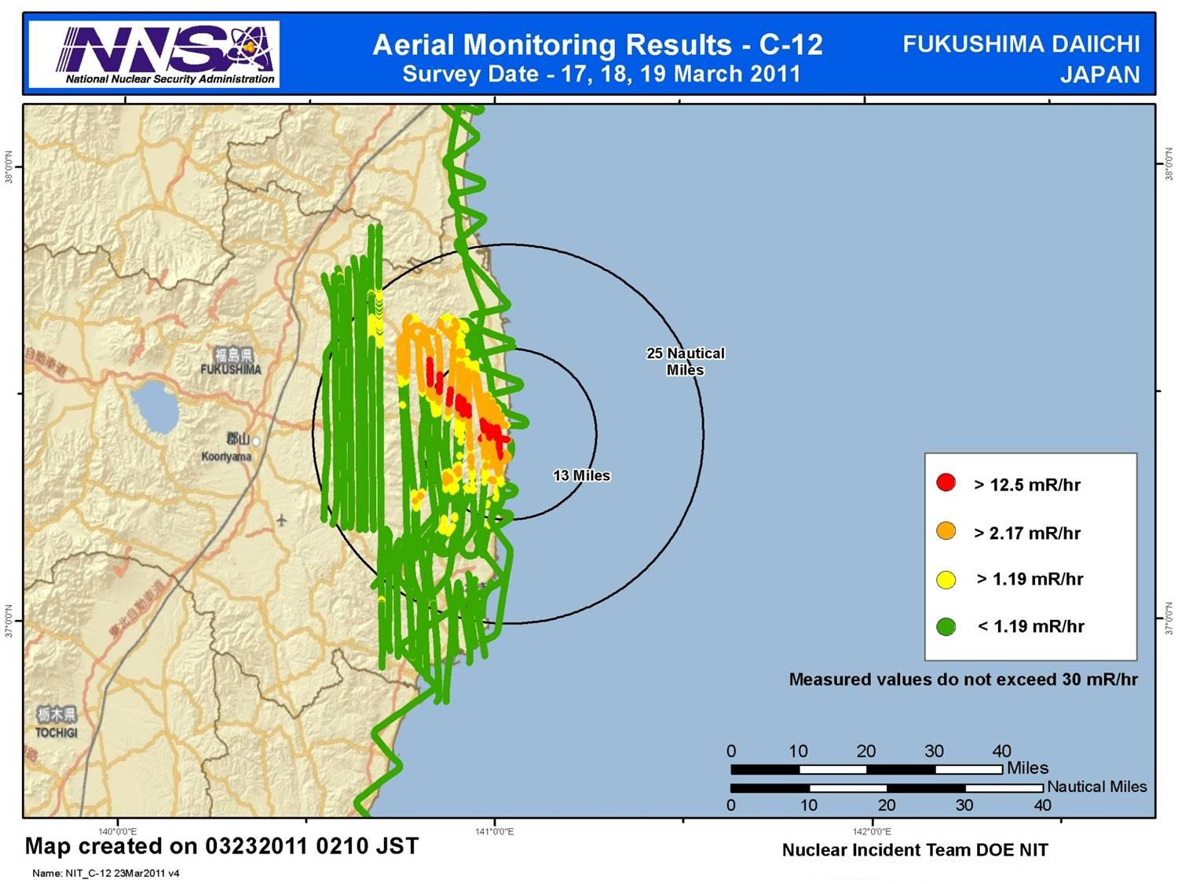
Department of Energy Aerial Measurements

Slide 16
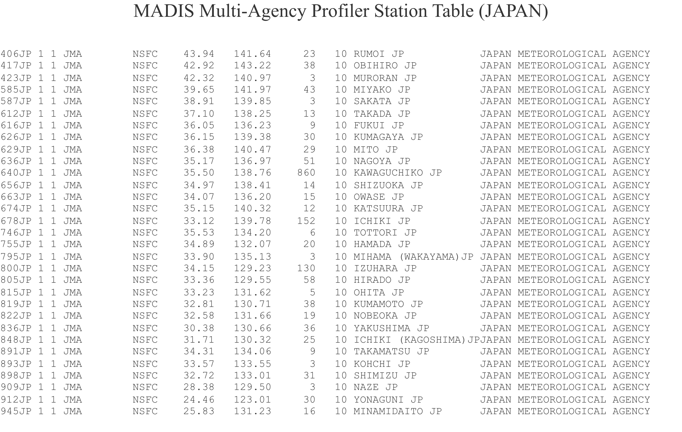
JMA Profilers
Useful for met. Model evaluation

Slide 17
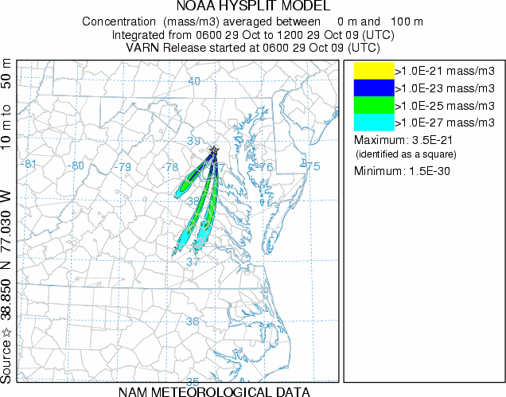
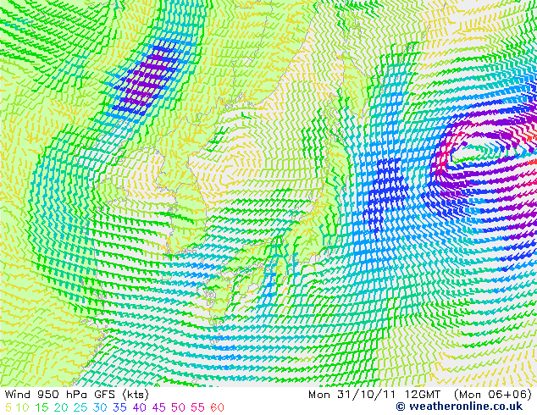
New Products
Higher Res. GFS T574 (35 km)
Ensemble Variance

Slide 18
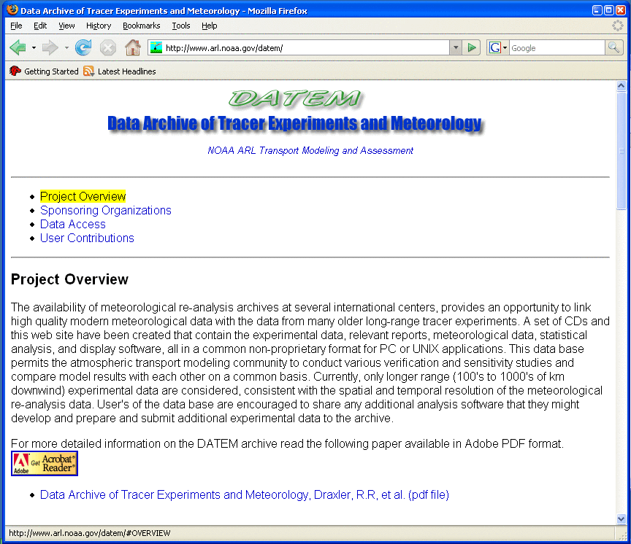
Evaluation Techniques
Comparison to experimental data
Archive of NOAA experimental tracer data and meteorology is on-line and in a common data format
Meteorology comes primarily from the regional reanalysis
WEB directory also includes all statistical programs, and the …
model configuration used to produce tabulated results
http://www.arl.noaa.gov/DATEM.php

Slide 19
Comparison to experimental data, cont’d
19
http://www.arl.noaa.gov/DATEM_results.php
EXPERIMENT | Average | Paired
ACURATE (18 m) | 3.25 | 1.77
ANATEX (33) | 3.48 | 1.84
ANATEX (33) | 2.66 | 1.63
CAPTEX (6) | 3.24 | 1.63
¹ETEX (1) | 2.37 | 1.55
¹INEL74 (2 m) | 1.71 | 1.37
METREX (243) | 2.81 | 1.77
METREX (243) | 2.27 | 1.58
OKC80 (2) | 2.50 | 1.73
North American Regional Reanalysis: http://nomads.ncdc.noaa.gov

Slide 20
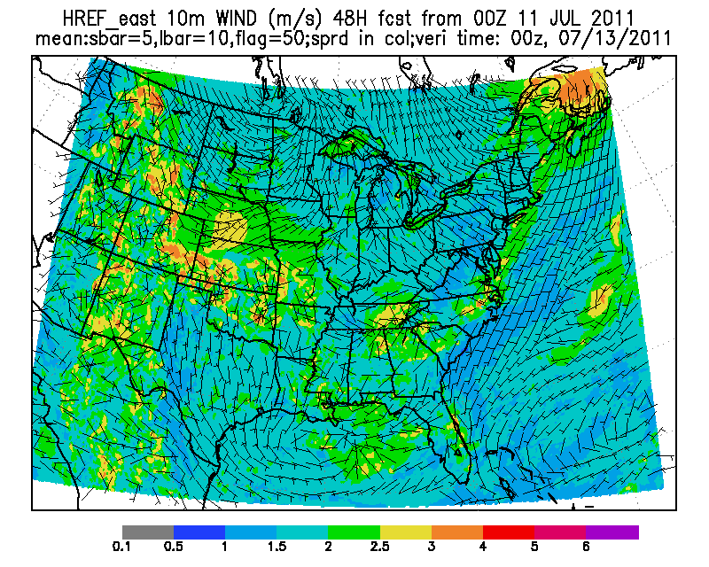
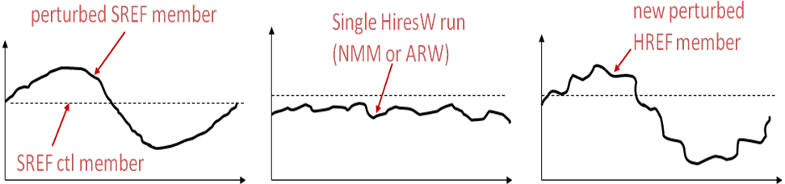
Hybrid High Resolution
Ensemble Prediction
High Resolution Model | Domain | Resolution | Time lagged members | # members
NAM NEMS NMMB nest | CONUS | 4 km/L35 | Current, T-6, T-12h | 3
NOAA/ ESRL HRRR | CONUS | 3 km/L35 | Current, T-1, T-2, T-3, T-4, T-5, T-6 | 7
WRF High Resolution Window ARW | Eastern U.S. Western U.S. | 4.5 km/L35 | Current, T-12 | 2
WRF High Resolution Window NMM | Eastern U.S. Western U.S. | 4 km/L35 | Current, T-12 | 2
NEMS/NMMB Storm Prediction Center (SPC) Configuration | CONUS | 4 km/L35 | Current, T-12 | 2

Slide 21
Probabilistic verification
Reliability Diagram – indicates joint bias
4 km MM5 Analysis SCIPUFF “Truth” vs
32 km SREF SCIPUFF Forecast
June-July reliability
Lower dosage show good reliability
Higher dosage has positive bias over higher probability range
Aug-Sept-Oct Reliability
Overwhelmingly large positive bias over high probability range

Slide 22
Economic Value (EV)
Performance over different cost/loss ratio
High dosage prediction over low cost/ratio has high EV.
Answer such questions as:
If cost/loss is extremely low, e.g. loss is so high that cost can be neglected, then take action in lower probability has skill?
The answer is YES, according to EV
Lower probability means higher FAR
(don’t care false alarm to take action)
For high, less dangerous dosage, should use moderate prob thresholds
Low prob High prob

Slide 23
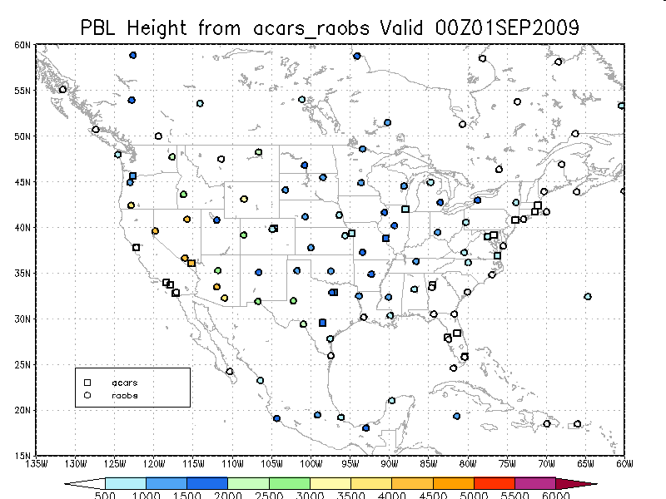
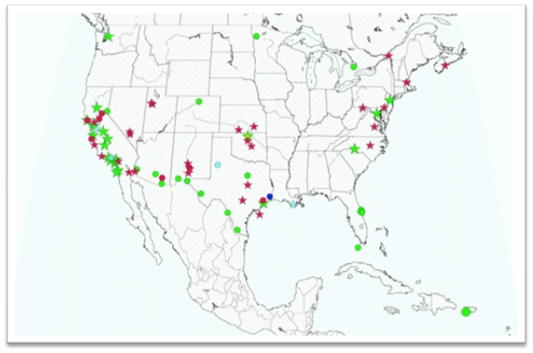
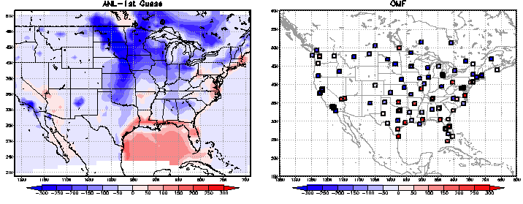
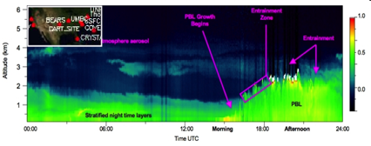
Improved Boundary Layer Analysis
Cap PBL Profilers
MPLNET Lidars
Need more observations for analysis to have an impact
Need more independent observations for verification

Slide 24
Lessons Learned
& Recommendations
NRT re-locatable, global high resolution NWP – atmospheric dispersion modeling
  WMO/RSMC → Most useful for long rang transport (GFS-HYSPLIT)
  High Resolution reanalysis (GFS GSI too coarse) capability
  Near real-time Met model evaluation near the event
Suprises encountered
  On the fly Improvements (re.g: long-lasting release)
  Misinterpretation of RSMC products (unit release, long-range transport)
  NOAA RSMC web server is not operational (at ARL on a research platform)
Coordination with RSMCs
  Define & interpret model output strengths/weakness (long range vs near-field products) with uncertainties
  Need for access of real-time monitoring data at centrally located web site

Slide 25
Lessons Learned
& Recommendations
Enhance boundary layer measurements for evaluation, assimilation:
  Radiosondes, ACARS
  PBL Profilers (e.g.: U.S., Japan, Europe)
  Lidar (EARLINET, WMO- GALION), ASOS Ceilometers (PBLH, Aerosols)
Develop and evaluate high resolution ensemble systems

