Slide 1
Dispersion Modeling Support at the NOAA /NWS
National Centers for Environmental Prediction (NCEP) and OAR/Air Resources Lab (ARL)
Jeff McQueen, Geoff DiMego,
Caterina Tassone, Marina Tsidulko, Binbin Zhou,
Yanqui Zhu, Sarah Lu, Ho-Chun Huang and Geoff Manikin
(NCEP/EMC)
Roland Draxler, Barbara Stunder and Glenn Rolph
(NOAA/ARL)
July 12, 2011

Slide 2
Progress with Operational Meteorological and Dispersion Model Support
Progress towards:
  WMO Regional Specialized Meteorological Center support
    Run at NCEP 24/7 by Senior Duty Met (SDM)
  Homeland Security support
    1.3 km nest
  Volcanic Ash, dust, smoke global capability
Probabilistic Prediction
  High Resolution Meteorological Ensembles
Evaluation Techniques
  Concentration Evaluation
Future Directions

Slide 3


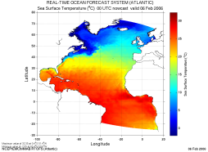
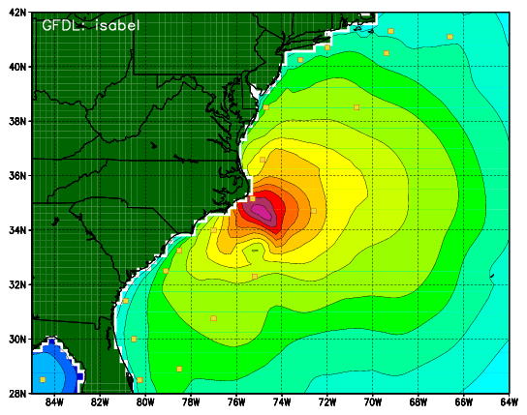
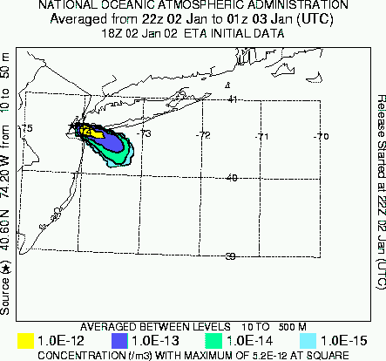
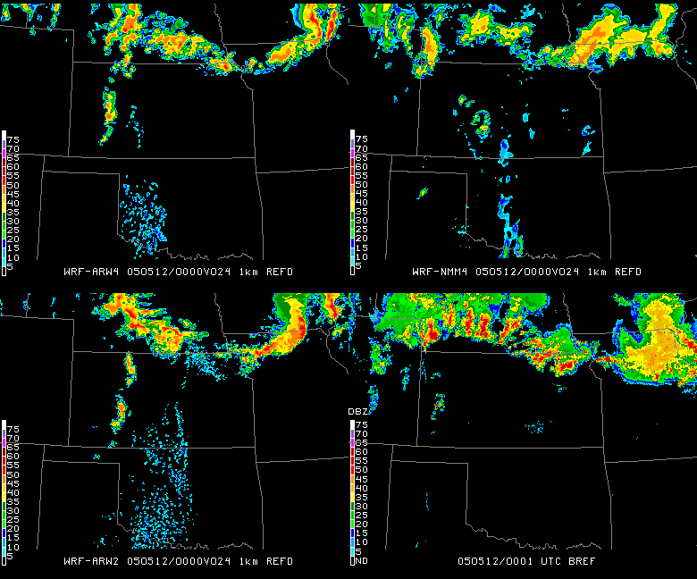
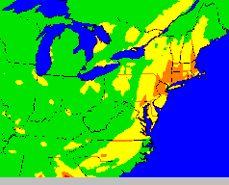
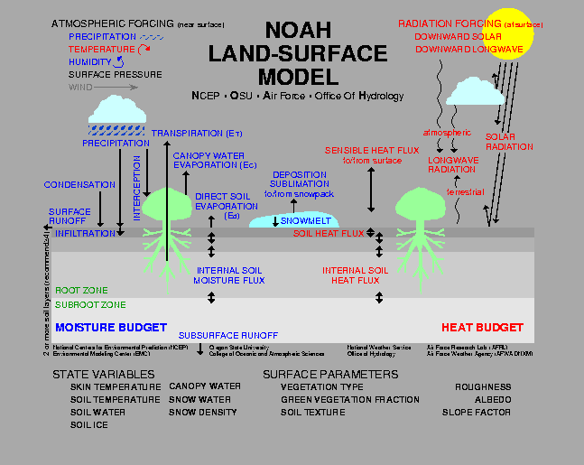
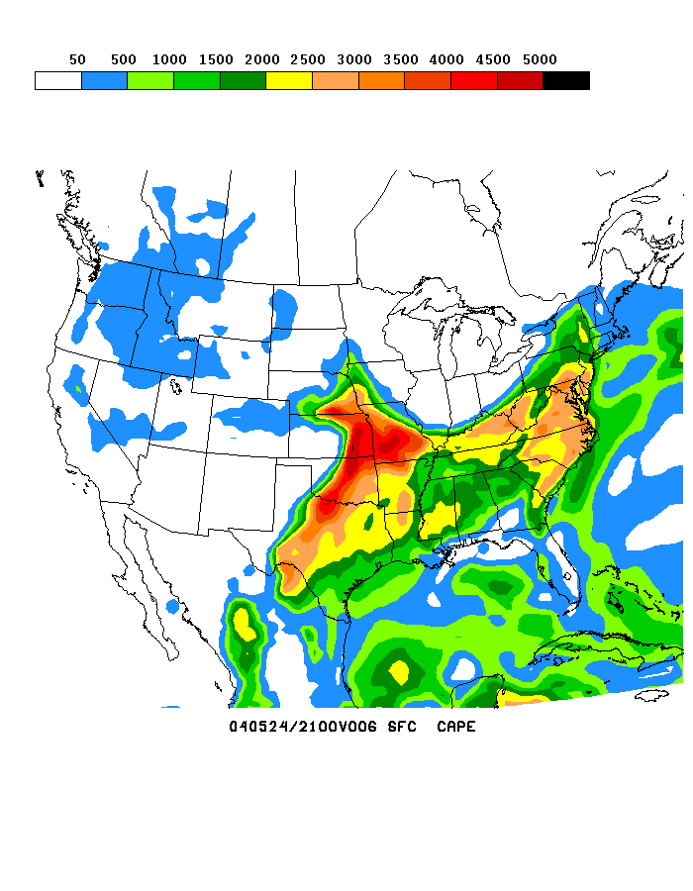
NOAA’s Model Production Suite
Climate
CFSv2
Oceans
HYCOM
WAVEWATCH III
NOS
PORTS
GLOFS
Coupled
Hurricane GFDL
HWRF
MOM4
Chesapeake
Tampa
Delaware
ADCIRC
3.5B Obs/Day
Satellites + Radar
99.9%
Global
Forecast
System
Regional NAM
NEMS NMM
Dispersion
ARL/HYSPLIT RSMC, Volc Ash
Regional
DA
Global Data
Assimilation
Severe Weather
WRF NMM/ARW
Workstation WRF
Short-Range
Ensemble Forecast
North American Ensemble Forecast System
Regional
DA
WRF: ARW, NMM
ETA, RSM
Air Quality
GFS, Canadian Global Model
NAM/CMAQ, smoke, dust
Forecast
Rapid Update
for Aviation
3
NOAH Land Surface Model

Slide 4
NEMS Component Structure
All boxes represent
ESMF components.
MAIN
NEMS
NEMS
LAYER
EARTH(1:NM)
Ensemble
Coupler
Below the dashed line, the source codes are organized by the model developers.
Ocean
Atm
Ice
NMM
GFS
FIM
ARW
Nest Domains(1:ND)
Dyn
Phy
Wrt
Dyn
Phy
Wrt
Dyn
Phy
Wrt
Dyn
Phy
Wrt
CMAQ
GOCART
WRFChem

Slide 5
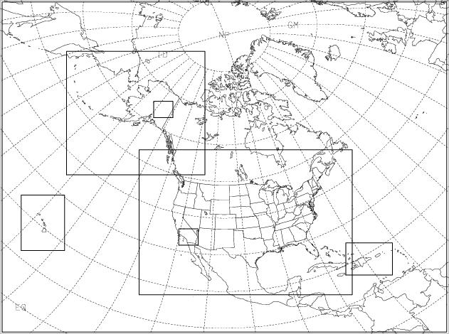
National Environmental Modeling System FY11; Q3
12 km
1.5 km
Parent (12 km)
– 84 hrs
Children (6, 4 & 3 km)
– 60 hrs
IMET (1.5 & 1.33 km)
– 36 hrs
6 km
3 km
4 km
3 km
1.33 km
Nonhydrostatic Mesoscale Model (NMM) → NonHydrostatic Multiscale Model on B grid (NMMB)
-- Physics retuned for NMMB
-- Additional data sets: Windsat, ASCAT, ACARS humidity, NOAA-19 (HIRS and AMSU-A), IASI radiances, AQUA (AMSU-A), GPS (radio occultation)

Slide 6
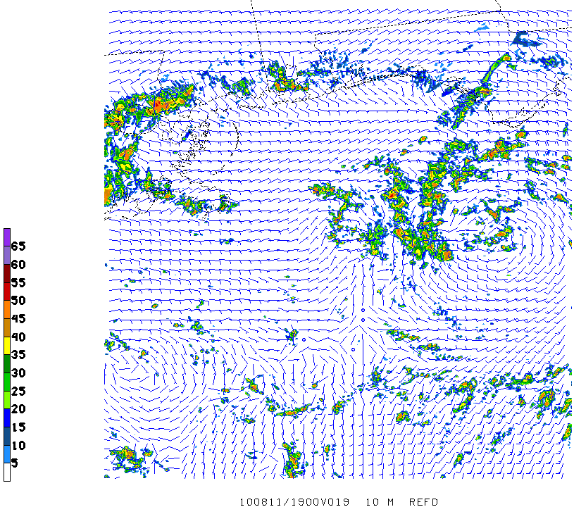
NCEP Test of Fire Wx Nest Capability Gulf Spill 1.33 km NEMS/NMMB nest
Tropical Depression 5
19Z 11 August
1000 m REFD, 10 m winds

Slide 7
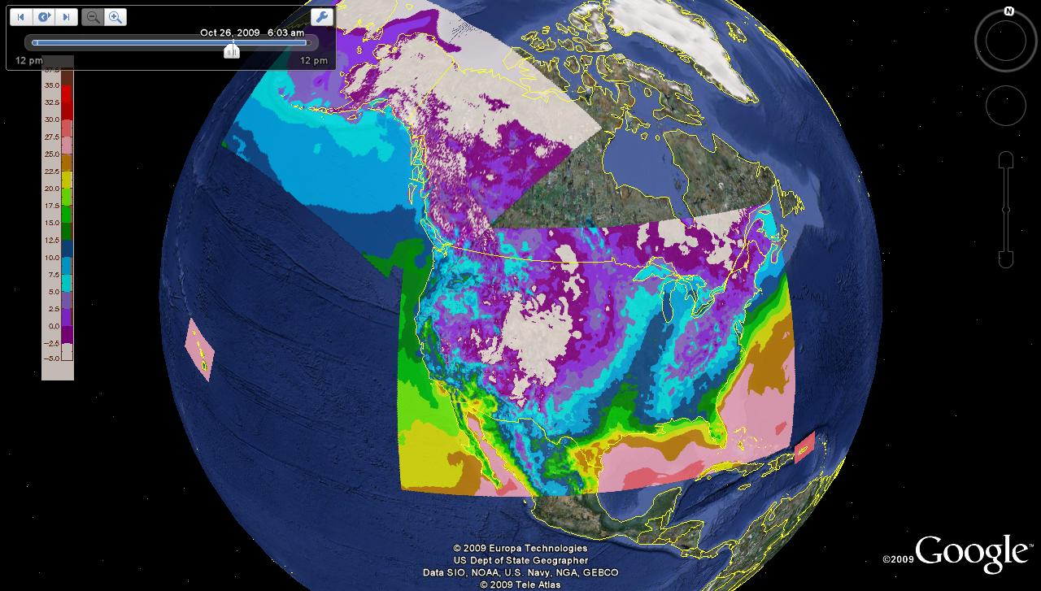
Google Map of 4 RTMA Domains
First Phase of Analysis of Record
Courtesy of Yan Zheng University of Utah
Real Time Mesoscale Analysis
Analyzed every hour on the NWS’ NDFD grids
10 m wind + est. anal. uncertainty
2m Temperature + est.anal.unc.
2m dew point + est.anal.unc.
Sfc pressure + est.anal.uncertainty
1 hr precip (Stage 2)
GOES Eff. Cloud Amount, PBLH

Slide 8
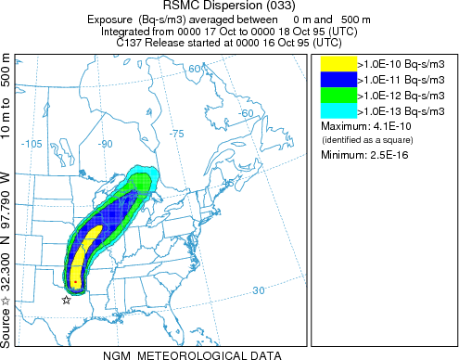
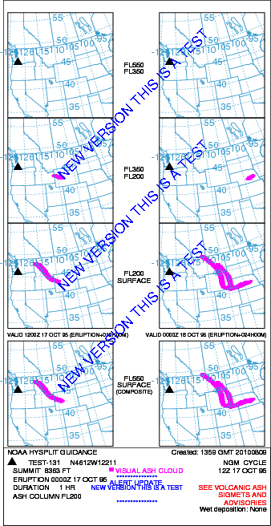
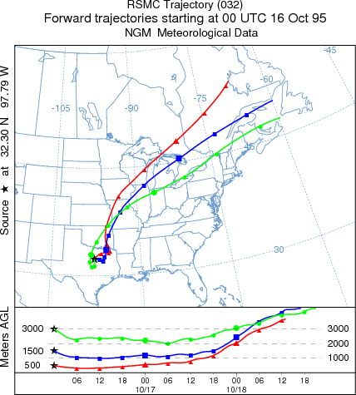
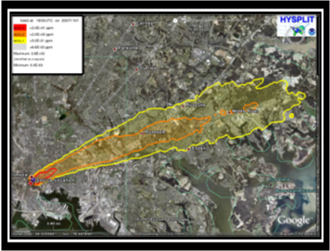
Operational HYSPLIT
  Volcano, RSMC, Homeland Security
HLS

Slide 9
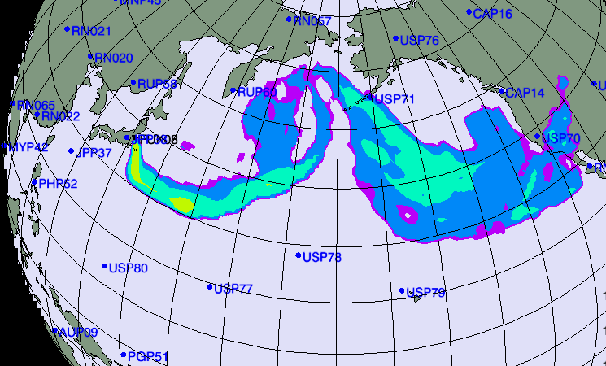
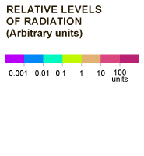
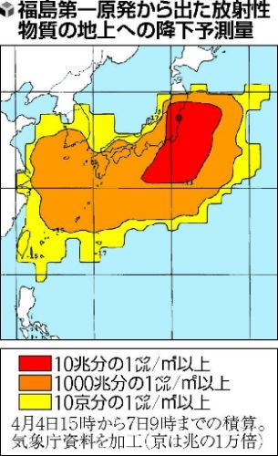
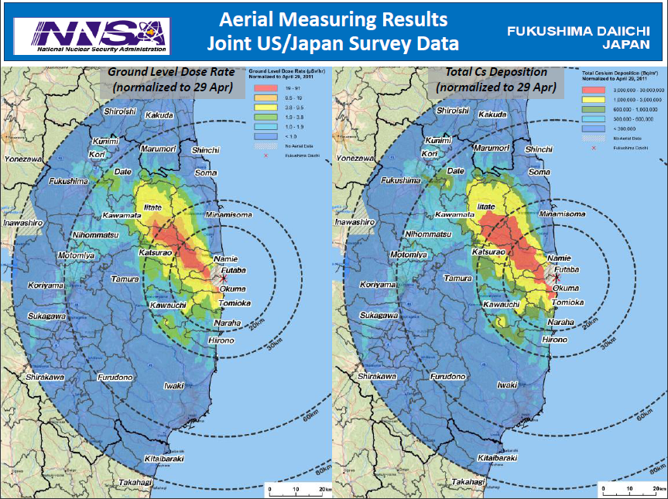
IAEA Long Range Transport Plume
New York Times March 16, 2011
JMA estimate

Slide 10
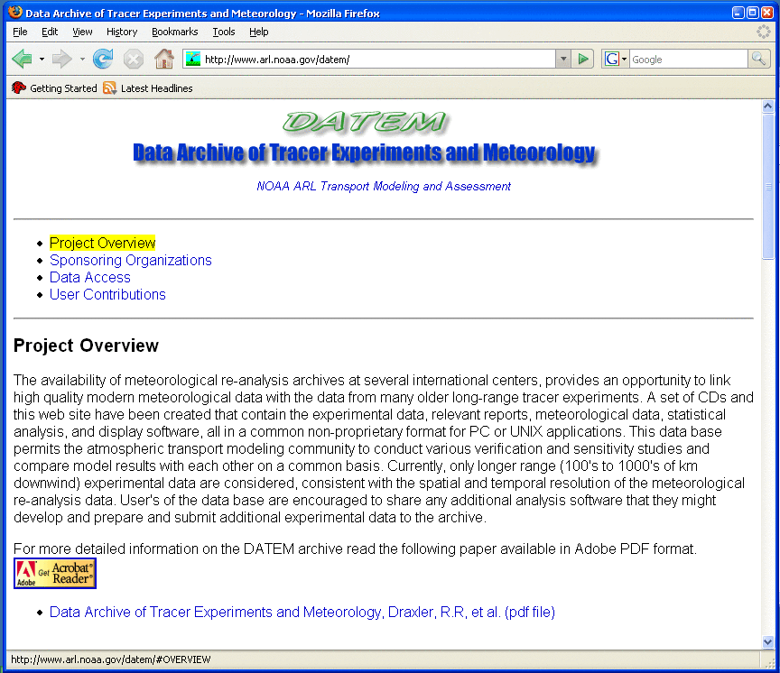
Evaluation Techniques
Comparison to experimental data
Archive of NOAA experimental tracer data and meteorology is on-line and in a common data format
Meteorology comes primarily from the regional reanalysis
WEB directory also includes all statistical programs, and the …
model configuration used to produce tabulated results
http://www.arl.noaa.gov/DATEM.php

Slide 11
Comparison to experimental data, cont’d
11
http://www.arl.noaa.gov/DATEM_results.php
EXPERIMENT | Average | Paired
ACURATE (18 m) | 3.25 | 1.77
ANATEX (33) | 3.48 | 1.84
ANATEX (33) | 2.66 | 1.63
CAPTEX (6) | 3.24 | 1.63
¹ETEX (1) | 2.37 | 1.55
¹INEL74 (2 m) | 1.71 | 1.37
METREX (243) | 2.81 | 1.77
METREX (243) | 2.27 | 1.58
OKC80 (2) | 2.50 | 1.73
North American Regional Reanalysis: http://nomads.ncdc.noaa.gov

Slide 12
Probabilistic verification
Reliability Diagram – indicates joint bias
4 km MM5 Analysis SCIPUFF “Truth” vs
32 km SREF SCIPUFF Forecast
June-July reliability
Lower dosage show good reliability
Higher dosage has positive bias over higher probability range
Aug-Sept-Oct Reliability
Overwhelmingly large positive bias over high probability range

Slide 13
Economic Value (EV)
Performance over different cost/loss ratio
High dosage prediction over low cost/ratio has high EV.
Answer such questions as:
If cost/loss is extremely low, e.g. loss is so high that cost can be neglected, then take action in lower probability has skill?
The answer is YES, according to EV
Lower probability means higher FAR
(don’t care false alarm to take action)
For high, less dangerous dosage, should use moderate prob thresholds
Low prob High prob

Slide 14
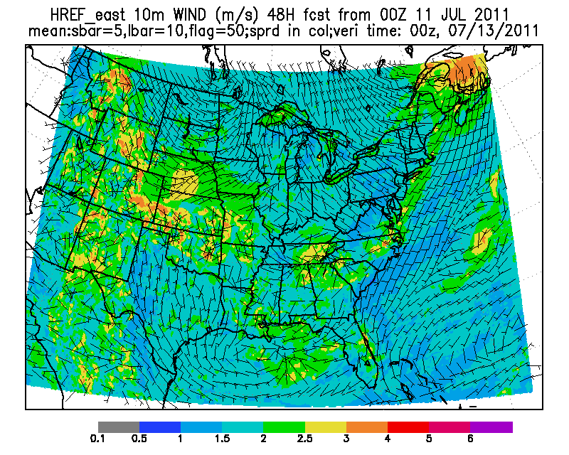
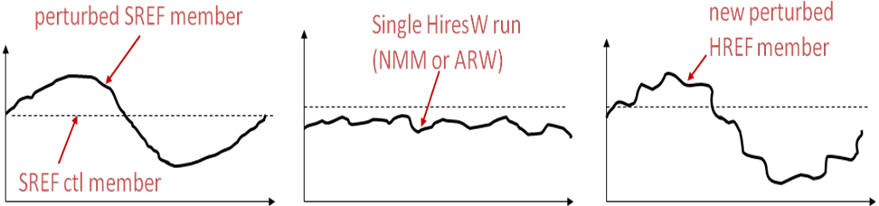
Hybrid High Resolution
Ensemble Prediction
High Resolution Model | Domain | Resolution | Time lagged members | # members
NAM NEMS NMMB nest | CONUS | 4 km/L35 | Current, T-6, T-12h | 3
NOAA/ ESRL HRRR | CONUS | 3 km/L35 | Current, T-1, T-2, T-3, T-4, T-5, T-6 | 7
WRF High Resolution Window ARW | Eastern U.S. Western U.S. | 4.5 km/L35 | Current, T-12 | 2
WRF High Resolution Window NMM | Eastern U.S. Western U.S. | 4 km/L35 | Current, T-12 | 2
NEMS/NMMB Storm Prediction Center (SPC) Configuration | CONUS | 4 km/L35 | Current, T-12 | 2

Slide 15
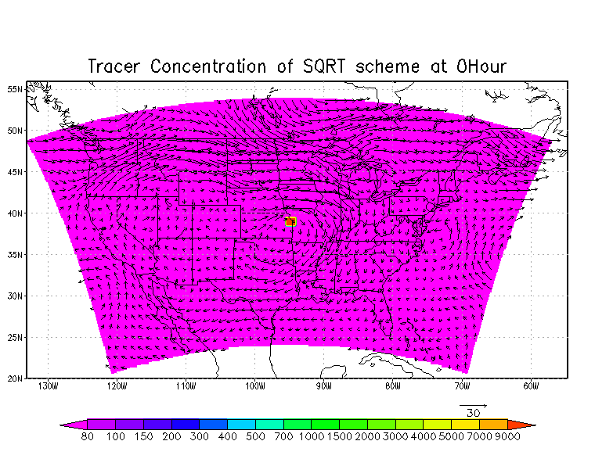
Inline Tracer Development courtesy of Youhua Tang
Regional NMM-B with 3-D tracer advection (no tracer physics & diffusion)
Tracer initialized at center of the domain from bottom to top (cuboid form)
Zero lateral boundary conditions
500 hPa field shown
NMM-B tracer run with initial cuboid-shaped field

Slide 16
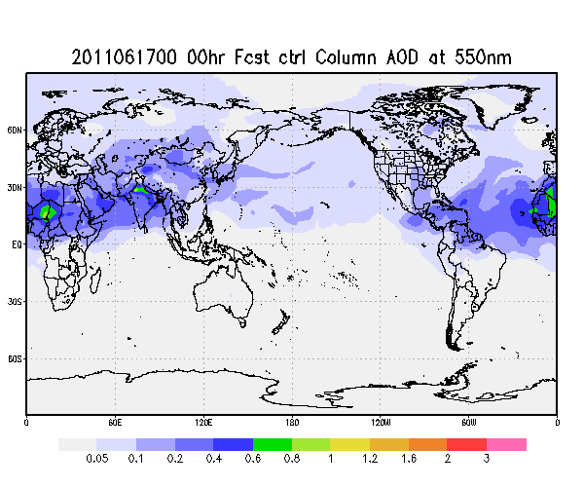
Global Dispersion Modeling
Experimental (non-operational)
Executable compiled from NEMS trunk code repository
120-hr dust-only forecast
Once per day (00Z)
3-hourly products: 3d distribution of dust aerosols (5 bins from 0.1 – 10 µm)
Automatic output archive, post processing and web update since June 11, 2011
Same physics and dynamics as operational GFS with the following exceptions:
  Lower resolution (T126 L64)
  Use RAS with convective transport and tracer scavenging
  Aerosol-radiation feedback is turned off

Slide 17
Boundary Layer Analysis
Verification:
Calipso products
NCAS lidar, ESRL Profilers
National PBL Products
NASA GPS RO (COSMIC) data
+ Sonde/ACARS data
+MPLNET lidar + NexRad data

Slide 18
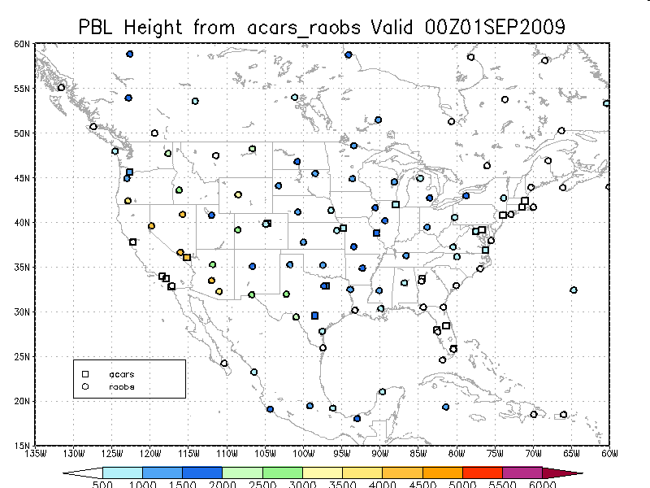
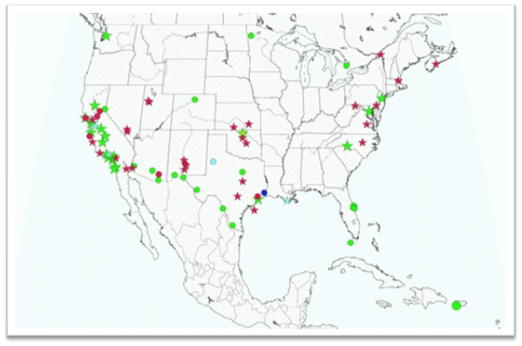
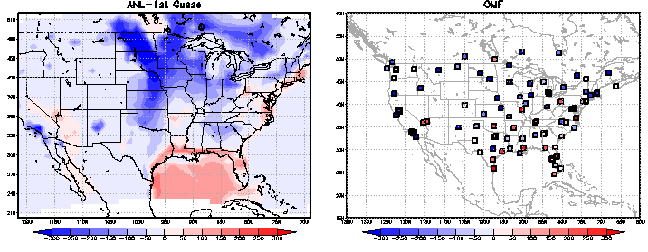
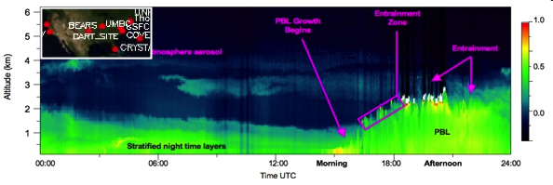
Improved Boundary Layer Analysis
Cap PBL Profilers
MPLNET Lidars
Need more observations for analysis to have an impact
Need more independent observations for verification

Slide 19
Lessons Learned
& Recommendations
Need for NRT relocatable, global operational high resolution NWP – Atmospheric Dispersion modeling capability w/ data assimilation
  WMO/RSMC → Most useful for long rang transport (GFS-HYSPLIT)
  NMCs coordination thru RSMC process (information thru secure web pages)
    Better coordination with non-NMC centers (eg: DOE, DOD…)
    Better define & interpret model output strengths/weaknesss (long range vs near-field products)
Enhance boundary layer measurements for evaluation, assimilation:
  Radiosondes, field experiments, ACARS
  PBL Profilers (e.g.: U.S., Japan, Europe)
  Lidar (EARLINET, WMO- GALION), ASOS Ceilometers (PBLH, Aerosols)
  Develop boundary layer reanalysis (downscale NARR, ERA ?)
Develop and evaluate high resolution ensemble met systems
  HRRR, Time Lagging, Composite
  Include boundary layer uncertainty, new metrics
  Additional products: threshold probabilities, Plume time of arrival
Evaluate in-line dispersion within NWP modeling techniques
  Esp for aerosol interactions w radiation/clouds (smoke, dust, ash)

