Slide 1
NWS/NCEP Modeling for Potential Fire Weather Support
September 14, 2011
NOAA/OAR/ARL and NWS/NCEP/EMC
Air Quality Team

Slide 2


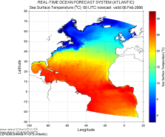
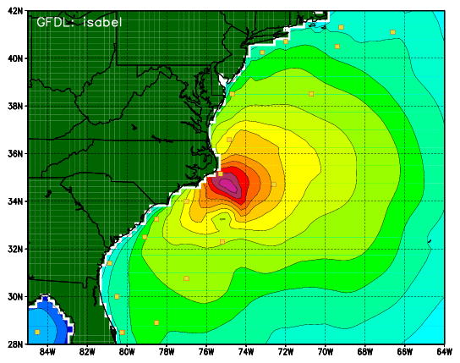


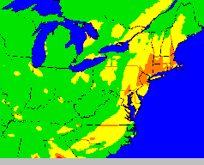

Where We Fit Into NCEP’s Model Suite
Items in RED are MMB’s Concern
Climate
CFS
Oceans
HYCOM
WaveWatch III
Hurricane GFDL
HWRF (NMM)
Coupled
MOM3
~3B Obs / Day
Mostly
Satellite
+Radar
Dispersion, Ash,
Smoke & Dust
ARL’s HYSPLIT
Global
Forecast
System
North American
Mesoscale
NMM
Global Data
Assimilation
Severe Weather
NMM + ARW
Regional Data
Assimilation
Short-Range
Ensemble Forecast
DGEX
NMM
Air Quality
NMM + ARW +
ETA + RSM
NAM +
EPA’s CMAQ
North American Ensemble Forecast System
Rapid Update
for Aviation
GSD’s RUC/RR
GFS, Canadian Global Model, FNMOC +
VSREF
RUC + NAM + SREF
NOAH Land Surface Model
R T M A

Slide 3
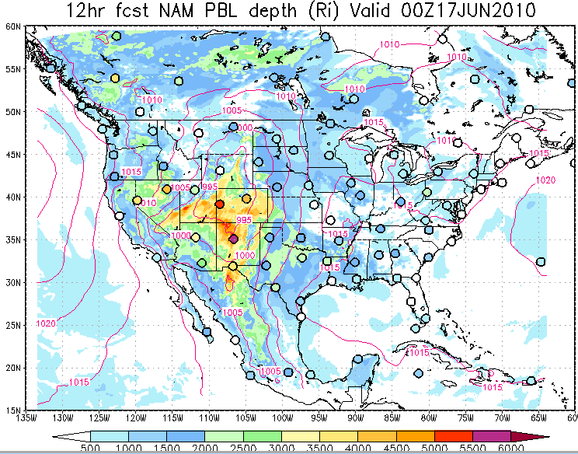
NAM 12 hr Forecast Ri-Based PBL Height with Verifying RAOBs

Slide 4
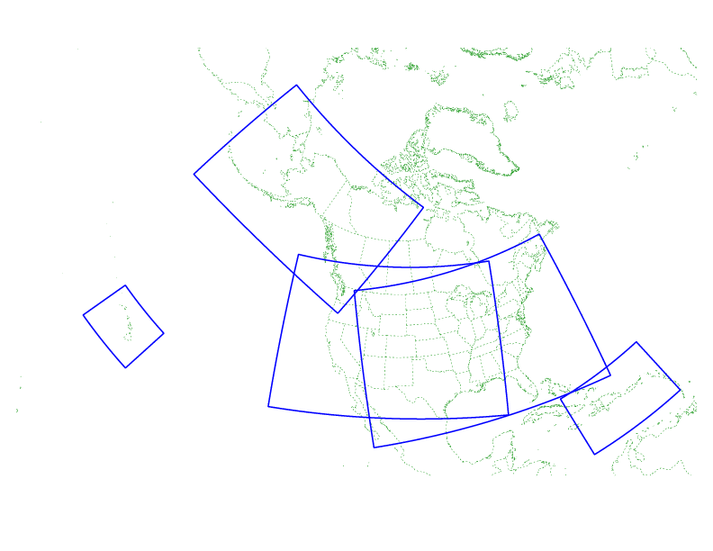
~Feb 2011 Upgrade of HiResWindow
Upgrade NMM & ARW to WRF v3.2
Use improved passive advection in both cores
Add High Resolution Ensemble Forecast (HREF), BUFR & SPC max product generation
4.0 km WRF-NMM
5.15 km WRF-ARW
48 hr fcsts from both
Unless there are hurricanes
18Z
Expanded PR domain
00Z,
12Z
00Z
12Z
06Z,
18Z
06Z
00Z,
12Z
Guam
Daily displays of these runs can be seen at:
  http://www.nco.ncep.noaa.gov/pmb/nwprod/analysis/ and
  http://www.emc.ncep.noaa.gov/mmb/mmbpll/nestpage/
Question for Thursday morning on 6z/18z scheduling

Slide 5
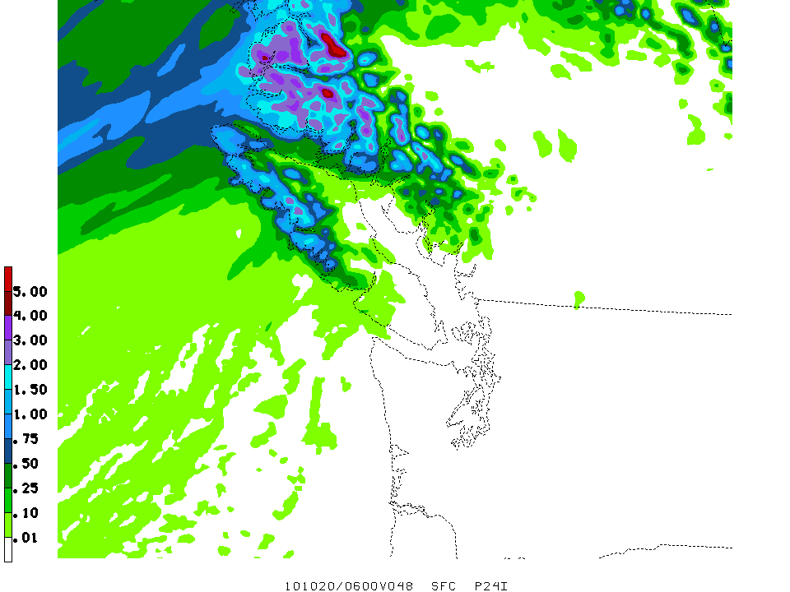
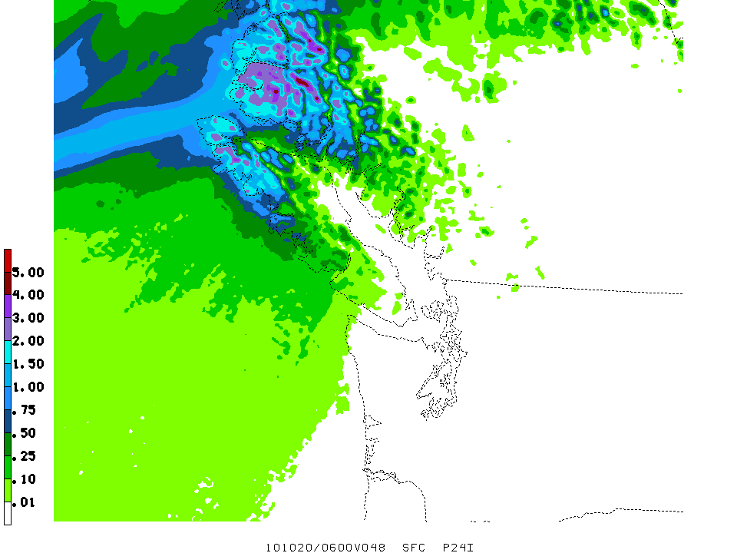
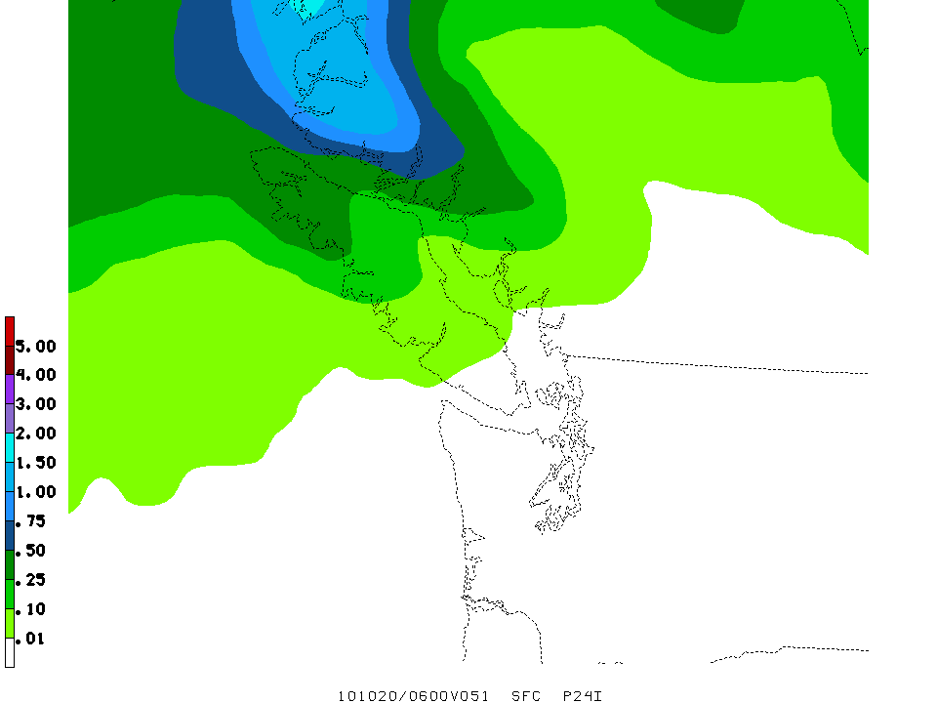
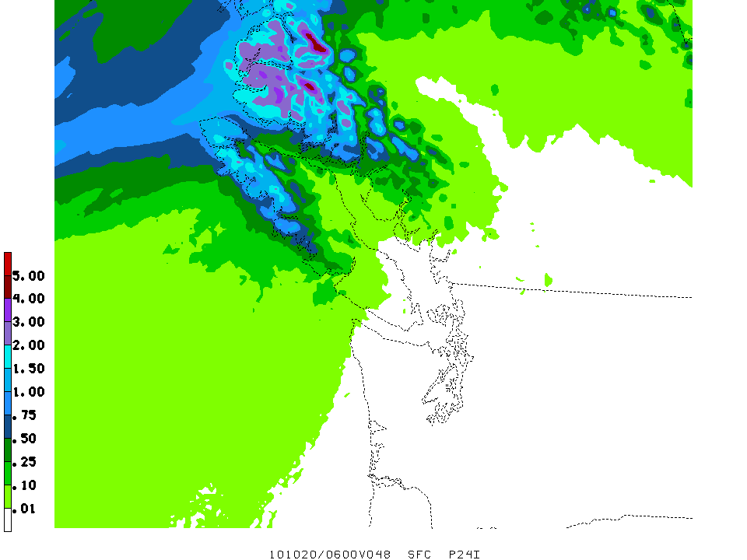
ARW 24 h total qpf
NMM 24 h total qpf
20101020/06f48
20101020/06f48
SREF mean of 21 members 24 h total qpf
HREF mean of 44 members 24 h total qpf
20101020/03f51
20101020/06f48

Slide 6
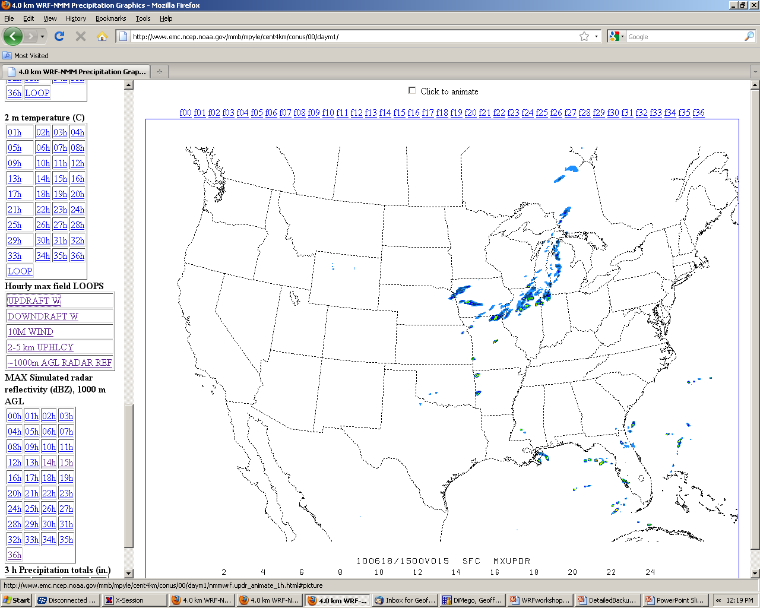
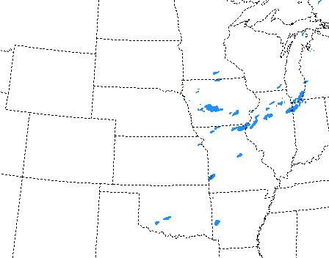
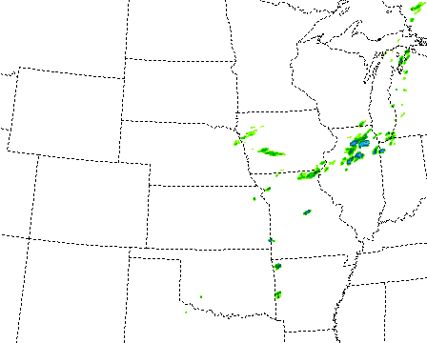
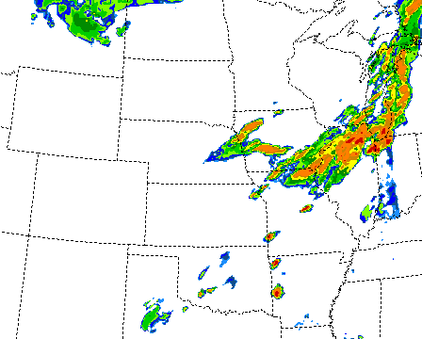
Matt Pyle Webpage

Slide 7
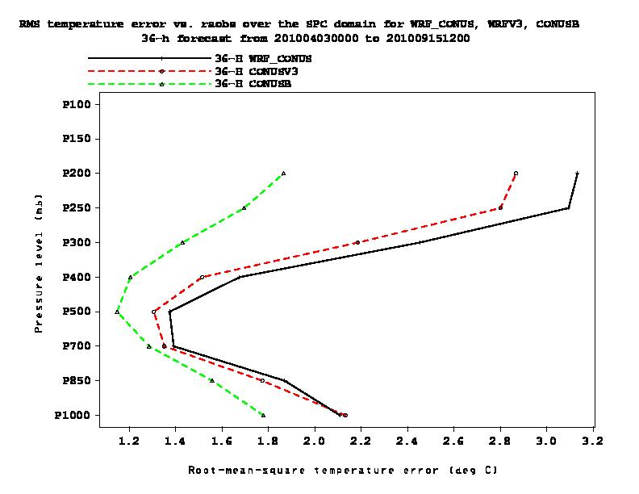
Development CONUS 4 km runs
04/03-09/27
36 h forecast
T rms
WRF-NMM V2 (“SPC run”)
NMMB
WRF-NMM V3
Root-mean-square temperature error (K)

Slide 8
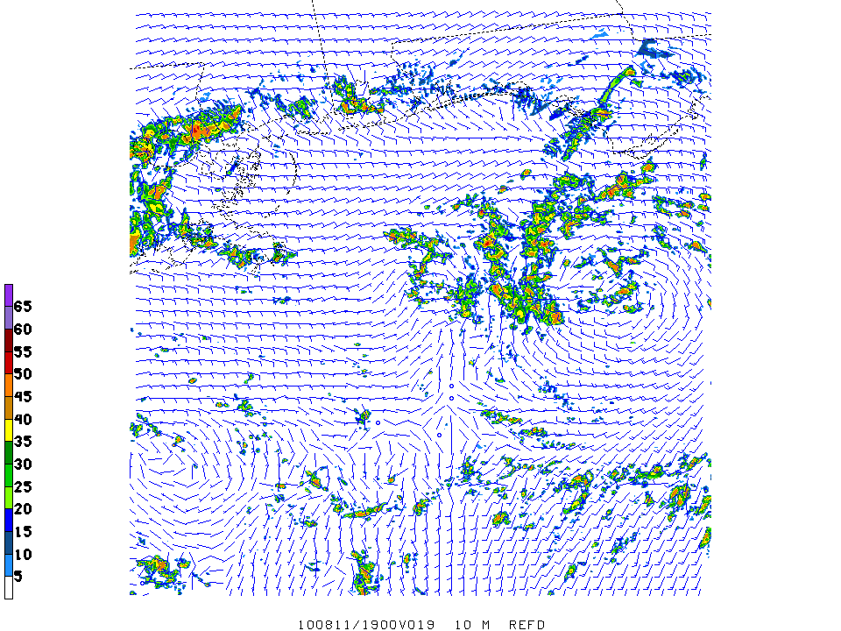
Gulf Spill 1.33 km NEMS/NMMB nest
Tropical Depression 5
19Z 11 August
1000 m REFD, 10 m winds

Slide 9
Plans For 2012 HiResWindow
Use Guam forecast as first guess for RTMA
Upgrade ARW to WRF version 3.3
Replace WRF-NMM with NEMS-NMMB
Increase resolution to ~2 km
Expand to full CONUS
  CONUS, Hawaii & Guam at 00z and 12z
  Alaska, Puerto Rico-Hispaniola at 06z an 18z
  Can AWIPS distribution adapt to this?
Improve Initialization of HiResWindow runs
  GSI using all available data & mini-NDAS
  GSI adapted specially for Level II winds
  Digital filter with Level II reflectivity (ala RUC/RR)
  Some or all of the above

Slide 10
NEMS Component Structure
All boxes represent
ESMF components (now supported by NOAA/ESRL).
MAIN
NEMS
NEMS
LAYER
EARTH(1:NM)
Ensemble
Coupler
Below the dashed line, the source codes are organized by the model developers.
Ocean
Atm
Ice
NMM
GFS
FIM
ARW
Domains(1:ND)
Dyn
Phy
Wrt
Dyn
Phy
Wrt
Dyn
Phy
Wrt
Dyn
Phy
Wrt
CMAQ
GOCART
WRF-Chem

Slide 11
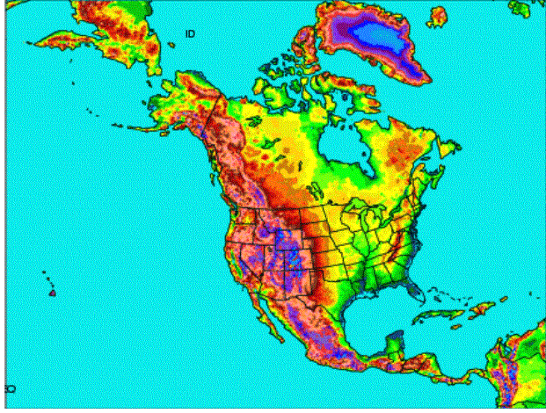
Fall 2011 NAM Upgrade
New NAM
NEMS based NMMB
B-grid replaces E-grid
Parent remains 12 km to 84 hr
Multiple Nests Run to 60 hr
  4 km CONUS nest
  6 km Alaska nest
  3 km HI & PR nests
Single locatable ~1.33-1.5 km FireWeather/IMET/DHS run to 36hr
Current NAM
WRF-NMM (E-grid)
GSI analysis
4/Day = 6 hr update
Forecasts to 84 hours
12 km horizontal
12 hr pre-forecast assimilation period with 3hr updates (catch-up)

Slide 12
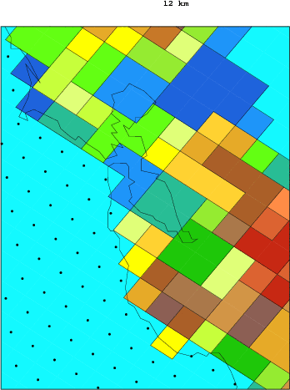
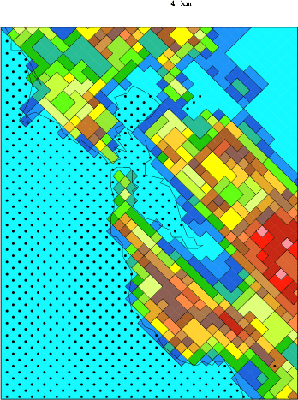
12 km Terrain 4 km Terrain
GFS ~27km
Dots represent water points Domain is San Francisco Bay

Slide 13
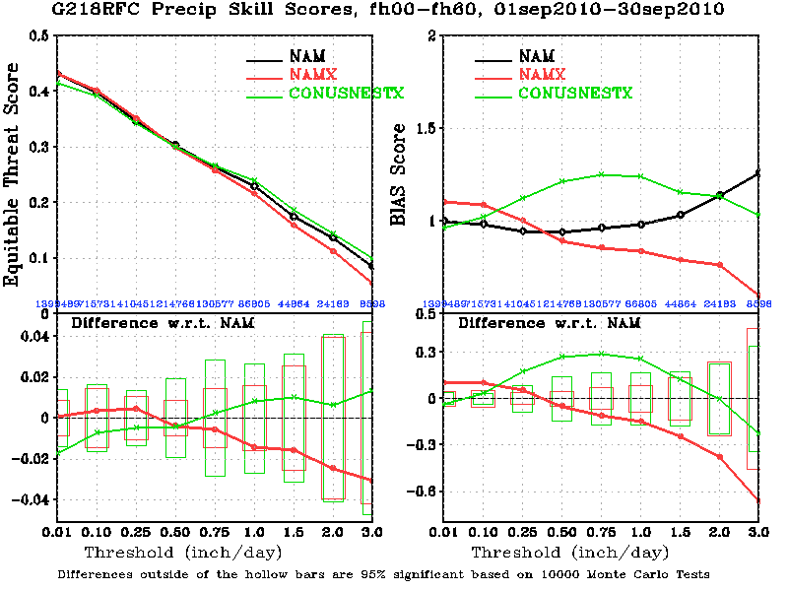
NAM, NAMX, CONUSNESTX scores
1 – 30 Sept 2010, 24+36+48+60h forecasts, ConUS

Slide 14
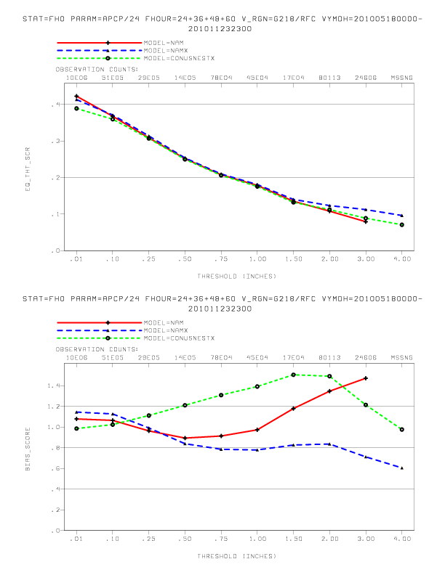
NAM, NAMX, CONUSNESTX 24/36/48/60h fcst scores, 18 May – 23 Nov 2010
NAMX corrected the opnl NAM's high bias at higher thresholds.
ETS
Bias=1
BIAS
(An extra threshold – 4”/day has been added to parallel verif. Not opnl yet)

Slide 15
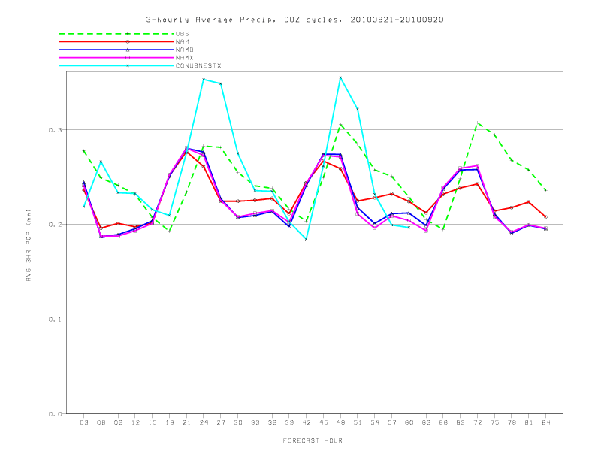
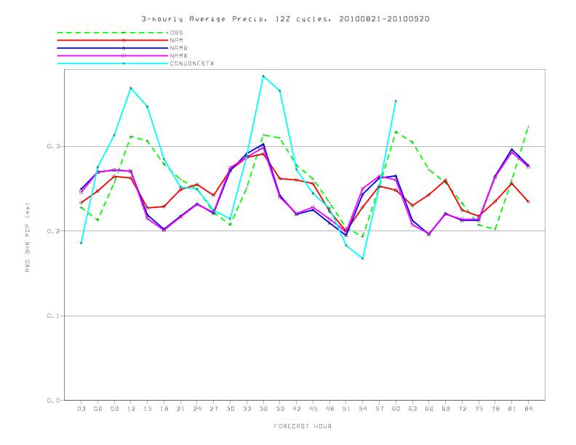
NAM, NAMB, NAMX, CONUSNESTX Diurnal Cycles
3-hourly ConUS avg, 21 Aug – 20 Sept 2010 (verifying: Stage II)
00Z cycles
12Z cycles
(CONUSNESTX forecast goes to 60h; the other models go to 84h)

Slide 16
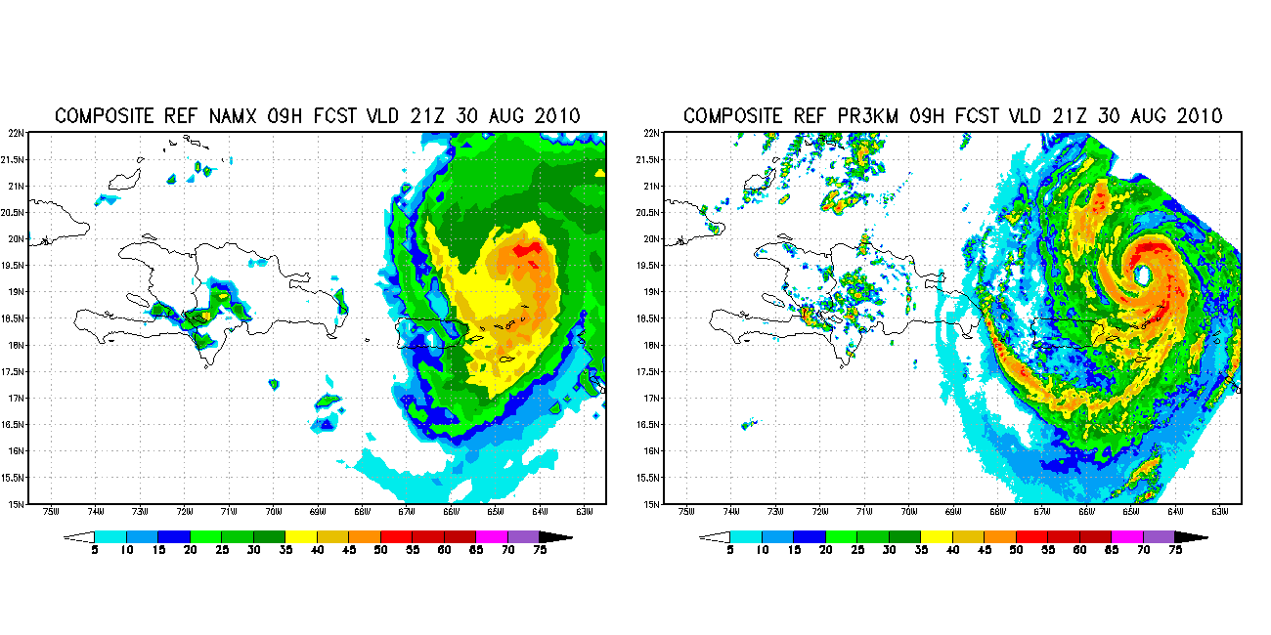
Hurricane Earl near Puerto Rico
12 km NMMB parent
3 km Puerto Rico nest

Slide 17
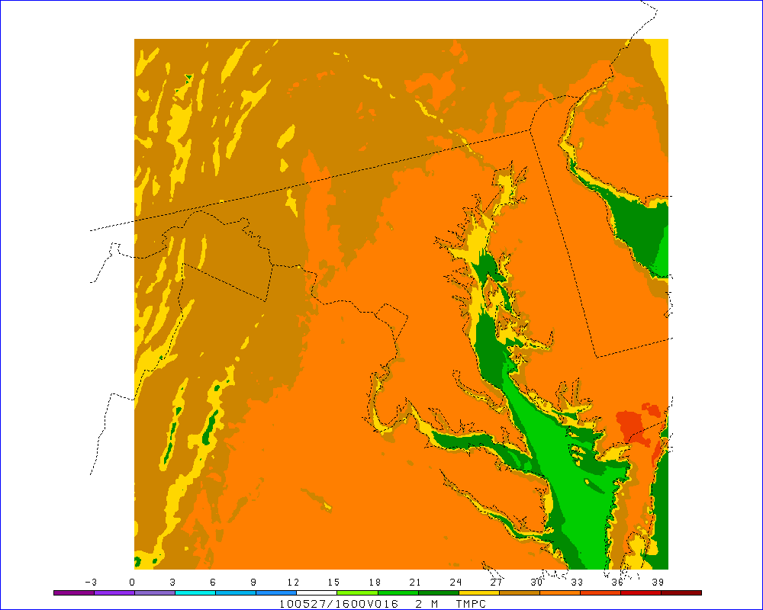
MD Backdoor Coldfront in 1.33km Nest
May 2010 27/16Z to 28/12Z

Slide 18
Convergence of NAM & RUC into hourly NARRE & HRRRE
There is a signed agreement on NARRE between NCEP/EMC and ESRL/GSD
Based on NEMS common modeling infrastructure
Ensembles:
  Sample uncertainty within membership
    Initial & Lateral Boundary conditions
    Dynamics & Physics
  Provide full description of uncertainty
  Can adapt to rapidly evolving science of underlying data assimilation and modeling

Slide 19
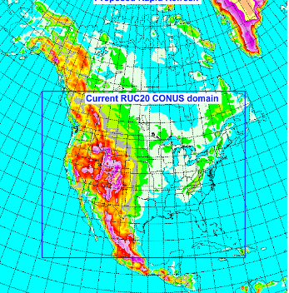
2011
NAM
NEMS based NMMB
Bgrid replaces Egrid
Parent remains at 12 km to 84 hr
Multiple Nests Run to 60hr
  4 km CONUS nest
  6 km Alaska nest
  3 km HI & PR nests
Reinstate Fire Weather/IMET Support/DHS run to 36hr
  Locate a single 1.33-1.5 km run
  In either CONUS or Alaska
Rapid Refresh
WRF-based ARW
NCEP’s GSI analysis
Expanded 13 km Domain to include Alaska
Experimental 3 km HRRR
WRF-Rapid Refresh domain – 2010
RUC-13 CONUS domain
Original CONUS domain
Experimental 3 km HRRR

Slide 20
2014-2015
North American Rapid Refresh ENSEMBLE (NARRE)
NMMB (from NCEP) & ARW (from ESRL) dynamic cores
Common use of NEMS infrastructure and GSI analysis
Common NAM parent domain at 10-12 km
Initially ~6 member ensemble made up of equal numbers of NMMB- & ARW-based configurations
Hourly updated with forecasts to 24 hours
NMMB & ARW control data assimilation cycles with 3 hour pre-forecast period (catch-up) with hourly updating
NAM & SREF 84 hr forecasts are extensions of the 00z, 06z, 12z, & 18z runs – for continuity sake.
  SREF will be at same 10-12 km resolution as NARRE by then
  SREF will have 21 members plus 6 from NARRE for total of 27
NARRE requires an increase in current HPCC funding

Slide 21
Very Short Range Ensemble Forecast (VSREF) System [courtesy of Binbin Zhou]
Example: Ensemble member combination for 06Z cycle run
4 NAM cycles, weighted 0.7, 0.5, 0.3, 0.1, respectively
6 RUC cycles, weighted 1.0, 0.9, 0.8, 0.7, 0.6, 0.5, respectively
Forecast hour extended to 12 hr (with extension of RUC forecasts to 18hr)
NAM cycles always older than RUC → VSREF gives more weight to RUC
NAM
RUC
06
12
18
21
00
03
06
09
12
15
18
21
00
Soon-to-be-known-as the NARRE-TL for Time Lagged NARRE

Slide 22
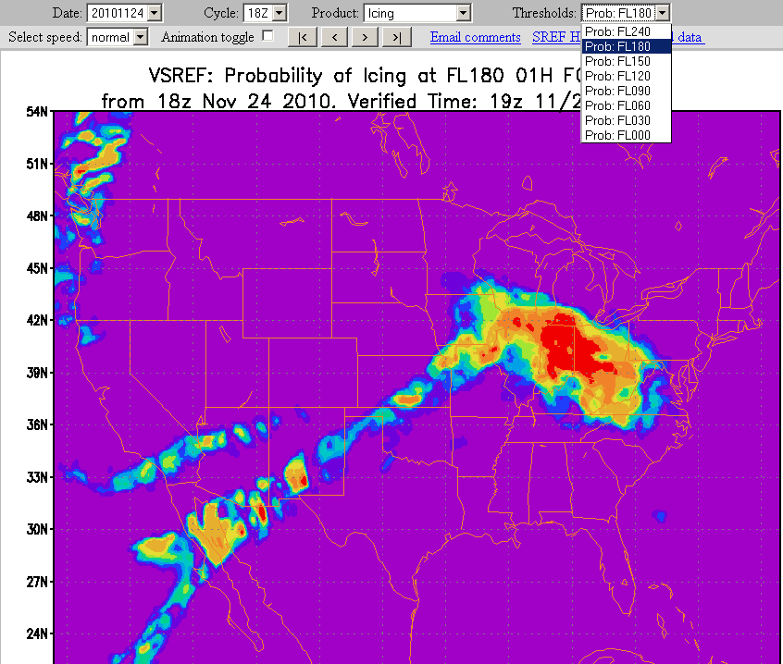

VSREF Webpage
Download grids from here

Slide 23
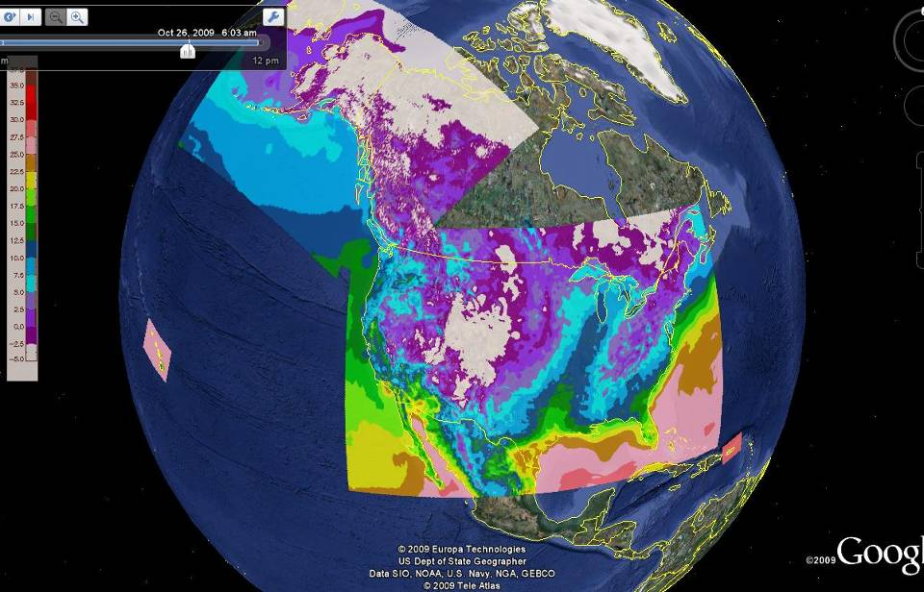
Google Map of 4 RTMA Domains
First Phase of Analysis of Record
Courtesy of Yan Zheng University of Utah
Real Time Mesoscale Analysis
Analyzed every hour on the NWS’ NDFD grids
10 m wind + est. anal. uncertainty
2m Temperature + est.anal.unc.
2m dew point + est.anal.unc.
Sfc pressure + est.anal.uncertainty
1 hr precip (Stage 2)
GOES Eff. Cloud Amount

Slide 24
UPGRADE TO THE CONUS RTMA
(Implemented 28 September 2010)
1 . Increased Horizontal Resolution (from 5 to 2.5 km)
2. Extended Assimilation Time window for the obs:
Now -/+30 min around the anl time. Note that 5km RTMA uses -/+12 min
3. Use First Guess at the Appropriate Time (FGAT)
4. Apply sequential bias-correction algorithm for the background temperature
Use decaying average to update bias
bias(n+1) =(1-a) bias(n-1)+ a*bias(n) ; 0 < a < 1 ; chosen parameter
5. Improved Quality Control for the OBS / Gross-error check
6. Add ocean surface WindSat and ASCAT winds and low-level satellite drift winds. Time window is -/+3h for these ob types!

Slide 25
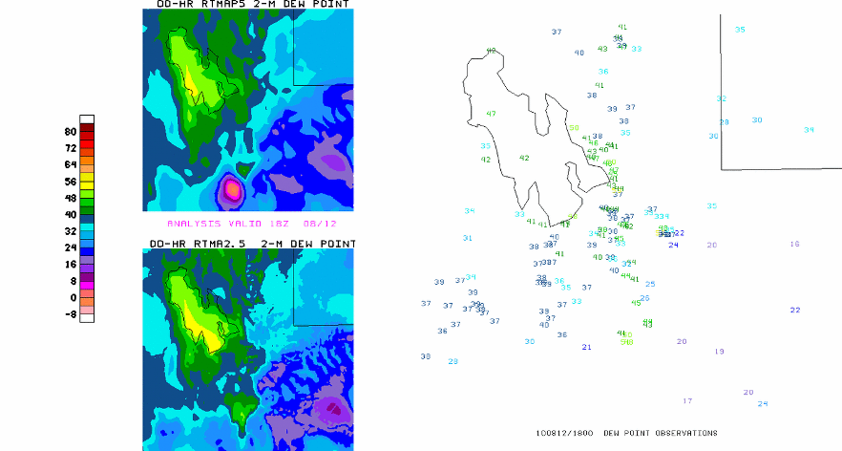
IMPACT OF THE IMPROVED OB-QC. EXAMPLE OF MOISTURE ANALYSIS OVER UTAH
DEW POINT VALID 18Z 12 August 2010
The dry bullseye in the 5 km version is eliminated in the 2.5 km RTMA

Slide 26
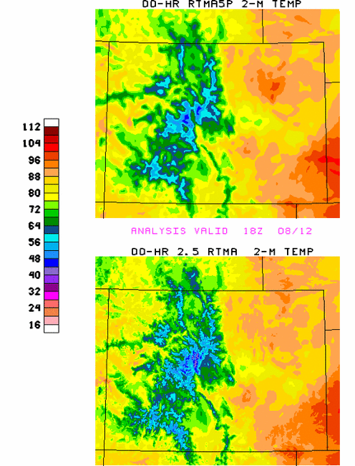
RTMA 2-m TEMPERATURES
5 KM
2.5 KM

Slide 27
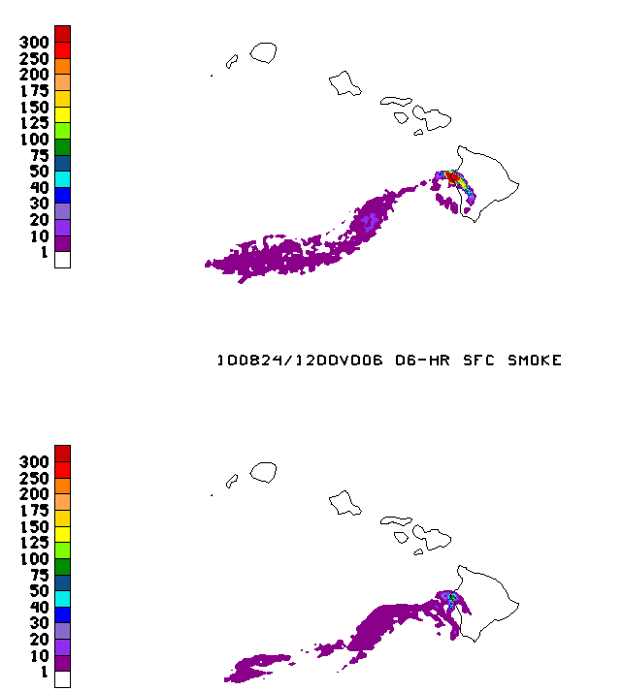
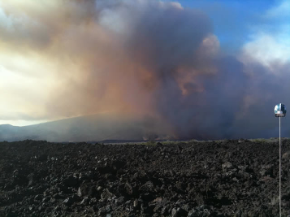
Hawaii Smoke Simulations
POHAKULOA TRAINING AREA, Hawaii (HawaiiNewsNow) - A massive brushfire, which started early Sunday morning near the entrance to Mauna Kea State Park remains 60%
contained, according to officials with the Department of Land and Natural Resources. It has burned an estimated 1,387 acres over six days.

Slide 28
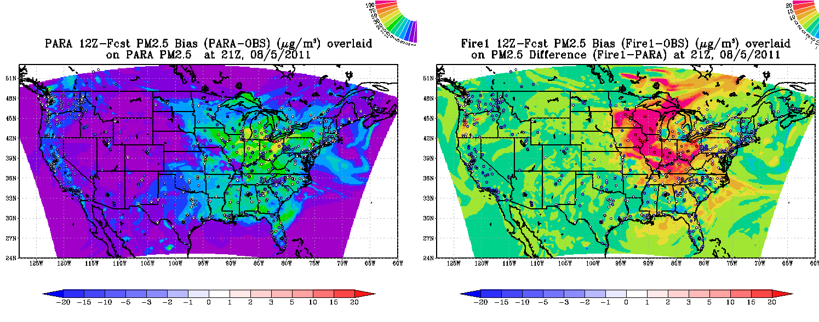
August 5, 2011 Case
34 hour (21 Z) CMAQ CB05 PM forecasts
NAM-CMAQ Experimental run
(w/o fire sources)
1 hr avg PM2.5
Difference between CMAQ
w/ and w/o fire sources
1 hr avg PM2.5
Canadian smoke plumes impact large portion of Midwest sfc PM
Sources too strong, downward mixing ???

Slide 29

NRT NGAC configuration
Experimental (non-operational)
EMC parallel on NCEP’s CCS (dev)
Executable compiled from NEMS
code repository
120-hr dust-only forecast once
per day (00Z)
ICs: Aerosols from previous day
forecast and meteorology from
operational GDAS
3-hourly products: 3d distribution
of dust aerosols (5 bins from
0.1 – 10 µm)
Automatic output archive, post-processing and web update since June 11, 2011
Same physics and dynamics as operational GFS with the following exceptions:
  Lower resolution (T126 L64)
  Use Relaxed Arakawa-Schubert scheme [Moorthi and Suarez, 1999] with convective transport and tracer scavenging
  Turn off aerosol-radiation feedback

