Slide 1
Reducing Systematic Biases with Improved Physics in NOAA’s Next Generation Global Prediction System
Fanglin Yang
Anning Cheng, Jongil Han, Jack Kain, Jesse Meng, Shrinivas Moorthi, Ruiyu Sun, Helin Wei, Youlong Xia, Rongqian Yang, Valery Yudin, Weizhong Zheng
Environmental Modeling Center
National Centers for Environmental Prediction
College Park, Maryland, USA
WGNE34, 24-27 Sept 2019, DWD, Offenbach, Germany

Slide 2
GFS.v15 Transition to Operation
Finite-Volume Cubed-Sphere Dynamical Core (FV3)
Microphysics Scheme with Multiple Prognostic Cloud Hydrometers
In Operation: June 12, 2019
Configuration:
High-res: C768 (~13km)
Data Assimilation: C384 (~25km, 80 member ensemble)
64 layer, top at 0.2 hPa
Uniform resolution for all 16 days of forecast
Dycore: FV3, non-hydrostatic, single precision
Physics: GFS Physics + GFDL Cloud Microphysics, double precision

Slide 3
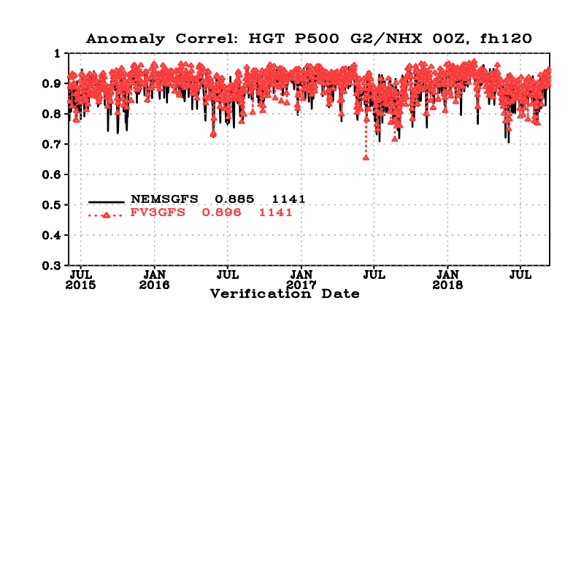
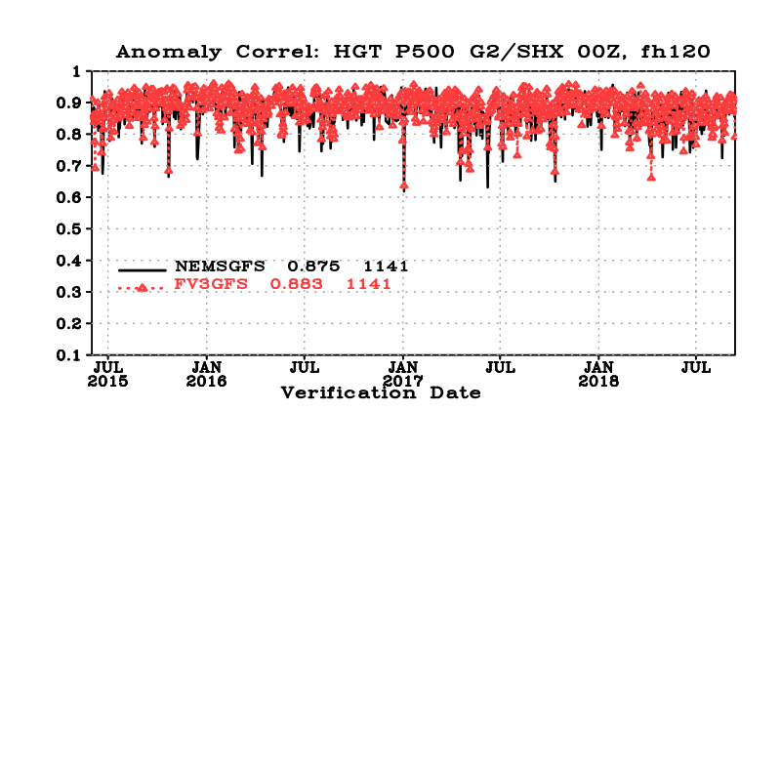
500-hPa HGT Anomaly Correlation
(20150601 ~ 20180912)
Day-5
NH
SH
A gain of 0.011
Die-off
SH
NH
Increase is significant up to day 10

Slide 4
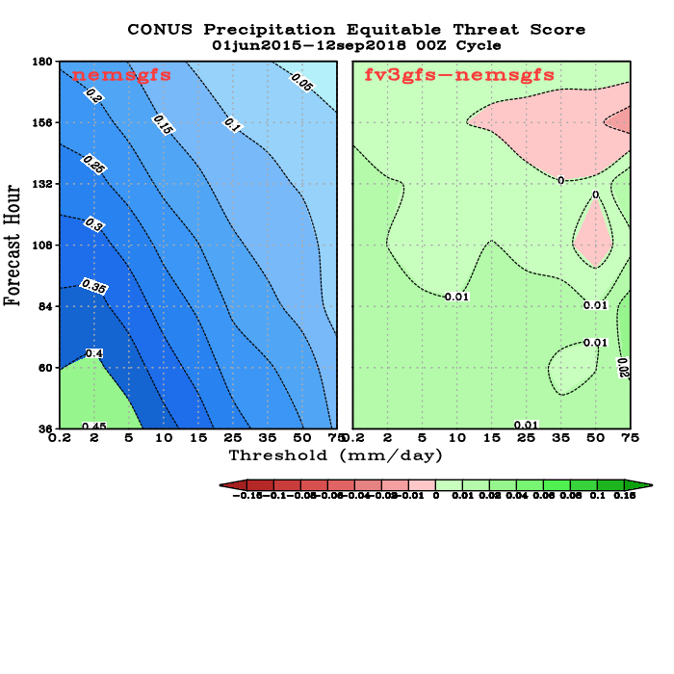
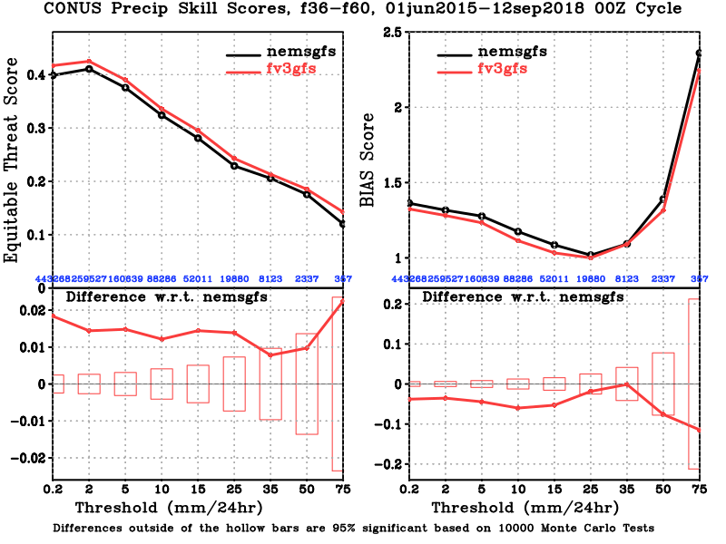
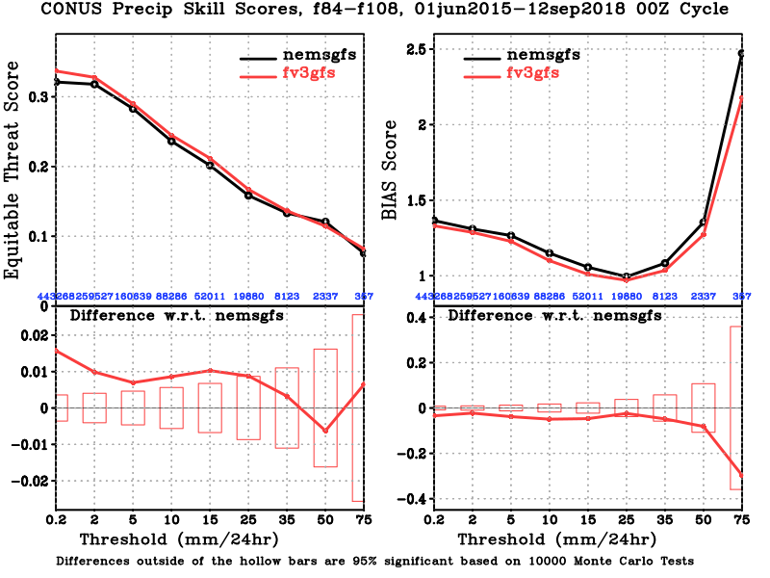
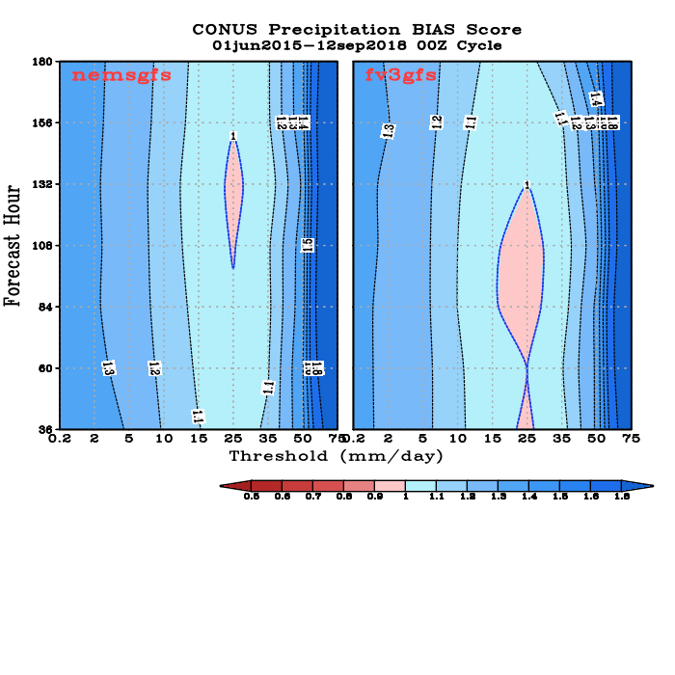
CONUS Precip ETS and BIAS SCORES
00Z Cycle, verified against gauge data, 20150601~ 20180912
FH 36-60
FH 84-108
Improved ETS scores for almost all thresholds and at all forecast length
Reduced wet bias for light rains
Slightly worsened dry bias for moderate rain categories

Slide 5
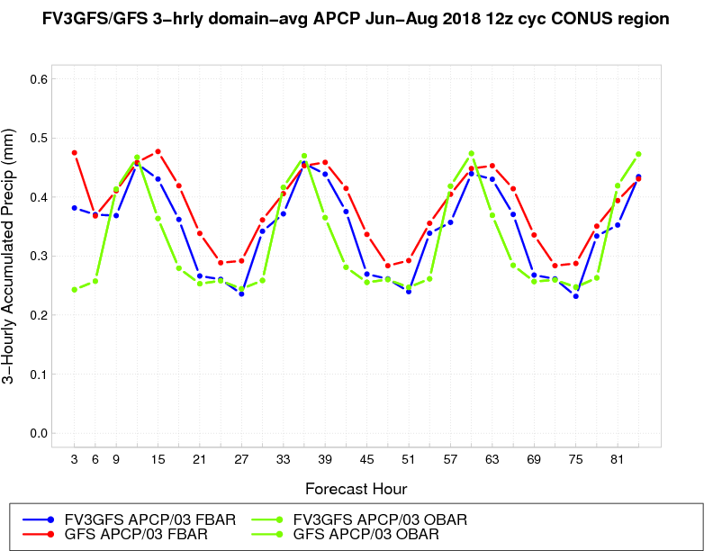
Improved Precipitation Diurnal Cycle
SUMMER 2018 CONUS DOMAIN-AVG PCP
2018: FV3GFS better than GSM,
especially overnight
FV3GFS ops GFS OBS
From: Ying Lin

Slide 6
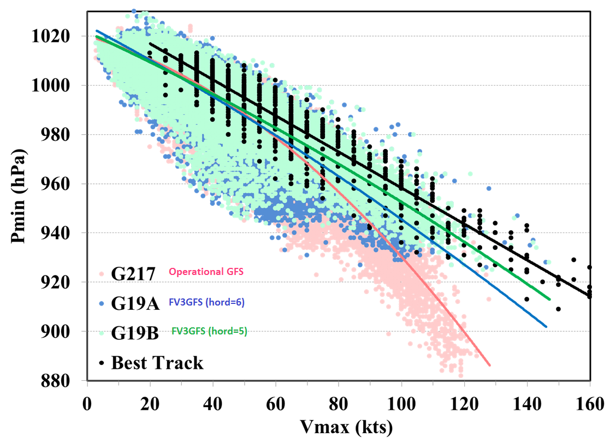
Improved Wind-Pressure Relationship
GFS.v15 shows a much better W-P relation than GFS.v14 for strong storms
Graph made by HWRF group

Slide 7
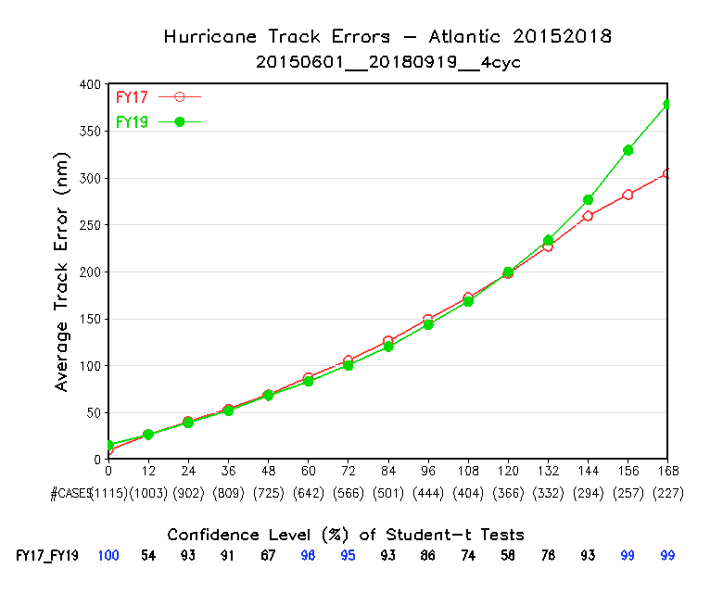
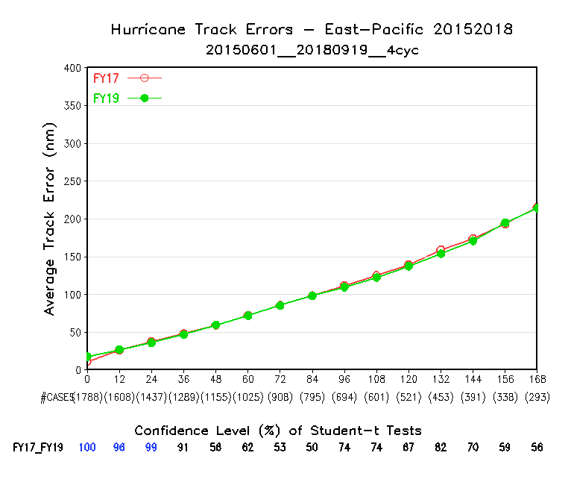
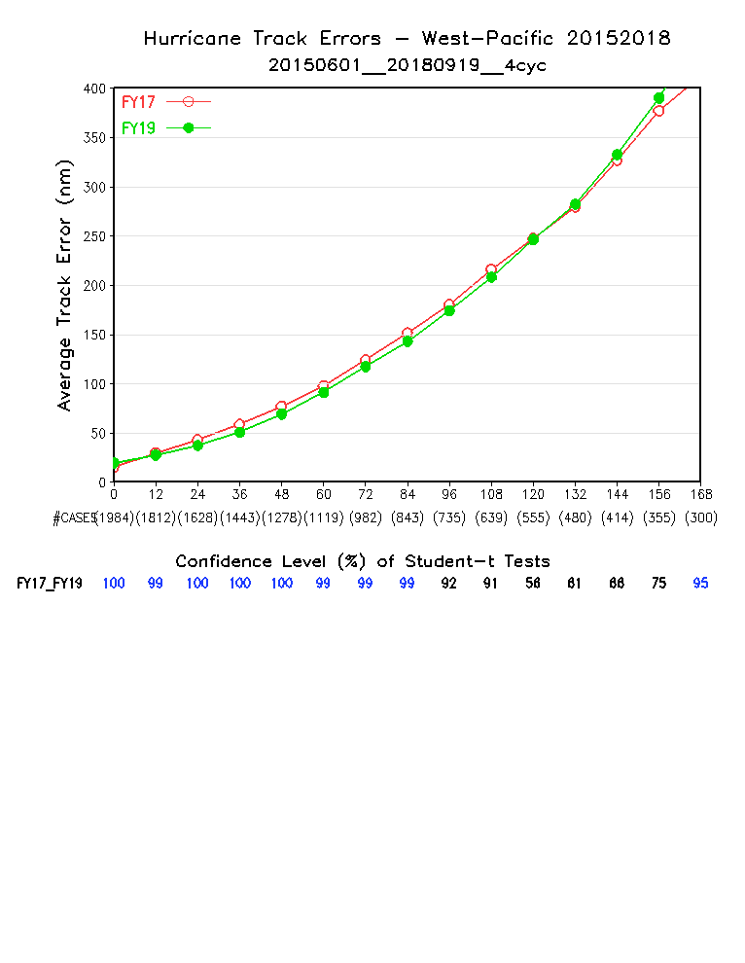
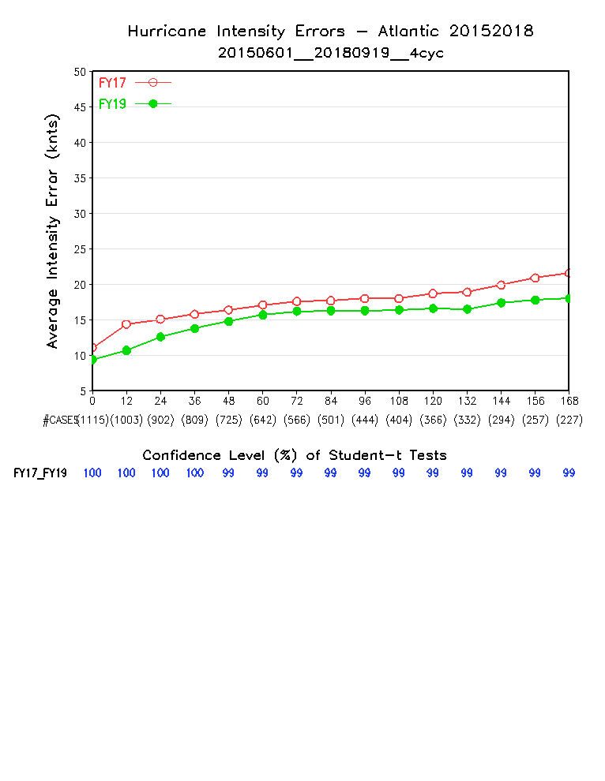
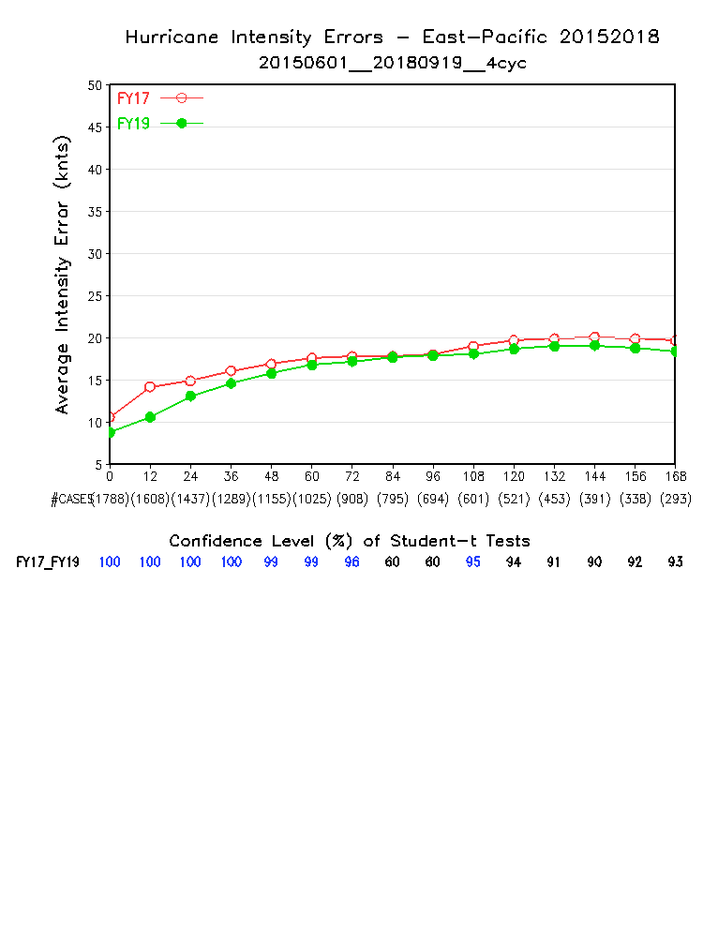
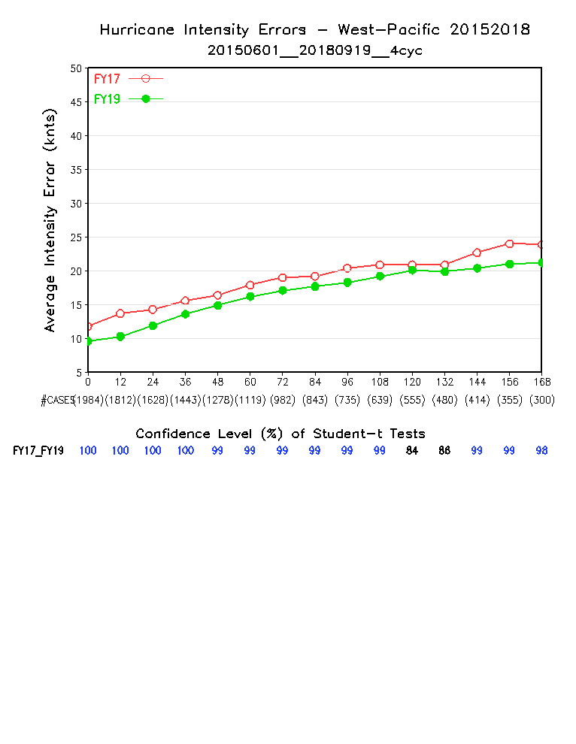
Hurricane Track and Intensity 20150601 ~ 20180919
Red: NEMS GFS; Green FV3GFS
Track
AL
EP
WP
Intensity
AL
EP
WP
Intensity is improved over all basins
Tracks in AL and WP are improved for the first 5 days except at FH00, and degraded in day 6 and day 7. Track in EP is neutral

Slide 8
Improvements over operational GFS in retrospective runs
(significantly) Improved 500-hpa anomaly correlation (NH and SH)
Intense tropical cyclone deepening in GFS not observed in FV3GFS
FV3GFS tropical cyclone track forecasts improved (within 5 days)
Warm season diurnal cycle of precipitation improved
Multiple tropical cyclone centers generated by GFS not seen in FV3GFS forecasts or analyses
General improvement in HWRF and HMON runs
New simulated composite reflectivity output is a nice addition
Some indication that fv3gfs can generate modest surface cold pools from significant convection
FV3GFS with advanced GFDL MP provides better initial and boundary conditions for driving stand alone FV3, and for running downstream models that use advanced MP.
FV3 based GEFS V12 showed significant improvements when initialized with FV3GFS
Improved ozone and water vapor physics and products
Improved extratropical cyclone tracks
Improved precipitation ETS score (hit/miss/false alarm)
Overall reduced T2m biases over CONUS
✔ = Retained in the new configuration
Documented concerns include:
FV3GFS can be too progressive with synoptic pattern
Precipitation dry bias for moderate rainfall
Extremely hot 2-m temperatures observed in mid-west
Spurious secondary (non-tropical) lows show up occasionally in FV3GFS since the advection scheme change was made
T2m over Alaska is too cold, likely caused by cold NSST and/or cloud microphysics issue in the Arctic region – mitigated with NSST fix
NHC reported that FV3GFS degraded track forecast of hurricanes (initial wind > 65 kts) in the Atlantic basin
Both GFS and FV3GFS struggle with inversions
Both GFS and FV3GFS often has too little precip on the northwest side of east coast cyclones

Slide 9
Systematic Biases to be Addressed in GFS.v16
PBL inversion
Cold bias in the lower troposphere in winter
Surface temperature biases
Biases in the upper atmosphere
Degraded track forecast of hurricanes (initial wind > 65 kts) in the Atlantic basin

Slide 10
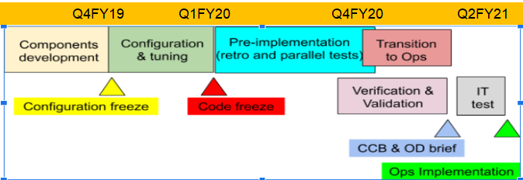
GFS V16 Implementation Schedule

Slide 11
GFS V16: Major Upgrades to Deterministic Global Model
Model resolution:
Increased vertical resolution from 64 to 127 layers and raise model top from 54 km to 80 km
Physics updates
PBL/turbulence: K-EDMF => sa-TKE-EDMF
Land surface: Noah => Noah-MP
Orographic Gravity Wave Drag: => OGWD + CGWD
Radiation: updates to cloud-overlap assumptions
Microphysics: Improvements to GFDL MP
Coupling to Wave
One-way coupling of atmospheric model with Global Wave Model (GWM)
Data Assimilation Upgrades:
Local Ensemble Kalman Filter (LETKF)
4-Dimensional Incremental Analysis Update (4DIAU)
Stratospheric humidity increments
Improved Near Surface Sea Temperature (NSST) analysis
Land Data Assimilation (GLADS)

Slide 12
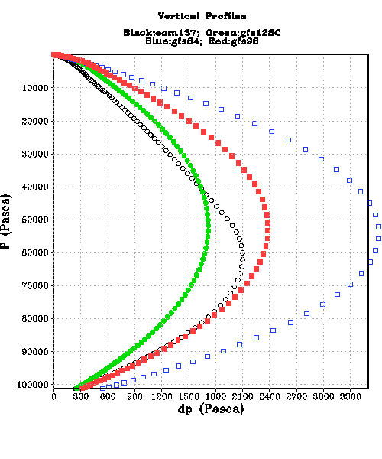
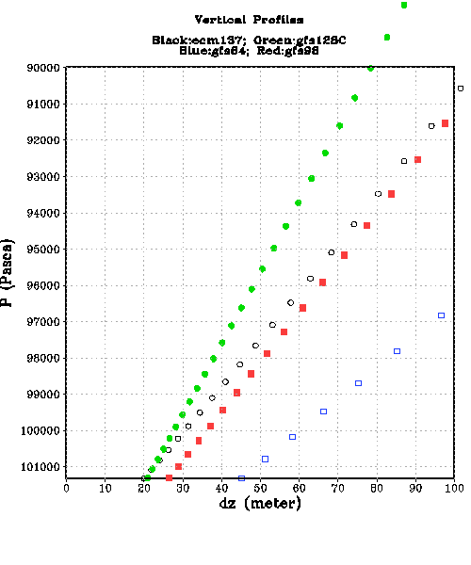
GFS Vertical Profiles
64L GFS
Top 54km
137L ECMWF
Top 80km
97L GFS
Top 80km
127L GFS
Top 80km
127L GFS has higher resolution than 137L IFS in the middle to lower troposphere, but coarser resolution above 400 hPa.
127L GFS 1st layer is 20m thick; 64L GFS 1st layer is 40m thick.

Slide 13
Reducing Biases in the Upper Atmosphere
model’s “climate” mean state
2-year C192L127 “AMIP” Run
IFS IC, 5Jan2017
RUN1 : GFS.v15.1 configuration

Slide 14
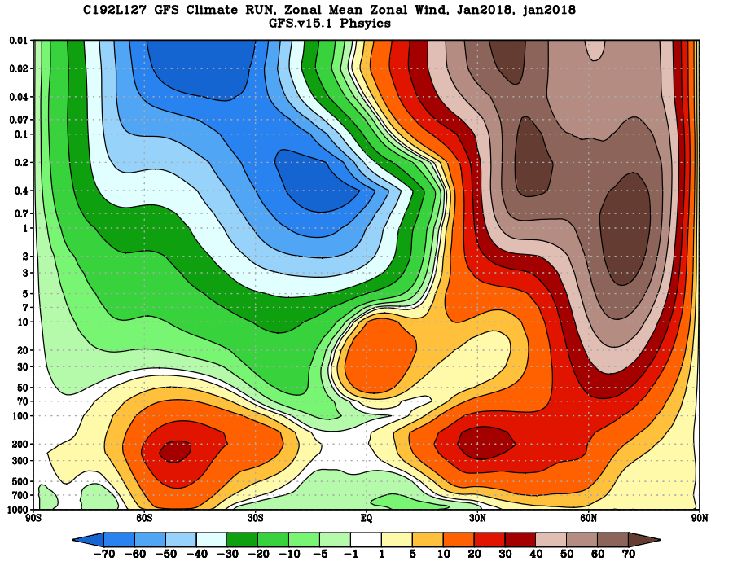
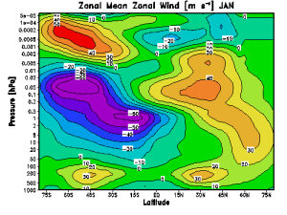
Zonal Mean Zonal Wind
Jan 2018
COSPAR Climatology
NH polar night jet is too strong, does not tilt towards the equator from the stratosphere to the mesosphere.
SH easterly wind near the mesopause region is too strong, does not transition to westerly

Slide 15
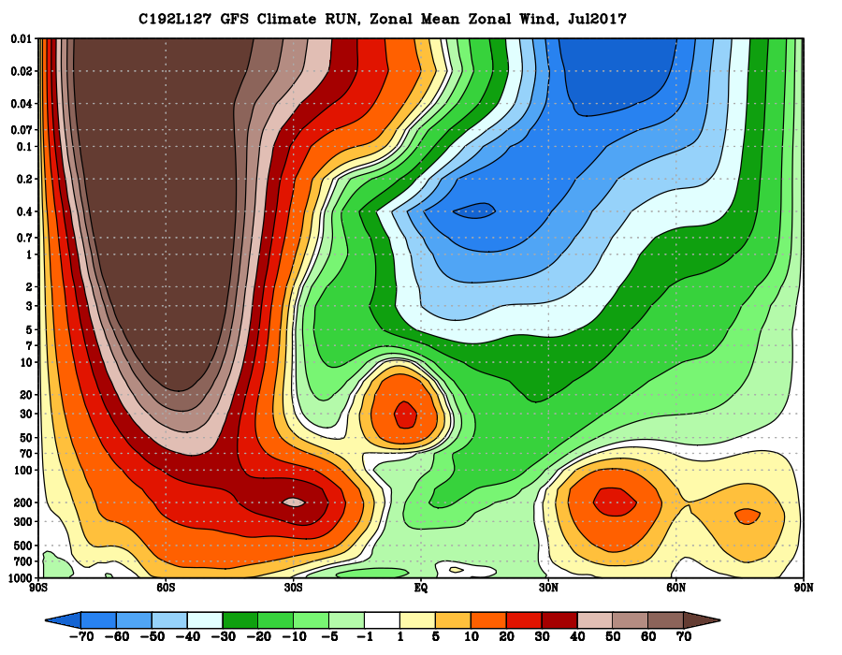
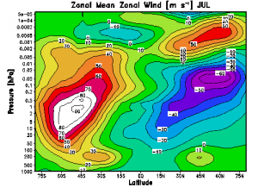
Zonal Mean Zonal Wind
July 2017
COSPAR Climatology
SH polar night jet is too strong, does not tilt towards the equator from the stratosphere to the mesosphere.
NH easterly wind near the mesopause region is too strong, does not transition to westerly

Slide 16
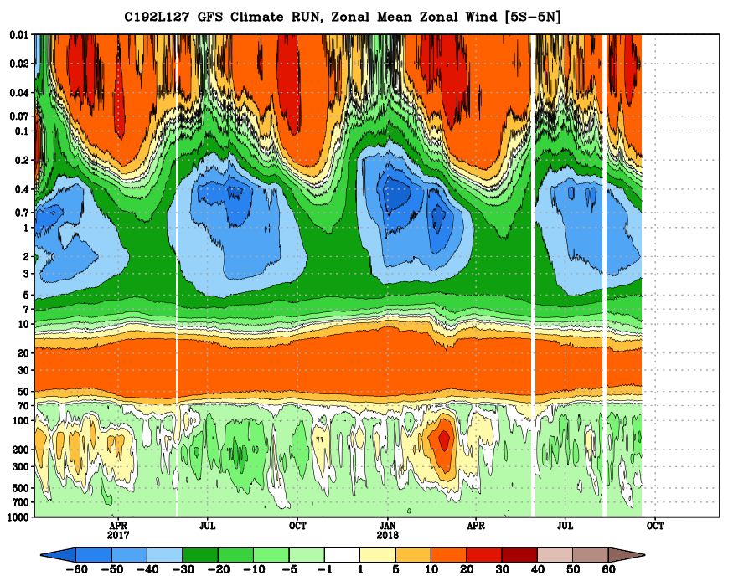
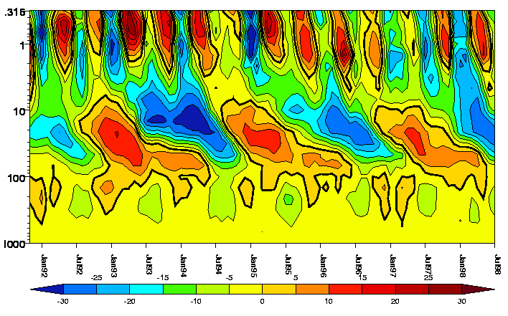
QBO, SAO
UKMO assimilated dataset
http://ugamp.nerc.ac.uk/hot/ajh/qbo.htm
The Model failed to capture the QBO
SAO westerly phase is too weak.

Slide 17
Improved climate mean state
with Unified Gravity-Wave Physics, which includes both parameterized orographic and non-orographic GWD
2-year C192L127 Climate/AMIP Run
IFS IC, 5Jan2017

Slide 18
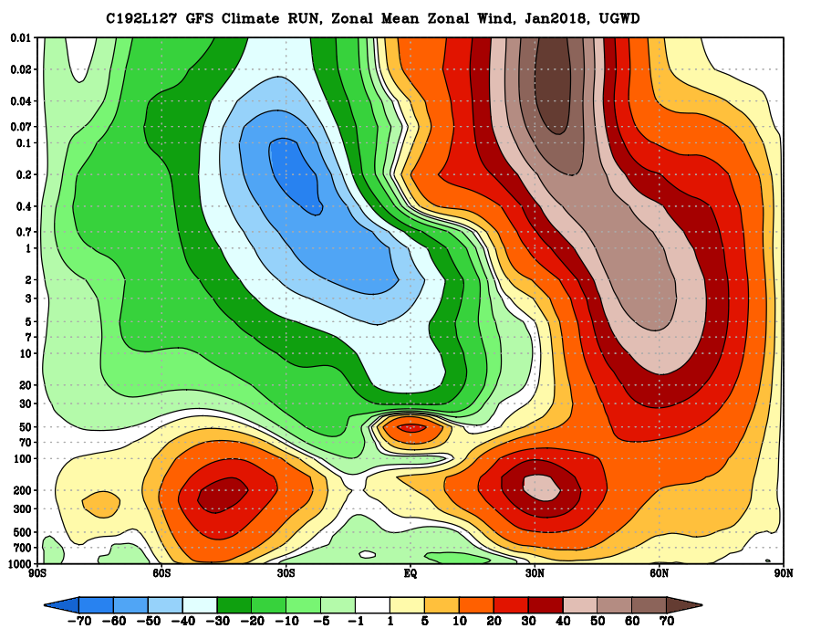
Zonal Mean Zonal Wind
Jan 2018
COSPAR Climatology
NH polar night jet is improved, has the correct orientation, although it is still too strong near the mesopause.
SH easterly wind near the mesopause is also greatly improved.

Slide 19
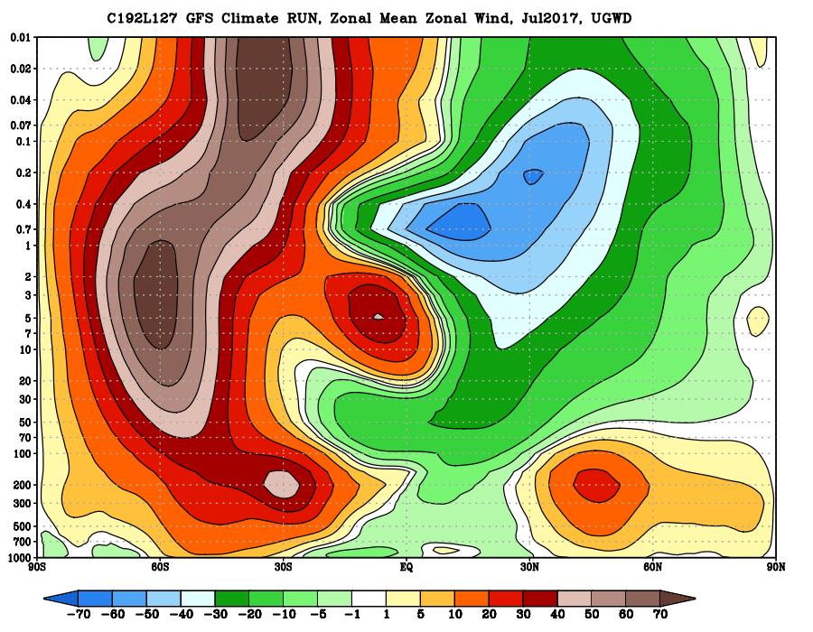
Zonal Mean Zonal Wind
July 2017
COSPAR Climatology

Slide 20
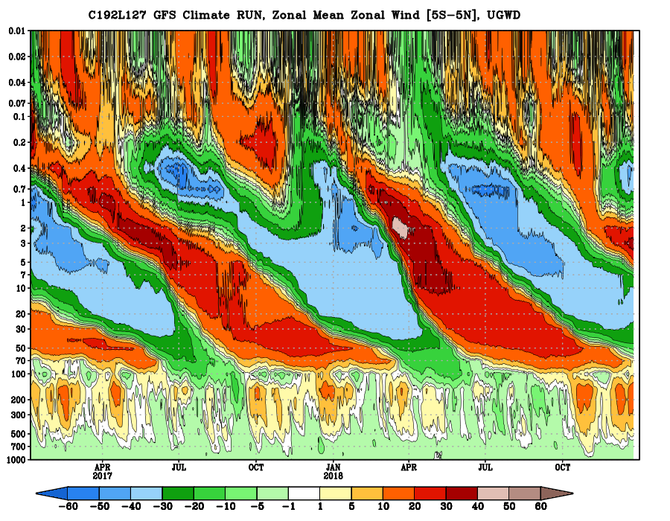
QBO, SAO
QBO-like feature captured, but the period is too short, appears to be an downward propagating SAO. Needs further improvement.

Slide 21
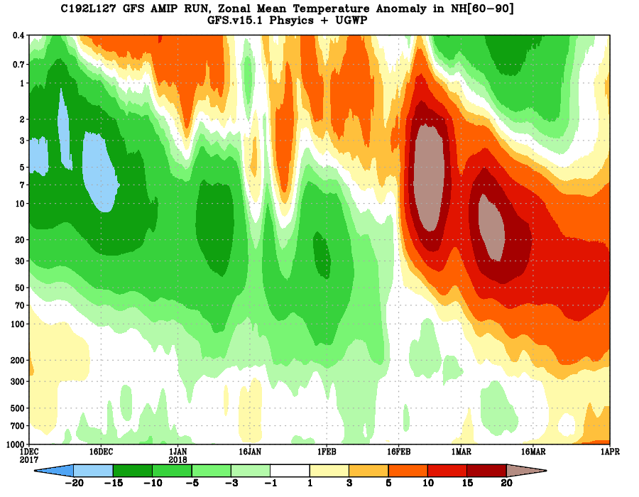
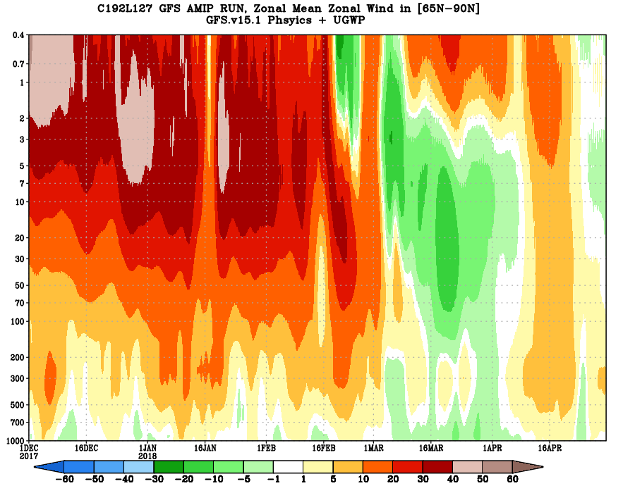
SSW (Dec-Apr, 2018)
SSW is simulated with UGWP included as well.
Temp Anomaly [ 60N-90N]
Zonal Wind [65N-90N]

Slide 22
Improving PBL Inversion
RUN1 : GFS.v15.1 configuration

Slide 23
GFS.v15 often struggles to handle PBL inversions
Bold: OBS
Dash: FCST
High elevation case
low elevation case
Credit: Geoff Manikin

Slide 24
Making background diffusivity coefficient scale dependent slightly improved the PBL inversion
Current operational GFS background diffusivity (K₀)
K₀ decreases with increasing grid resolution as
d_{k}=0.01+(d_{k0}-0.01)×(Δx-5)/(Δx_{ref} -5)
d_{k0}=1.0 m²s⁻¹, Δ x_{ref}=25000 m
d_{k}=1.0 for Δx=25km, d_{k}=0.01 for Δx=5m
d_{k}~0.5 for Δx=13km
d_{k}=1.0

Slide 25
To further improve the prediction of low-level inversion, K₀ (d_{k}) is decreased with increasing surface layer stability as well as with increasing resolution in the updated TKE-EDMF
d_{k}=d_{k}'(∆x) f(Ri_{b}, z/L)
1) f(Ri_{b})=0.1+0.9/(1+5Ri_{b})² : SL1 (PRMA04)
2) f(Ri_{b})=(1-Ri_{b}/0.25)²+0.1(1-[1-Ri_{b}/0.25]²) : SL2
(Weizhong Zheng)
3) f(z/L)=0.1+0.9/(1+5z/L)² : SL3

Slide 27
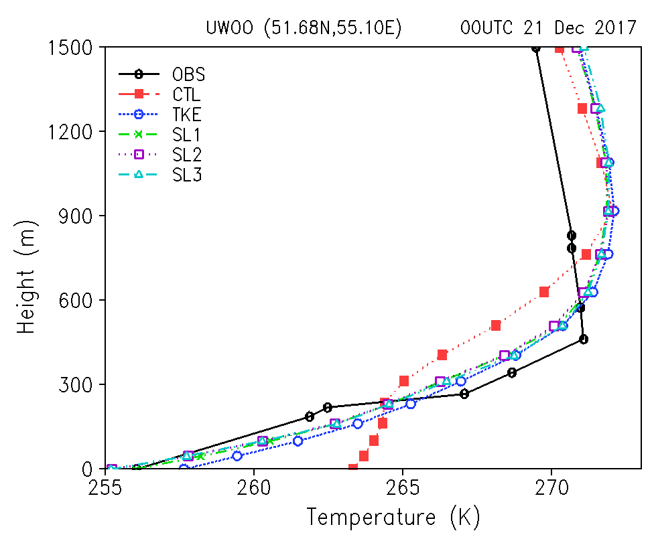
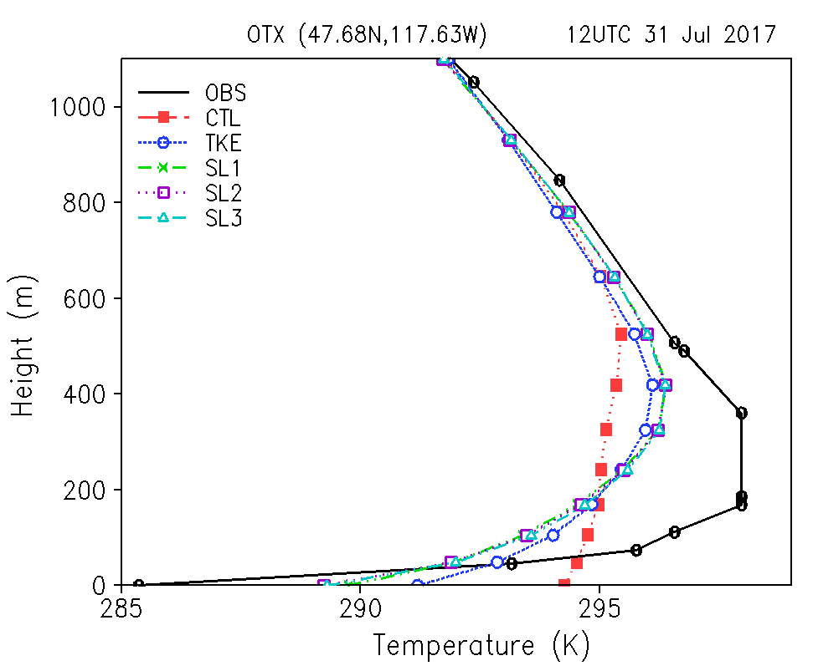
FV3GFS(L64) Test: Temperature profiles

Slide 28
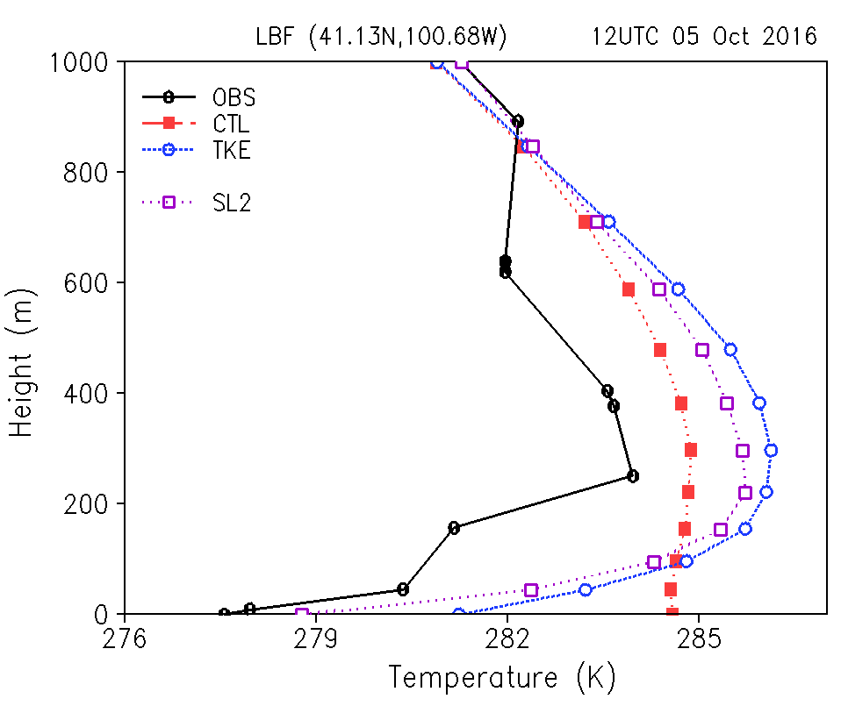
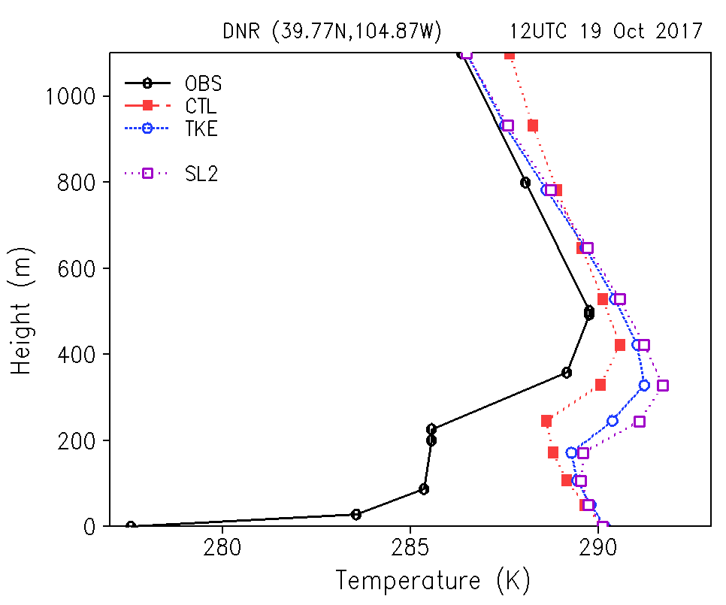
FV3GFS Test (L64): Temperature profiles
A case still not improved

Slide 29
Reducing Cold Biases in the lower troposphere

Slide 30
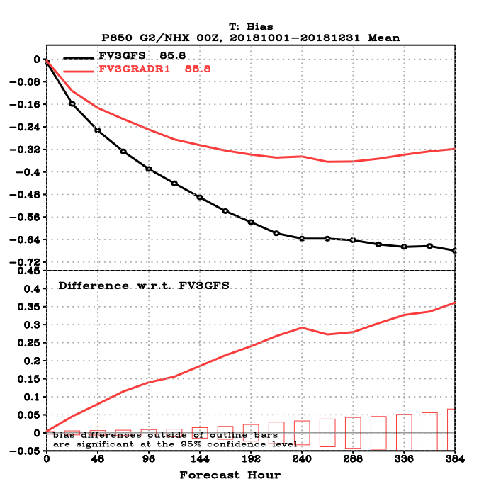
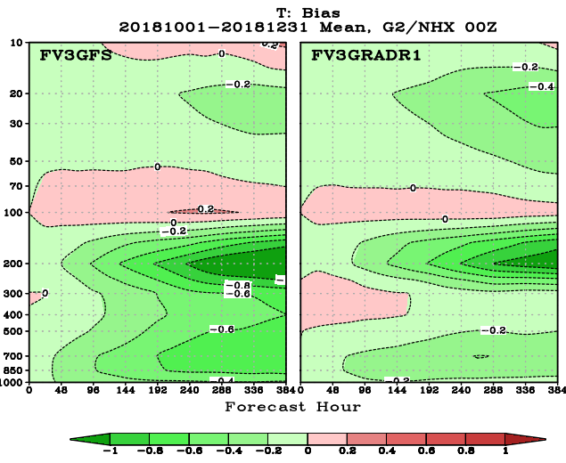
Reducing cold bias in the lower troposphere
More consistent cloud-radiation interactions
Modify the model physics so that the radiation can interact with each hydrometeor type from cloud microphysics directly instead of assuming empirical classification of hydrometeors. This is expected to warm the lower atmosphere.
This improves representation of cloud-radiation interactions and is not directly related to the solar zenith angle bug fix.
NH Temperature Bias
Cold Bias at 850hPa reduced by ~50%

Slide 31
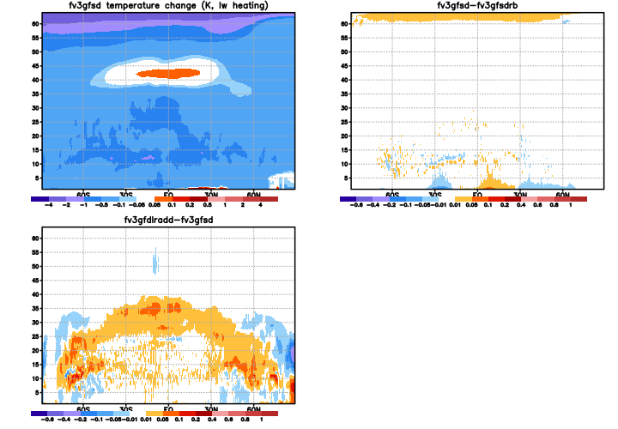
Longwave Heating Rate (K/6hr)
5
30
Control
200
pressure (hPa)
500
800
1000
5
Impact of new cloud-radiation interaction: reduced longwave cooling in the troposphere
30
200
pressure (hPa)
500
800
1000
Notes:
31

Slide 32
Reducing bias in the lower troposphere
Noah-MP: Improved land-atmosphere interaction
New Features in Noah-MP LSM
Model Structure Differences
Major components include a 1-layer canopy; 3-layer snow; 4-layer soil
Subgrid scheme: semi-tile vegetation and bare soil (Niu et al. 2010a)
Interactive energy balance method to predict skin temperature of the canopy and snow/soil surface
Modified two-stream radiation transfer scheme to consider the 3-D structure of the canopy (Niu and Yang, 2004)
More realistic snow physics: a thin layer, liquid water retention and refreezing, and snowpack densification (Yang and Niu, 2003)
A TOPMODEL- based runoff scheme (Niu et al., 2005)
An unconfined aquifer interacting with soil (Niu et al., 2007)
More permeable frozen soil (Niu and Yang, 2006)
Ball-Berry stomatal resistance related to photosynthesis
A short-term leaf dynamic model. (Dickinson et al., 1998)
Noah
Noah-MP
Single surface temperature
Multiple surface temperatures and distinct canopy
T_{can}
T_{skin}
T_{snow}(z)
T_{bc}
Snow
T_{g}
Snow
Noah LSM in NCEP Eta, MM5 and WRF Models (Pan and Mahrt 1987, Chen et al. 1996, Chen and Dudhia 2001, Ek et al., 2003)
Noah-MP LSM in WRF and NCEP CFS (Yang et al., 2011; Niu et al., 2011)

Slide 33
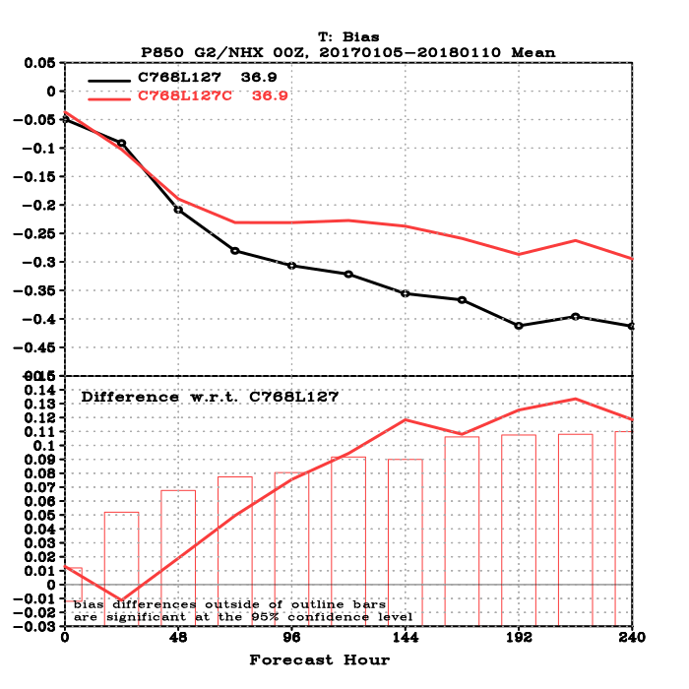
Reducing temperature bias in the lower troposphere
Noah-MP: Improved land-atmosphere interaction
Forecast experiments with IFS ICs
C768L127 GFS forecasts initialized with IFS ICs, every 10 days for the period from Jan 5 through Dec 31, 2017.
Temperature biases on 850 hPa in the Northern Hemisphere (20N-80N), verified against IFS analyses
Noah-MP LSM
Noah LSM

Slide 34
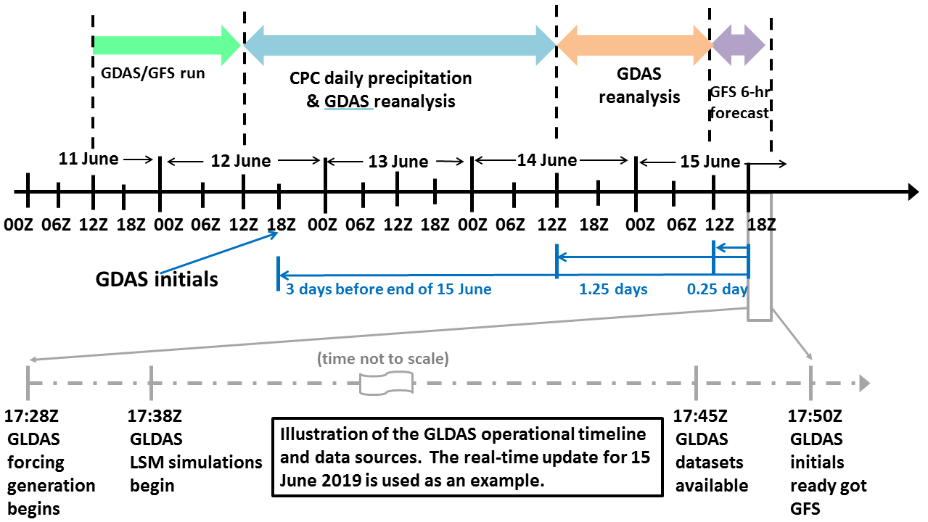
Reducing biases in surface temperature and precipitation forecast:
Spin up land model initial conditions with observed precipitation
Coupling GLDAS to Data Assimilation

Slide 35
Thanks

