Slide 1
Briefing to EMC CCB
September 24, 2018
GDAS/GFS V15.0.0
Upgrades for Q3FY2019
Presented by:
Fanglin Yang
FV3GFS T2O Project Lead
EMC Modeling and Data Assimilation Branch
Based on work done by EMC MDA, VPPP, and EI branches, GFDL and PSD collaborators, and various GFS downstream code managers and external collaborators
With Special thanks to NCO for securing computing resources for us to run a massive amount of experiments in a short period of time

Slide 2
Topics
Geoff Manikin, representing the VPPP Model Evaluation Group, gave a comprehensive evaluation of the FV3GFS forecast skills at the MEG weekly meeting on September 20th. Please refer to MEG Recording for Geoff’s presentation.
This presentation will be focused on
Science changes
Product changes
System configuration and resource requirement
General performances
Downstream user and model evaluation
Benefits and concerns

Slide 3
Change History of GFS Configurations
Mon/Year |  | Lev | Truncations | Z-cor/dyncore | Major components upgrade
Aug 1980 | 12 |  | R30 (375km) | Sigma Eulerian | first global spectral model, rhomboidal
Oct 1983 | 12 |  | R40 (300km) | Sigma Eulerian
Apr 1985 | 18 |  | R40 (300km) | Sigma Eulerian | GFDL Physics
Aug 1987 | 18 |  | T80 (150km) | Sigma Eulerian | First triangular truncation; diurnal cycle
Mar 1991 | 18 |  | T126 (105km) | Sigma Eulerian
Aug 1993 | 28 |  | T126 (105km) | Sigma Eulerian | Arakawa-Schubert convection
Jun 1998 | 42 |  | T170 (80km) | Sigma Eulerian | Prognostic ozone; SW from GFDL to NASA
Oct 1998 | 28 |  | T170 (80km) | Sigma Eulerian | the restoration
Jan 2000 | 42 |  | T170 (80km) | Sigma Eulerian | first on IBM
Oct 2002 | 64 |  | T254 (55km) | Sigma Eulerian | RRTM LW;
May 2005 | 64 |  | T382 (35km) | Sigma Eulerian | 2L OSU to 4L NOAH LSM; high-res to 180hr
May 2007 | 64 |  | T382 (35km) | Hybrid Eulerian | SSI to GSI
Jul 2010 | 64 |  | T574 (23km) | Hybrid Eulerian | RRTM SW; New shallow cnvtion; TVD tracer
Jan 2015 | 64 |  | T1534 (13km) | Hybrid Semi-Lag | SLG; Hybrid EDMF; McICA etc
May2016 | 64 |  | T1534 (13km) | Hybrid Semi-Lag | 4-D Hybrid En-Var DA
Jun2017 | 64 |  | T1534 (13km) | Hybrid Semi-Lag | NEMS GSM, advanced physics
April 2019 | 64 |  | FV3 (13km) | Finite-Volume | NGGPS FV3 dycore, GFDL MP
GSM has been in service for NWS operation for 38 years !
3

Slide 4
NGGPS FV3GFS-v1 Transition to Operations
FV3GFS is being configured to replace spectral model (NEMS GSM) in operations in Q2FY19
Configuration:
FV3GFS C768 (~13km deterministic)
GFS Physics + GFDL Microphysics
FV3GDAS C384 (~25km, 80 member ensemble)
64 layer, top at 0.2 hPa
Uniform resolution for all 16 days of forecast
Schedule:
3/7/18: code freeze of FV3GFS-V1 (GFS V15.0)
3/30/18: Public release of FV3GFS-V1
4/1 – 1/25/19: real-time EMC parallel
5/25 – 9/10/18: retrospectives and case studies (May 2015 – September 2018; three summers and three winters)
9/24/2018: Field evaluation due; EMC CCB
10/01/2018: OD Brief, code hand-off to NCO
12/20/2018-1/20/2019: NCO 30-day IT Test
01/24/2019: Implementation (delayed due to US government shutdown)

Slide 5
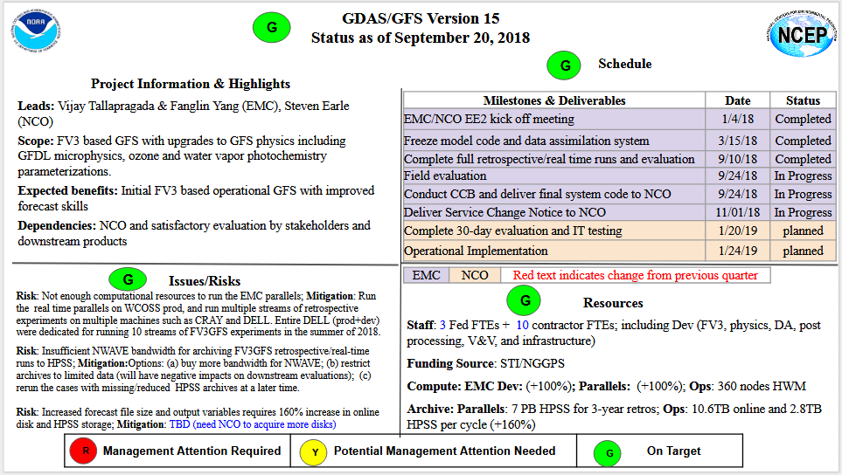
Quad Chart
On Target

Slide 6
Model: Infrastructure & Physics Upgrades
New parameterization of middle atmospheric water vapor photochemistry
a revised bare soil evaporation scheme.
Modify convection schemes to reduce excessive cloud top cooling
Updated Stochastic physics
Improved NSST in FV3
Use GMTED2010 terrain to replace TOPO30 terrain
Integrated FV3 dycore into NEMS
Added IPD in NEMSfv3gfs
Newly developed write grid component -- write out model history in native cubed sphere grid and Gaussian grid
Replaced Zhao-Carr microphysics with the more advanced GFDL microphysics
Updated parameterization of ozone photochemistry with additional production and loss terms

Slide 7

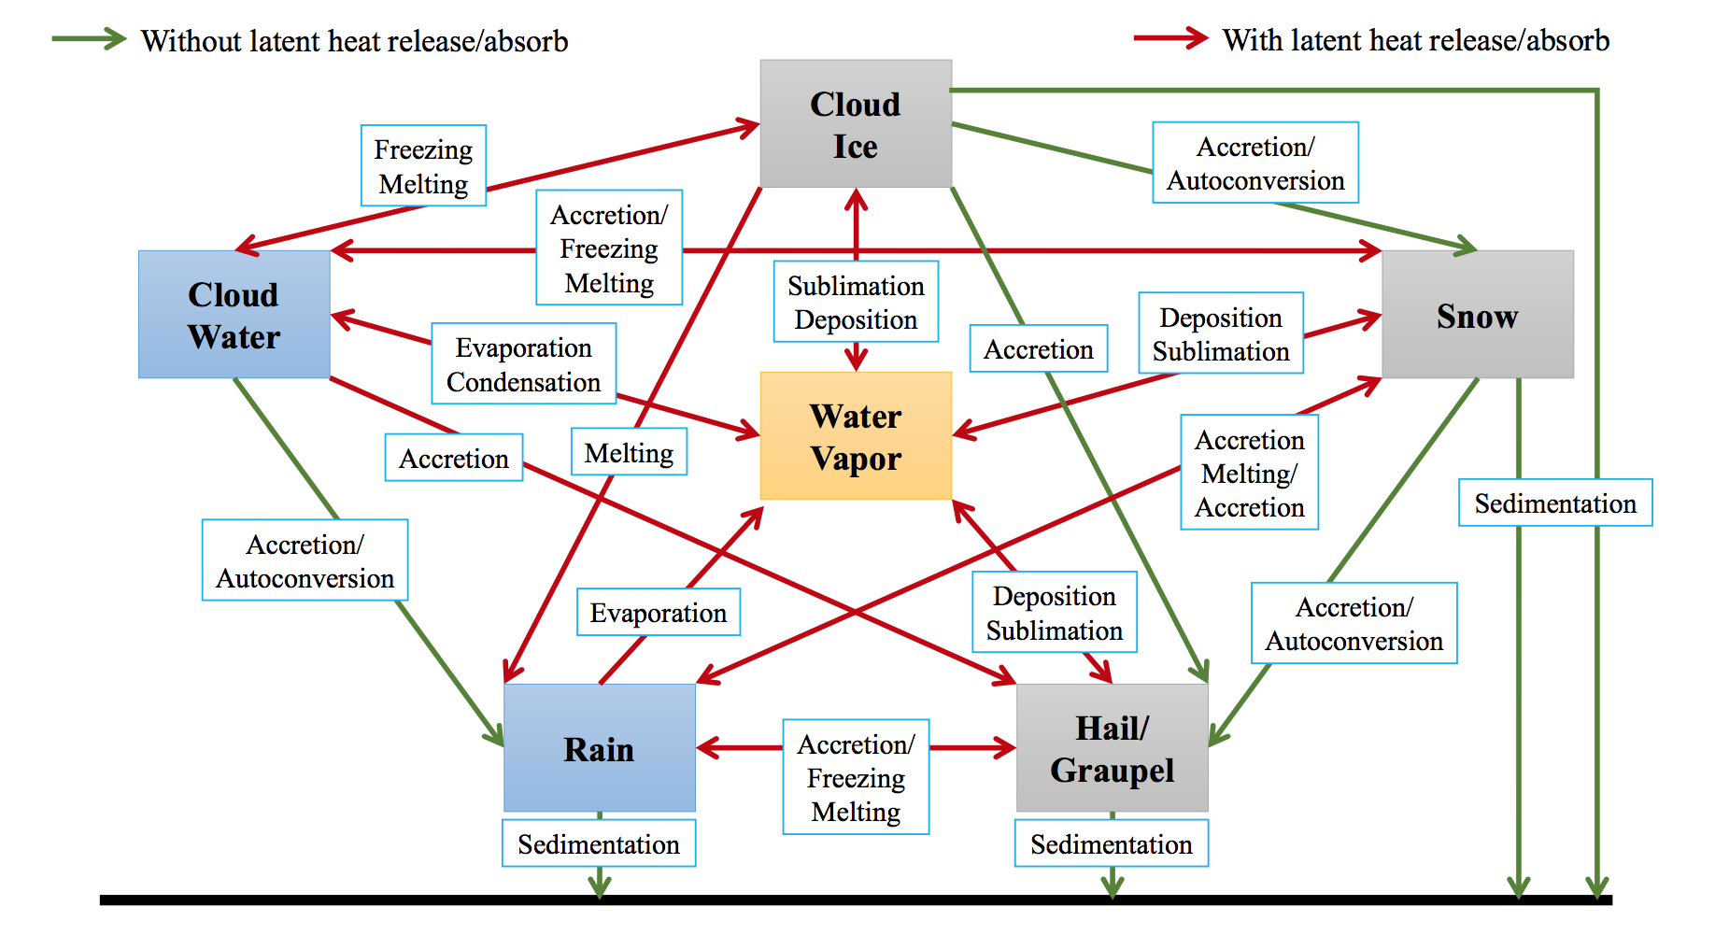
GFDL FV3 Dycore and Microphysics
GSM
Zhao-Carr MP
Spectral
Gaussian
Hydrostatic
64-bit precision
Prognostic could species: one
total cloud water
GFDL MP
Prognostics cloud species : five
Liquid, ice, snow, graupel, rain
more sophisticated cloud processes
Finite-volume
Cubed-Sphere
non-hydrostatic
32-bit precision
Physics still runs at 64-bit precision

Slide 8
Unique attributes of GFDL MP
Fast physics (phase changes ONLY, for now) between “Lagrangian-to-Eulerian” remapping in FV3
Time-split between warm-rain (faster) and ice-phase (slower) processes
Time implicit monotonic scheme for terminal fall of condensates
Thermodynamic consistency: exact moist energy conservation; condensates carry heat & momentum → heat and momentum transported during the sedimentation processes
“Scale-awareness” achieved by an assumed horizontal subgrid variability and a 2nd order FV-type vertical reconstruction for autoconversions
From: SJ Lin

Slide 9

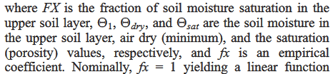
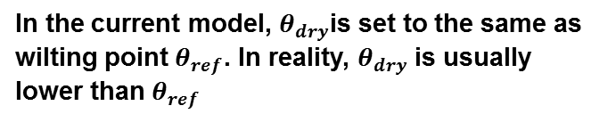
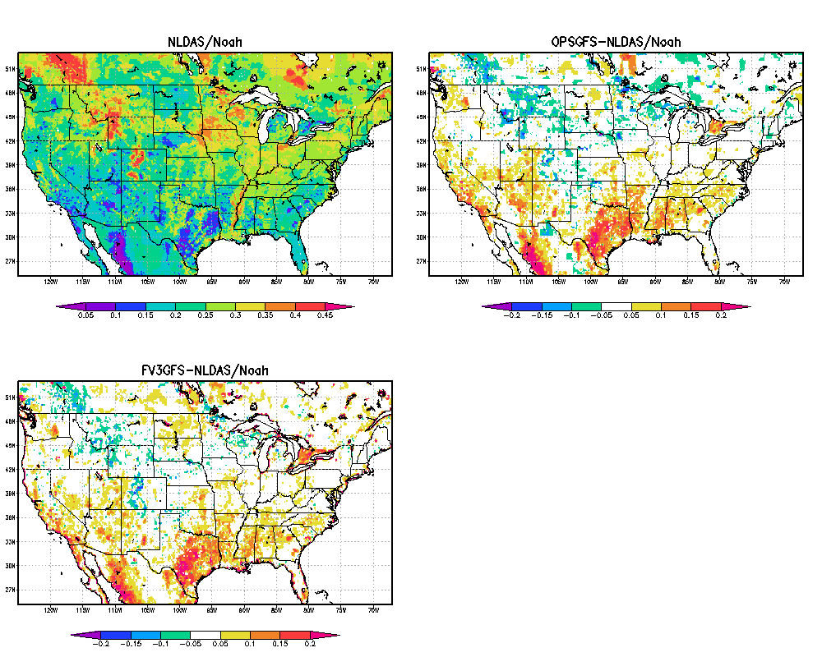
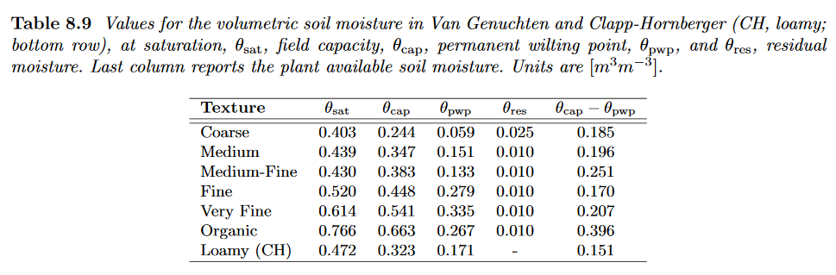
Revised Bare-Soil Evaporation
For Reducing Dry and Warm Biases
The latent heat flux now contributed more from the bare soil evaporation which is directly dependent on the first layer soil moisture. Thus we have strong and fast coupling between precip and soil moisture.
The goal is to keep or increase the latent heat flux while keeping the deep soil moisture intact
But ECMWF uses the table below
NLDS
GFS - NLDS
4th-layer Soil Moisture
Reduced dry bias
Credit: Helin Wei
FV3 - NLDS
From: Helin Wei

Slide 10
Updated Ozone Physics in FV3GFS
Funded by NOAA Climate Program Office
Naval Research Laboratory CHEM2D Ozone Photochemistry Parameterization (CHEM2D-OPP, McCormack et al. (2006))
NEMS GSM
Includes reference tendency and dependence on O3 mixing ratio
FV3GFS
Additional dependences on temperature
and column total ozone
Reference tendency (P-L)₀ and all partial derivatives are computed from odd oxygen (Ox ≡ O₃+O) reaction rates in the CHEM2D photochemical transport model.
CHEM2D is a global model extending from the surface to ~120 km that solves 280 chemical reactions for 100 different species within a transformed Eulerian mean framework with fully interactive radiative heating and dynamics.
prognostic Ozone mixing ratio
Temperature
column ozone above
From: Shrivinas Moorthi
Notes:
10

Slide 11
Water Vapor Sources and Sinks
in the Stratosphere/Mesosphere
  This new scheme is based on “Parameterization of middle atmospheric water vapor photochemistry for high-altitude NWP and data assimilation” by McCormack et al. (2008), from NRL
  Accounts for the altitude, latitude, and seasonal variations in the photochemical sources and sinks of water vapor over the pressure region from 100–0.001hPa (∼16–90km altitude)
  Monthly and zonal mean H₂O production and loss rates are provided by NRL based on the CHEM2D zonally averaged photochemical-transport model of the middle atmosphere
  The scheme mirrors that of ozone, with only production and loss terms.
From: Shrivinas Moorthi

Slide 12
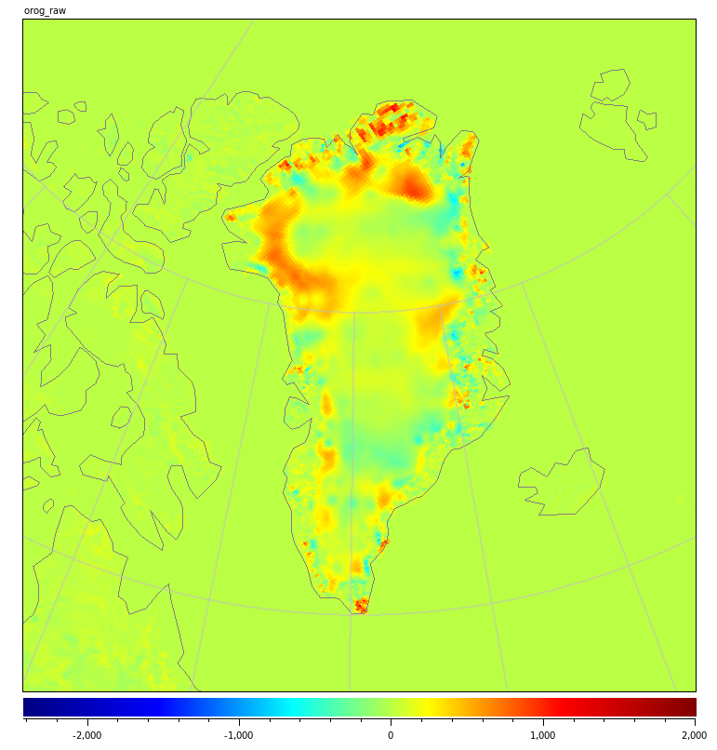
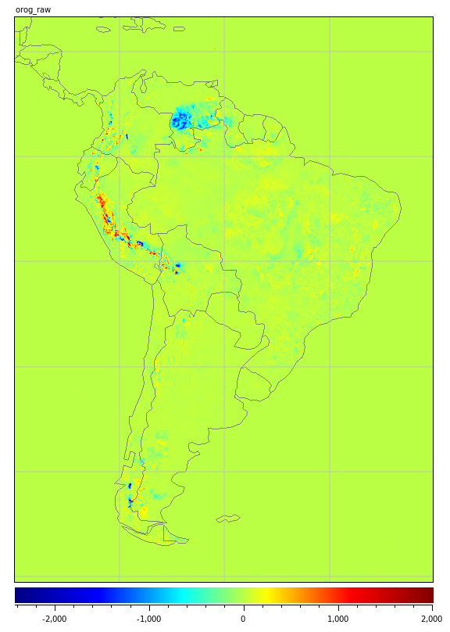
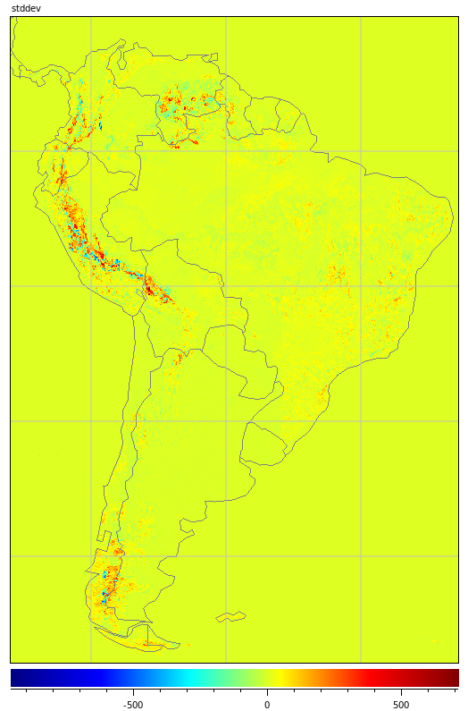
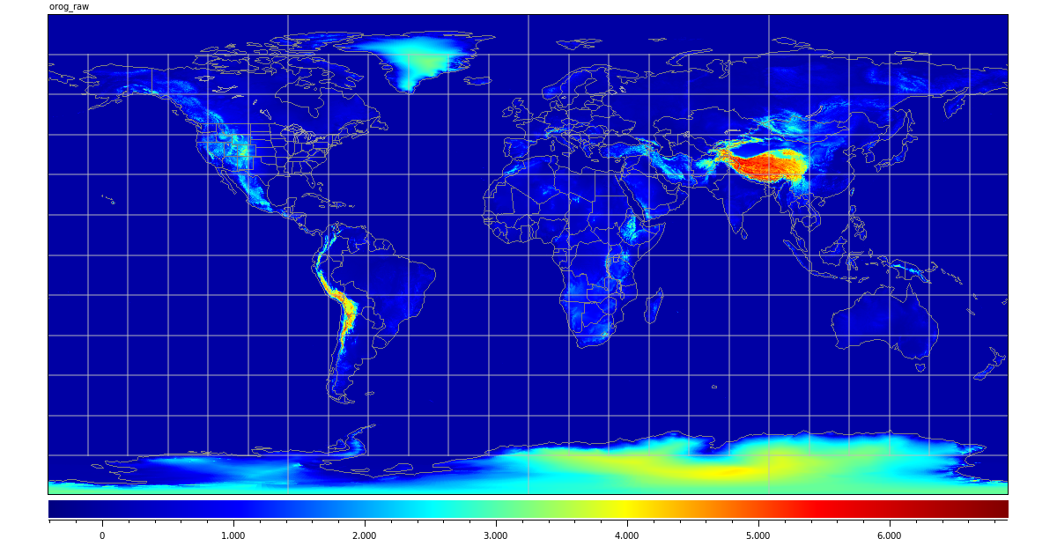
Terrain: GMTED2010 vs GTOPO30
GMTED2010:
A more accurate replacement for GTOPO30 data, created by USGS in 2010. Primarily derived from NASA Shuttle Radar Topography Mission (SRTM) data.
GMTED minus GTOPO30
> 1000 m
South America
Greenland
DIFFERENCES IN GREENLAND ARE LARGE IN MAGNITUDE AND AREAL EXTENT.
2000 m
GMTED2010 – Terrain height
HEIGHT
DIFFERENCE in STANDARD
DEVIATION
From: George Gayno & Fanglin Yang

Slide 13
FV3GFS Stochastic Physics Update
SKEB, SPPT, and SHUM were implemented into FV3GFS
GFS generates random patterns in spectral space, and transforms patterns to a Gaussian grid
FV3GFS still uses spectral patterns in spectral space, transforms them to a Gaussain grid, then interpolates to model’s cubed-sphere grid. The spectral resolution of the random pattern is decoupled from the resolution of the model, but due to the way the spectral transforms are decomposed with MPI, there is a limit of the number of MPI tasks for a spectral resolution (this decomposition is taken from the GSM core).
Stochastic Kinetic Energy Backscatter
GFS only uses the numerical dissipation estimate based on the vorticity gradient, and smoothed in spectral space.
FV3 core calculates Kinetic Energy loss at each time step in terms of a heat source that is added to the temperature equation. This loss smoothed in grid-point space for SKEB.
Vertical correlation of random patterns
GFS produces a unique random pattern at every model level, then smoothed in the vertical using 40 passes of a 1-2-1 filter.
Update to FV3GFS is to use the evolution of the random patterns over time to create vertical correlation. The pattern are saved on a independent vertical coordinate and interpolated to model levels. This allows for a separation of vertical and temporal correlation but only needing to carry one random pattern
Zonal Mean of dissipation estimate
GFS
FV3GFS
From: Phil Pegion

Slide 14
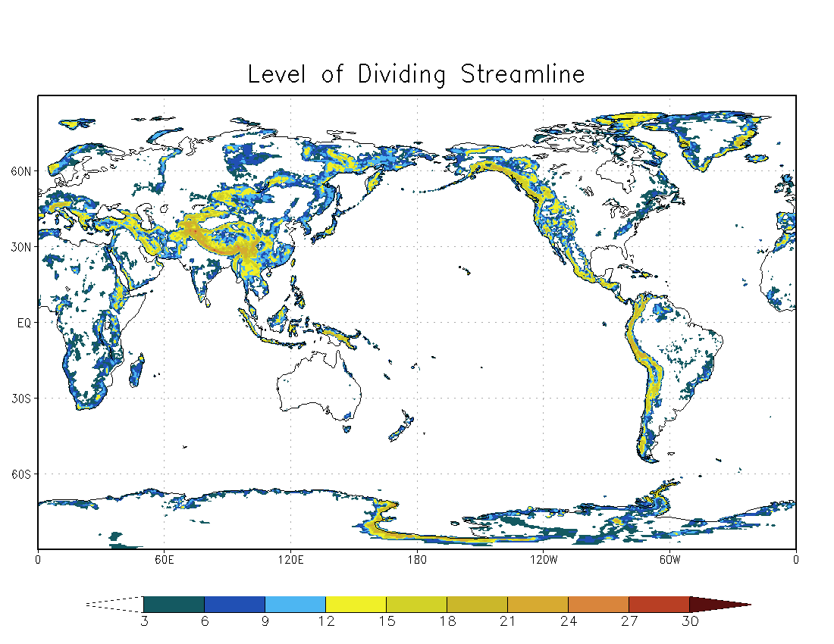
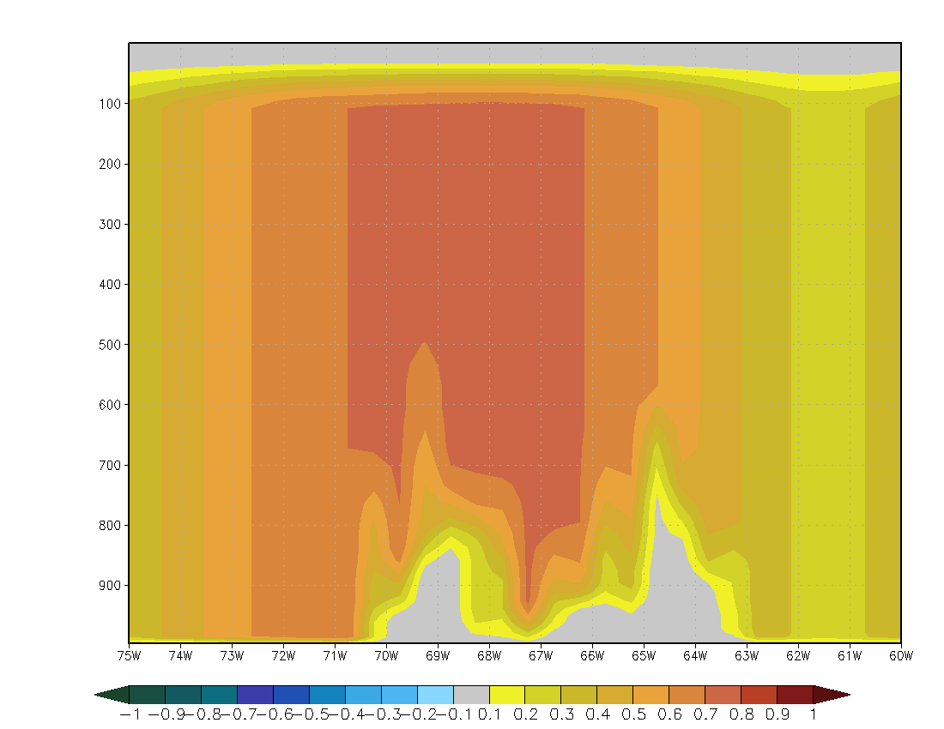
FV3GFS Stochastic Physics Update
Modification to SPPT
level of the dividing streamline
Several crashes were traced back to an interaction of the PBL scheme and mountain blocking scheme with SPPT.
Gravity wave/mountain blocking scheme diagnoses a “dividing streamline” based on orography and kinetic energy (Lott and Miller 1997)
This fix is to not apply any SPPT perturbations where the model diagnoses the flow as blocked, then ramp up to full perturbations over 3 grid points in the vertical.
Cross section across the Andes
From: Phil Pegion

Slide 15
Parallelized NEMS FV3 Write Grid Component
GFDL FMS writes files in native cubed sphere grid in six tiles, one file for each tile in netcdf format with all output times at once.
NEMSIO writes
history files in cubed sphere grid in six tiles, one file one tile in netcdf format at a specific output time
  history files in global Gaussian grid, one file for global at a specific output time in either netcdf format or NEMSIO format
PE1
nggps3df00
PE2
nggps2df00
PEm
PE1
wrt grid comp
pgbf00
FH=00
PE2
PE3
PE1
nggps3df00
FH=03
PE2
PEm
nggps2df00
wrt grid comp
pgbf00
PEn
FH=x
FCST grid component
PE1
PE2
nggps3df00
Forecast grid comp
Parallel domain
PEm
nggps2df00
wrt grid comp
pgbf00
Write grid comp
Parallel domain
From : Jun Wang

Slide 16
DA: Infrastructure Changes
Improved GSI code efficiency
The GSI does not currently have the capability to operate on a non-rectangular grid. Forecasts are therefore provided via the FV3 write-grid component on the Gaussian grid required by the GSI. Increments are interpolated back on the cube-sphere grid within the FV3 model itself.
Both the analysis and EnKF components are now performed at one-half of the deterministic forecast resolution (increased from one-third in current operations) and is now C384 (~26km) instead of 35km. This reduced issues when interpolating between ensemble and control resolutions.
Tropical cyclone relocation is omitted from the implementation, as is the full field digital filter.
The current operational GDAS/GFS system uses a total (non-precipitating) cloud condensate, whereas the FV3-GFS has five separate hydrometeor variables.
From: DA Team

Slide 17
DA Infrastructure Changes – cont’d
The initial FV3 data assimilation scheme retains the total cloud condensate control variable by combining liquid water and ice amounts from the model, but avoids issues with how to split the analysis increments into the component species by not feeding the increment back at all.
  This approach (treating the cloud as a “sink variable”) will still update the other model fields to be consistent with the cloud increment through the multivariate error correlation in the background error specification while also mitigating “spin-down” issues seen in current operations.
Only the SHUM (Stochastically Perturbed Boundary Layer Specific Humidity) and SPPT (Stochastically Perturbed Physics Tendencies) are included as stochastic physics in the EnKF. The SKEB (Stochastic Energy Backscatter) was not available to be used at the time the code was frozen, and amplitude parameters for SHUM and SPPT were modified to compensate.
From: DA Team

Slide 18
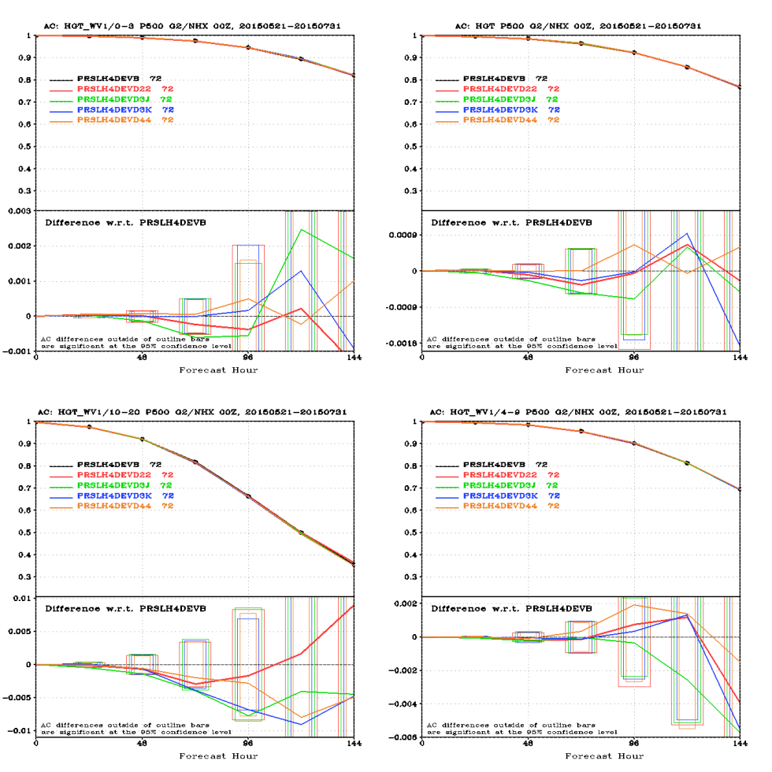
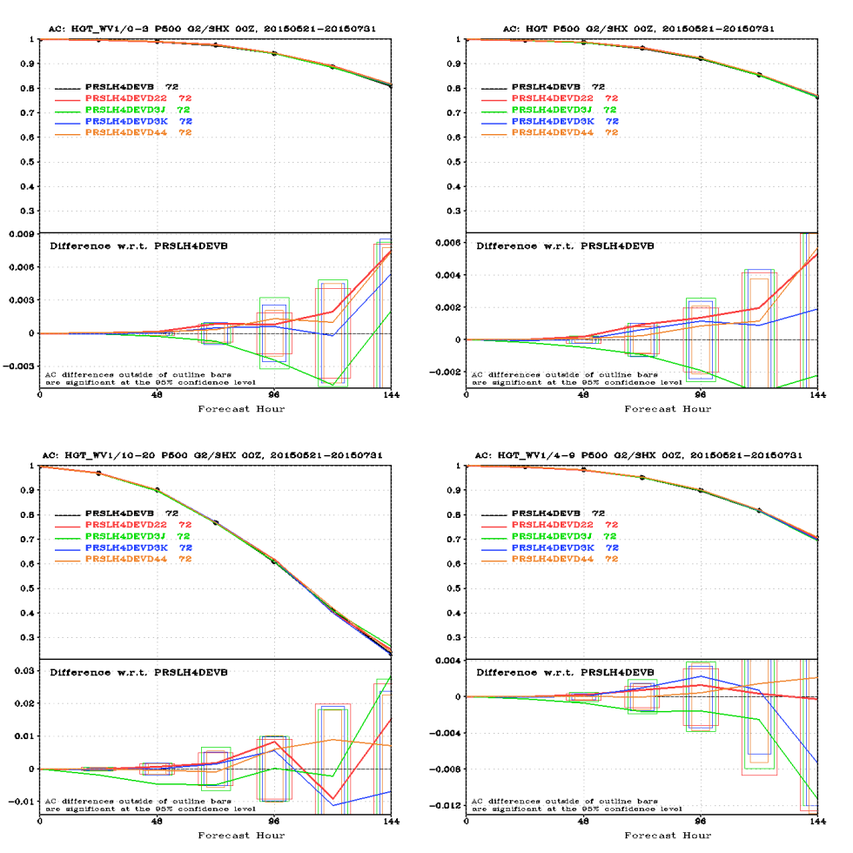
DA: Observation Changes
ATMS has been upgraded from clear-sky to all-sky assimilation to be consistent with the AMSU-A sensors.
CrIS on Suomi-NPP was upgraded to use the full spectral resolution (FSR) data stream – consistent with CrIS on NOAA-20 (moisture and pressure).
CrIS and ATMS on NOAA-20 as well as GOES-16 winds were made operational in 2018 and this is reflected in the FV3-GFS package. CrIS has slightly modified observation errors and thinning compared to operations.
Turn on 10 water vapor channels for IASI.
Turn on Megha-Tropiques Saphir (humidity)
Monitor Suomi-NPP OMPS retrievals (ozone)
500hPa HGT ACC
ATMS Change to All-Sky
Cntl: Clear-Sky ATMS
All-Sky ATMS
(other curves are alternative configurations for all-aky)
20150521 ~ 20150731
NH
SH
From: DA Team

Slide 19
Post Processing Upgrade and Changes
Changes in products:
      Vertical velocity from FV3GFS is dz/dt in m/s but omega will be derived in UPP using hydrostatic equation and still be provided to users
      GFS Bufr sounding will output nonhydrostatic dz/dt only
      Global aviation products have been adjusted to new MP and FV3 dynamic core
Several new products are added:
  More cloud hydrometers predicted by the advanced microphysics scheme
  Global composite radar reflectivity derived using these new cloud hydrometers
  Isobaric (3D) cloud fractions
  Continuous accumulated precipitation
  Complete list can be found in this Google Sheet
GFS DNG products over Guam will be discontinued. EMC has coordinated with users to switch to new and better products.
From: Hui-ya Chuang & Wen Meng

Slide 20
Workflow Unification
Almost all scripts adopted from the NEMS GFS were rewritten for the FV3GFS
The old psub/pend job submission system is replaced by Rocoto drivers
The 4-package superstructure workflow was merged into one package with a flat structure
All JJOBS were rewritten. Both EMC parallels and NCO operation will use the same JJOBS
EMC parallels and NCO operation follow the same file name convention and directory structure
An important achievement to simplify and unify the GFS systems between the development (EMC) and operation (NCO)

Slide 21
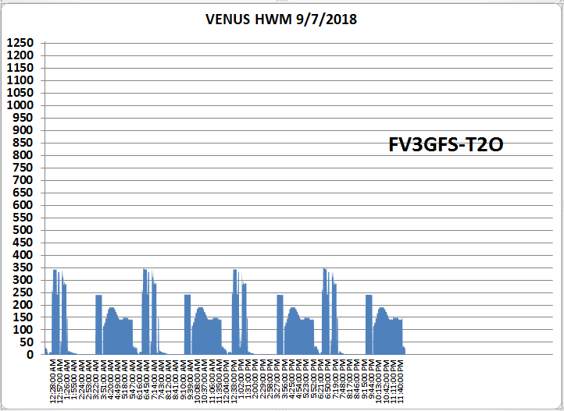
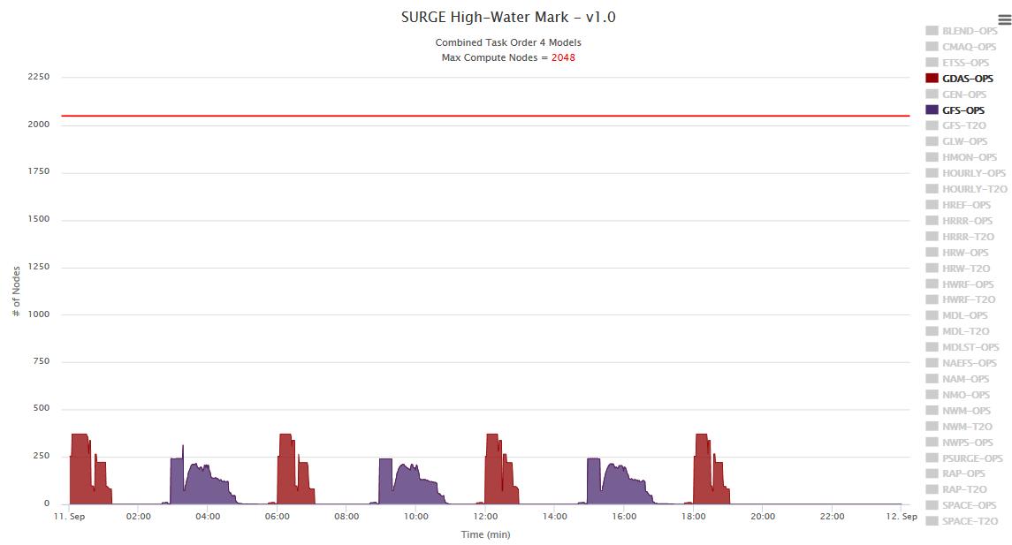
High Water Mark Test
With detailed node distribution
FV3 is more expensive to run than GSM
Dell
FV3GFS
CRAY
Operational GFS
Peak 350 nodes
(w/o downstream products)
Peak 370 nodes
(all included)
GFS fcst: 116 nodes
GDAS fcst: 28 nodes
Analysis: 240 nodes
ENKF fcst: 280 nodes
GFS fcst: 65nodes
GDAS fcst: 55 nodes
Analysis: 240 nodes
ENKF fcst: 200 nodes
Dell has 28 processors per node while Cray has 24 processors per node
From: Russ Treadon, Fanglin Yang, Matt Pyle

Slide 22
Timing Test and Forecast Configuration
RUN TIME (minutes) | J-Job prod | J-Job para | prod (minutes) | para (minutes) | para-prod
gfs_analysis | JGFS_ANALYSIS | JGLOBAL_ANALYSIS | 22.9 | 26.8 | 4.2
gfs_forecast (0-10 days) | JGFS_FORECAST_HIGH | --- | 78.5 | 75.5 | -3
gfs_forecast (11-16days) | JGFS_FORECAST_LOW | --- | 11.3 | 45.3 | 34
gfs_forecast (0-16 days) | --- | JGLOBAL_FORECAST | 89.8 | 120.8 | 31
gdas_analysis_high | JGDAS_ANALYSIS_HIGH | JGLOBAL_ANALYSIS | 29.7 | 30.7 | 1.0
gdas_forecast_high | JGDAS_FORECAST_HIGH | JGLOBAL_FORECAST | 12.3 | 11.7 | -0.6
Highlights:
current operational GFS runs at T1534 (13 km) for the 1st 10 days, then at T574 (35 km) up to 16 days
V3GFS runs at the same C768 resolution (~13 km) up to 16 days
Operational GFS write hourly output for the 1st 5 days, 3 hourly up to 10 days, then 12 hourly up to 16 days
FV3GFS writes hourly output for the 1st 5 days, then 3 hourly up to 16 days
FV3GFS analysis will be 4.2 minutes slower than current operation; day-10 products will be delivered 3 minutes earlier; day-16 product will be delayed by 31 minutes.
GDAS cycles remains almost the same in terms of timing (+/- 1.0 minutes)

Slide 23
Changes in Online Disk Usage
Per Cycle
~160% increase
 | anl+forecast | products & misc | total
ops gfs | 1.70 TB | 0.30 TB | 2.0 TB
ops GDAS | 0.157 TB | 0.029 TB | 0.186 TB
ops ENKF | 1.831 TB | 0.043 TB | 1.874 TB
ops total |  |  | 4.06 TB
FV3 GFS | 4.0 | 0.70 | 4.7
FV3 GDAS | 0.295 | 0.05 | 0.3
FV3 ENKF | 5.4 | 0.3 | 5.7
FV3 total |  |  | 10.7 TB
Ops GDAS and ENKF are run at T574 (1152x576), while FV3GFS is run at C384, e.g. T766 (1532x768). This is equivalent to a 77.7% increase in forecast file size. Factoring in the increase of output variables, ENKF and GDAS file size will increase by 200%.

Slide 24
Changes in HPSS Archives per cycle (link)
 | Ops GFS | Proposed for FV3GFS
Tarball naming convention | gfs.yyyymmddhh.sigma.tar enkf.yyyymmdd_hh.anl.tar enkf.yyyymmdd_hh.fcs.tar enkf.yyyymmdd_hh.fcs03.tar enkf.yyyymmdd_hh.fcs09.tar enkf.yyyymmdd_hh.omg.tar gdas.yyyymmddhh.tar gdas.yyyymmdd_radmonhh.ieee.tar gfs.yyyymmddhh.anl.tar gfs.yyyymmddhh.pgrb2_0p25.targ fs.yyyymmddhh.pgrb2_0p50.tar gfs.yyyymmddhh.pgrb2_1p00.tar gfs.yyyymmddhh.sfluxgrb.tar | gfs.targfs_flux.tar gfs_nemsioa.tar gfs_restarta.tar gdas.targdas_restarta.targdas_restartb.targfs.pgrb2_0p25.targfs.pgrb2_0p50.targfs.pgrb2_1p00.tarenkf.gdas.tarenkf.gdas_grp01.tarenkf.gdas_grp02.tarenkf.gdas_grp03.tarenkf.gdas_grp04.tarenkf.gdas_grp05.tarenkf.gdas_grp06.tarenkf.gdas_grp07.tarenkf.gdas_grp08.tarenkf.gdas_restarta_grp01.tarenkf.gdas_restarta_grp02.tarenkf.gdas_restarta_grp03.tarenkf.gdas_restarta_grp04.tarenkf.gdas_restarta_grp05.tarenkf.gdas_restarta_grp06.tarenkf.gdas_restarta_grp07.tarenkf.gdas_restarta_grp08.tar
permanent | 1171 GB | 1858 GB
2-year | 55 GB | 991 GB
total | 1226 GB | 2849 GB
All tarball names are changed
nemsioa.tar: saving forecast history nemsio files 3-hourly up to 84 hours for running standalone FV3
2-year “991GB” : saving forecast history nemsio files 6-hourly from 90 to 384 hours. (optional)

Slide 25
Retrospective and Real-Time Parallels
Initially, six streams of retrospective parallel were carried out to cover the period from May 2015 through May 2018.
Most of the streams were run on WCOSS DELL, which was used as a dedicated computing resource for running fv3gfs with all other uses blocked.
The real-time parallel was moved from CRAY to DELL in August.
http://www.emc.ncep.noaa.gov/gmb/emc.glopara/vsdb/prfv3rt1 real-time parallel
http://www.emc.ncep.noaa.gov/gmb/emc.glopara/vsdb/fv3q2fy19retro1 hord=6, Dec2017 ~ May2018
http://www.emc.ncep.noaa.gov/gmb/emc.glopara/vsdb/fv3q2fy19retro2 hord=6, Jun2017 ~ Nov2018
http://www.emc.ncep.noaa.gov/gmb/emc.glopara/vsdb/fv3q2fy19retro3 hord=6, Dec2016 ~ May2017
http://www.emc.ncep.noaa.gov/gmb/emc.glopara/vsdb/fv3q2fy19retro4 hord=6, Jun2016 ~ Nov2016
http://www.emc.ncep.noaa.gov/gmb/emc.glopara/vsdb/fv3q2fy19retro5 hord=6, Dec2015 ~ May2016
http://www.emc.ncep.noaa.gov/gmb/emc.glopara/vsdb/fv3q2fy19retro6 hord=6, Jun2015 ~ Nov2015
http://www.emc.ncep.noaa.gov/gmb/emc.glopara/vsdb/gfs2019
Aggregated: Comparing NEMS GFS with FV3GFS (hord=6). Including all streams
With the support of MDL scientists, we included MDL GFSMOS in the real-time parallel and two retro runs. This effort streamlined MOS evaluation of GFS for current and future implementations.

Slide 26
HORD5 v.s. HORD6
It was found hurricane intensity was too weak in the first set of parallels.
GFDL suggested we rerun the deterministic forecast using an alternative advection scheme (HORD5), while keep using the original scheme (HORD6) in the data assimilation cycle.
A set of experiments were conducted to demonstrate that using HORD5 does improve hurricane intensity and does not degrade other forecast skills http://www.emc.ncep.noaa.gov/gmb/emc.glopara/vsdb/gfs2019c
A Brief Guide to Advection Operators in FV3, by Lucas Harris, Shian-Jiann Lin, and Xi Chen .
…The operators in the most recent version of FV3 all use the piecewise-parabolic method (Collella and Woodward 1984), …Here we briefly describe three PPM operators, all formally the same fourth-order accuracy but with different reconstruction limiters: An unlimited (also called linear) “fifth-order” operator (hord = 5), an unlimited operator with a 2dx filter (hord = 6), and the monotone Lin 2004 operator (hord = 8). … They do not change the order of accuracy of the advection, only the diffusivity and shape-preserving characteristics.
…Hord = 6 uses a much stronger 2dx filter: the hord = 5 method is extended by reverting to first-order upwind flux if the difference in cell-interface values exceeds the mean of the two interface values by a tunable threshold (1.5x by default).

Slide 27
Retrospective and Real-Time Parallels
NCEP Director approved the use of HORD5 starting from the 2018081518 cycle in the real-time parallel. We also reran all past hurricane seasons and one winter/spring season with HORD5.
In total
11 streams, 2000 days, 8000 cycles
http://www.emc.ncep.noaa.gov/gmb/emc.glopara/vsdb/prfv3rt1 real-time parallel
http://www.emc.ncep.noaa.gov/gmb/emc.glopara/vsdb/fv3q2fy19retro1c hord=5, Dec2017 ~ Aug2018
http://www.emc.ncep.noaa.gov/gmb/emc.glopara/vsdb/fv3q2fy19retro2c hord=5, Jun2017 ~ Nov2018
http://www.emc.ncep.noaa.gov/gmb/emc.glopara/vsdb/fv3q2fy19retro4c hord=5, Jun2016 ~ Nov2016
http://www.emc.ncep.noaa.gov/gmb/emc.glopara/vsdb/fv3q2fy19retro6c hord=5, Jun2015 ~ Nov2015
Aggregated STATS
http://www.emc.ncep.noaa.gov/gmb/emc.glopara/vsdb/gfs2019b
Comparing NEMS GFS with FV3GFS, including all cases from hord5 runs, and 2015 and 2016 winter/spring streams with hord6.
http://www.emc.ncep.noaa.gov/users/Alicia.Bentley/fv3gfs/ MEG evaluation page
http://www.emc.ncep.noaa.gov/gmb/STATS_vsdb/ International models

Slide 28
Verification & Evaluation
Geoff Manikin presented a comprehensive evaluation of the FV3GFS forecast skills at the MEG weekly meeting on September 20th.
A few of the highlights will be repeated here.
Additional verification and evaluation will be added.
Benefits and concerns from both MEG’s presentation and this briefing will be summarized at the end of this talk.
nomenclatures: ops GFS, NEMSGFS or GSM referred in this talk are the same spectral model

Slide 29
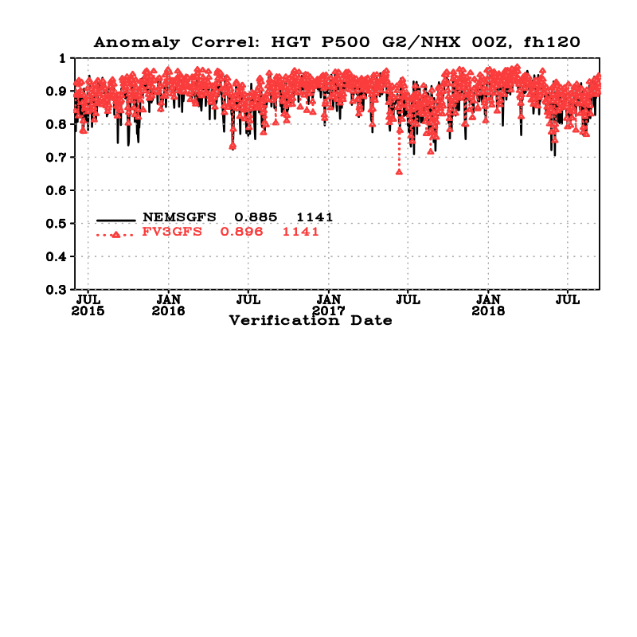
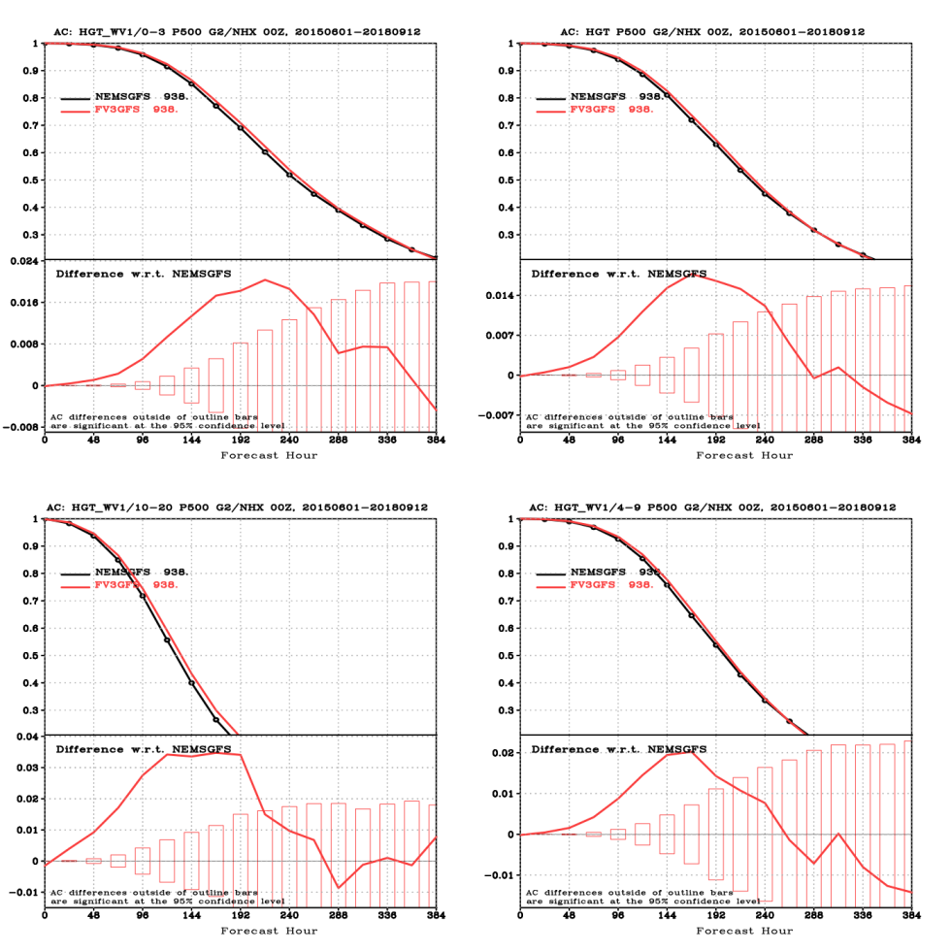
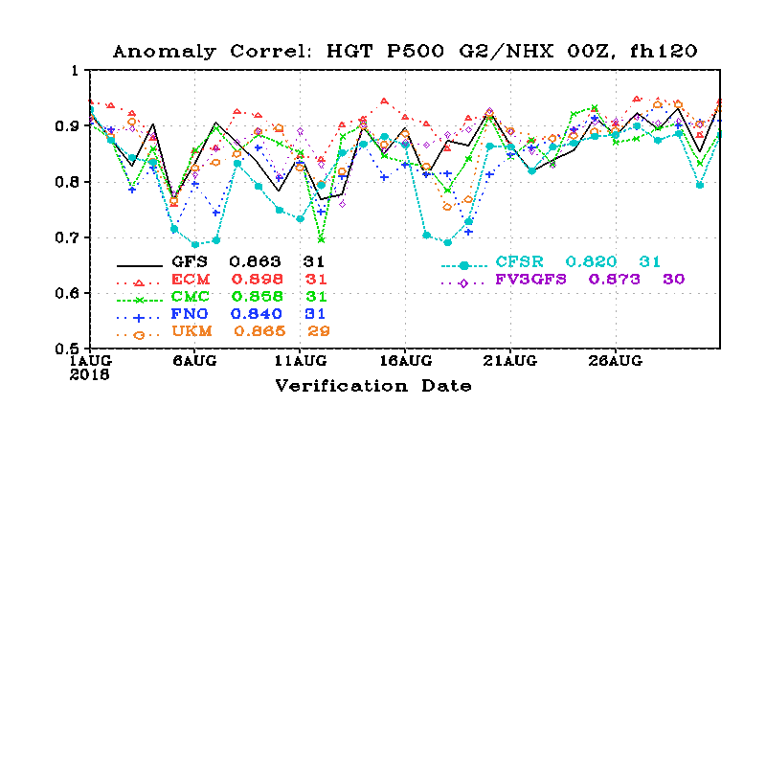
NH 500-hPa HGT Anomaly Correlation
(20150601 ~ 20180912)
Day-5
Annual Mean day-5 ACC, GFS - CFSR
A gain of 0.011
2008~2017 gain: 0.04
Die-off
Major International NWP, August 2018 Mean
fv3gfs ranked #2
Increase is significant up to day 10

Slide 30
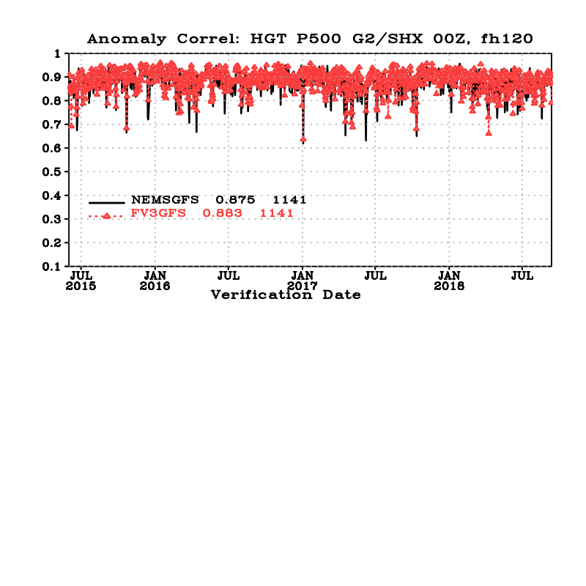
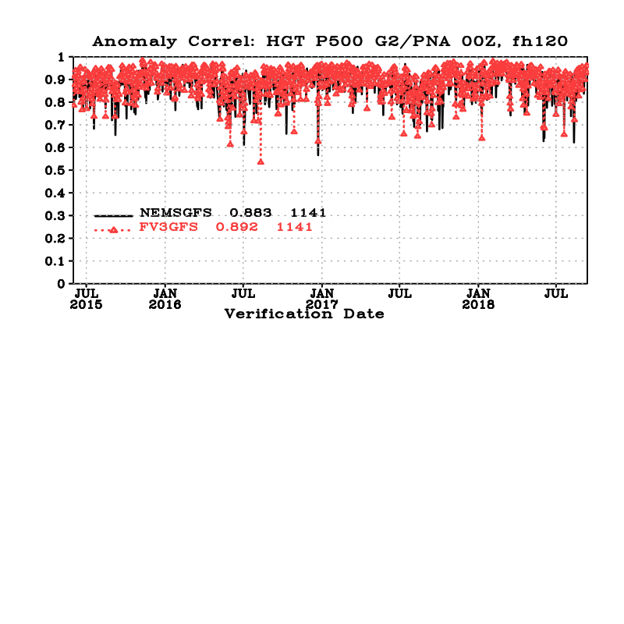
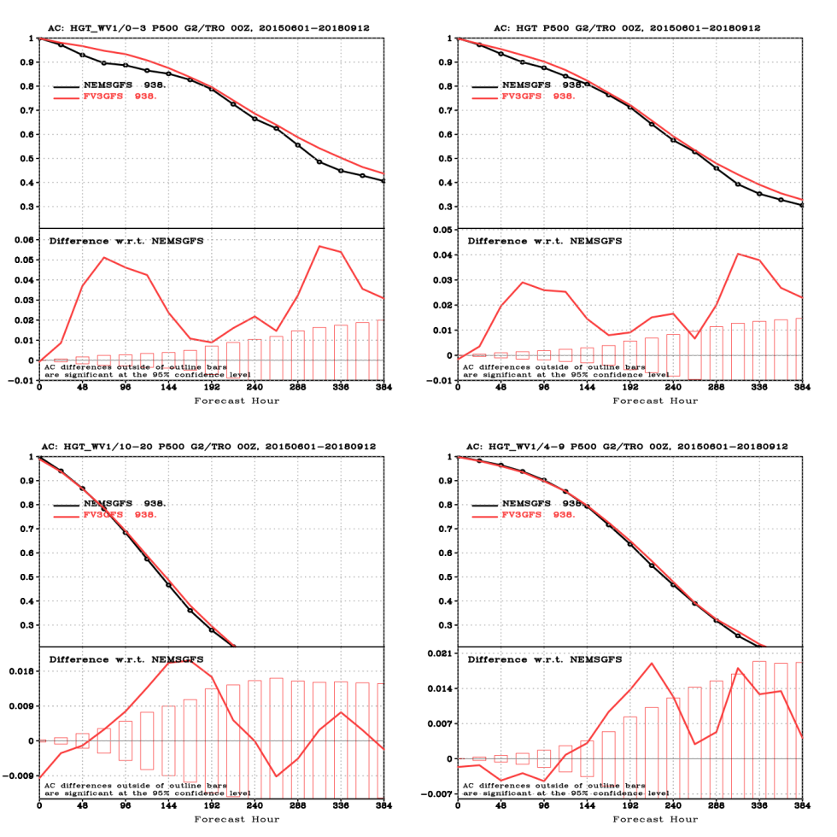
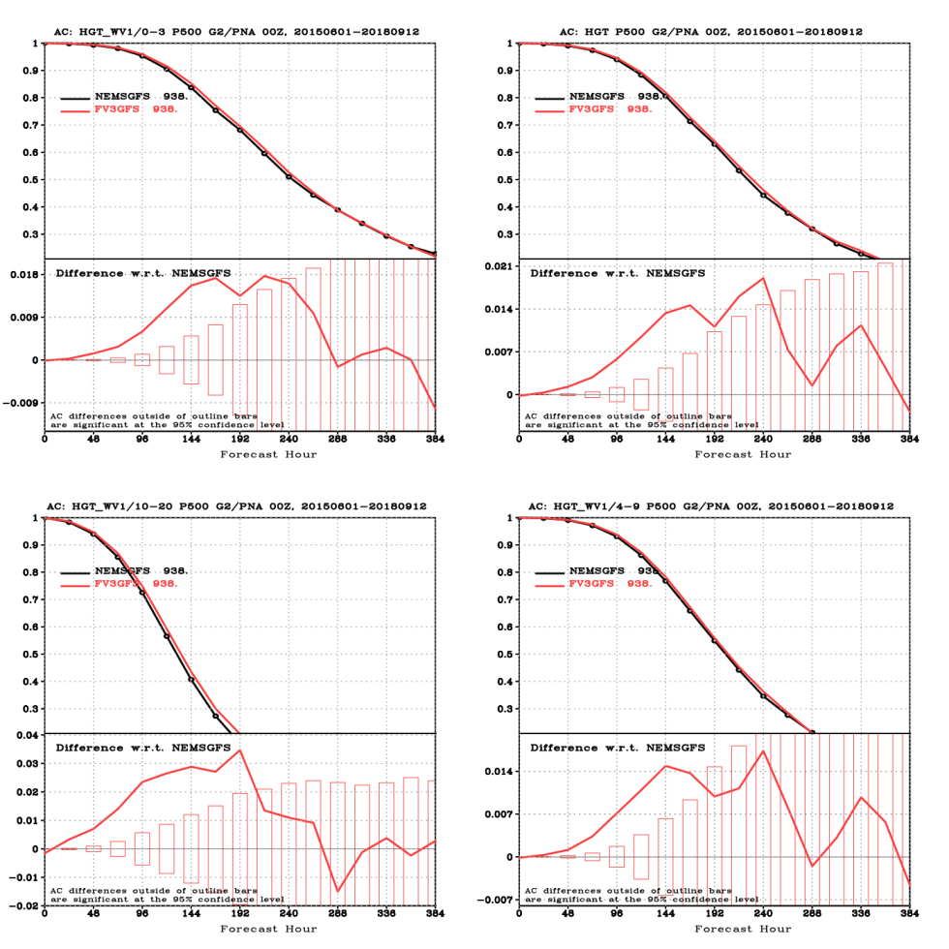
SH and N. America 500-hPa HGT ACC
(20150601 ~ 20180912)
SH
Pacific North America
A gain of 0.008
A gain of 0.009

Slide 31
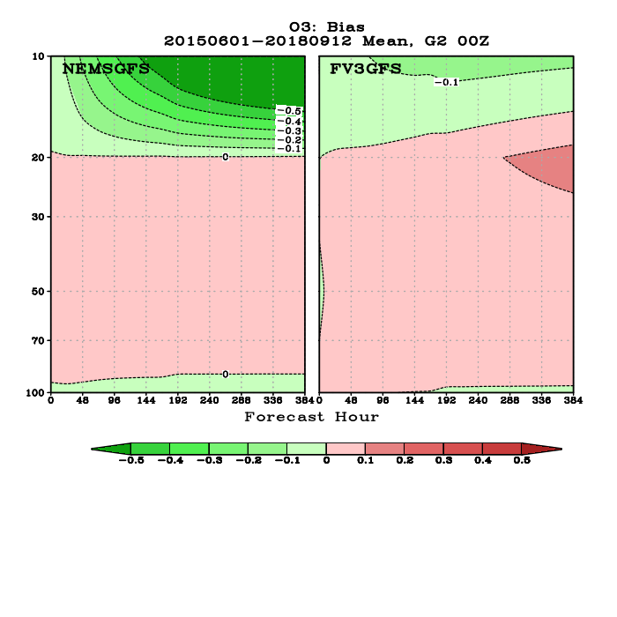
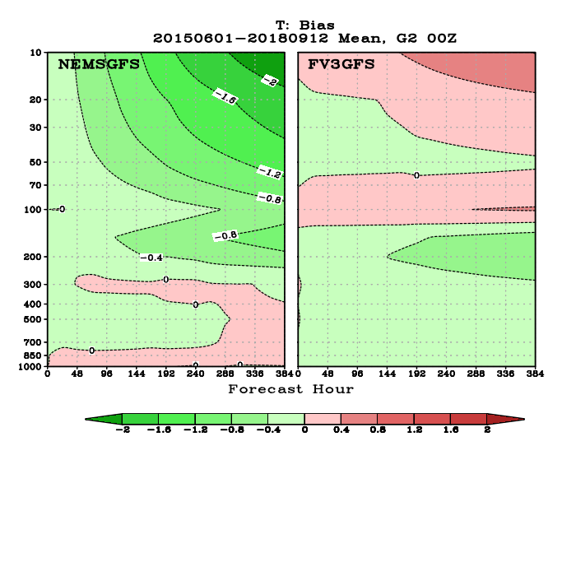
Global Mean Temperature & Ozone Bias
Verified against analyses
Temperature
Ozone
- 2.0 K
+ 0.8K
GSM has strong cold bias in the middle to upper stratosphere ( - 2K).
FV3GFS warm bias ( +0.8K) is caused by a radiation bug (more to come)
GSM loses ozone in forecast.
FV3GFS conserves better.

Slide 32
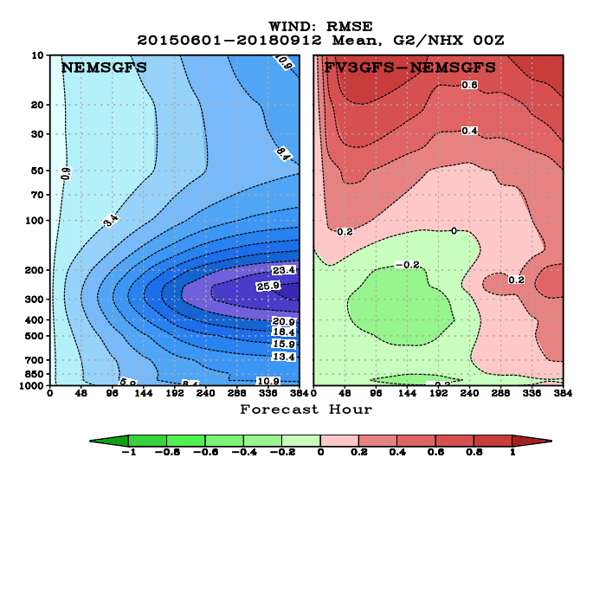
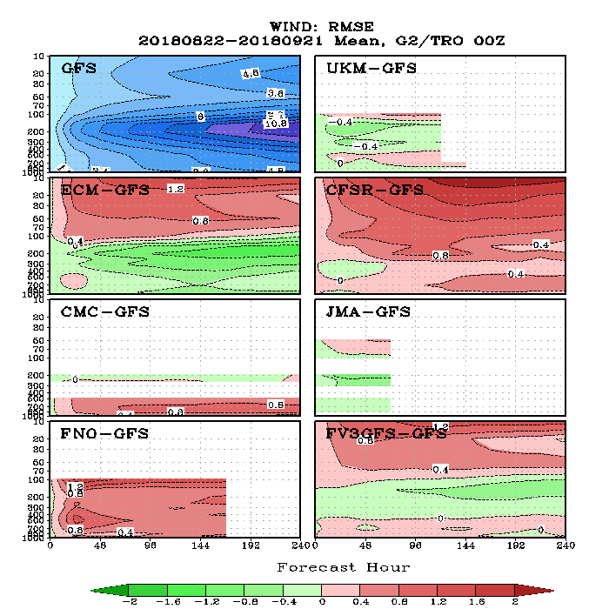
NH WIND RMSE
Verified against analyses
August 2018
FV3GFS has larger RMSE than GSM in the stratosphere
FV3GFS RMSE is similar to ECMWF RMSE
It is believed GSM winds in the stratosphere is too smooth due to strong damping

Slide 33
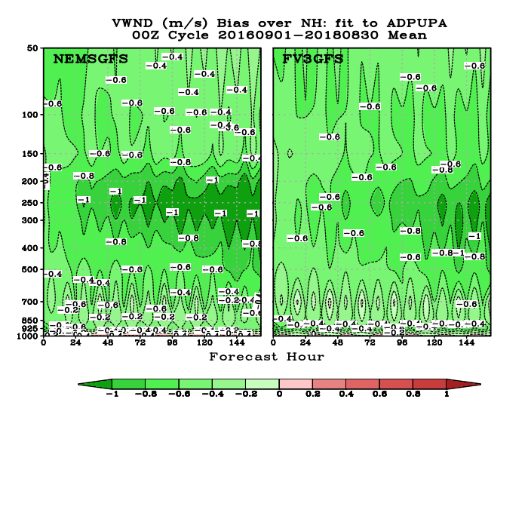
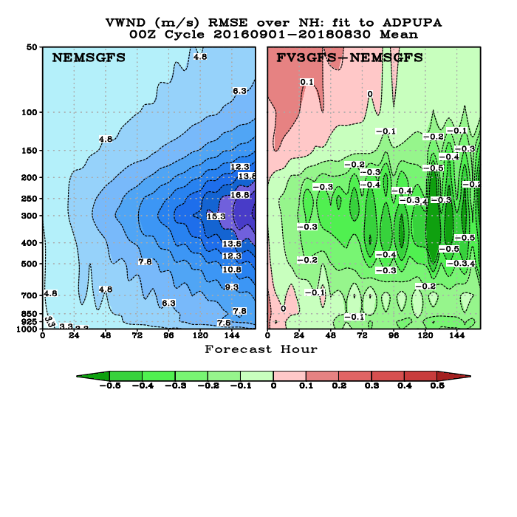
NH WIND BIAS and RMSE
Verified against ROBS, 20160901 ~ 20180831
BIAS
RMSE
Winds in both GSM and FV3GFS are weaker than observed, but FV3GFS is closer to the observation.
FV3GFS has stronger winds at the jet level, reduced RMSE in the troposphere, but worse in the stratosphere

Slide 34
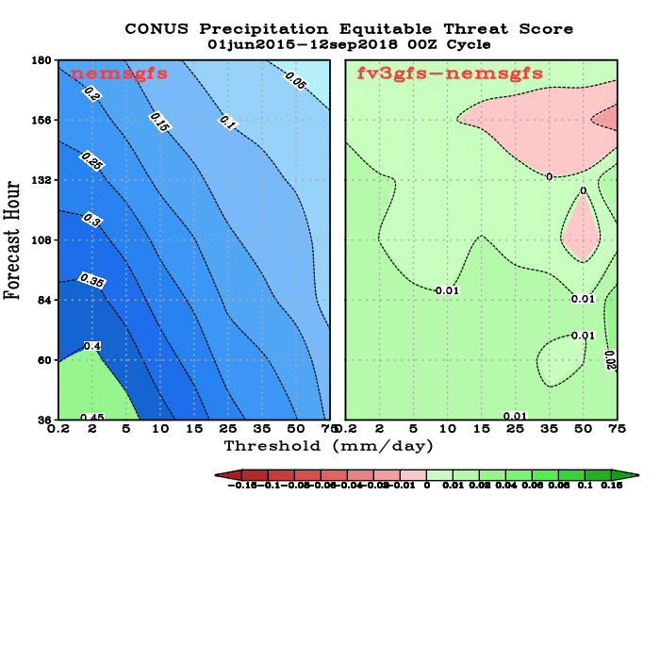
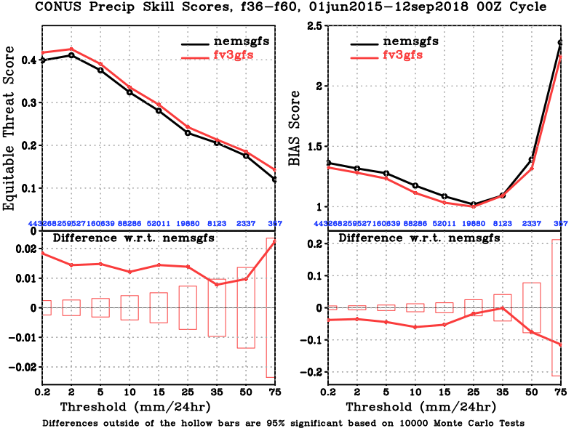
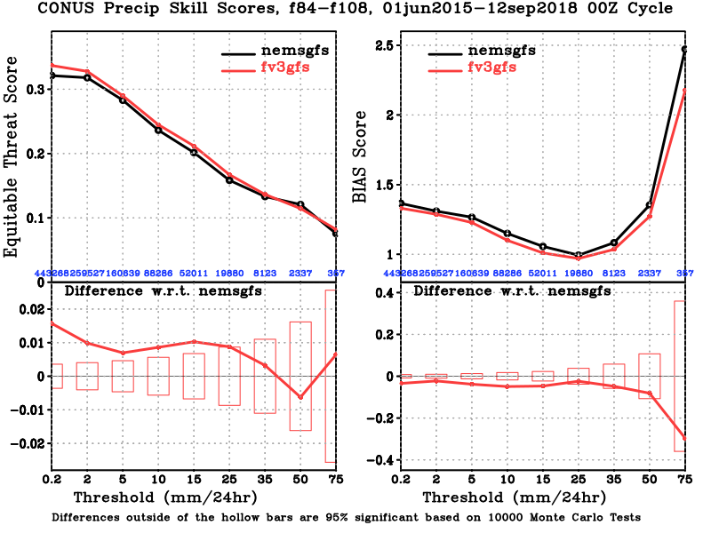
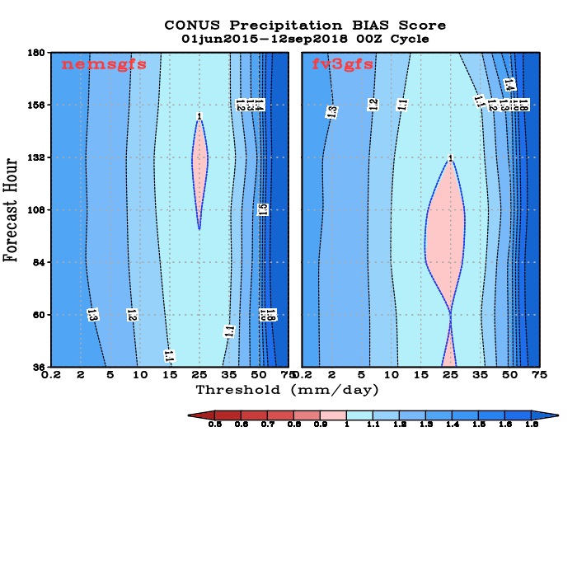
CONUS Precip ETS and BIAS SCORES
00Z Cycle, verified against gauge data, 20150601~ 20180912
FH 36-60
FH 84-108
Improved ETS scores for almost all thresholds and at all forecast length
Reduced wet bias for light rains
Slightly worsened dry bias for moderate rain categories

Slide 35
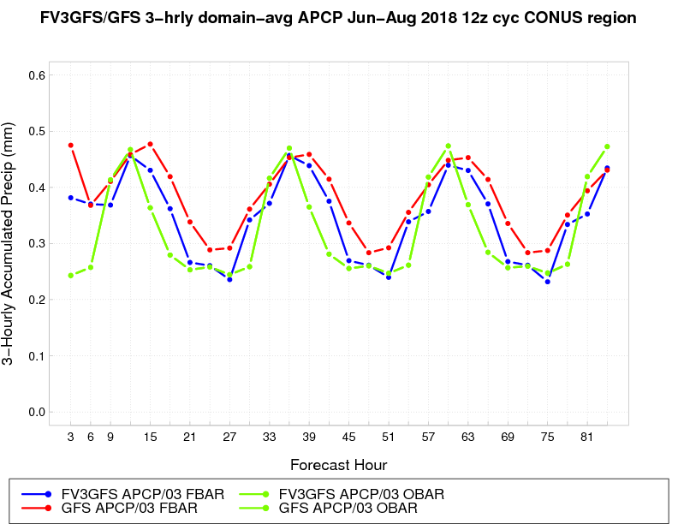
Improved Precipitation Diurnal Cycle
SUMMER 2018 CONUS DOMAIN-AVG PCP
2018: FV3GFS better than GSM,
especially overnight
FV3GFS ops GFS OBS
From: Ying Lin

Slide 36
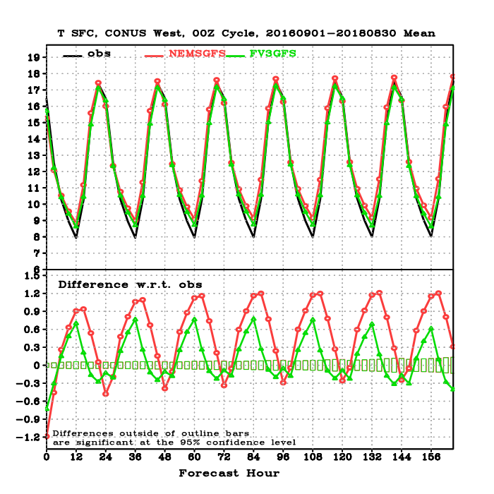
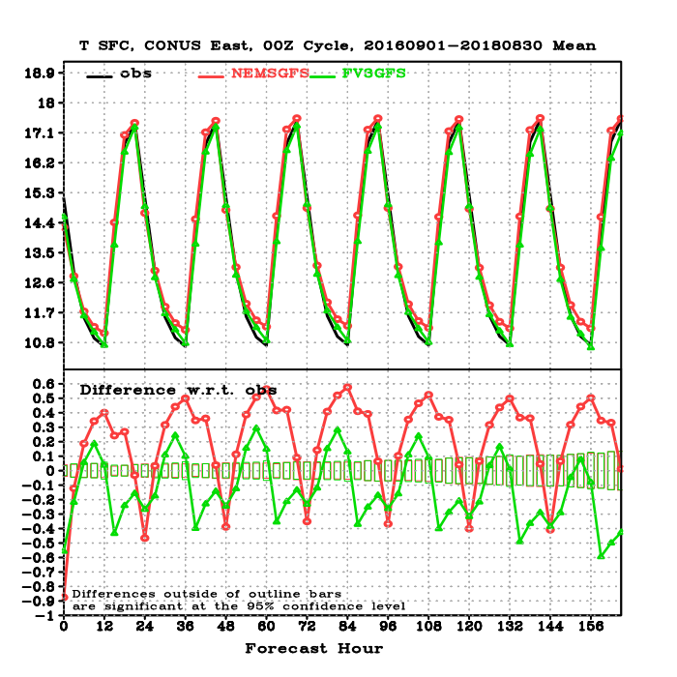
CONUS 2-m Temperature
Verified against Station Observations, 3-year mean
WEST
OBS GFS FV3GFS
EAST
Slight FV3GFS improvement in both the min and the max

Slide 37
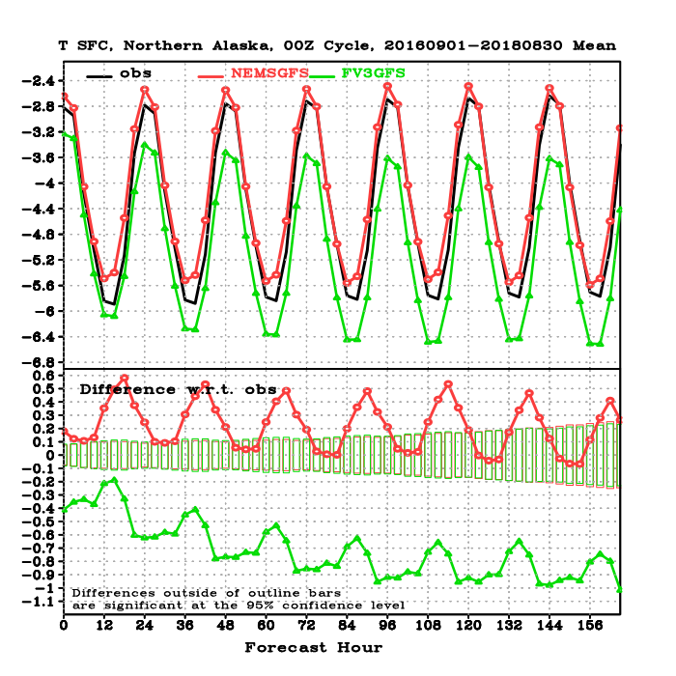
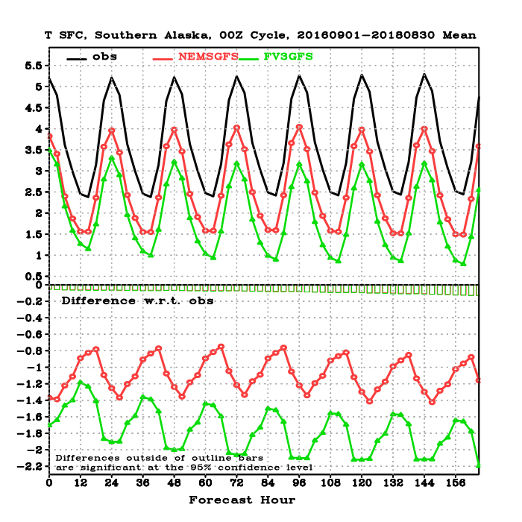
2-m Temperature over Alaska
Verified against Station Observations, 3-year mean
NORTH ALASKA
SOUTH ALASKA
OBS GFS FV3GFS
FV3GFS has large cold bias !
Likely caused by a cold NSST and an overestimate (underestimate) of cloud in summer (winter)

Slide 38
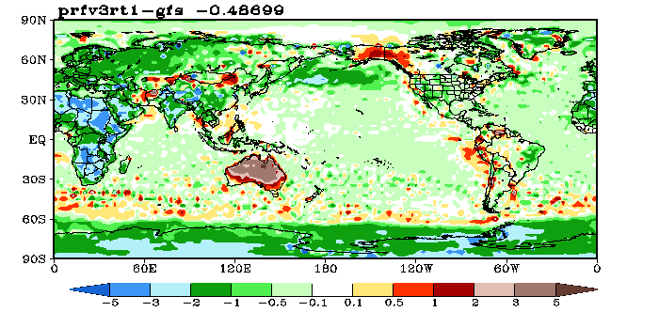
Diagnosing and Fixing the NSST Issue
In response to feedback on how well gulf stream was resolved, the background error correlation lengths were revised to be more consistent with those used in other operational SST analyses (50km).
After a number of months of pre-operational testing an SST anomaly of ~3K was noted in the northern Pacific. This was a symptom of a lack of observations in the area and the reduced influence of distant observations because of the reduction in length scales.
At the same time anomalies in lake temperatures were noted by the MEG team which was also traced to a lack of observations being assimilated.
Tref, 26 May – 18 September 2018
Both of these are solved by switching on a climatological update of the tref to the background SST field. This option is currently being tested along with an increase in background error length scales to 100km.
gcycle is now called hourly in GDAS forecast step
From: DA Team

Slide 39
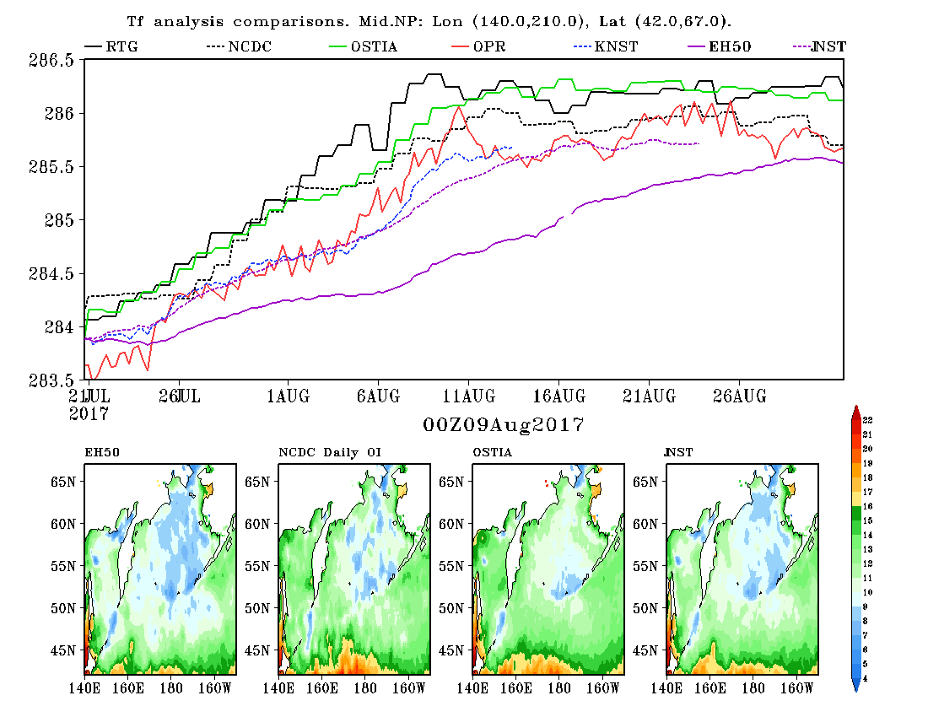
Fixing the N. Pacific Cold Bias
RTG Analysis
NCDC OI Analysis (dashed)
Ostia Analysis
Operational NSST
NSST 100km + clim. update.
NSST 50km + clim. update.
NSST 50km

Slide 40
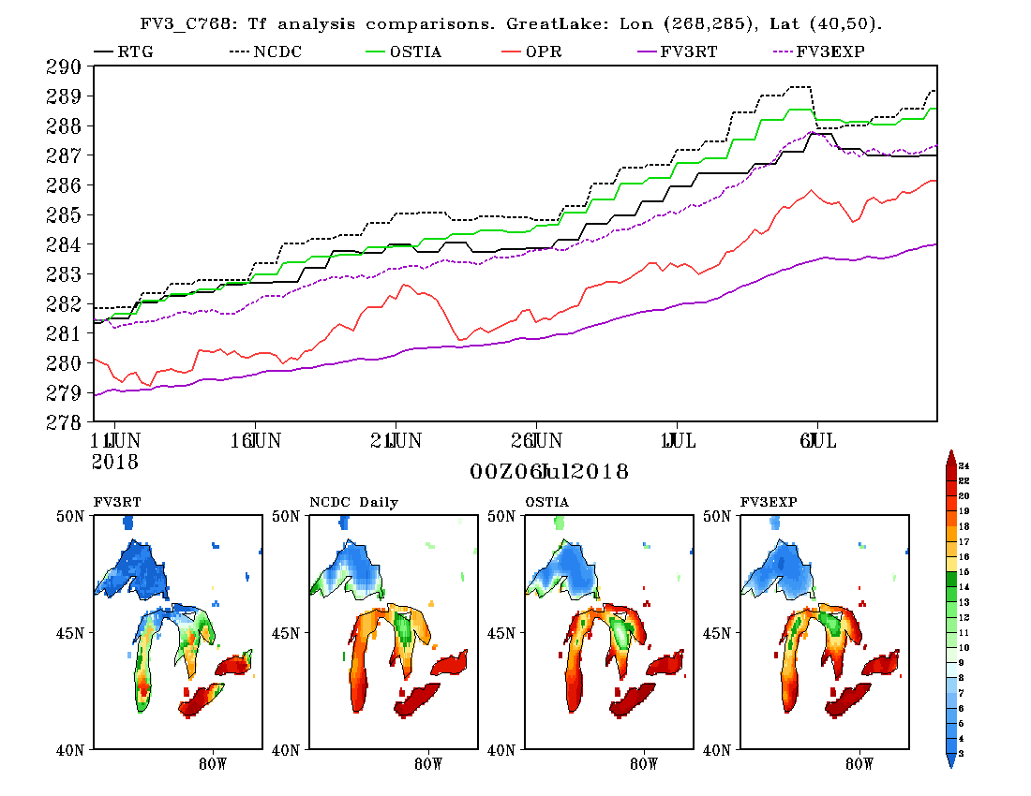
Fixing the Great Lakes Cold Bias
RTG Analysis
NCDC OI Analysis (dotted)
Ostia Analysis
Operational NSST
NSST: FV3 real time parallel
NSST: FV3 EXP with fixes (dashed)
Cold
warmer

Slide 41
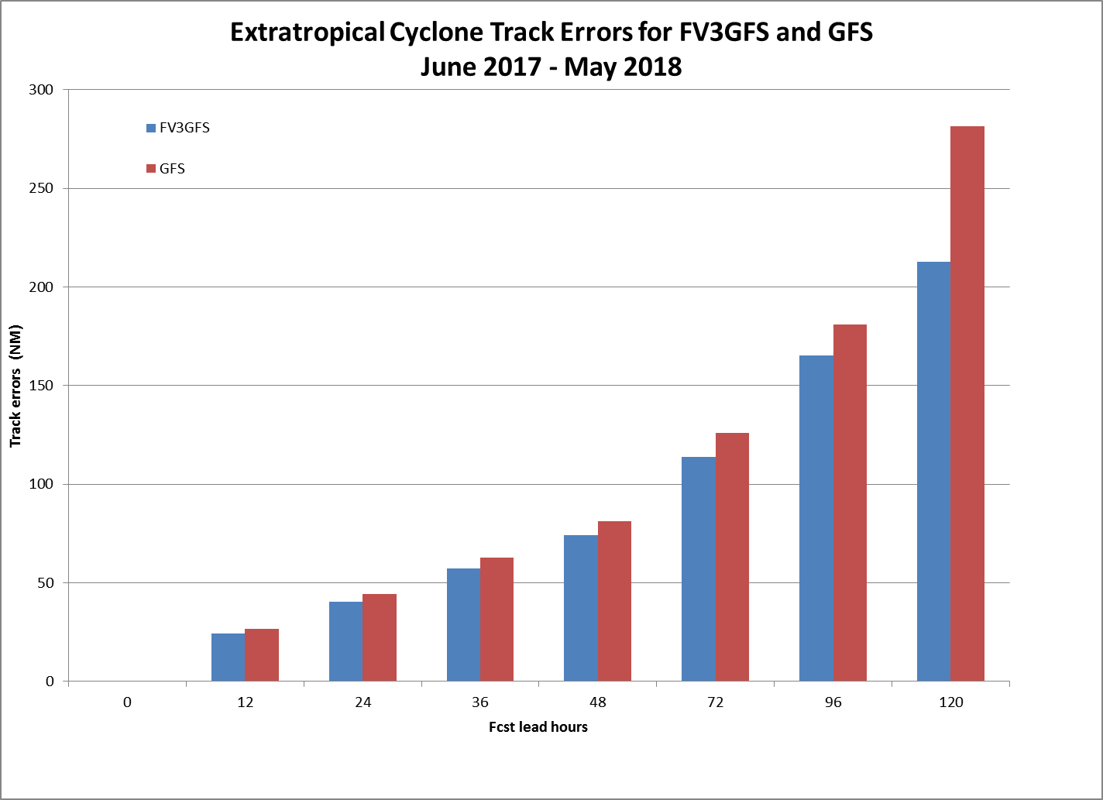
Extratropical Cyclone Track
Jun 2017 ~ May 2018
FV3GFS track errors are consistently smaller than that of GFS. Error at 120 hour is substantially smaller. (Unit: NM)
FV3GFS
Ops
GFS
FCST hr | 0 | 12 | 24 | 26 | 48 | 72 | 96 | 120
FV3GFS | 0.0 | 24.09 | 40.38 | 57.04 | 73.91 | 113.66 | 165.22 | 212.75
GFS | 0.0 | 26.59 | 44.17 | 62.87 | 81.08 | 125.89 | 180.85 | 281.57
diff | 0.0 | -2.50 | -3.79 | -5.83 | -7.17 | -12.23 | -15.63 | -68.82
Track
errors
FCST hr | 0 | 12 | 24 | 26 | 48 | 72 | 96 | 120
FV3GFS | 15490 | 14895 | 13904 | 10069 | 6231 | 2285 | 799 | 239
GFS | 16672 | 16156 | 15031 | 10906 | 6776 | 2563 | 925 | 281
diff | -1182 | -1261 | -1127 | -837 | -545 | -278 | -126 | -42
Number
of cases
FV3GFS captures slightly smaller number of cases.
From: Guang-Ping Luo

Slide 42
Tropical Cyclone Genesis
 |  | AL2015 | AL2016 | AL2017 | EP2015 | EP2016 | EP2017
# Cases | Ops GFS | 139 | 145 | 119 | 210 | 234 | 100
 | FV3GFS |  | 171 | 145 |  | 196 | 104
Hit (POD) | Ops GFS | 63% | 60% | 92% | 74% | 65% | 63%
 | FV3GFS |  | 65% | 71% |  | 77% | 67%
False Alarm | Ops GFS | 65% | 49% | 64% | 49% | 28% | 57%
 | FV3GFS |  | 51% | 49% |  | 63% | 68%
FV3GFS has overall higher POD,
but also higher false alarm rate.
From: Jiayi Peng

Slide 43
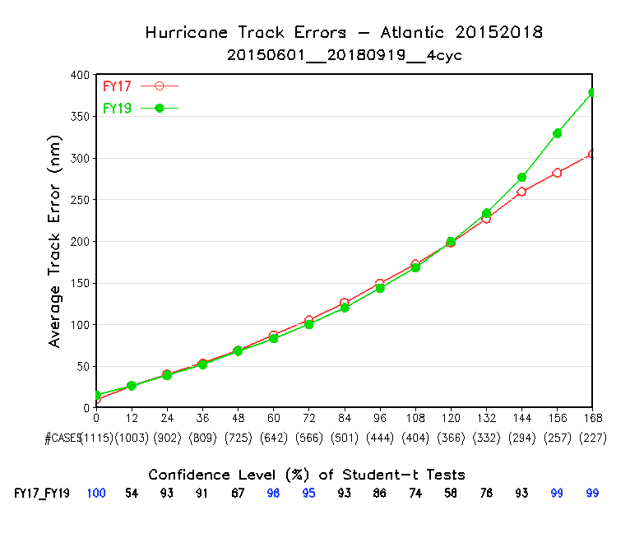
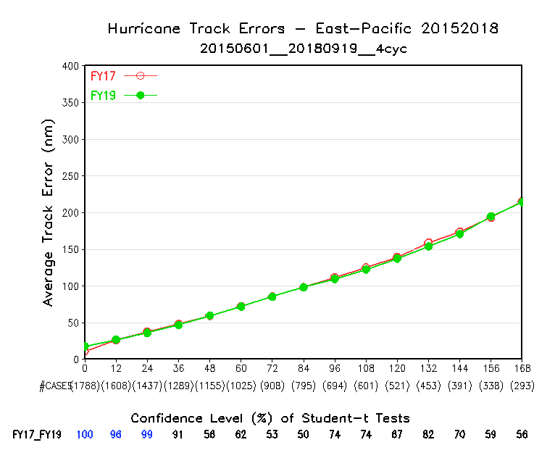
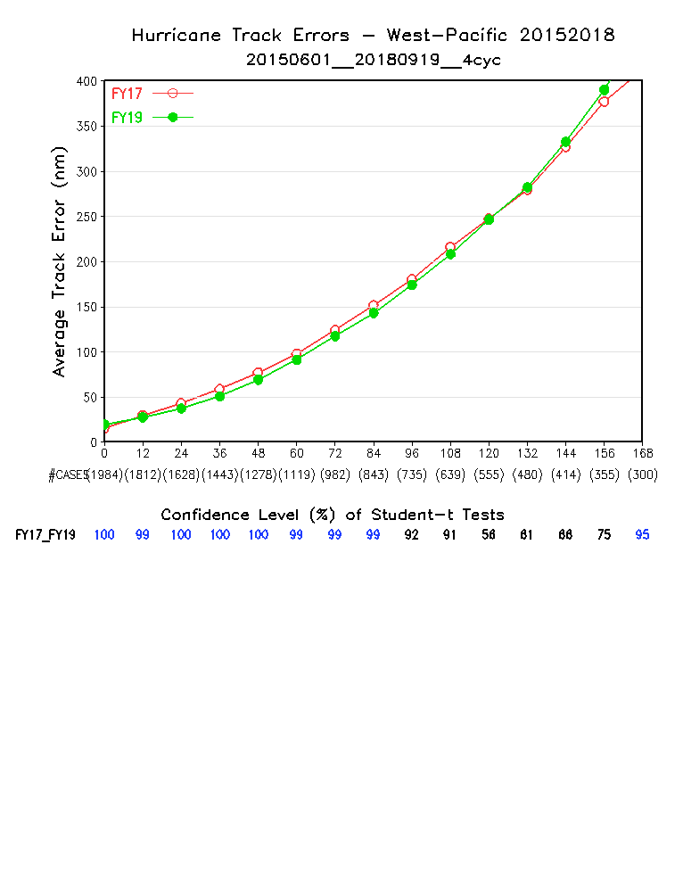
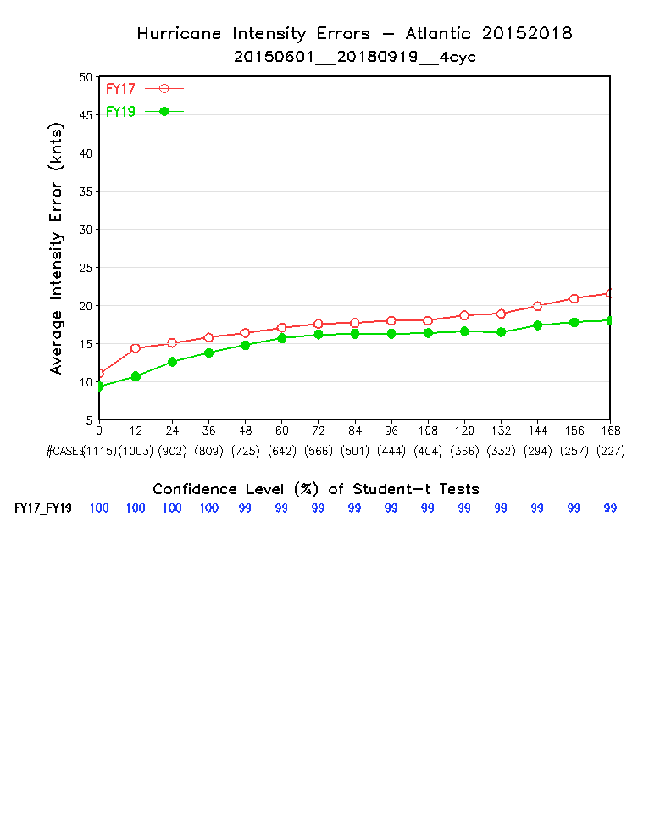
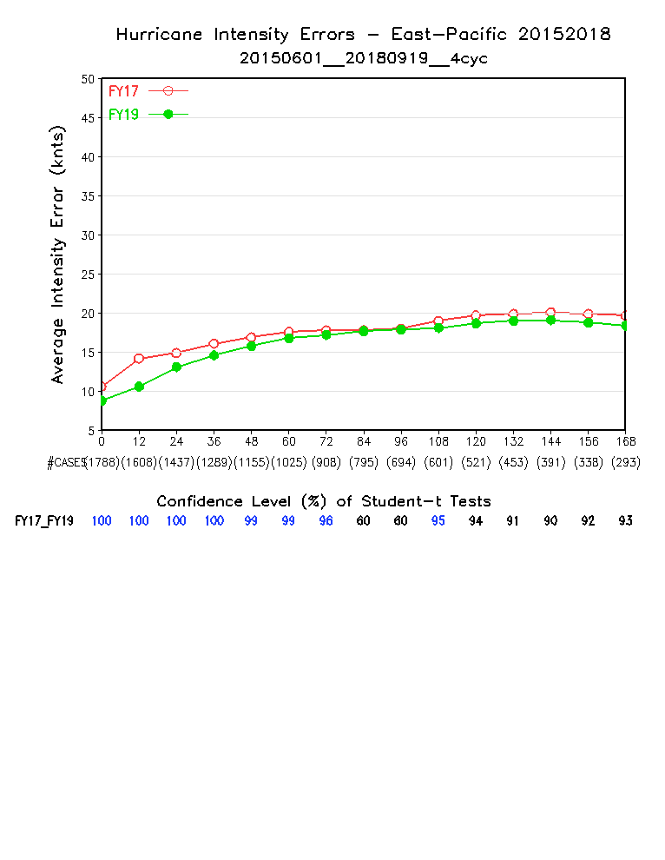
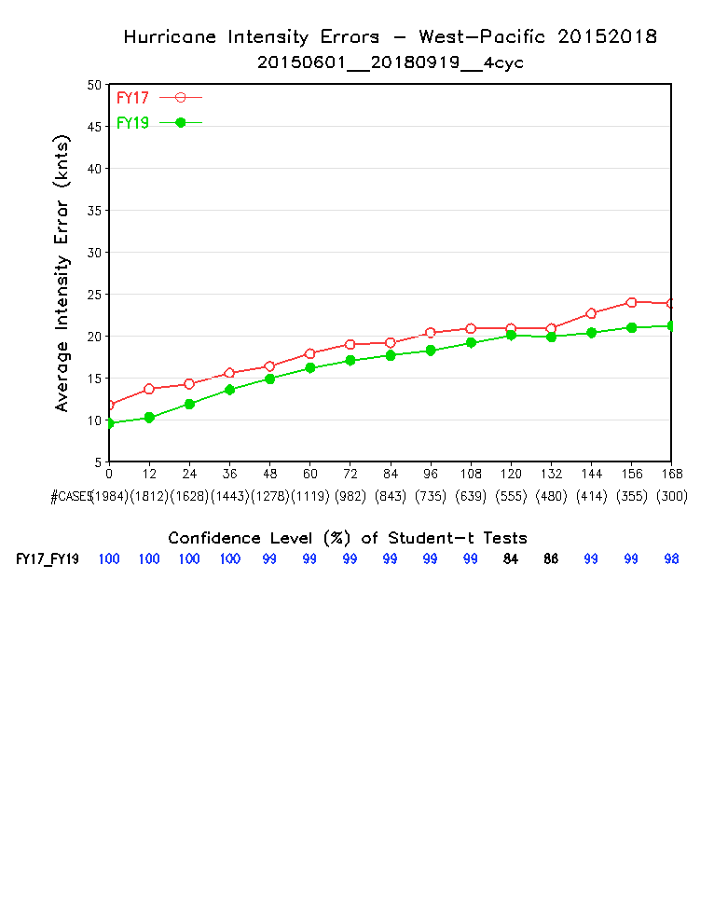
Hurricane Track and Intensity
20150601 ~ 20180919
Red: NEMS GFS; Green FV3GFS
Track
AL
EP
WP
Intensity
AL
EP
WP
Intensity is improved over all basins
Tracks in AL and WP are improved for the first 5 days except at FH00, and degraded in day 6 and day 7. Track in EP is neutral

Slide 44
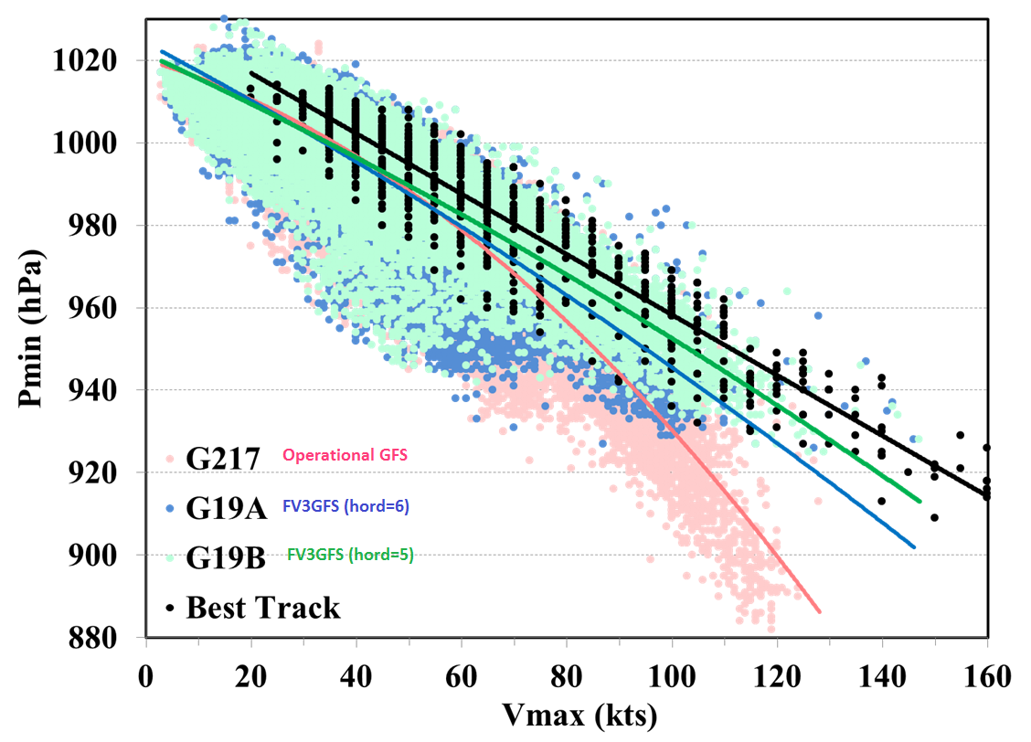
Improved Wind-Pressure Relationship
FV3GFS shows a much better W-P relation than ops GFS for strong storms
For FV3GFS, W-P relation with hord=5 is better than hord=6
Graph made by HWRF group

Slide 45
Evaluation by downstream models and product users

Slide 46
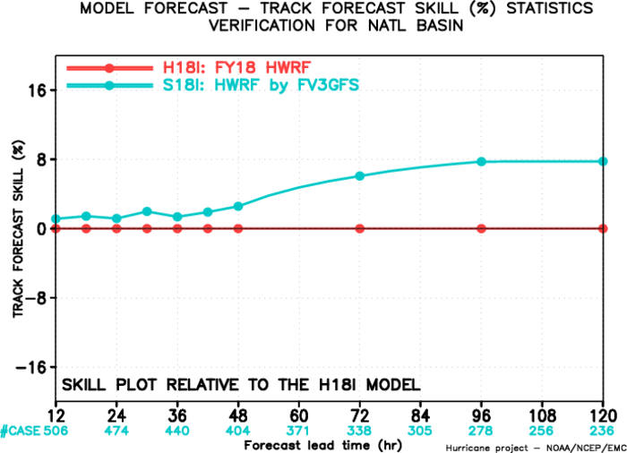

FY18 HWRF Testing with FV3GFS
Priority Storms, Early Model
2015-2017
Atlantic
NATL priority storms 2017 17L Ophelia* 2017 16L Nate* 2017 15L Maria* 2017 14L Lee 2017 12L Jose* 2017 11L Irma* 2017 09L Harvey* 2016 15L Nicole 2016 14L Matthew* 2016 12L Karl* 2016 09L Hermine* 2016 07L Gaston 2016 06L Fiona 2016 05L Earl* 2015 11L Joaquin* 2015 07L Grace 2015 06L Fred 2015 05L Erica* 2015 04L Danny*
There is good improvement in track skill especially for longer lead times reaching 8% at Days 4 and 5.
Intensity skill improvements are evident at all lead times with more than 8% improvements at Day 1 and again at Day 4.
* This list was jointly devised by NHC and EMC based on criterion related to best representation of basins
From: Avichal Mehra

Slide 47


FY18 HWRF Testing with FV3GFS
Priority Storms, Early Model
2015-2017
Eastern Pacific
EPAC priority storms 2017 17E Norma 2017 15E Otis 2017 13E Kenneth 2017 10E Irwin 2017 09E Hilary 2016 15E Newton 2016 13E Lester 2016 11E Javier* 2016 07E Frank 2016 05E Darby 2016 04E Celia 2015 20E Patricia* 2015 19E Olaf 2015 13E Jimena 2015 12E Ignacio 2015 06E Enrique
Track forecast skill is improved for the first 2 days and then neutral for Day 3, but behind for Days 4 and 5.
Intensity skill, on the other hand, is behind for the first 3 days and then mostly neutral for longer lead times at Days 4 and 5.
From: Avichal Mehra

Slide 48




FY18 HMON Testing with FV3GFS
Priority Storms, Early Model
AL: improvement in track skill for all lead times peaking at around 14 % (at Day 3) while giving an average improvement of 10%. Intensity skill improvements start after Day 2 with 4-6% improvements at Day 2 and 3.
AL Track
EP Track
EP: improvement in track skill for early lead times peaking at around 10 % (at hr 30) and once again at Day 5 while giving improvement at all lead times. Intensity relative skills are neutral till Day 3 and significantly positive at Day 4 (6%) and Day 5 (20%).
AL Intensity
EP Intensity
From: Avichal Mehra

Slide 49




Operational GEFS initialized with FV3GFS
20180820 ~ 20180908
NH Z500 RMSE and Spread
NH Z500 CRPSS
Slightly reduced ensemble spread
Minor degradation in CRPSS and RMSE.
Limited Sample size
RMSE
spread
NH T850 RMSE and Spread
SH Z500 CRPSS
Black: ops GEFS
Red: ops GFS w/ FV3GFS ICs

Slide 50




Experimental GEFSv12 Initialized with FV3GFS
20170601 ~ 20170806
Z500 CRPS
Z500 RMSE and Spread
Warm Season
20170601 ~ 20170806
Experimental GEFS (v12 beta) overall
outperforms OPS-GEFS
(v11) in various
standard verification scores
Cold Season
20171201-20180131

Slide 51




Experimental GEFSv12 Initialized with FV3GFS:
CONUS Precipitation
60-84hr forecast
>5mm Reliability
>1mm BSS
Warm Season
20170601 ~ 20170806
Precipitation forecast is
improved
compared with OPS-GEFS
(v11), especially for
reliability.
Cold Season
20171201-20180131

Slide 52


Global Wave Model Testing with FV3GFS
Nowcast wave heights generated by NCEP’s Global Wave Model
  GSM forcing (left)
  FV3 forcing (right)
Retrospective: June 2017
Relative to wave heights from ALTIKA altimeter
Consistent results for mean conditions at all ranges
FV3-forced waves positive bias
GSM negative bias of same magnitude
All other statistics, similar
GSM-forced Wave
FV3-forced Wave
From: Henrique Alves

Slide 53
CPC Assessment of FV3GFS Stratospheric Forecast
From Craig Long:
FV3GFS Temps are similar to GFS in middle and lower stratosphere
FV3GFS Temps are warmer in upper stratosphere
FV3GFS Temp fcsts in winter hem upper strat high lats are colder
Zonal Winds are slightly worse in FV3GFS at longer fcst times
Ozone mixing ratio analyses and fcsts are similar
Total ozone anal are diff at high lats, FV3GFS fcsts are slightly better
Specific Humidity is much more realistic
FV3GFS is similar to GFS forecasting the 2018 SSW
Most metrics are neutral
Improvement in specific humidity is attributed to the newly added water vapor physics and the assimilation of 10 IASI water vapor channels.

Slide 54





Radiation Bug Fix
A bug was found in the computation of short-wave radiation, and fixed
Hourly Surface Downward SW
BUG
FIX
FV3
Ops
GFS
SURFRAD Obs
Day-5 Zonal Mean Temp
Day-5 T2m
Cools the upper stratosphere by 1 to 2 degrees
Make the T2m slightly cooler
The Impact

Slide 55
Summary -- Benefits
From MEG Assessment
(significantly) Improved 500-hpa anomaly correlation
Intense tropical cyclone deepening in GFS not observed in FV3GFS
FV3GFS tropical cyclone track forecasts improved (within 5 days)
Warm season diurnal cycle of precipitation improved
Multiple tropical cyclone centers generated by GFS not seen in FV3GFS forecasts or analyses
General improvement in HWRF and HMON runs
New simulated composite reflectivity output is a nice addition
Some indication that fv3gfs can generate modest surface cold pools from significant convection

Slide 56
Summary -- Benefits
Other Benefits
FV3GFS with advanced GFDL MP provides better initial and boundary conditions for driving standard alone FV3, and for running downstream models that use advanced MP.
Improved ozone and water vapor physics and products
Improved extratropical cyclone tracks
Improved precipitation ETS score (hit/miss/false alarm)
Overall reduced T2m biases over CONUS

Slide 57
Summary -- Concerns
From MEG assessment
FV3GFS can be too progressive with synoptic pattern
Precipitation dry bias for moderate rainfall
SST issues – North Pacific and lakes are too cold in the transition season
Spurious secondary (non-tropical) lows show up occasionally in FV3GFS since the advection scheme change was made
Both GFS and FV3GFS struggle with inversions
Both GFS and FV3GFS often has too little precip on the northwest side of east coast cyclones
Other Concerns
T2m over Alaska is too cold, likely caused by cold NSST and/or cloud microphysics issue in the Arctic region.
NHC reported that FV3GFS degraded track forecast of hurricanes ( initial wind > 65 kts) in the Atlantic basin

Slide 58
Final Thoughts
It is understood that there are still certain science and technical issues with this new model that remain to be resolved. However, we believe the benefits greatly overweigh the concerns.
Some of the issues should be and could be addressed if there were a shorter GFS upgrading cycle. It has becoming increasingly unsustainable for us to run more than three years of retrospective parallels for every GFS implementation. There is not enough computing power and manpower. This practice is slowing down the improvement of the forecast system.
We hereby request EMC Director’s approval for the implementation of Q2FY19 GFS/GDAS V15.0
This implementation lays the foundation for building a unified national weather and climate forecast system
58
Notes:
58

Slide 59
Thank you

