Slide 1
Idealized Tropical Cyclone(TC) Simulation with FV3GFS
Jiayi Peng, Kate Zhou, Henry Juang, Sajal Kar
Jun Wang, Fanglin Yang, Xingren Wu, Dusan Jovic
HWRF Weekly Meeting on October 08, 2020

Slide 2
/ufs-weather-model/FV3/atmos_cubed_sphere/tools/test_cases.F90
(I) test_case=-55 in West Pacific with TC center (10N;180E)
(II) test_case= 55 in West Pacific with TC center (10N;180E)
(III) test_case= 57 in West Pacific with TC center (10N;180E) and f-plane (Coriolis parameter is constant)
(IV) test_case=57a in West Pacific with TC center (10N; 180E), f-plane and aqua-planet
(V) test_case= 4a/b Two-vortices interaction in Atlantic (shallow water model)

Slide 3
https://github.com/ClimateGlobalChange/DCMIP2016/blob/master/DCMIP2016-TestCaseDocument_v1.pdf
Jordan CL. Mean soundings for the west indies area. Journal of Meteorology 1958; 15(1):91–97.
subroutine DCMIP16_TC ----- test_case=-55 (./FV3/atmos_cubed_sphere/tools/test_cases.F90)
real, parameter :: zt = 15000 !< m
real, parameter :: q0 = 0.021 !< kg/kg
real, parameter :: qt = 1.e-11 !< kg/kg
real, parameter :: T0 = 302.15 !< K
real, parameter :: Tv0 = 302.15*(1.+0.608*q0) !< K
real, parameter :: Ts = 302.15 !< K
real, parameter :: zq1 = 3000. !< m
real, parameter :: zq2 = 8000. !< m
real, parameter :: lapse = 7.e-3 !< K/m
real, parameter :: Tvt = Tv0 - lapse*zt !< K
real, parameter :: pb = 101500. !< Pa
real, parameter :: ptt = pb*(TvT/Tv0)**(grav/Rdgas/lapse)
real(kind=R_GRID), parameter :: lamp = pi
real(kind=R_GRID), parameter :: phip = pi/18.
real(kind=R_GRID), parameter :: ppcenter(2) = (/ lamp, phip /)
real, parameter :: dp = 1115. !< Pa
real, parameter :: rp = 282000. !< m
real, parameter :: zp = 7000. !< m
real, parameter :: fc = 2.*OMEGA*sin(phip)
real, parameter :: zconv = 1.e-6
!PS
do j=js,je
do i=is,ie
ps(i,j) = pb - dp*exp( -sqrt((rc(i,j)/rp)**3) )
enddo
enddo
zs=0 ….no orography

Slide 4
Initial TC in West Pacific (Test No.I /test_case=-55)
(Coriolis parameter is not constant)
pb=1015.0hPa, dp=11.15hPa, rp=282.0km
SLP: max=1015.00000000000 min=1004.44141134051
Surface wind:
U max = 19.4412681540063 min = -19.6647631637477
V max = 19.5408656635388 min = -19.8586152022006
Initial surface temperature /SST: 2016/10/03 00Z GFS analysis
Physics(fv3_ccpp_gfs_v15p2):
NSSTM is active (2, 1, 0, 0, 0)
scale & aerosol-aware mass-flux deep conv scheme
scale-aware hybrid edmf PBL scheme used
scale- & aerosol-aware mass-flux shallow conv scheme (2017)
Original mountain blocking and oragraphic gravity wave drag parameterization used
non-statioary gravity wave drag parameterization used ( do_gwd= T )
Radiative heating calculated at 64 layers
max-random cloud overlap for Shortwave IOVR_SW= 1
max-random cloud overlap for Longwave IOVR_LW= 1
sub-grid cloud for Shortwave ISUBC_SW= 2
sub-grid cloud for Longwave ISUBC_LW= 2
Using GFDL Cloud Microphysics
!PS
do j=js,je
do i=is,ie
ps(i,j) = pb - dp*exp( -sqrt((rc(i,j)/rp)**3) )
enddo
enddo

Slide 5
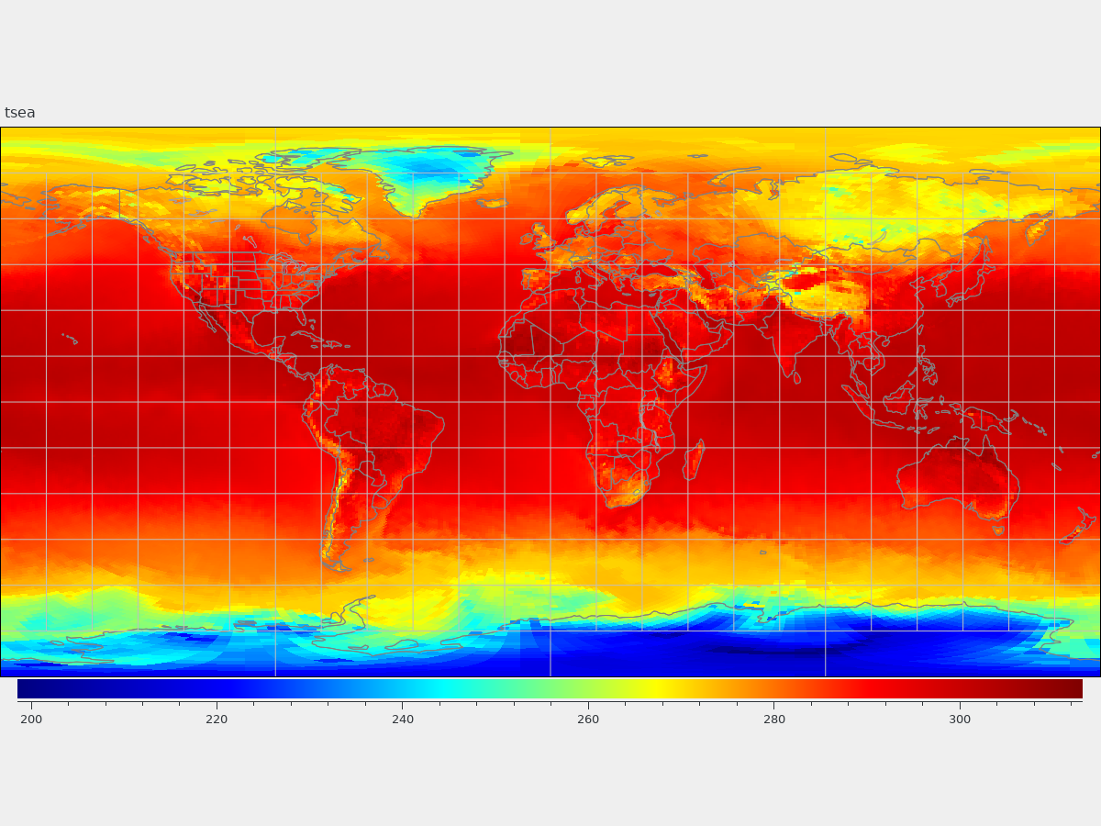
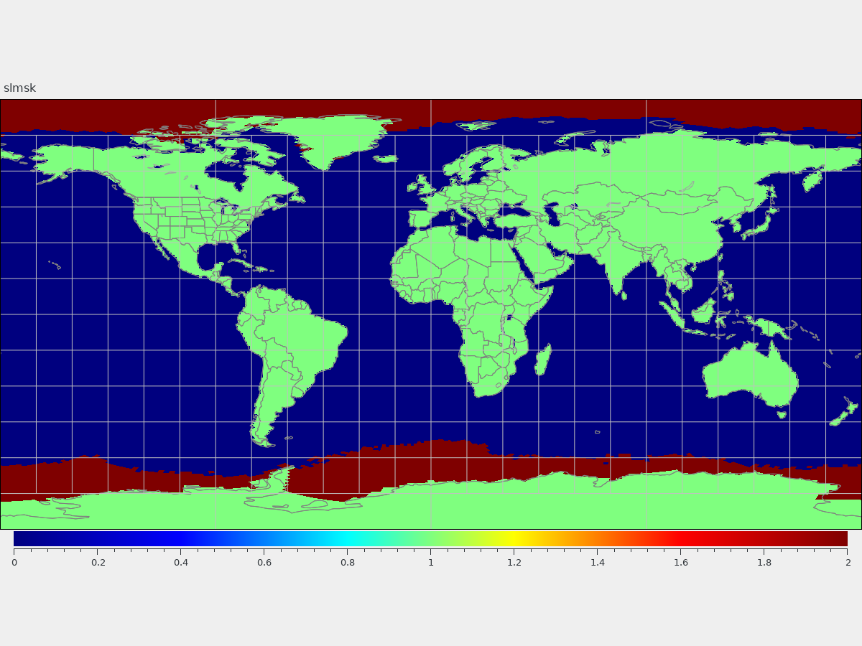
Land_sea_ice mask
SLMSK in sfc_data.tile*.nc
TSEA in sfc_data.tile*.nc
2016/10/03 00Z GFS analysis

Slide 6
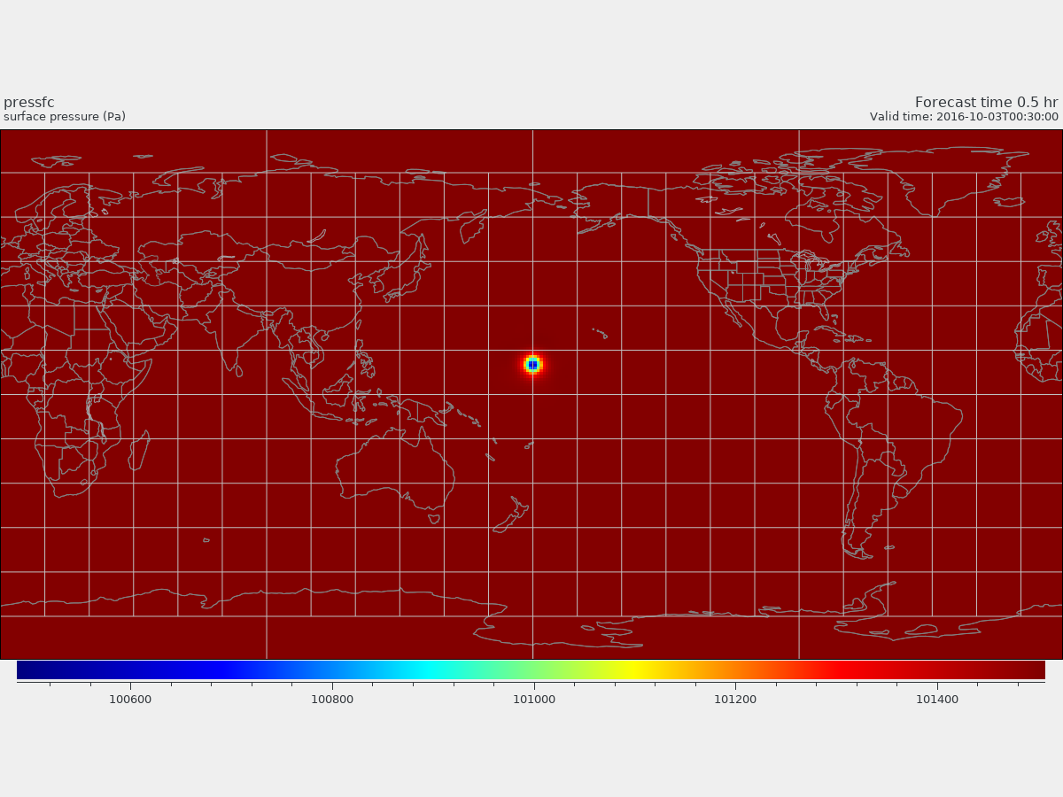
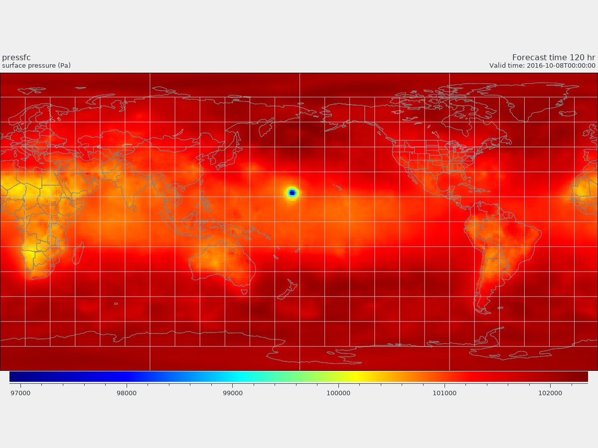
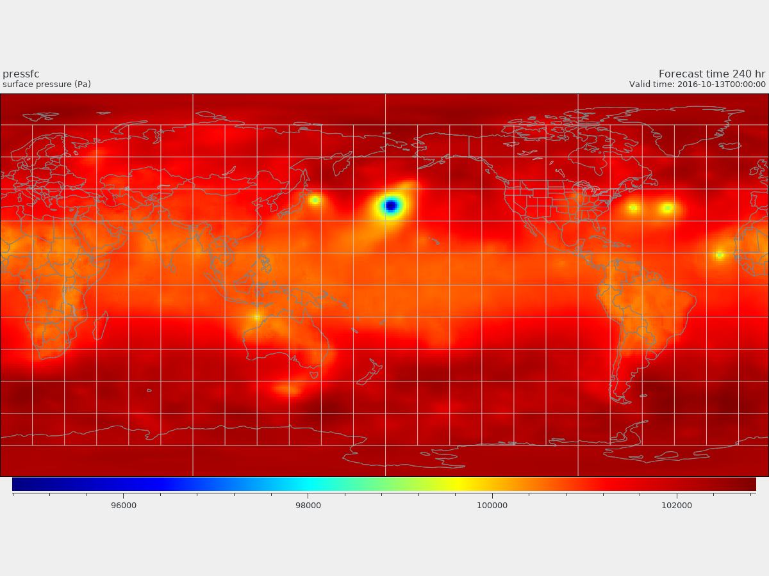
@0.5 hrs
Test No.I /-55
Surface Pressure
@120 hrs
@240 hrs

Slide 7
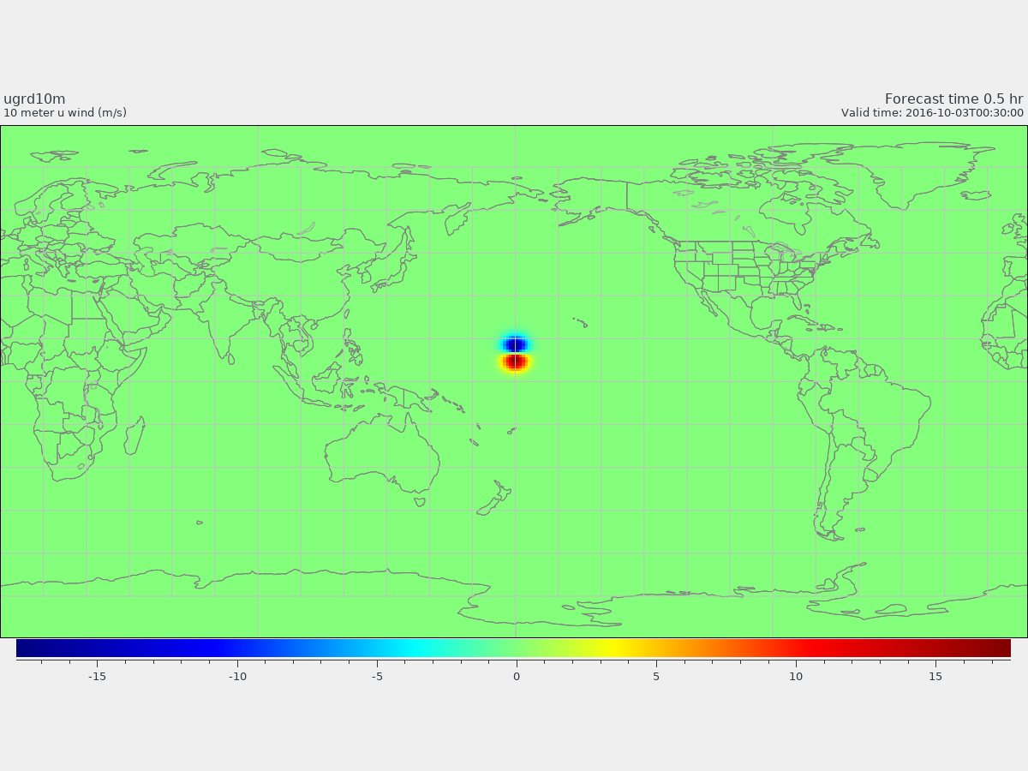
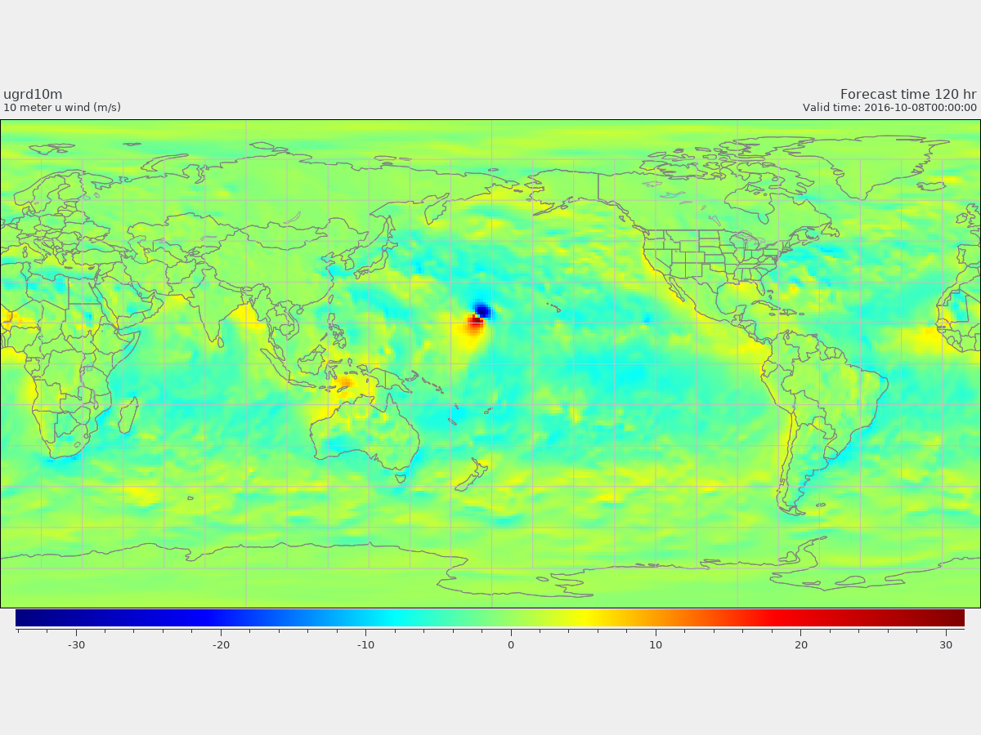
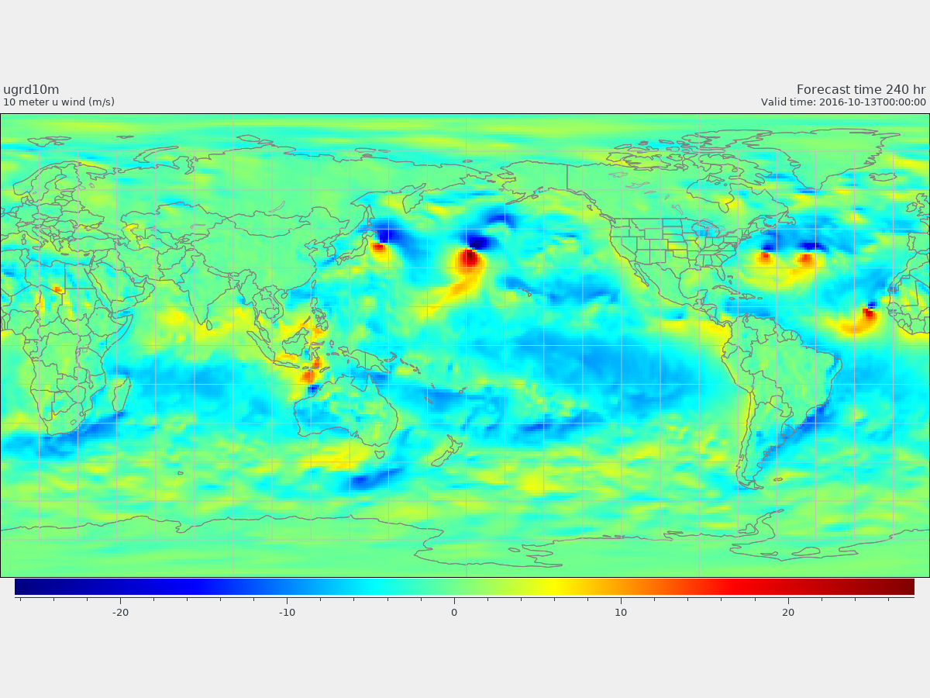
@0.5 hrs
Test No.I /-55
U at 10m
@120 hrs
@240 hrs

Slide 8
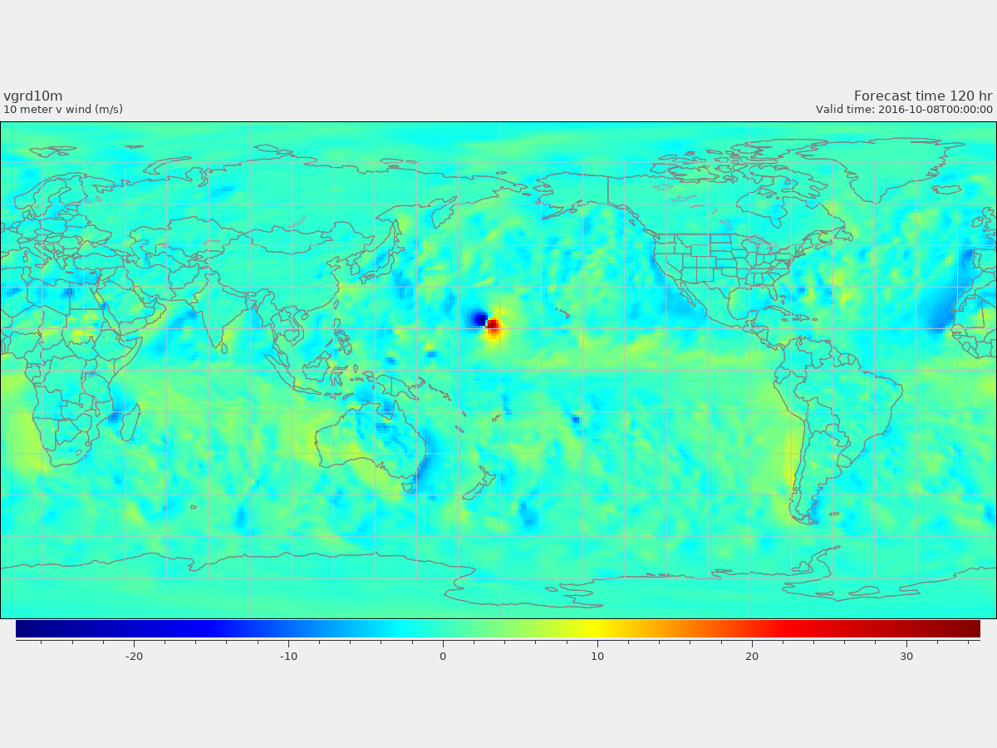
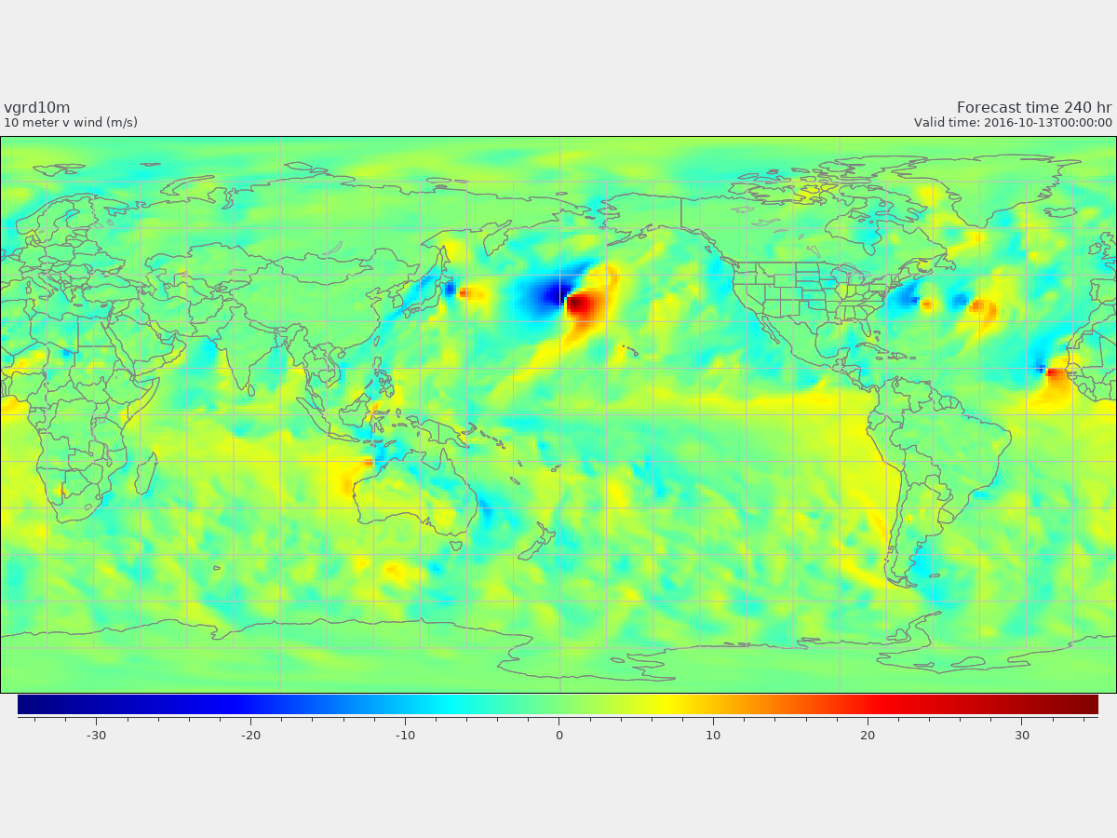
@0.5 hrs
Test No.I /-55
V at 10m
@120 hrs
@240 hrs

Slide 9
Test No.II /test_case= 55
(Coriolis parameter is not constant)
p00=1015.0hPa, dp=11.15hPa, rp=282.0km
The initial TC of Test No.II (test_case=55) is similar to Test No.I (test_case=-55), there may be some difference in thermal structure.
Surface pressure (PS) max=1015.00000000000 min=1004.44141134051
U max = 19.4412681540063 min = -19.6647631637477
V max = 19.5408656635388 min = -19.8586152022006
! Initialize surface Pressure
!Vortex perturbation
do j=js,je
do i=is,ie
p2(:) = agrid(i,j,1:2)
r = great_circle_dist( p0, p2, radius )
ps(i,j) = p00 - dp*exp(-(r/rp)**1.5)
phis(i,j) = 0.
enddo
enddo

Slide 10
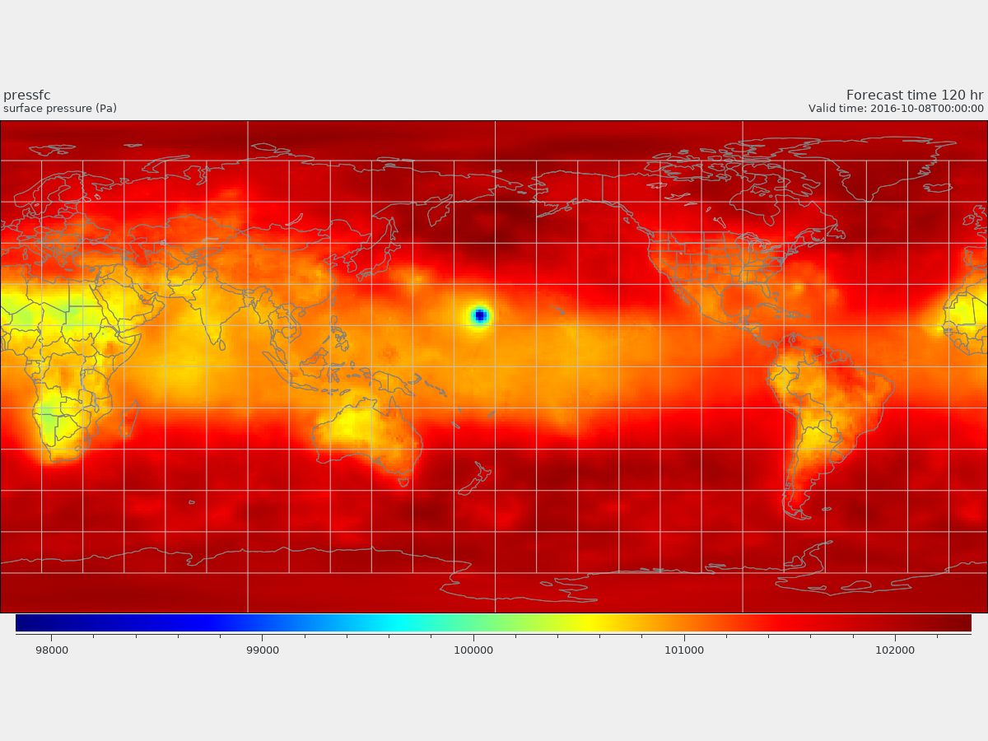
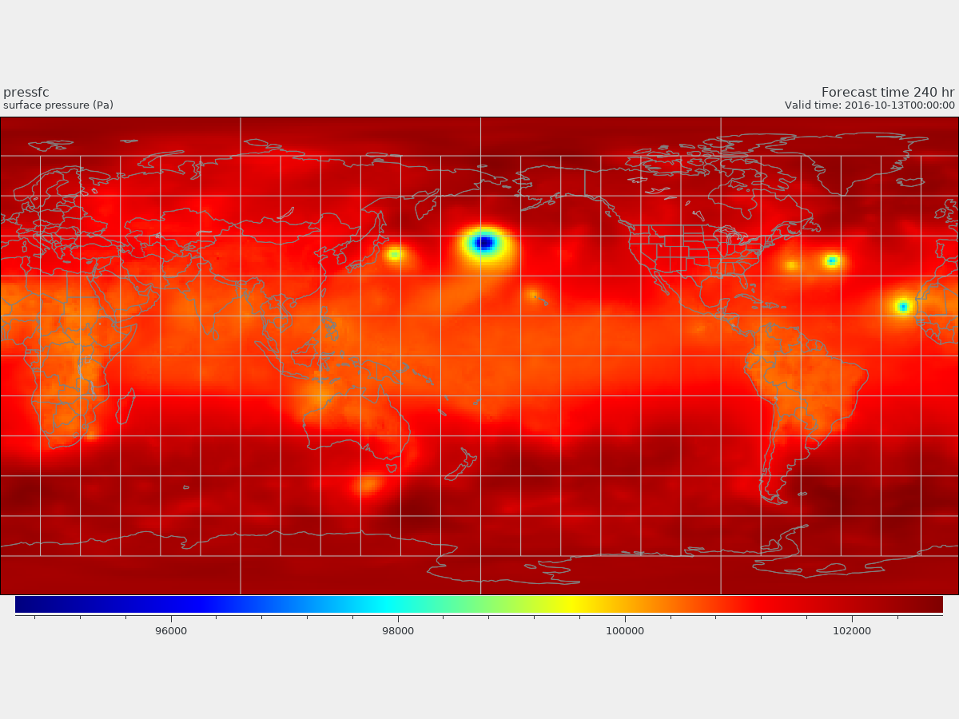
@0.5 hrs
Test No.II/ 55
Surface Pressure
@120 hrs
@240 hrs

Slide 11
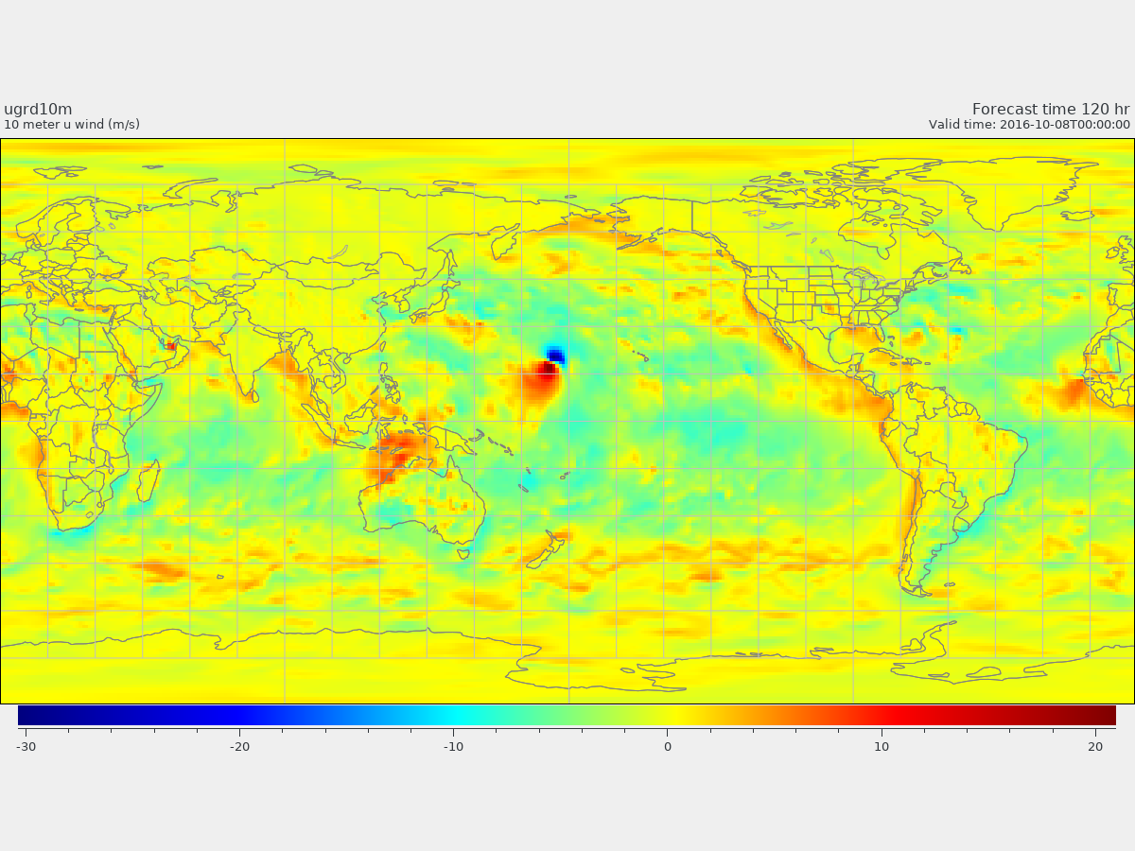
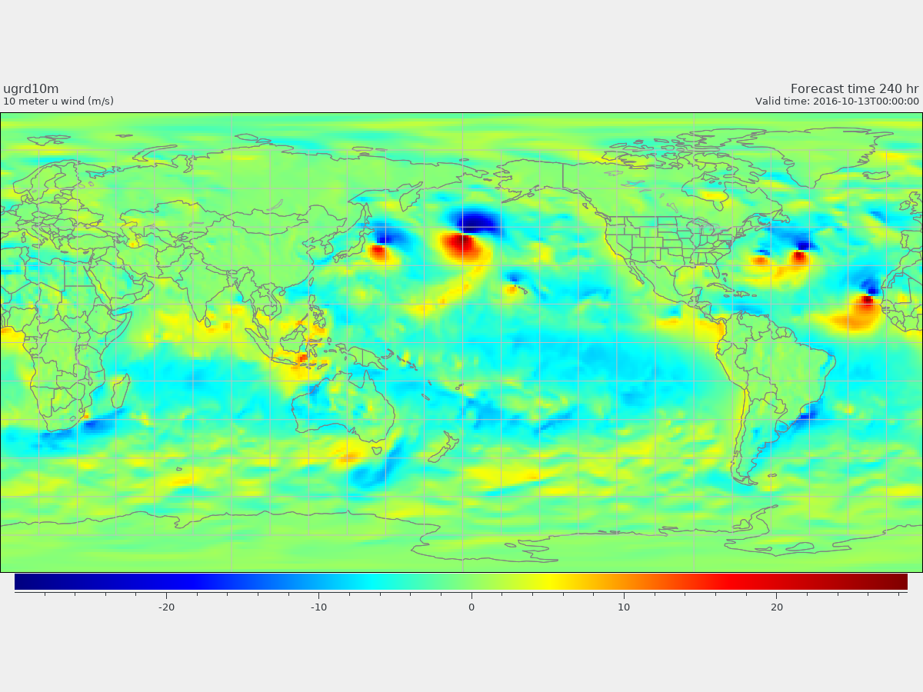
@0.5 hrs
Test No.II/ 55
U at 10m
@120 hrs
@240 hrs

Slide 12
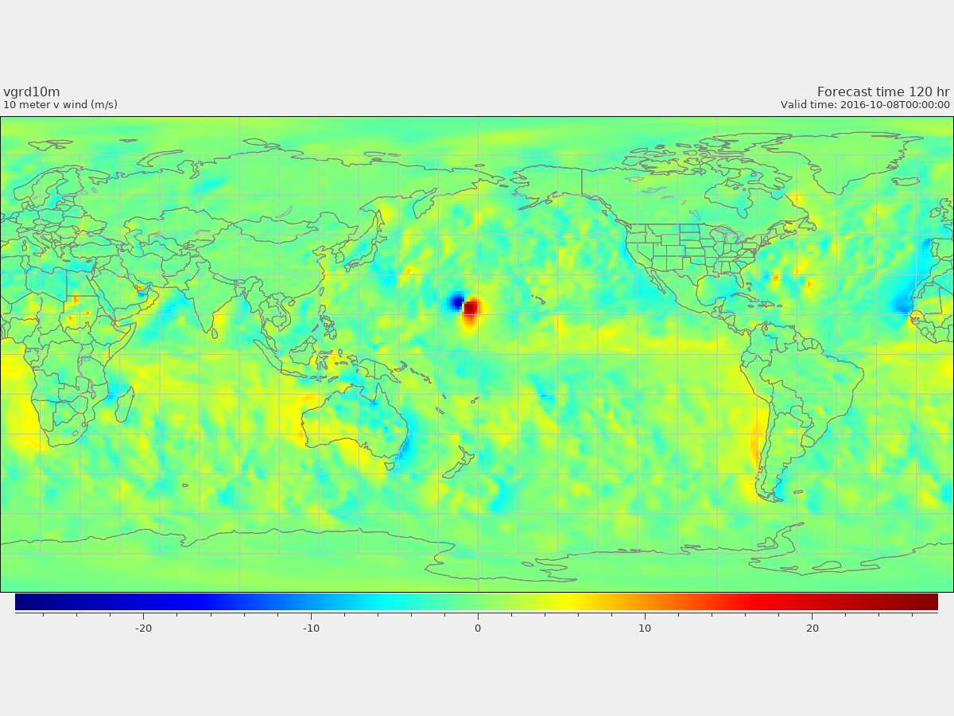
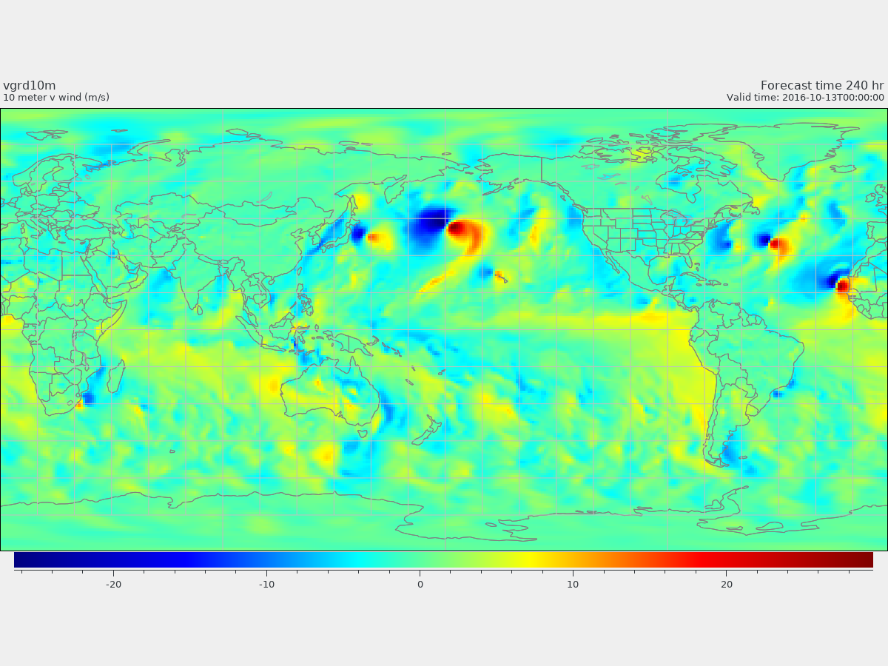
@0.5 hrs
Test No.II/ 55
V at 10m
@120 hrs
@240 hrs

Slide 13
Test NO.I/II SLP forecast
Forecast hours

Slide 14
Test No.III (test_case= 57) on f-plane
(Coriolis parameter is constant)
p00=1015.0hPa, dp=11.15hPa, rp=282.0km
! Initialize surface Pressure
!Vortex perturbation
do j=js,je
do i=is,ie
p2(:) = agrid(i,j,1:2)
r = great_circle_dist( p0, p2, radius )
ps(i,j) = p00 - dp*exp(-(r/rp)**1.5)
phis(i,j) = 0.
enddo
enddo
Surface pressure (PS) max= 1015.00000000000 min=1004.44141134051
U max = 19.4412124264969 min = -19.6647077418568
V max = 19.5408117630522 min = -19.8585596483430

Slide 15
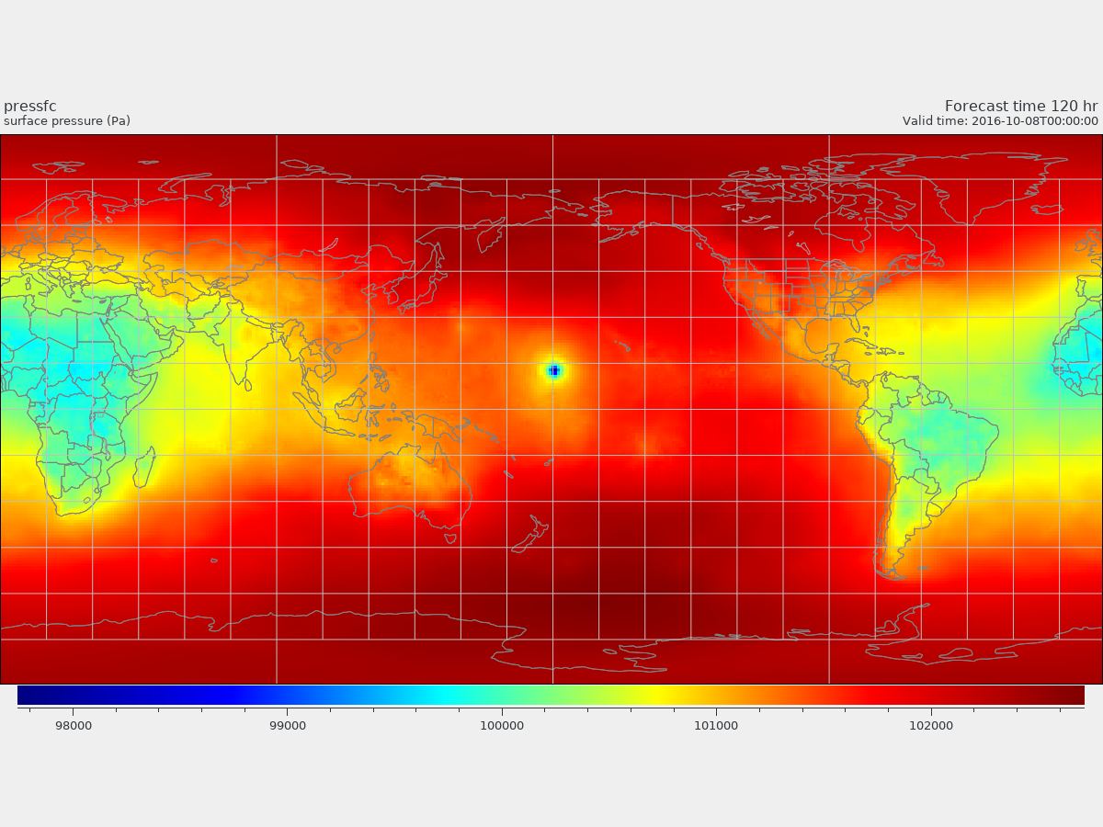
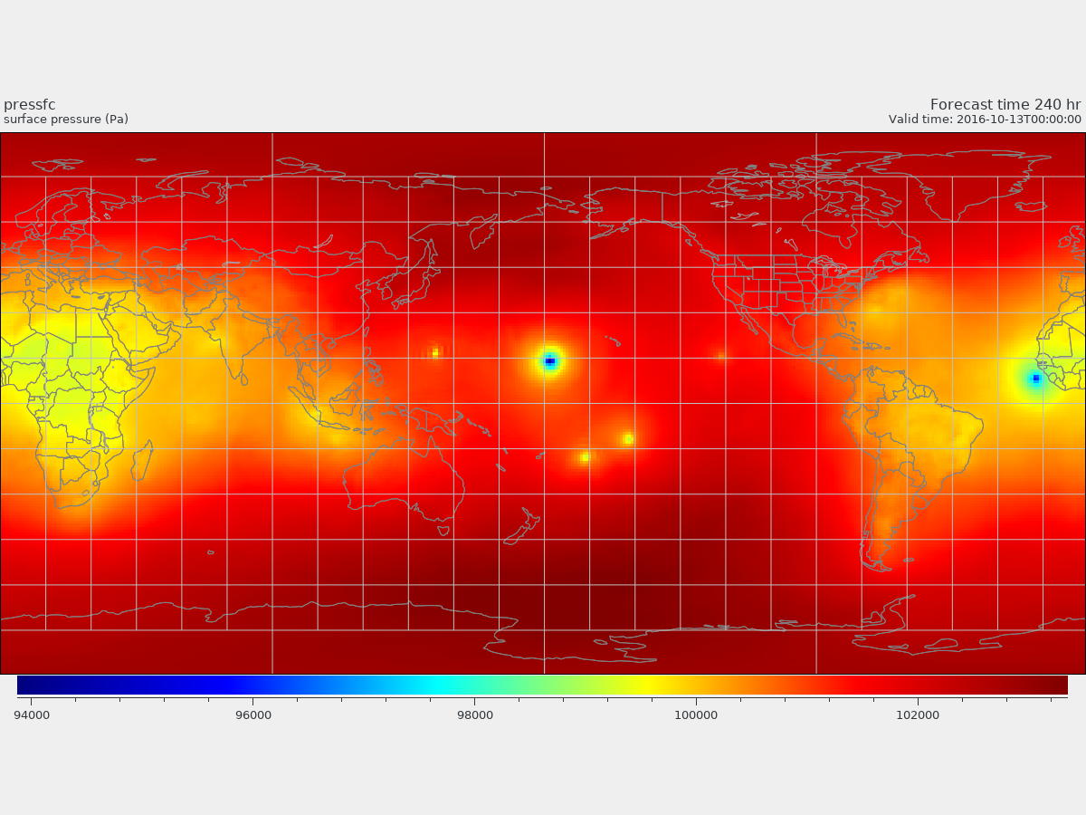
@0.5 hrs
Test No.III / 57
Surface Pressure
@120 hrs
@240 hrs

Slide 16
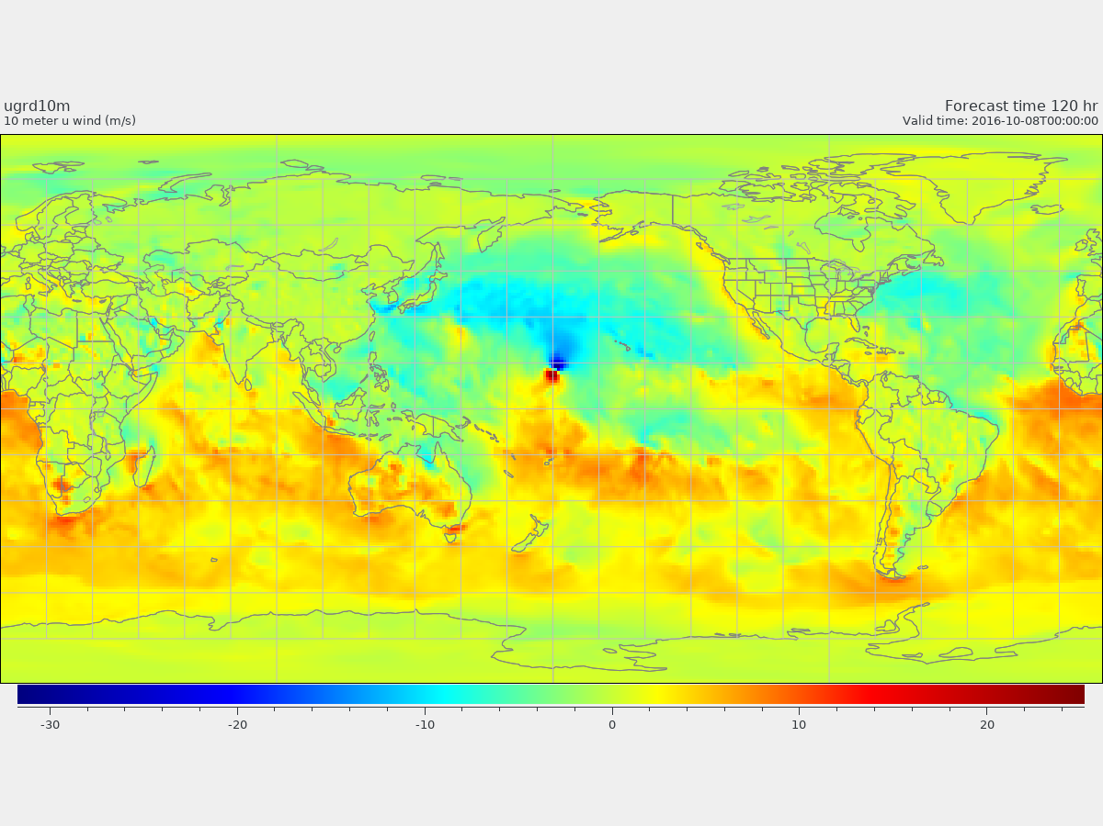
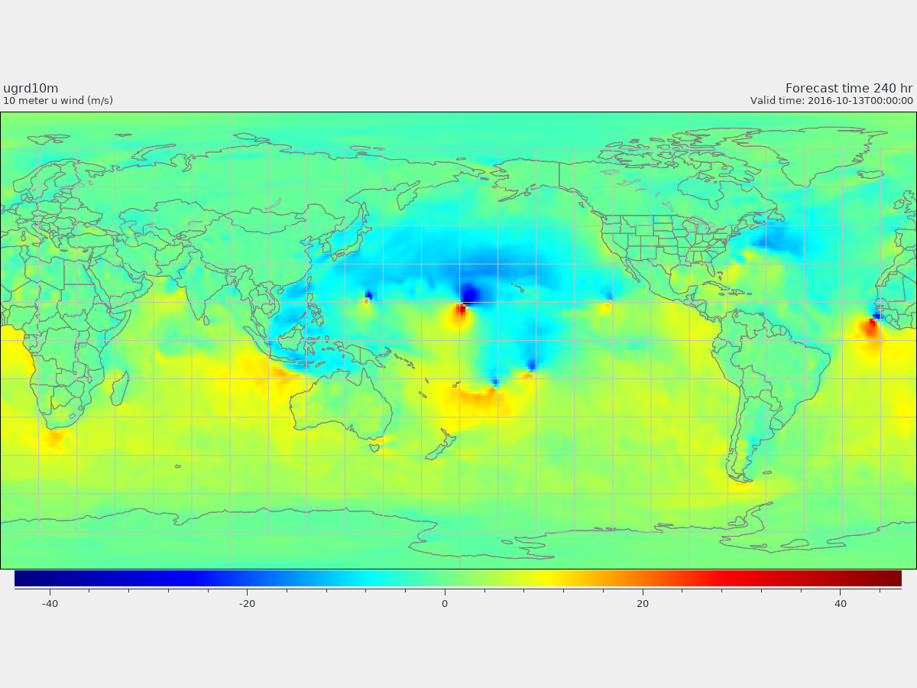
@0.5 hrs
Test No.III / 57
U at 10m
@120 hrs
@240 hrs

Slide 17
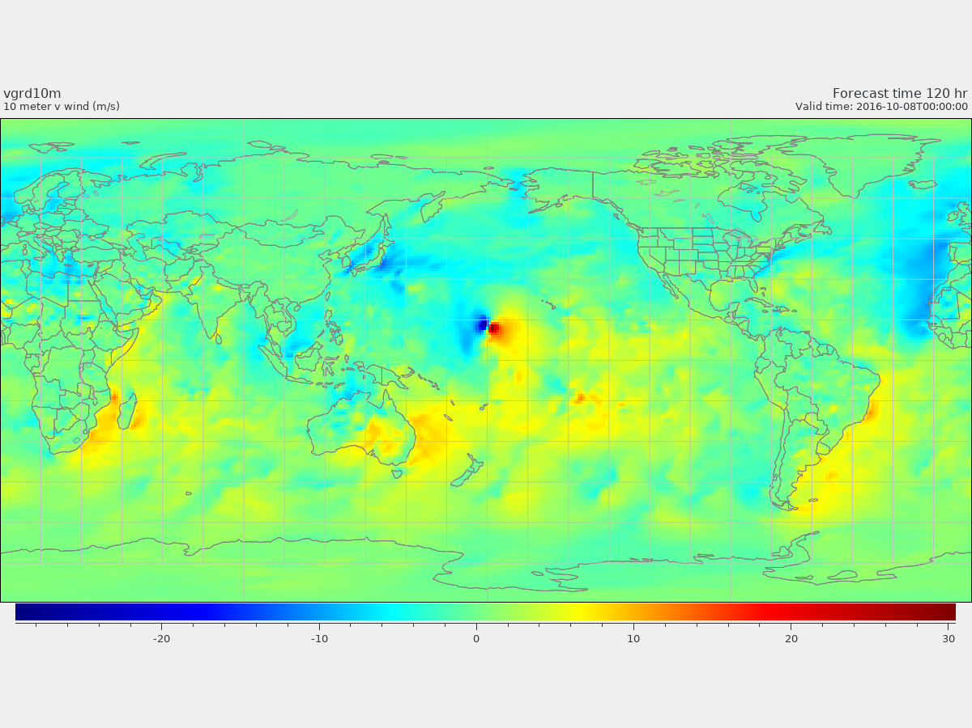
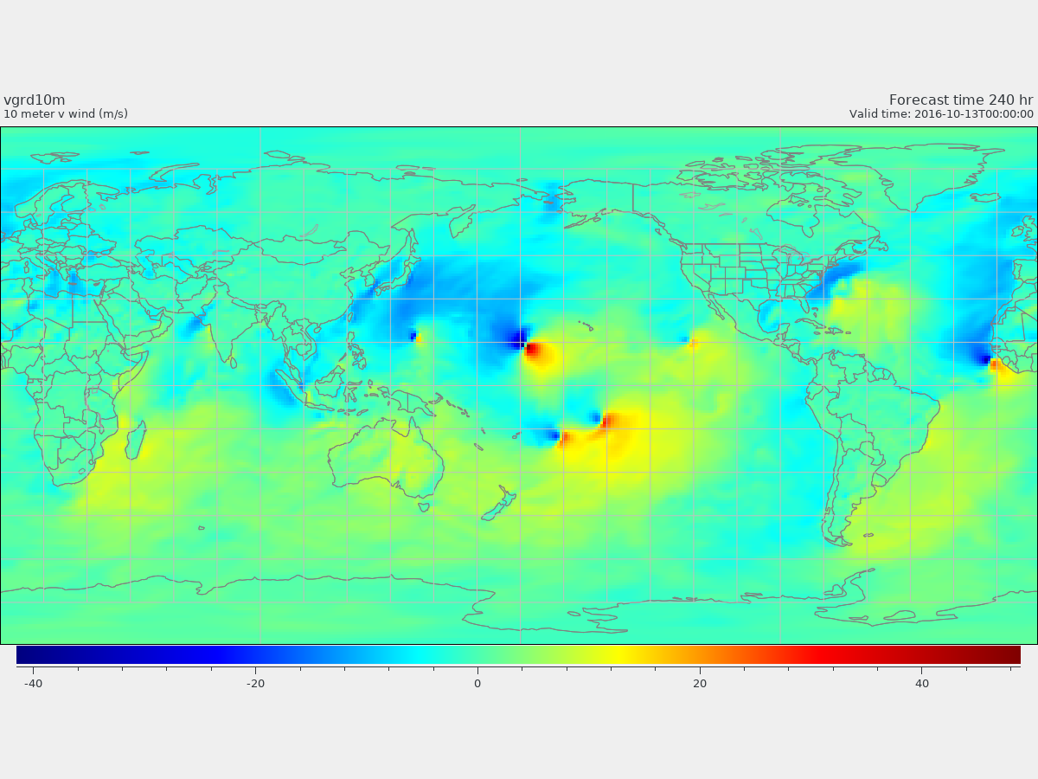
@0.5 hrs
Test No.III / 57
V at 10m
@120 hrs
@240 hrs

Slide 18
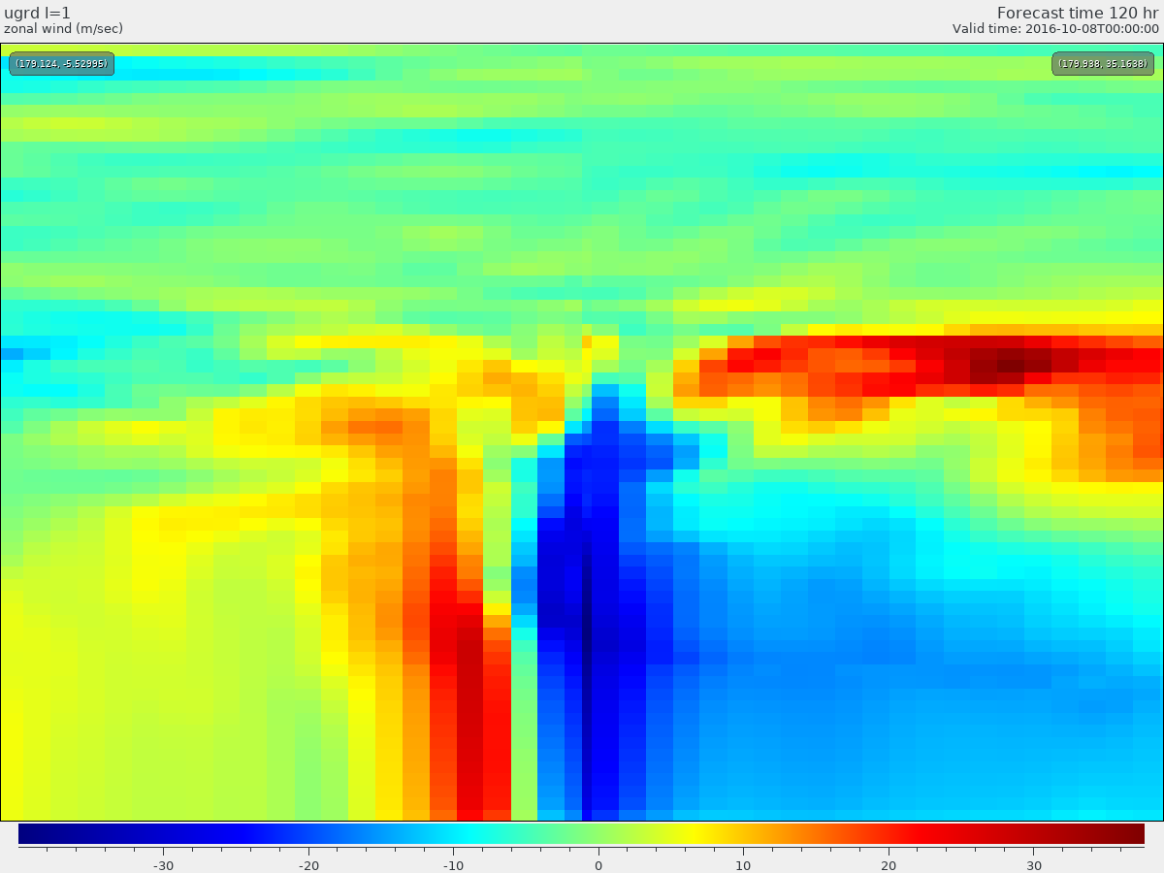
@120 hrs
Test No.III / 57
Zonal wind (U)
Cross-section @180E
South North

Slide 19
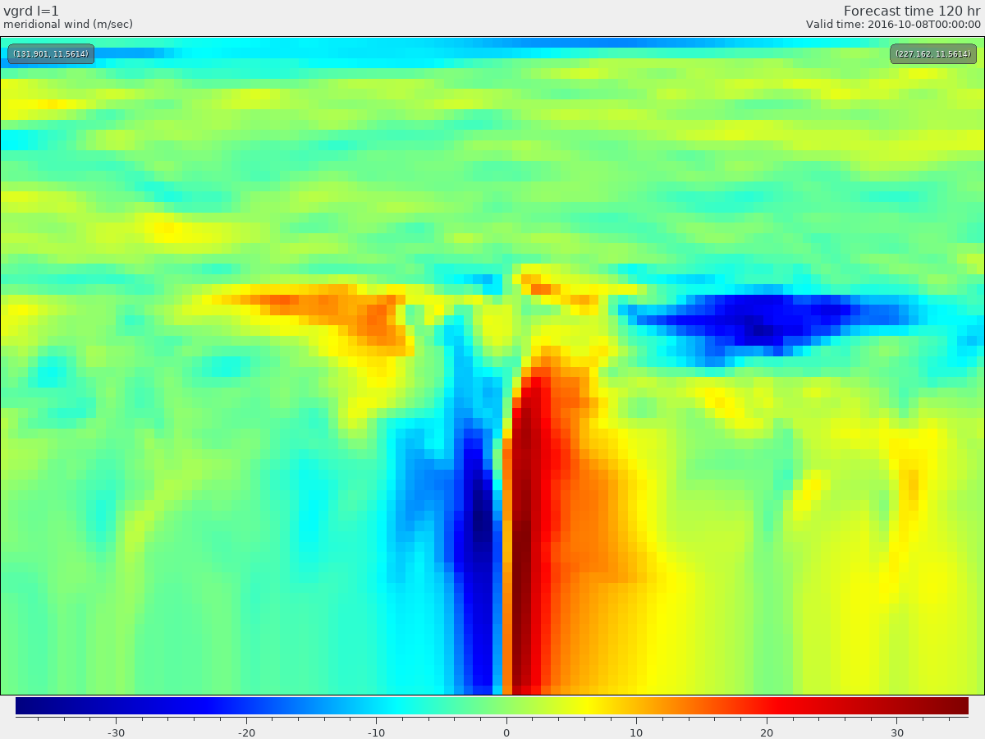
@120 hrs
Test No.III / 57
Meridional wind (V)
Cross-section @12N
West East

Slide 20
Test No.IV (test_case= 57a) on f-plane, aqua-planet
p00=1015.0hPa, dp=11.15hPa, rp=282.0km
Surface pressure (PS) max= 1015.00000000000 min=1004.44141134051
U max = 19.4412124264969 min = -19.6647077418568
V max = 19.5408117630522 min = -19.8585596483430
NSSTM is active (1, 1, 0, 0, 0)
!< nstf_name(1) : 0 = NSSTM off, 1 = NSSTM on but uncoupled
!< 2 = NSSTM on and coupled
!< nstf_name(2) : 1 = NSSTM spin up on, 0 = NSSTM spin up off
!< nstf_name(3) : 1 = NSST analysis on, 0 = NSSTM analysis off
!< nstf_name(4) : zsea1 in mm
!< nstf_name(5) : zsea2 in mm

Slide 21
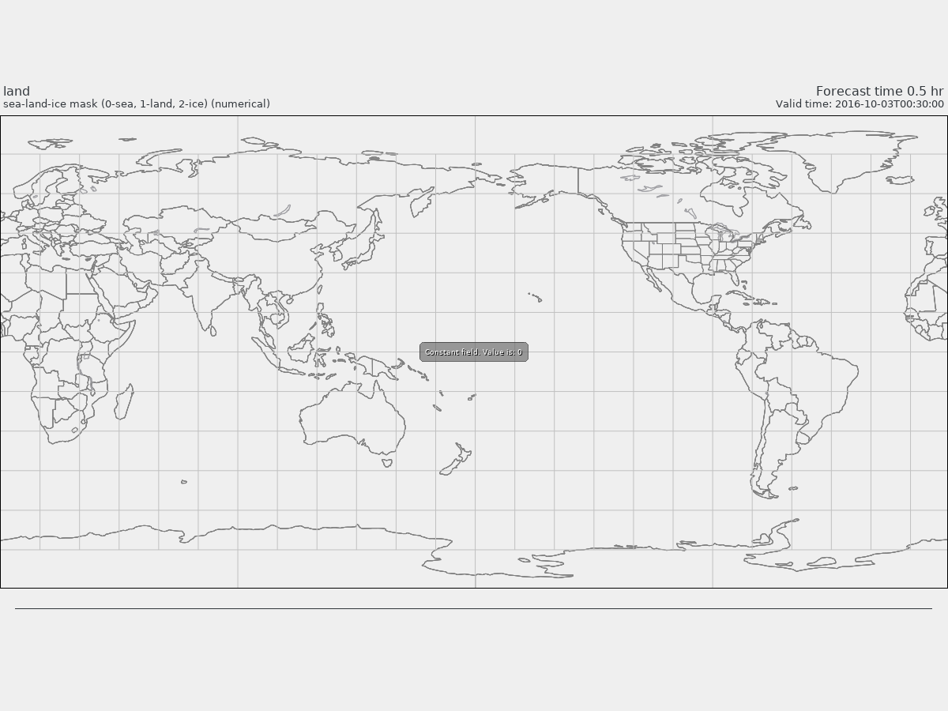
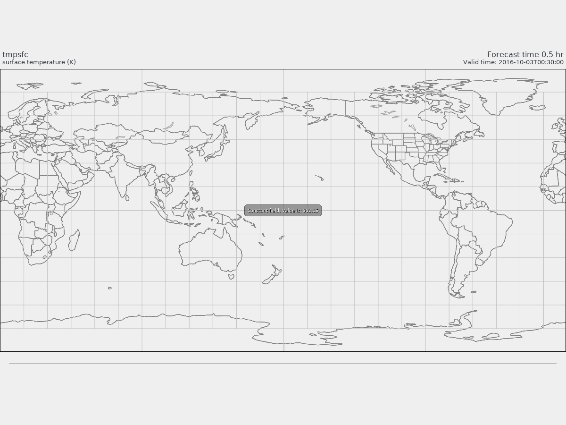
Test No.IV / 57a
Surface temperature=302.15 K @ hour 0.5
Land_Sea_Ice_mask=0 @ hour 0.5

Slide 22
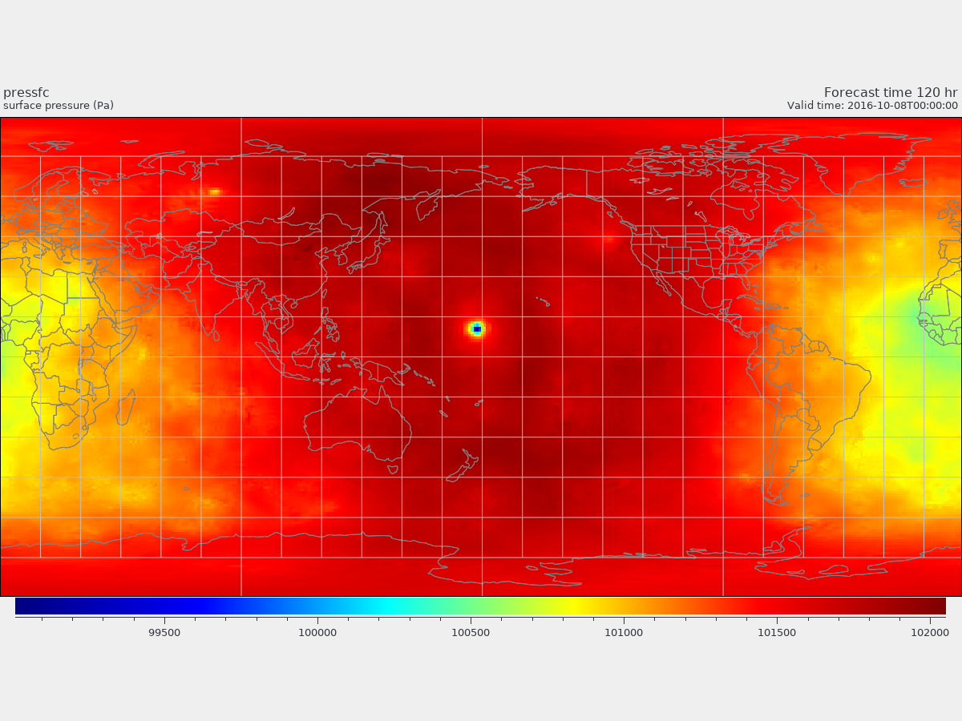
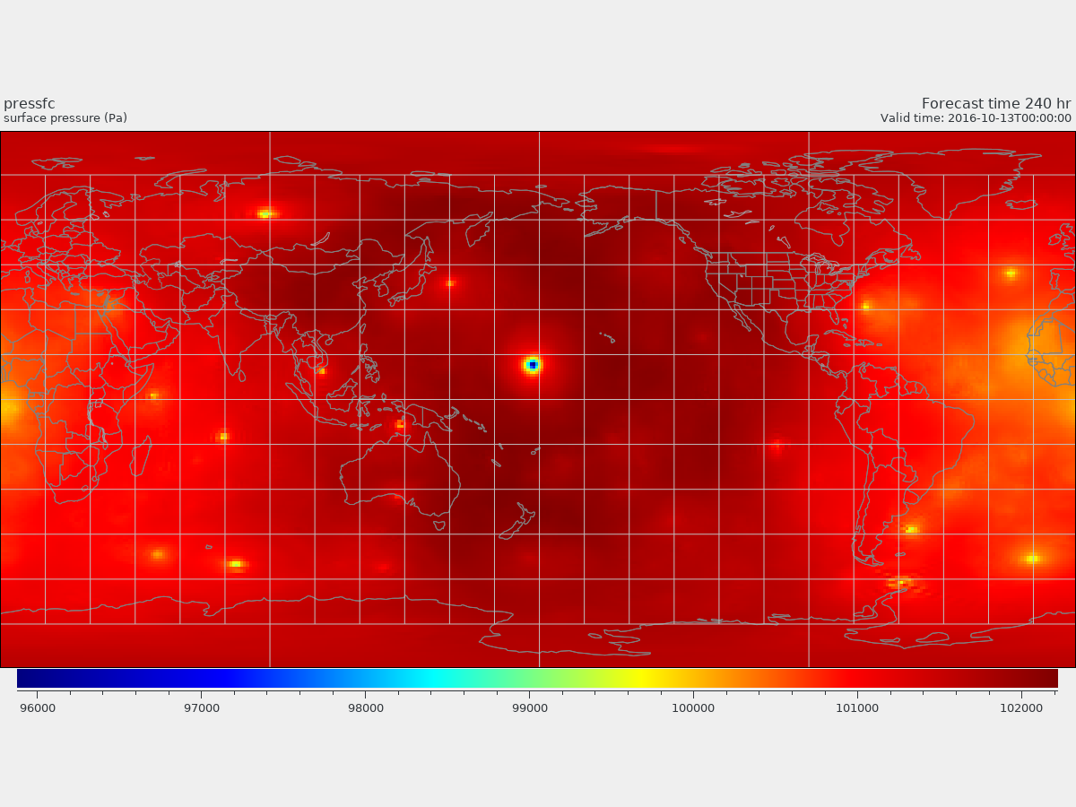
@0.5 hrs
Test No.IV / 57a
Surface Pressure
@120 hrs
@240 hrs

Slide 23
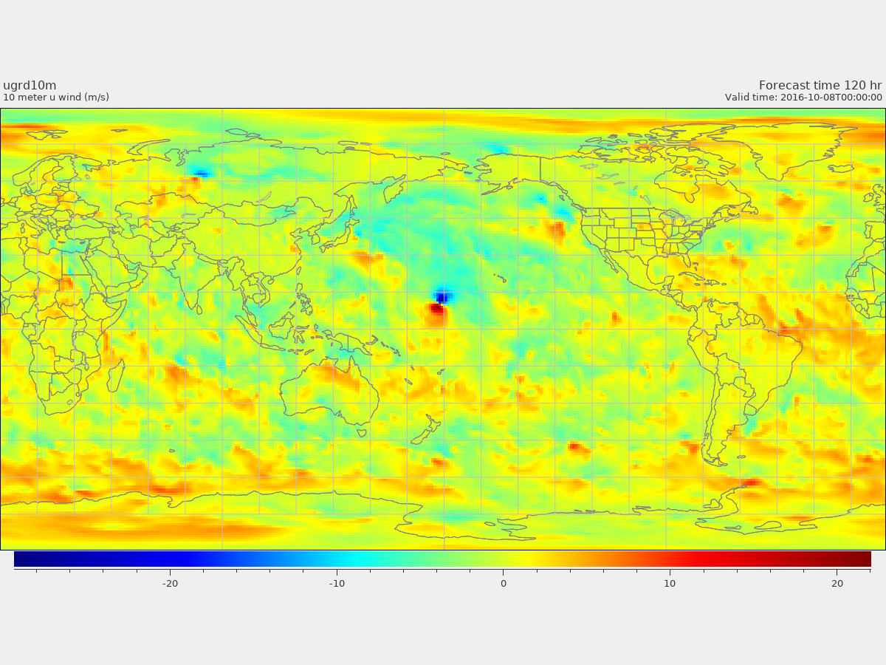
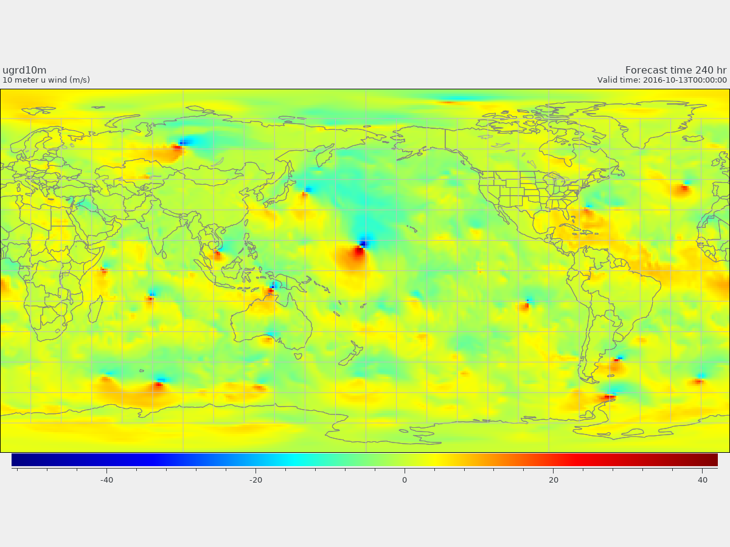
@0.5 hrs
Test No.IV / 57a
U at 10m
@120 hrs
@240 hrs

Slide 24
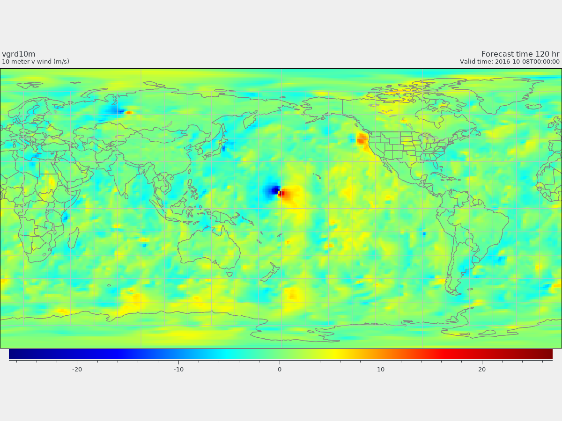
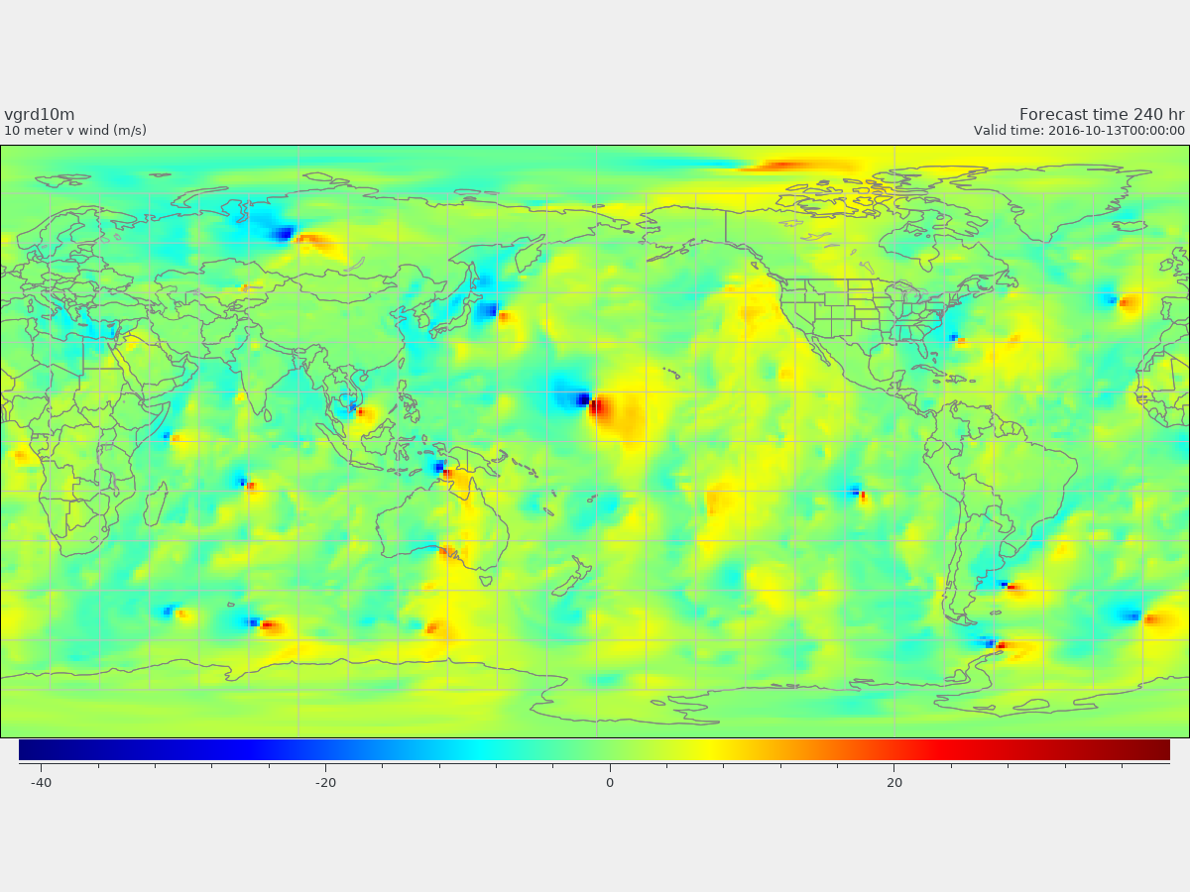
@0.5 hrs
Test No.IV / 57a
V at 10m
@120 hrs
@240 hrs

Slide 25
Test No.IV / 57a SLP forecast
Forecast hours

Slide 26
HOW TO RUN
(1) Download the code
https://github.com/ufs-community/ufs-weather-model/wiki
% git clone https://github.com/ufs-community/ufs-weather-model
(2) Build
https://ufs-weather-model.readthedocs.io/en/ufs-v1.0.0/ContributingDevelopment.html (3.3.1 /3.3.3)
cd ./modulefiles/hera.intel
module use . ---- module load fv3 ---- ./build.sh
(3) simple-test-case
https://github.com/ufs-community/ufs-weather-model/wiki/Getting-Started (3 /4 )
% wget https://ftp.emc.ncep.noaa.gov/EIB/UFS/simple-test-case.tar.gz
(4) input.nml .... changed
&test_case_nml ---- added ------
test_case = -55
bubble_do = .false.
alpha = 0.
Nsolitons = 1
soliton_size = 750.e3,
soliton_Umax = 50. /
external_ic = .false. ---- changed as "false"
external_eta = .false.
(5) Submit your job and relax

Slide 27
0: NOTE from PE 0: reading surface properties data from INPUT/sfc_data.tile*.nc
./ufs-weather-model/FV3/io/FV3GFS_io.F90
!--- 2D variables
! ------------
Sfcprop(nb)%slmsk(ix) = sfc_var2(i,j,1) !--- slmsk
Sfcprop(nb)%tsfco(ix) = sfc_var2(i,j,2) !--- tsfc (tsea in sfc file)
Sfcprop(nb)%weasd(ix) = sfc_var2(i,j,3) !--- weasd (sheleg in sfc file)
Sfcprop(nb)%tg3(ix) = sfc_var2(i,j,4) !--- tg3
Sfcprop(nb)%zorlo(ix) = sfc_var2(i,j,5) !--- zorl on ocean
Sfcprop(nb)%alvsf(ix) = sfc_var2(i,j,6) !--- alvsf
Sfcprop(nb)%alvwf(ix) = sfc_var2(i,j,7) !--- alvwf
Sfcprop(nb)%alnsf(ix) = sfc_var2(i,j,8) !--- alnsf
Sfcprop(nb)%alnwf(ix) = sfc_var2(i,j,9) !--- alnwf
Sfcprop(nb)%facsf(ix) = sfc_var2(i,j,10) !--- facsf
Sfcprop(nb)%facwf(ix) = sfc_var2(i,j,11) !--- facwf
Sfcprop(nb)%vfrac(ix) = sfc_var2(i,j,12) !--- vfrac
Sfcprop(nb)%canopy(ix) = sfc_var2(i,j,13) !--- canopy
Sfcprop(nb)%f10m(ix) = sfc_var2(i,j,14) !--- f10m
Sfcprop(nb)%t2m(ix) = sfc_var2(i,j,15) !--- t2m
Code modification

Slide 28
Sfcprop(nb)%q2m(ix) = sfc_var2(i,j,16) !--- q2m
Sfcprop(nb)%vtype(ix) = sfc_var2(i,j,17) !--- vtype
Sfcprop(nb)%stype(ix) = sfc_var2(i,j,18) !--- stype
Sfcprop(nb)%uustar(ix) = sfc_var2(i,j,19) !--- uustar
Sfcprop(nb)%ffmm(ix) = sfc_var2(i,j,20) !--- ffmm
Sfcprop(nb)%ffhh(ix) = sfc_var2(i,j,21) !--- ffhh
Sfcprop(nb)%hice(ix) = sfc_var2(i,j,22) !--- hice
Sfcprop(nb)%fice(ix) = sfc_var2(i,j,23) !--- fice
Sfcprop(nb)%tisfc(ix) = sfc_var2(i,j,24) !--- tisfc
Sfcprop(nb)%tprcp(ix) = sfc_var2(i,j,25) !--- tprcp
Sfcprop(nb)%srflag(ix) = sfc_var2(i,j,26) !--- srflag
Sfcprop(nb)%snowd(ix) = sfc_var2(i,j,27) !--- snowd (snwdph in the file)
Sfcprop(nb)%shdmin(ix) = sfc_var2(i,j,28) !--- shdmin
Sfcprop(nb)%shdmax(ix) = sfc_var2(i,j,29) !--- shdmax
Sfcprop(nb)%slope(ix) = sfc_var2(i,j,30) !--- slope
Sfcprop(nb)%snoalb(ix) = sfc_var2(i,j,31) !--- snoalb
Sfcprop(nb)%sncovr(ix) = sfc_var2(i,j,32) !--- sncovr
if(Model%cplflx) then
Sfcprop(nb)%tsfcl(ix) = sfc_var2(i,j,33) !--- sfcl (temp on land portion of a cell)
Sfcprop(nb)%zorll(ix) = sfc_var2(i,j,34) !--- zorll (zorl on land portion of a cell)
end if
Code modification

Slide 29
So far, two codes need to be modified for TC_AQUA, and more changes for FV3GFS shallow water model.
./ufs-weather-model/FV3/io/FV3GFS_io.F90
./ufs-weather-model/FV3/gfsphysics/physics/sfcsub.F
#ifdef SW_DYNAMICS
------------------------------------------------
#else
------------------------------------------------
#endif
#ifdef TC_AQUA
------------------------------------------------
#else
------------------------------------------------
#endif
#ifndef TC_AQUA
------------------------------------------------
#else
------------------------------------------------
#endif
#ifndef SW_DYNAMICS
------------------------------------------------
#else
------------------------------------------------
#endif

Slide 30
Test No.V (test_case= 4a/b) with FV3GFS shallow-water model
ubar = 50. (m/s) ! maxmium wind speed
r0 = 250.e3 (m) ! RADIUS of the maximum wind of the Rankine vortex
(4b)ddeg = 3.*r0/radius ! Distance between the Two-vortices (6.7 degree*2.0)
p1(1) = pi*1.75 – ddeg ! 45W -ddeg
p1(2) = pi/6. ! 30 N
call rankine_vortex(ubar, r0, p1, u, v, grid, bd)
p2(1) = pi*1.75 + ddeg ! 45W +ddeg
p2(2) = pi/6. ! 30 N
call rankine_vortex(ubar, r0, p2, u, v, grid, bd)
if( r<r0 ) then
vr = ubar*r/r0
else
vr = ubar*r0/r
endif
(4a)ddeg = 6.*r0/radius ! Distance between the Two-vortices (13.4 degree*2.0)

Slide 31
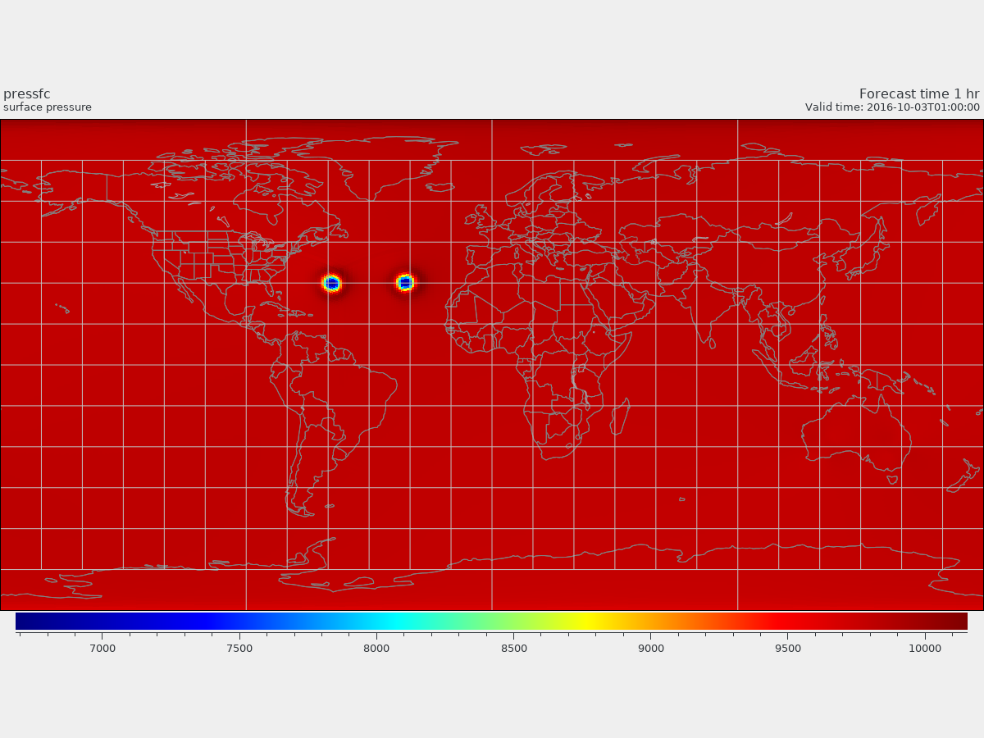
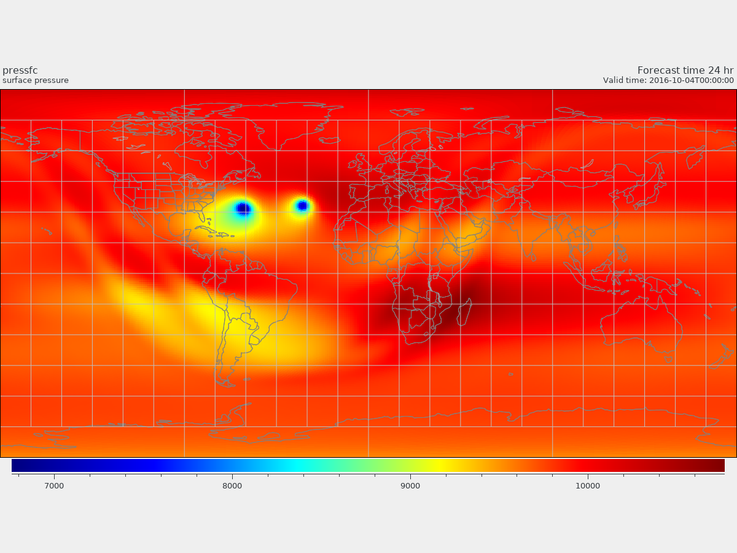
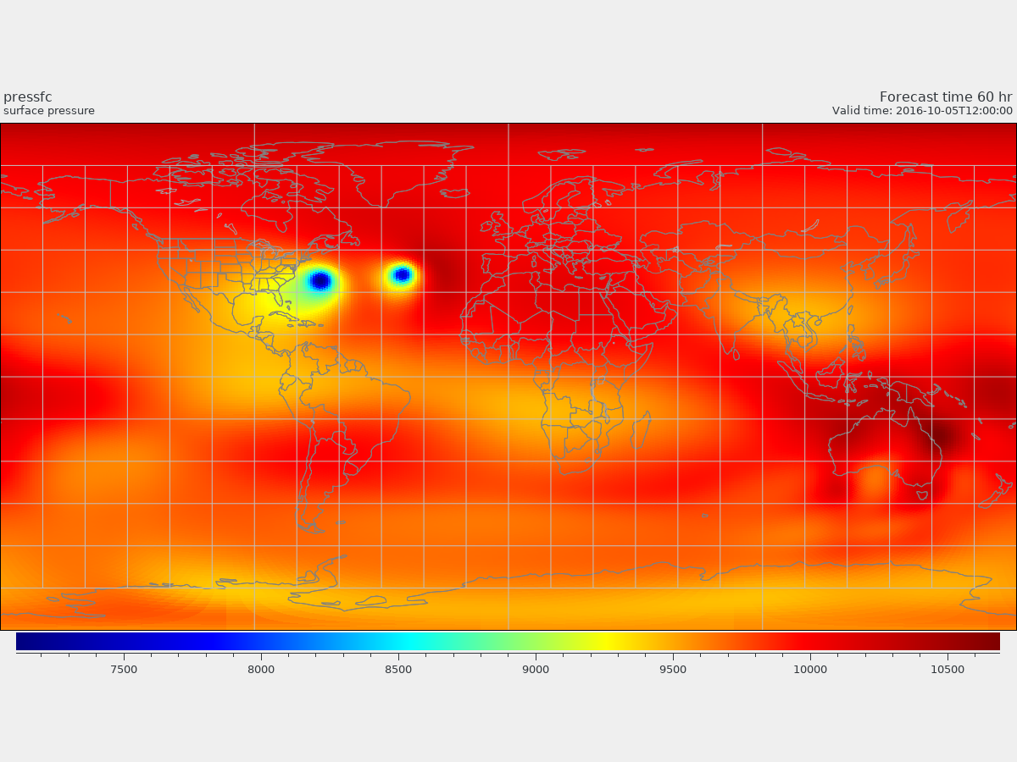
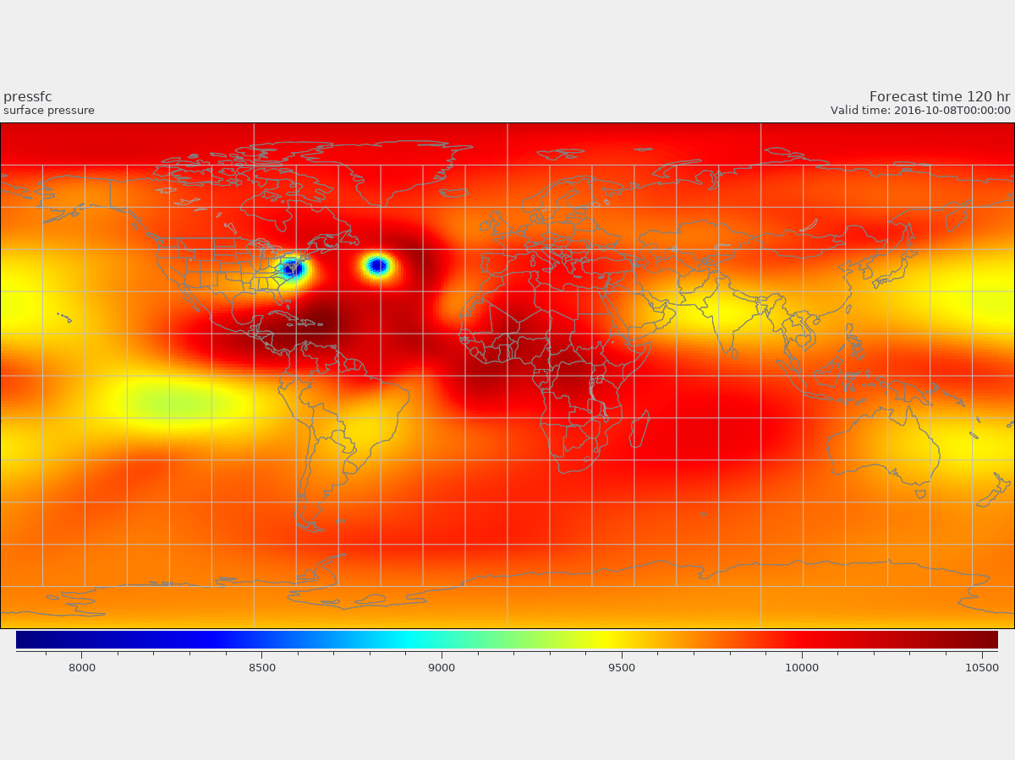
@001 hr
@024 hrs
@060 hrs
@120 hrs

Slide 32
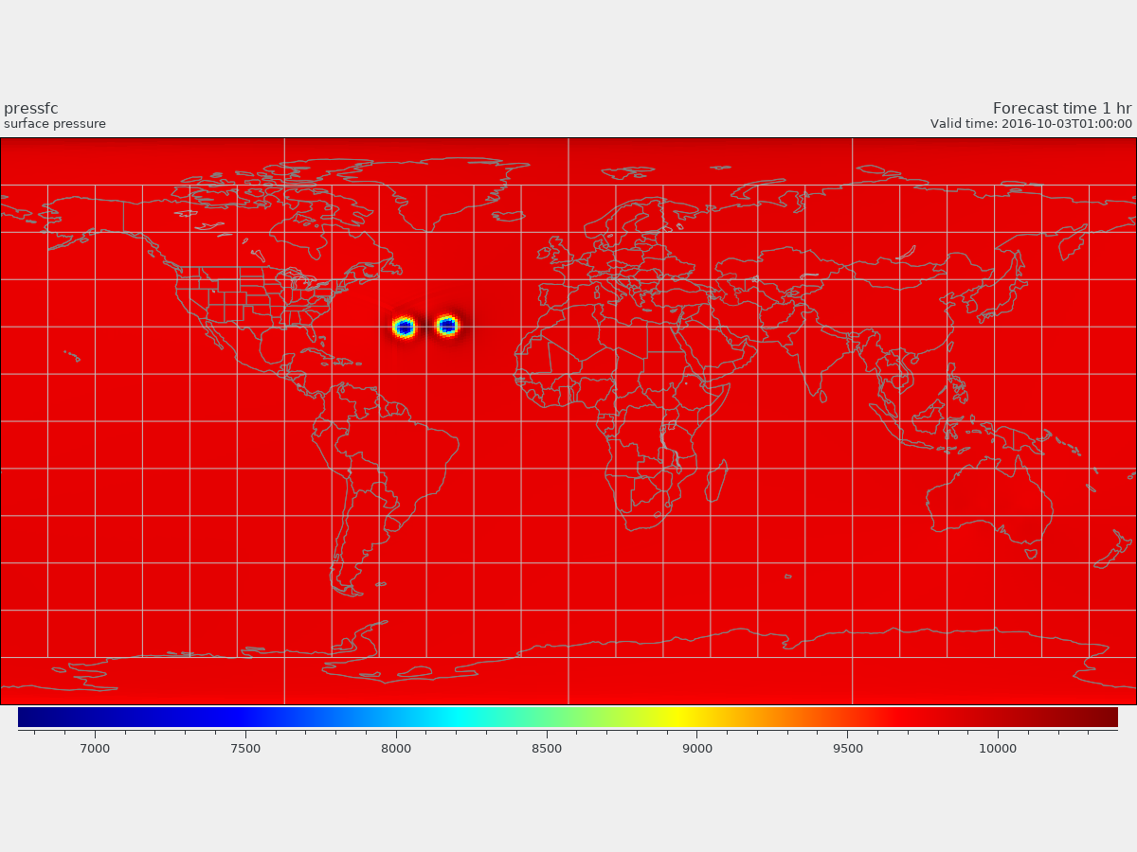
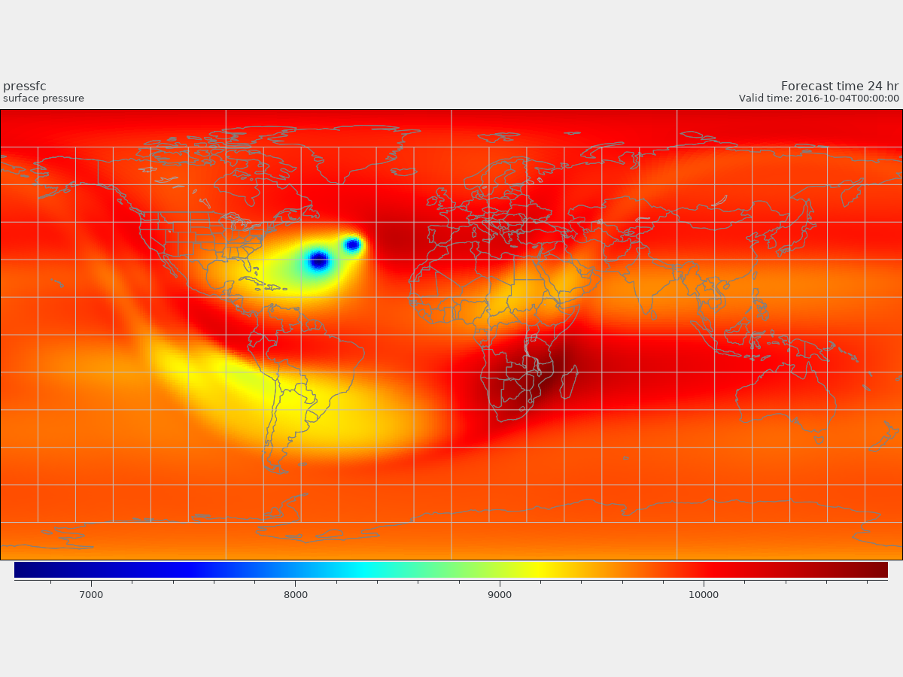
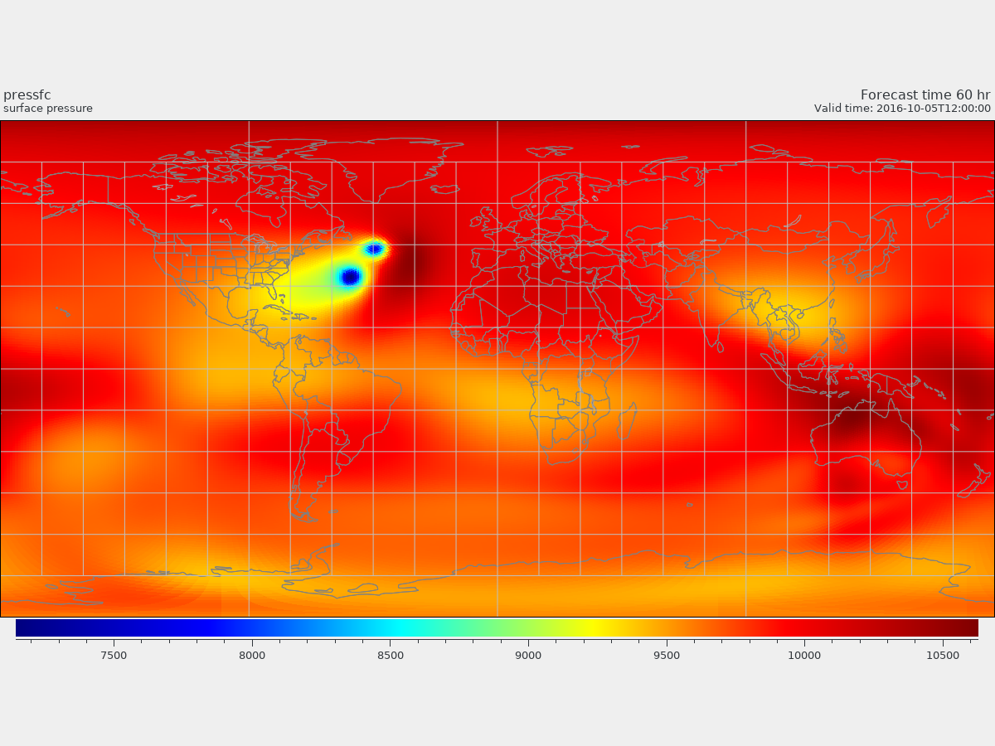
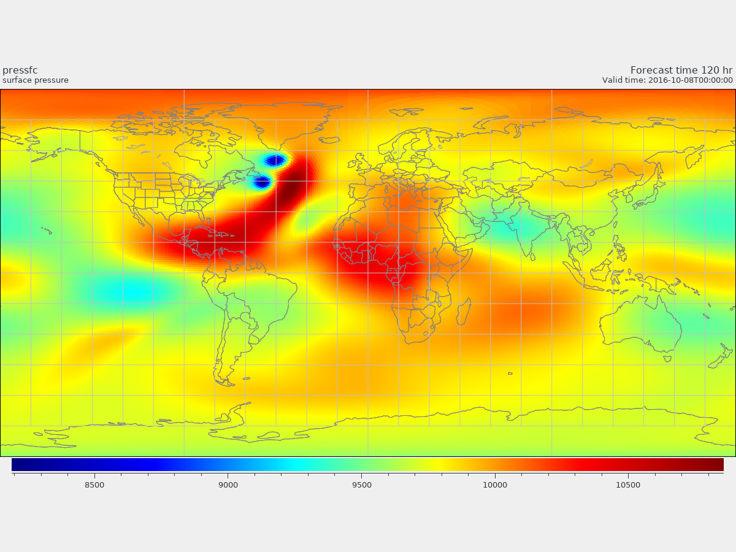
@001 hr
@024 hrs
@060 hrs
@120 hrs

Slide 33
Questions and suggestions ????
Summary:
the 2D/3D idealized TC could be run under FV3-GFS V15/16 framework.
Applications:
it could be a platform for the investigation of TC basic dynamics and physics as well.
Goal: this platform will be built on global 9Km/3Km resolution.
Hope: quantum computer is on the way!
C48 = 2­degree, C96=1­degree, C192 = 0.5­degree ≈ 50km, C384 = 0.25­degree ≈ 25km, C2560 ≈ 3.5km)

Slide 34
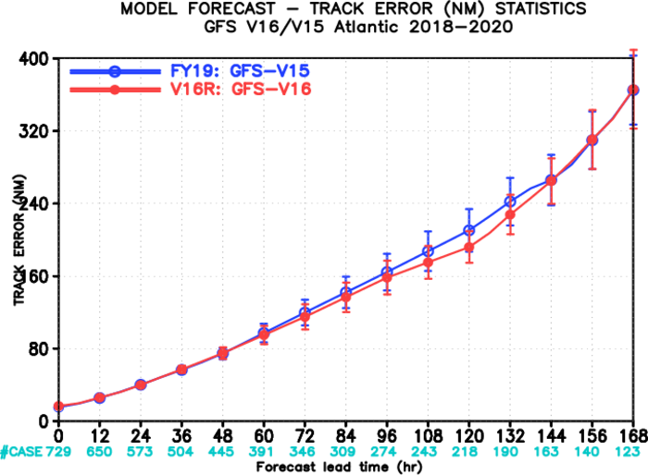
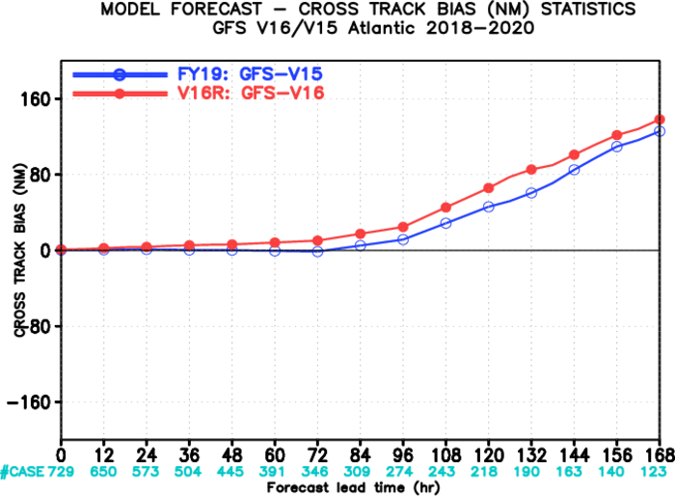
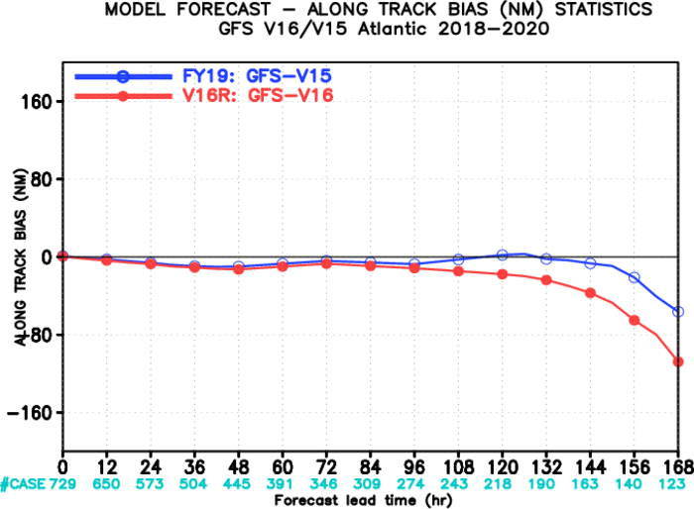
Questions and discussion: GFS-V15/16 has large cross-track bias, why?

