Slide 1

HAFS ensemble in AWS cloud for 2023 hurricane real time forecasts
Presented by Jiayi Peng
Zhan Zhang, Weiguo Wang, Bin Liu, Yonghui Weng, Avichal Mehra, Vijay Tallapragada
Rajendra Panda, Matt Long, Unni Kirandumkara
Xuejin Zhang, Sundararaman Gopalakrishnan, Aaron Poyer, William Komaromi, Jason Anderson
@EMC Hurricane Team; @parallelworks.com; @HRD; @HFIP management Team
36th Conference on Hurricanes and Tropical Meteorology
06-10 May 2024, Long Beach, CA

Slide 2
Outline
Motivations
HAFS ensemble configurations and products in 2023
Verifications for 2023 HAFS ensemble forecasts
New configurations for 2024 HAFS ensemble

Slide 3
Motivations
Transformation from deterministic Impact-based Decision Support Services (IDSS) to probabilistic/ensemble IDSS for hurricane forecasting was listed in the NWS Strategic Plan for the next 10 years (Ken Graham, 2023).
Lack of a skillful/reliable high-resolution ensemble remains a significant challenge for forecasters at NHC and JTWC when issuing forecasts related to TC intensity, structure changes, and hazards such as wind, waves, and storm surges. (Mike Brennan, Wallace Hogsett and Matthew Kucas, 9th NOAA Ensemble Users Workshop)
COAMPS-TC 11-member ensemble was in operational (FNMOC) in 2020. Up to two systems (runs) per cycle; slots allocated for NHC / CPHC systems if JTWC does not request.
We are here to fulfill the GAP through AWS Cloud Computing.

Slide 4
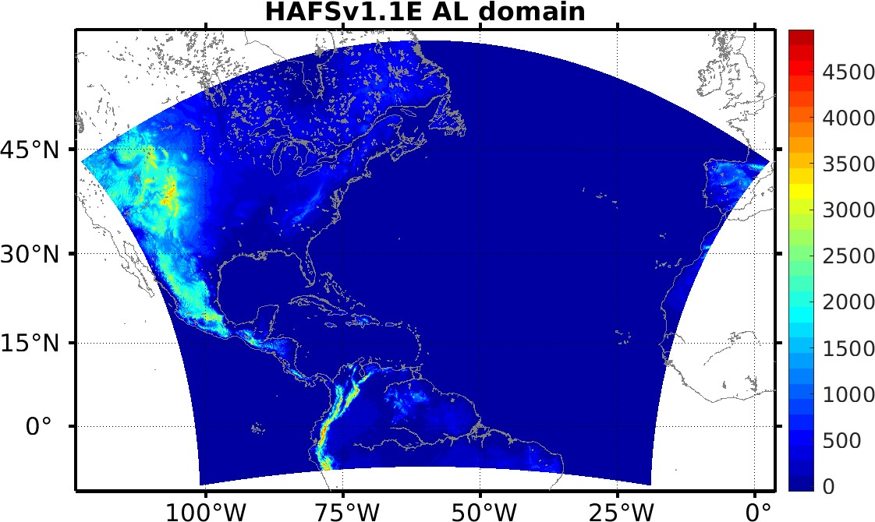
2023 HAFS Ensemble in Realtime in the Cloud (HERC)
based on HAFSv1.0(HFSA)
Atmospheric model: FV3 Dycore, ESG (6km), L65-vertical layers(2hPa)
CCPP Physics: GFDL Microphysics, RRTMG, unified UGWD(v1.0)
Upgraded scale-aware convection parameterization
Surface layer scheme (GFS)
Upgraded PBL, TKE-EDMF
TC-specific mixing length scale adjustment
Land model: NOAH-LSM
Ocean model: HYCOM (1/12 degree, Atlantic basin)
Stochastic physics:
Stochastically Perturbed Physics Tendencies (SPPT)
Stochastically Kinetic Energy Backscatter (SKEB)
Stochastically Perturbed PBL Humidity (SHUM)
IC/BC: GEFS grib2 (0.5x0.5), RTOFS
One control member plus 20 perturbed ensemble members
Runs 4 cycles per day (00Z, 06 Z, 12Z, 18Z), Atlantic basin only
Computing resources: In AWS cloud 6 nodes or 576 cores per forecast job.

Slide 5
Running HAFS ensemble in AWS Cloud
Computing
  Using Rocoto, 21 workflows (one per member) are run continuously
  Each workflow creates multiple jobs - submitted to the same SLURM job queue
  Entire workflow for a cycle – completes under 6 hours
Data movement – per cycle
  Majority of input data accessed from S3 bucket – intra-cloud transfer
  Output data – 6.6TB per cycle
    Output is stored initially in Lustre file system
    When a new cycle starts – output from previous cycle is transferred to S3 bucket
    aws s3 ls s3://noaa-nws-hafs-pds/herc/
  Limited set of output files transferred to a NOAA on-prem system
    Generate graphics for NOAA and other organizations

Slide 6
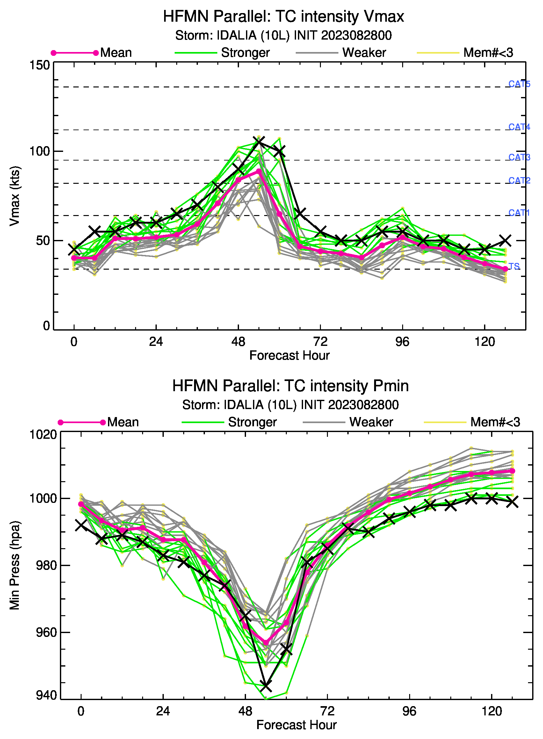
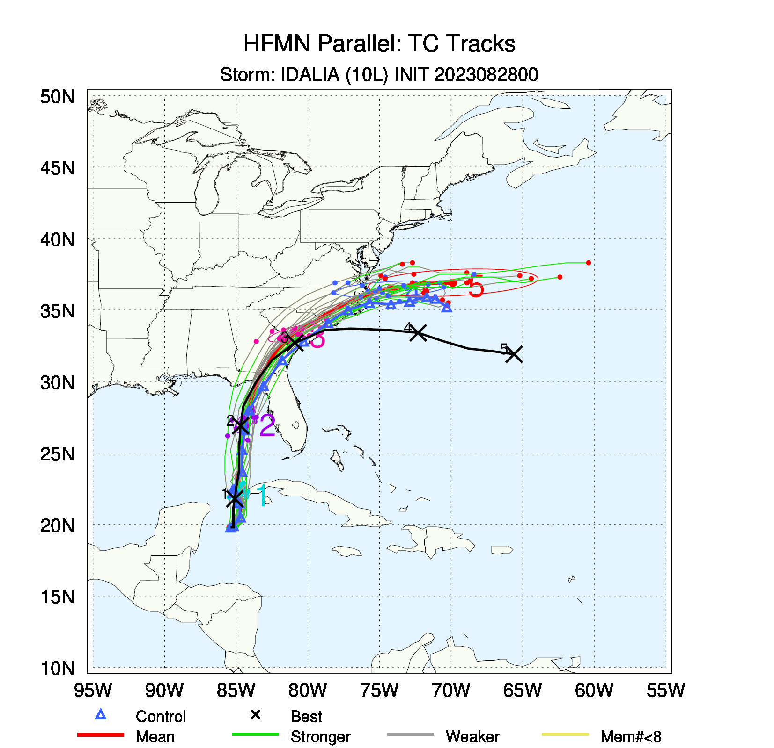
2023 HAFS Ensemble Products
10m wind
SLP

Slide 7
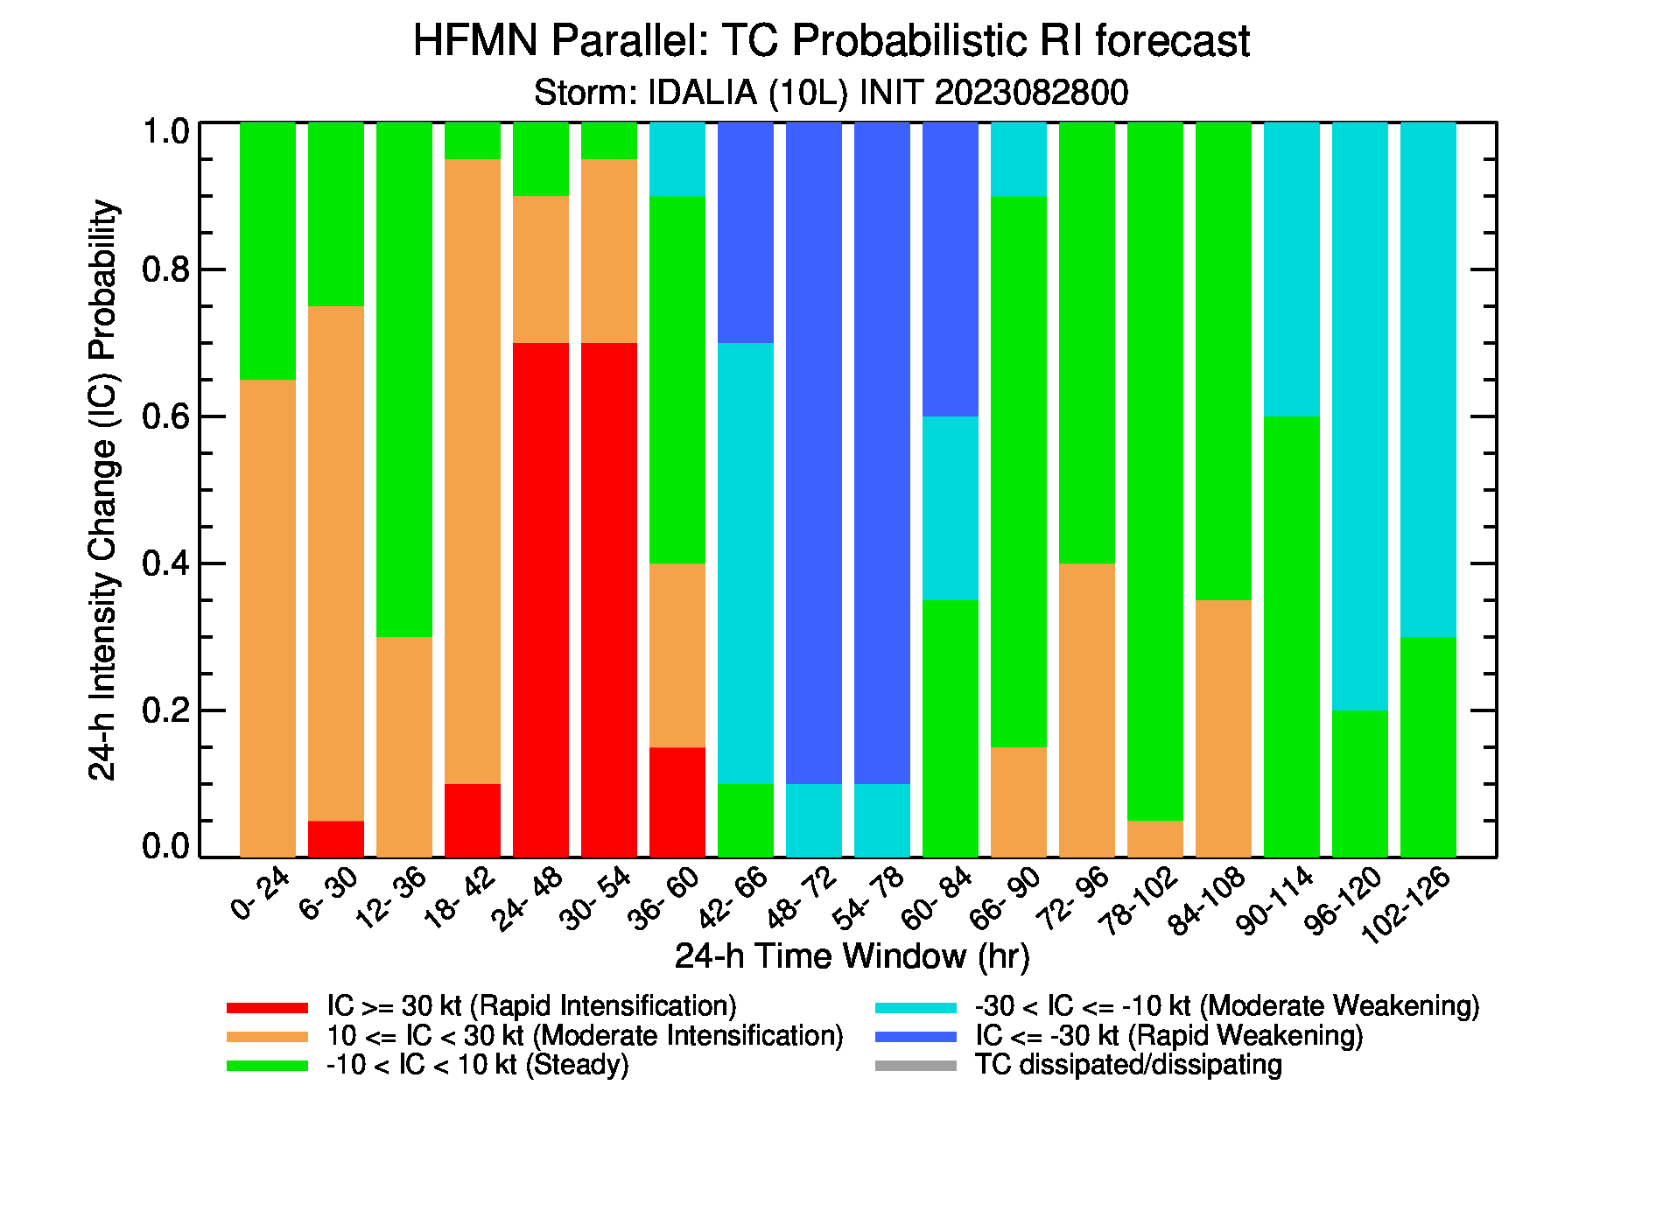
2023 HAFS Ensemble Products
https://www.emc.ncep.noaa.gov/HAFS/HAFSEPS/index.php
Rapid Intensification happened before Idalia’s landfall.

Slide 8
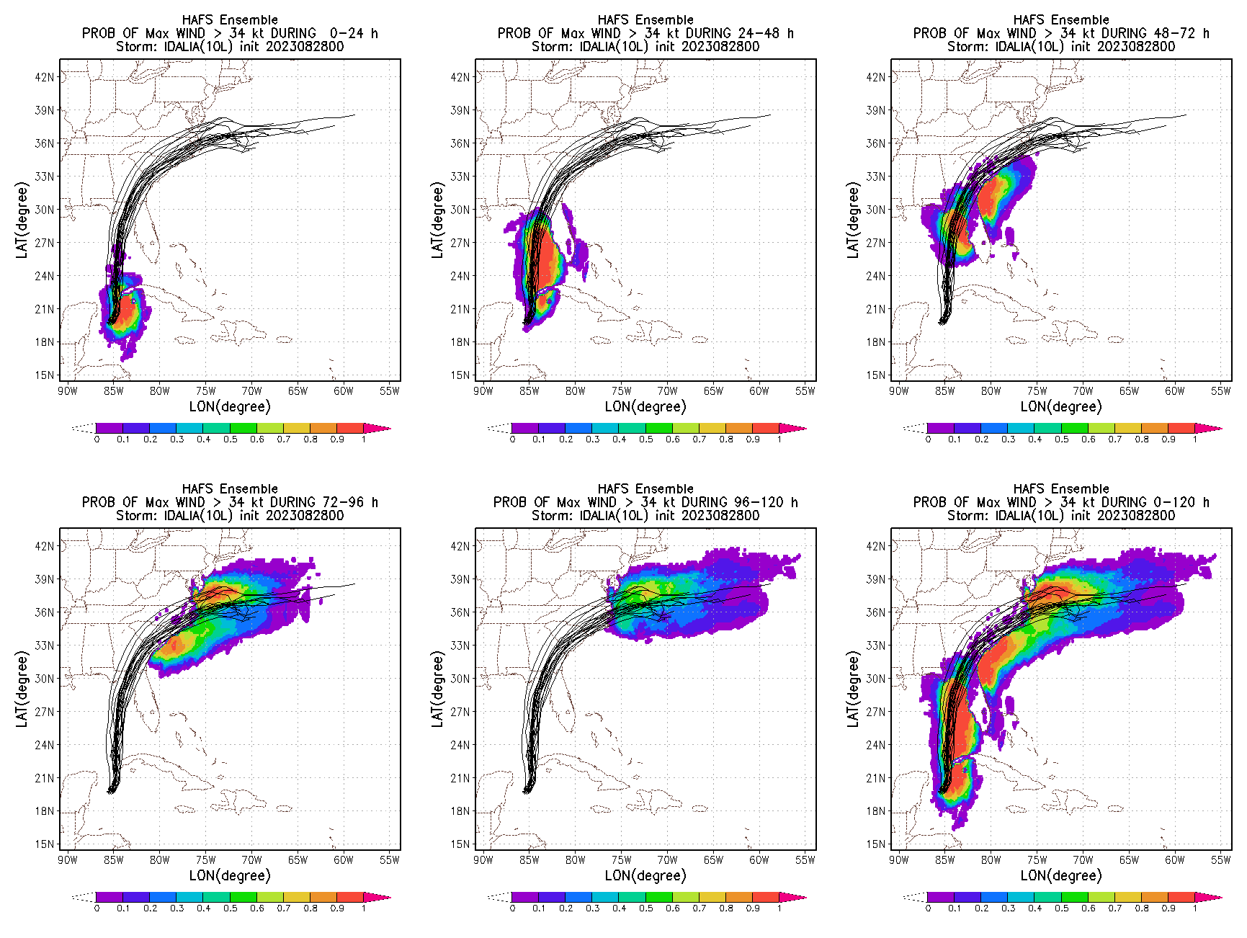
Wind Speed Probability (>34kts; 50kts; 64kts)
Day-1
Day-2
Day-3
Day-4
Day-5
HAFS ensemble surface wind fields could be applied to drive the WW3, P-surge model, etc., for hazards forecasts.

Slide 9
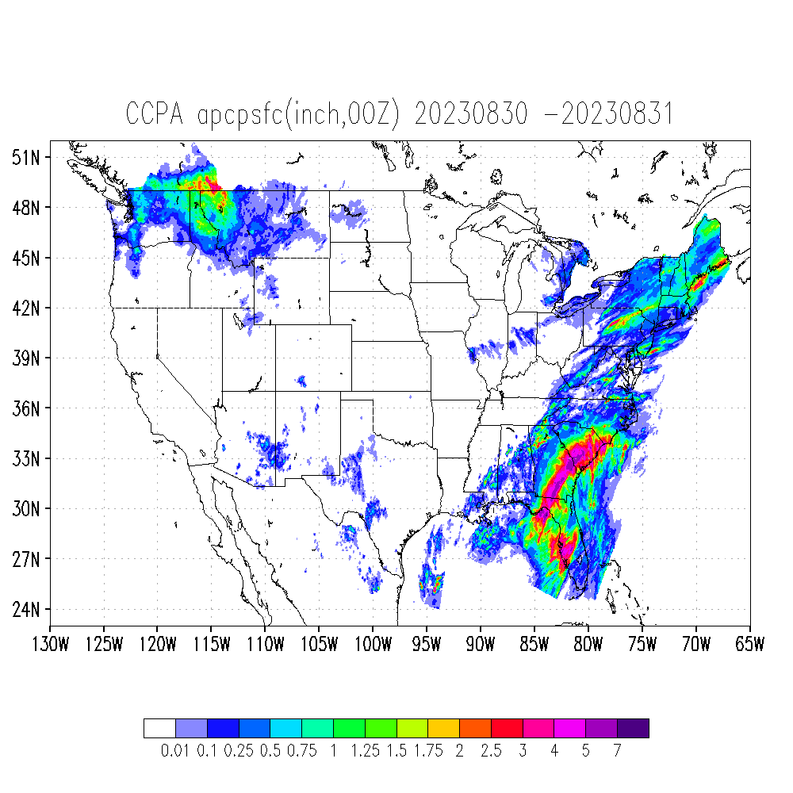
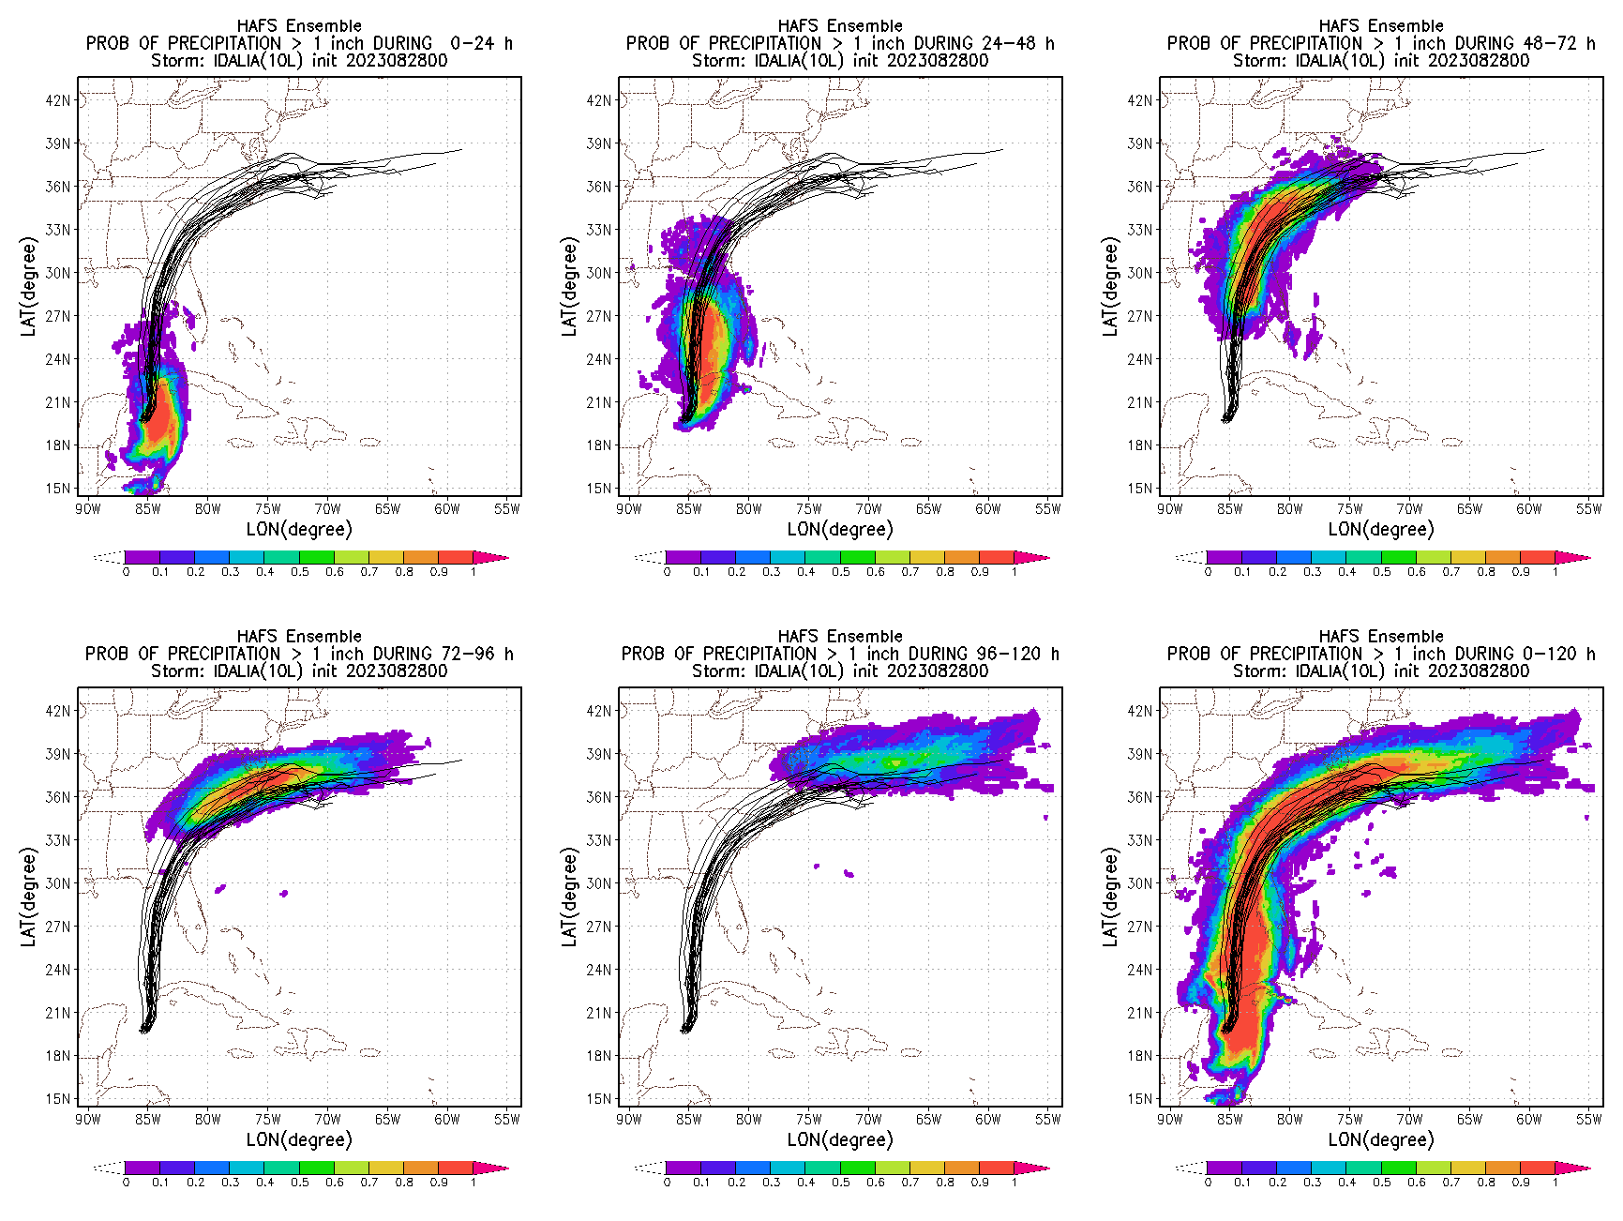
Precipitation Probability (> 1;4;8 inches)
Day-1
Day-2
Day-3
Day-3
We encourage WPC forecasters to use HAFS PQPF products.
Day-4
Day-5
More products, please visit:
https://www.emc.ncep.noaa.gov/HAFS/HAFSEPS/index.php

Slide 10
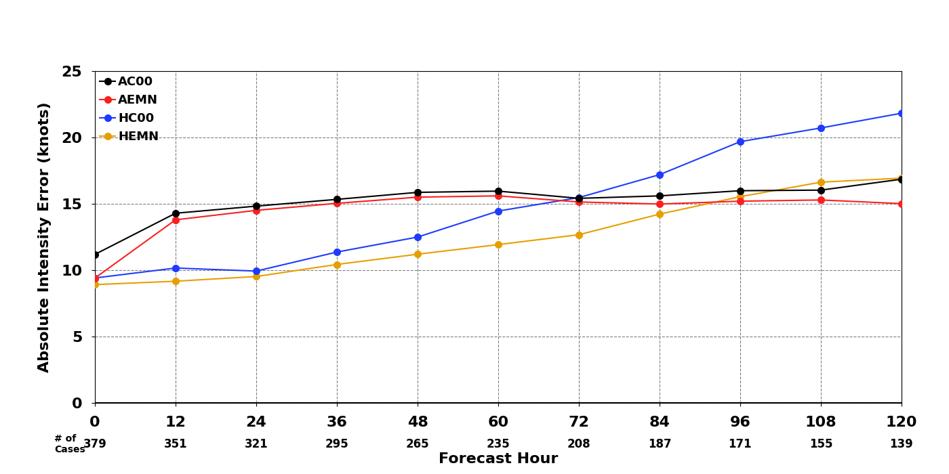
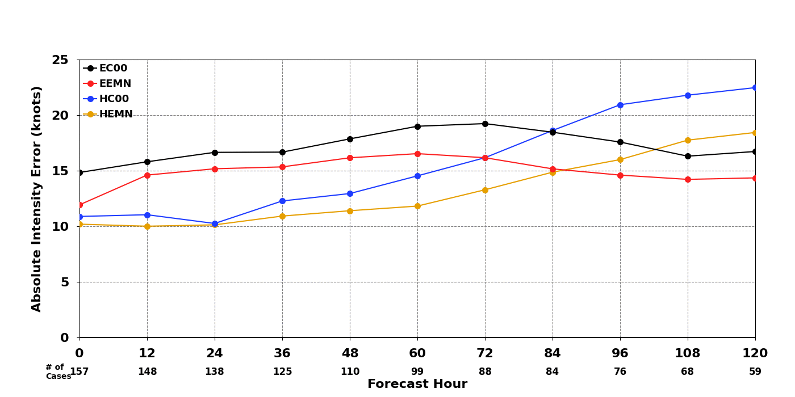
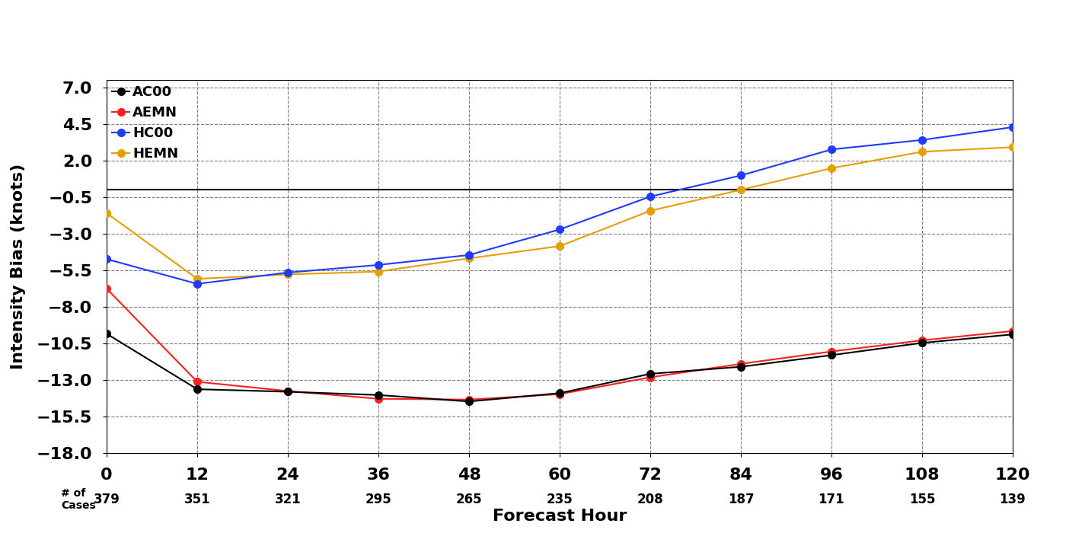
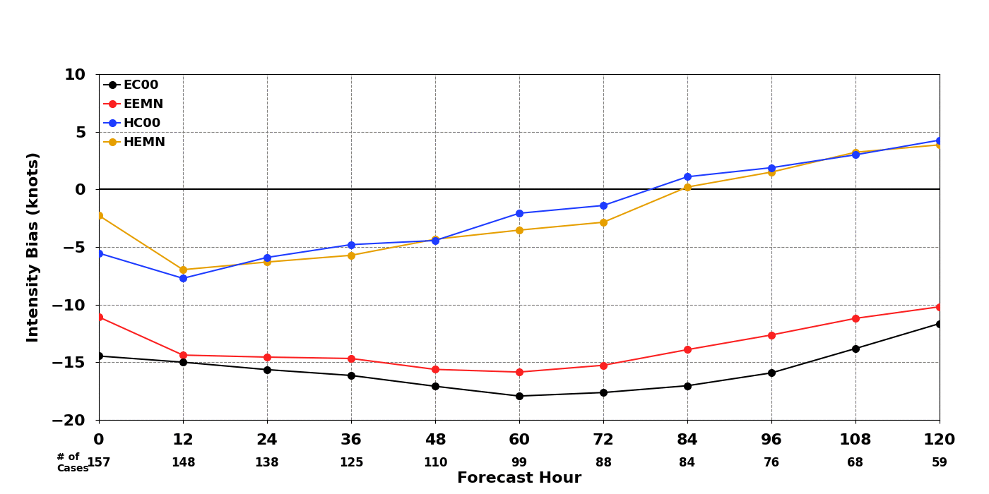
2023 TC Intensity Error and Bias (HAFSens VS. GEFS/EENS)
GEFS: 31 members, 25km resolution; ECMWF: 51 members, 9km resolution)
GEFS control member (AC00)
GEFS 30-member mean (AEMN)
HAFS control member (HC00)
HAFS 20-member mean (HEMN)
ECMWF control member (EC00/9km)
ECMWF 50-member mean (EEMN/9km)
HAFS control member (HC00)
HAFS 20-member mean (HEMN)
error
error
bias
bias
HAFSens: reduced intensity errors in first 3 days; reduced bias by 10kts.

Slide 11
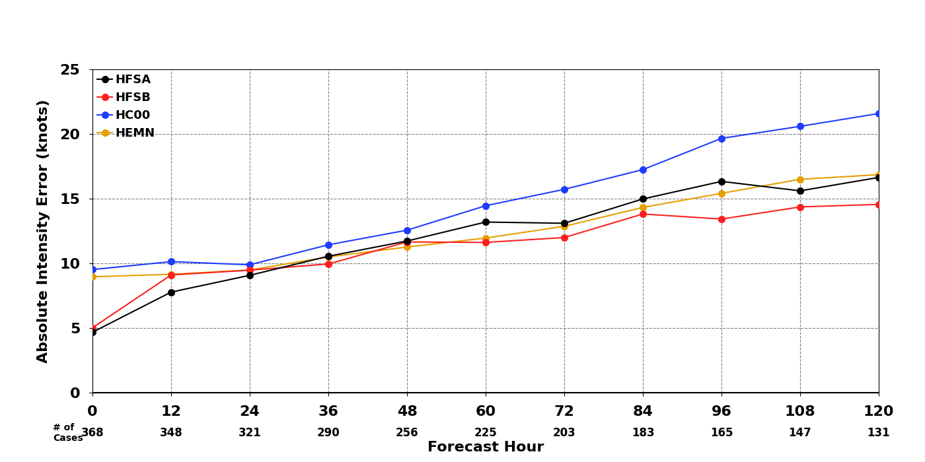
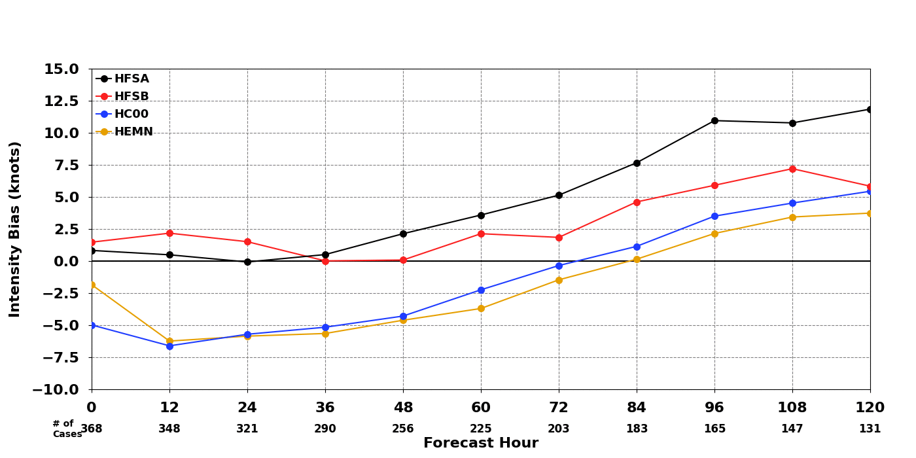
2023 Intensity Error/Bias (HAFSens VS. HFSA/B)
HFSA operational (HFSA)
HFSB operational (HFSB)
HAFS control member (HC00)
HAFS 20-member mean (HEMN)
Error
HAFS ens (HEMN):
Intensity error is close or better than HFSA after 24 hours.
Initial large error/bias due to “no VI/DA”.
Bias

Slide 12
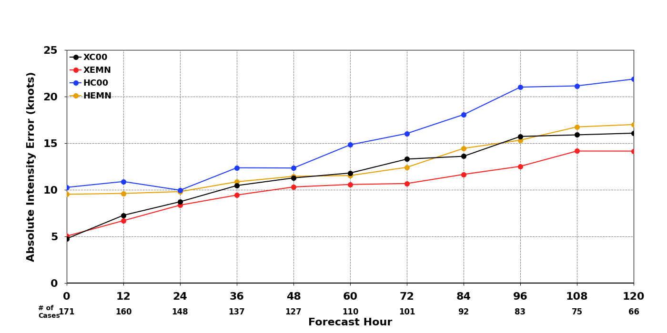
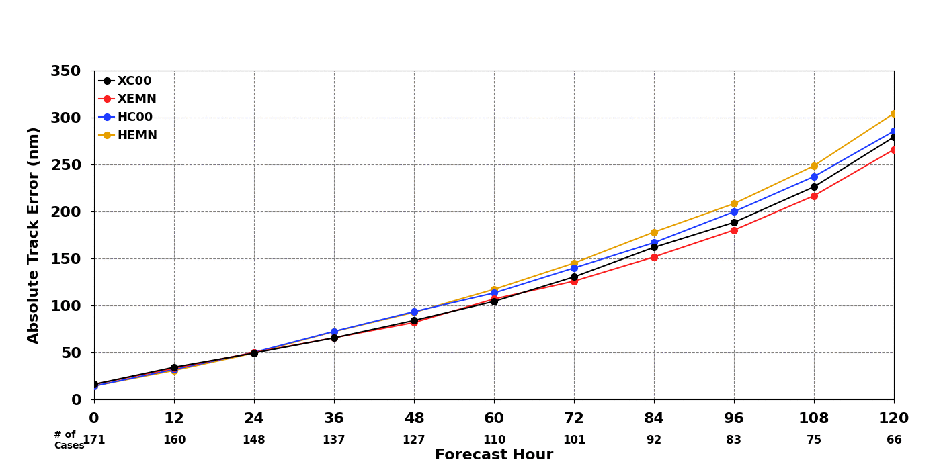
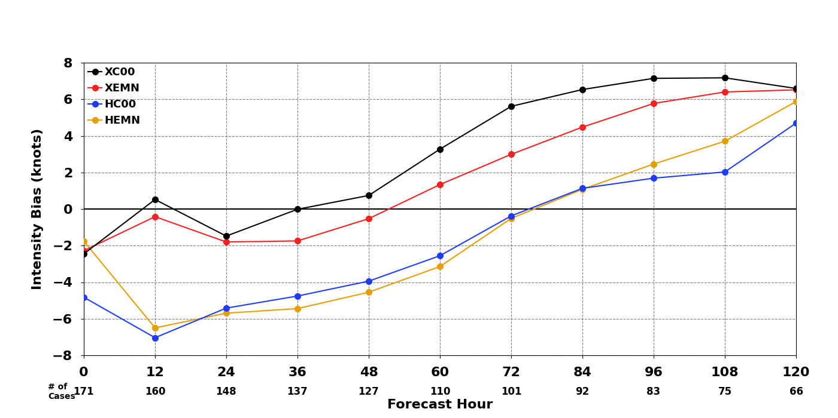
Intensity Error/Bias and Track Error (HAFSens VS. CTCXens)
Error
Track Error
CTCXens control member (XC00)
CTCXens 20-member mean (XEMN)
HAFS control member (HC00)
HAFS 20-member mean (HEMN)
CTCXens did better job for intensity forecast.
HAFSens has bigger negative intensity bias in the first 60-hours.
Bias

Slide 13
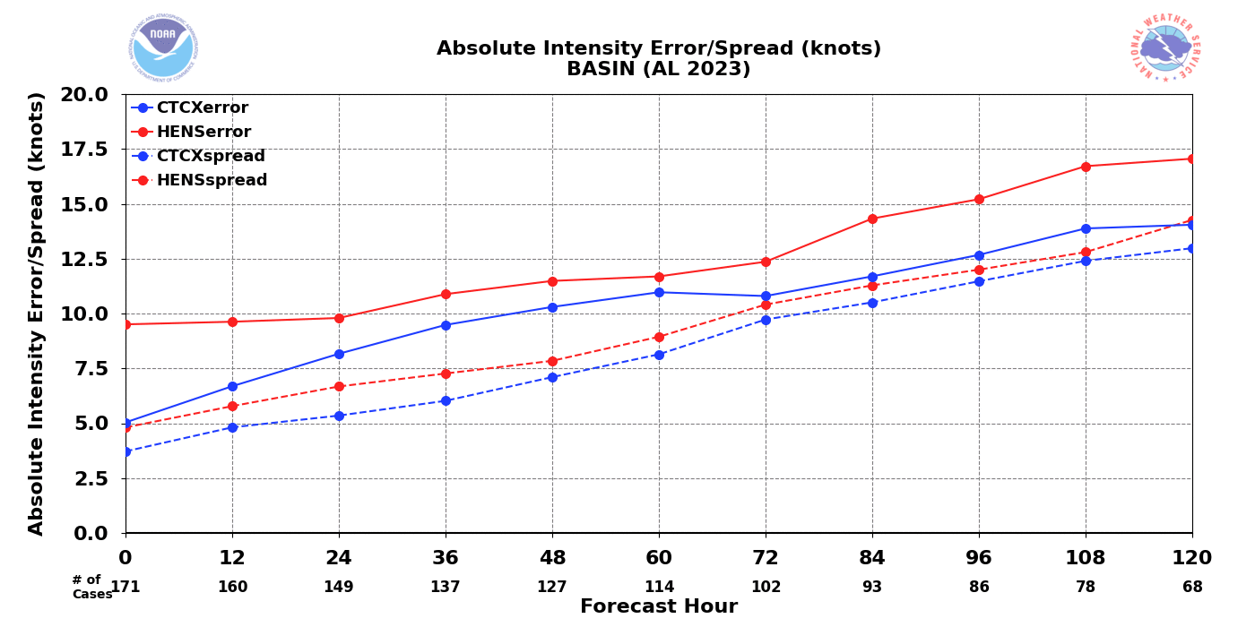
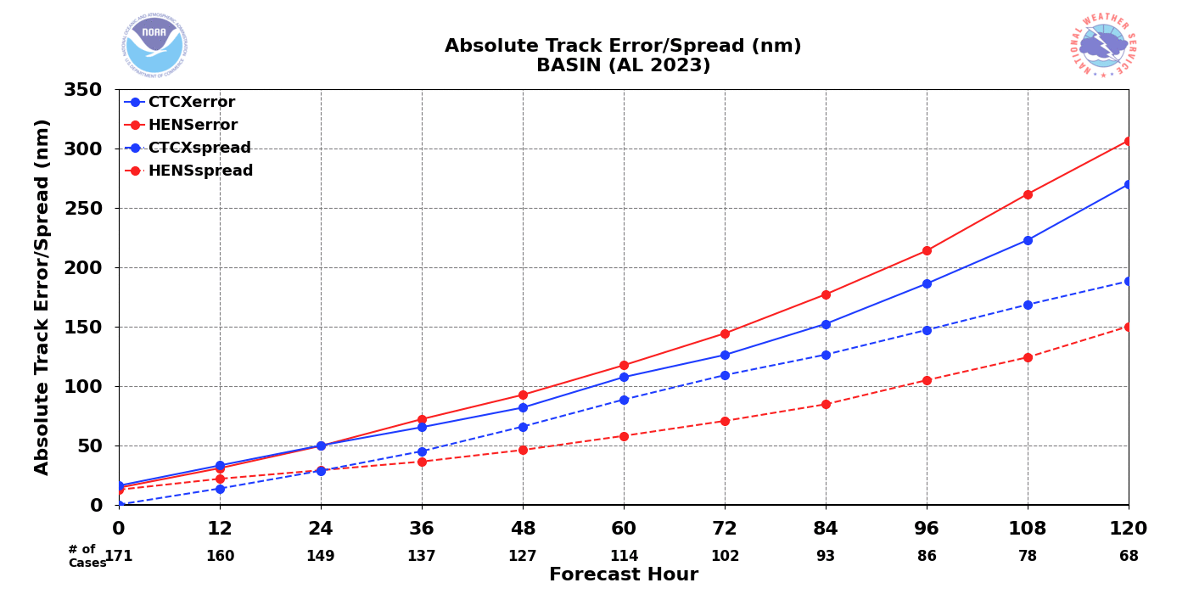
Intensity and Track Error/Spread Relationship
CTCXens error (solid blue))
CTCXens spread (dashed blue)
HAFSens error (solid red)
HAFSens spread (dashed red)
Intensity
Under dispersive for HAFSens
track/intensity forecasts
Track

Slide 14
2024 HAFS Ensemble Configurations
Atmospheric model: FV3 Dycore, ESG (4km), L81-vertical layers(2hPa)
CCPP Physics: Thompson Microphysics, RRTMG, unified UGWD(v1.0)
Upgraded scale-aware convection parameterization (Sa-SAS + shear)
Surface layer scheme (GFS)
Upgraded PBL, sa-TKE-EDMF + shear
TC-specific mixing length scale adjustment
Land model: NOAH-LSM
Ocean model: MOM6 (1/12 degree, Atlantic basin)
Stochastic physics: SPPT, SKEB, SHUM and ocean surface roughness perturbations
IC/BC: GEFS grib2 (0.5x0.5), RTOFS
One control member plus 20 perturbed ensemble members
Adding VI/DA in the initialization processes
Runs 2 cycles per day (00Z, 12Z), Atlantic basin only

Slide 15
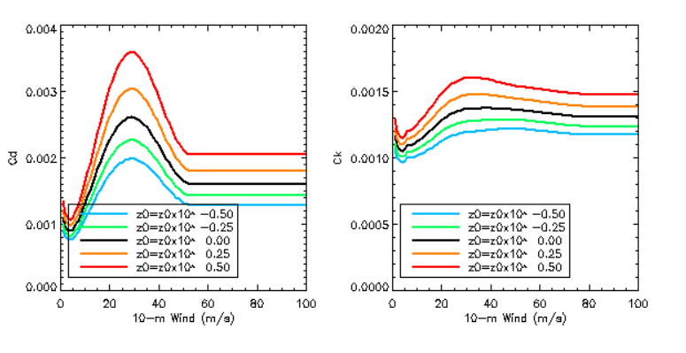
Ocean surface roughness (Z0) perturbations and the related (Cd/Ck) changes
Surface exchange coefficient
for momentum (Cd)
Surface exchange coefficient
for heat and moisture (Ck)

Slide 16
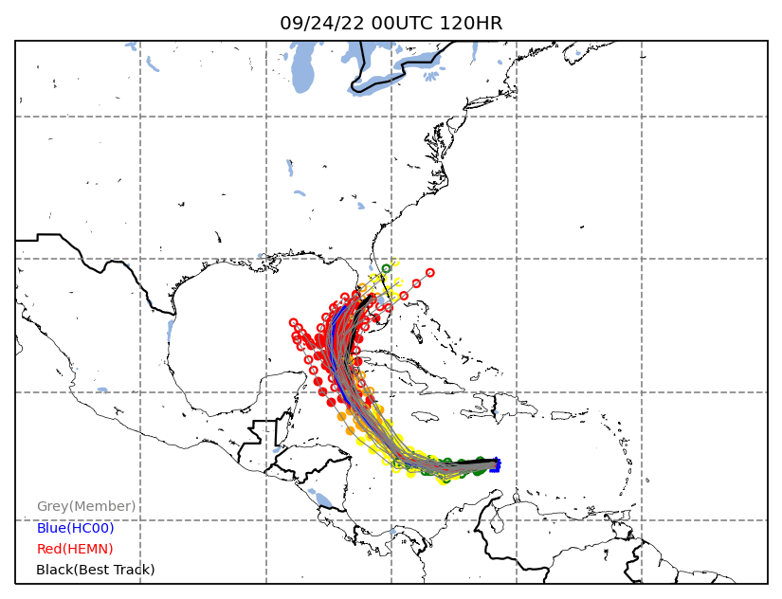
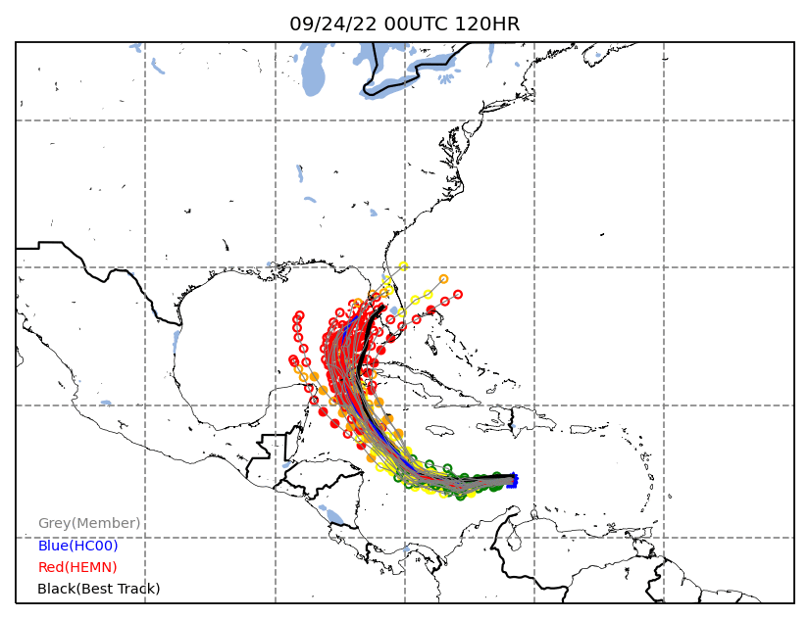
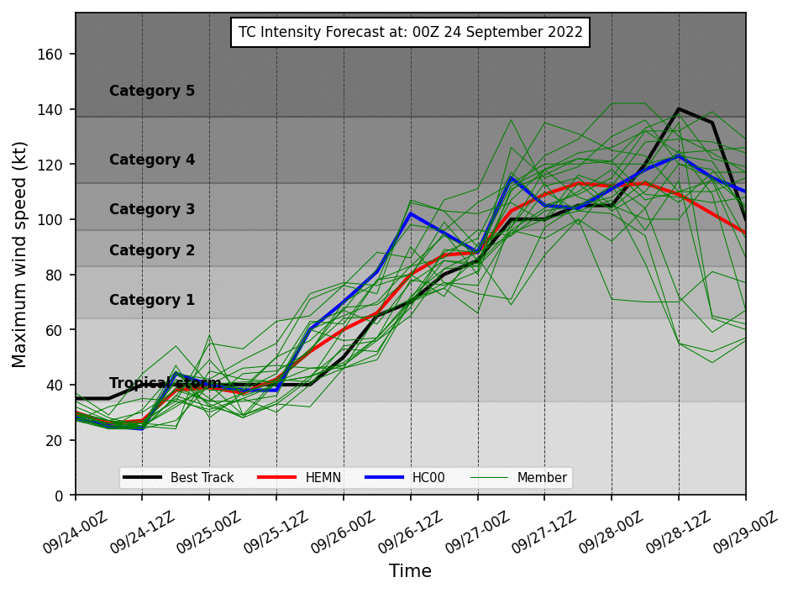
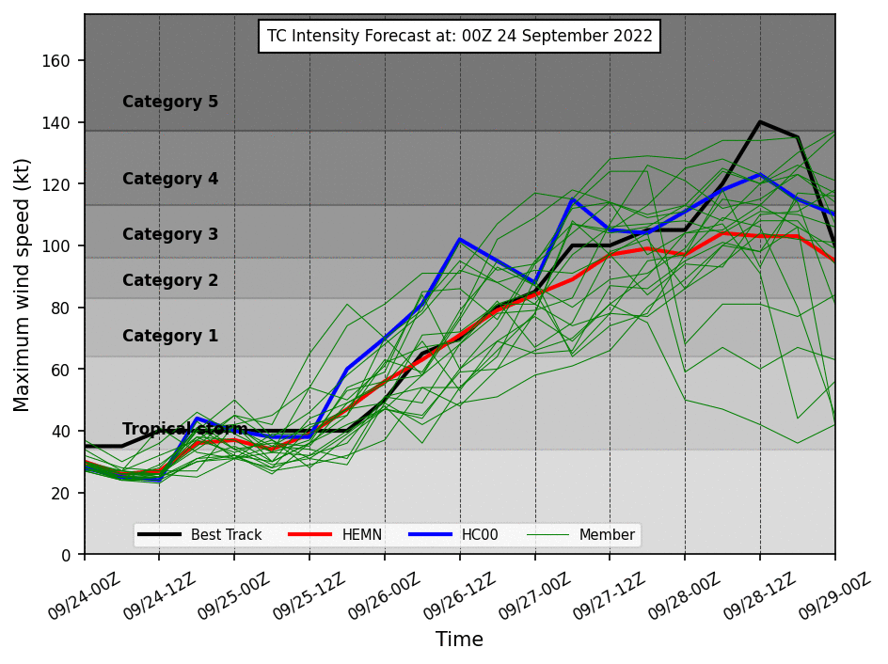
Without Ocean Z0 Perturbation
With Ocean Z0 Perturbation
HAFS ensemble (version 2)
forecast for IAN (2022)

Slide 17
Summary
The Hurricane Analysis and Forecast System (HAFS) Ensemble in Real-time on the Cloud (HERC) experiment of 2023 was a highly successful real-time demonstration of the feasibility of the National Weather Service (NWS) running a state-of-the-science hurricane modeling system on the cloud (hfip.org).
A new version of HAFS ensemble (V2) including the VI/DA and stochastic parameter perturbations is expected to do a better job for the 2024 hurricane forecasts.
Please go to: https://www.emc.ncep.noaa.gov/HAFS/HAFSEPS/index.php

Slide 18
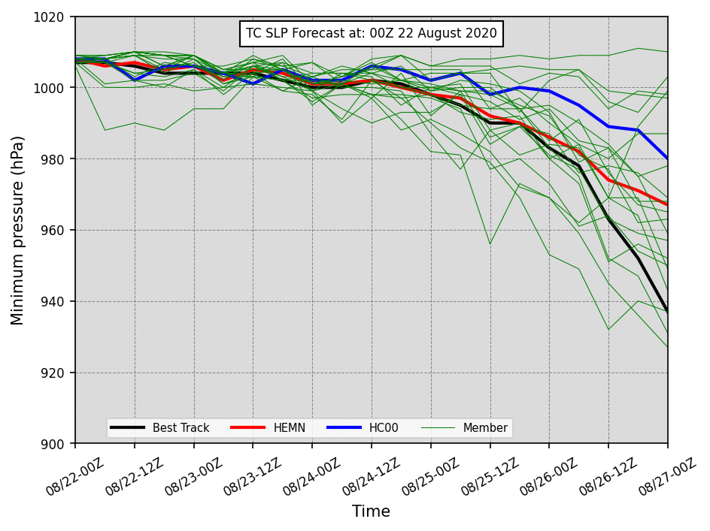
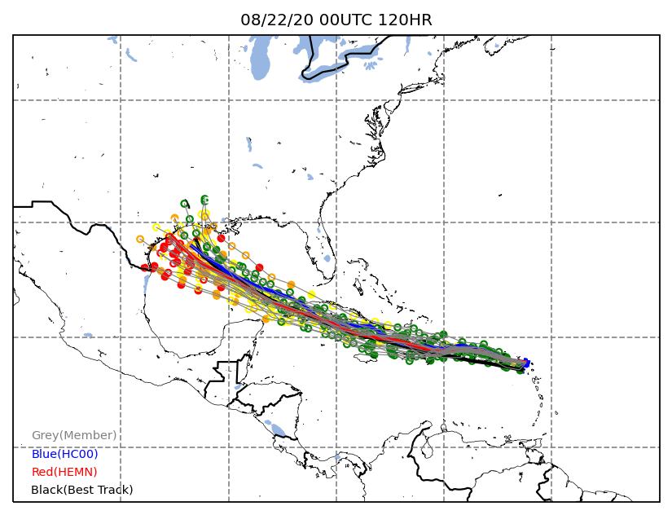
HAFS ensemble (version 2) forecast for Hurricane Laura (2020)

Slide 19
Final HAFS v2 physics schemes
 | Suite 1 (HFSAv2) | Suite 2 (HFSBv2)
Land/ocean Surface | NOAH LSM VIIRS veg type, MOM6 | NOAH LSM VIIRS veg type HYCOM
Surface Layer | GFS, HWRF TC-specific sea surface roughnesses | GFS, HWRF TC-specific sea surface roughnesses
Boundary Layer | Sa-TKE-EDMF+shear: sfc_rlm=1 tc_pbl=0 elmx/rlmx=250 (nest) | Sa-TKE-EDMF+shear: sfc_rlm=0 tc_pbl=1 elmx/rlmx=75 (nest)
Microphysics | Thompson, dt_inner=45s (AL) GFDL MPv1 (EP) | Thompson, dt_inner=36s
Radiation | RRTMG Calling frequency 900 s | RRTMG Calling frequency 720 s
Cumulus convection (deep&shallow) | sa-SAS +shear progsigma=F (AL), T (EP) entrainment:clam_deep=0.15 | sa-SAS +shear progsigma=F (AL), T (EP) entrainment: clam_deep=0.1
Gravity wave drag | Improved UGWPv1 (orographic on/convective off) | Improved UGWPv1 (orographic on/convective off)

Slide 20
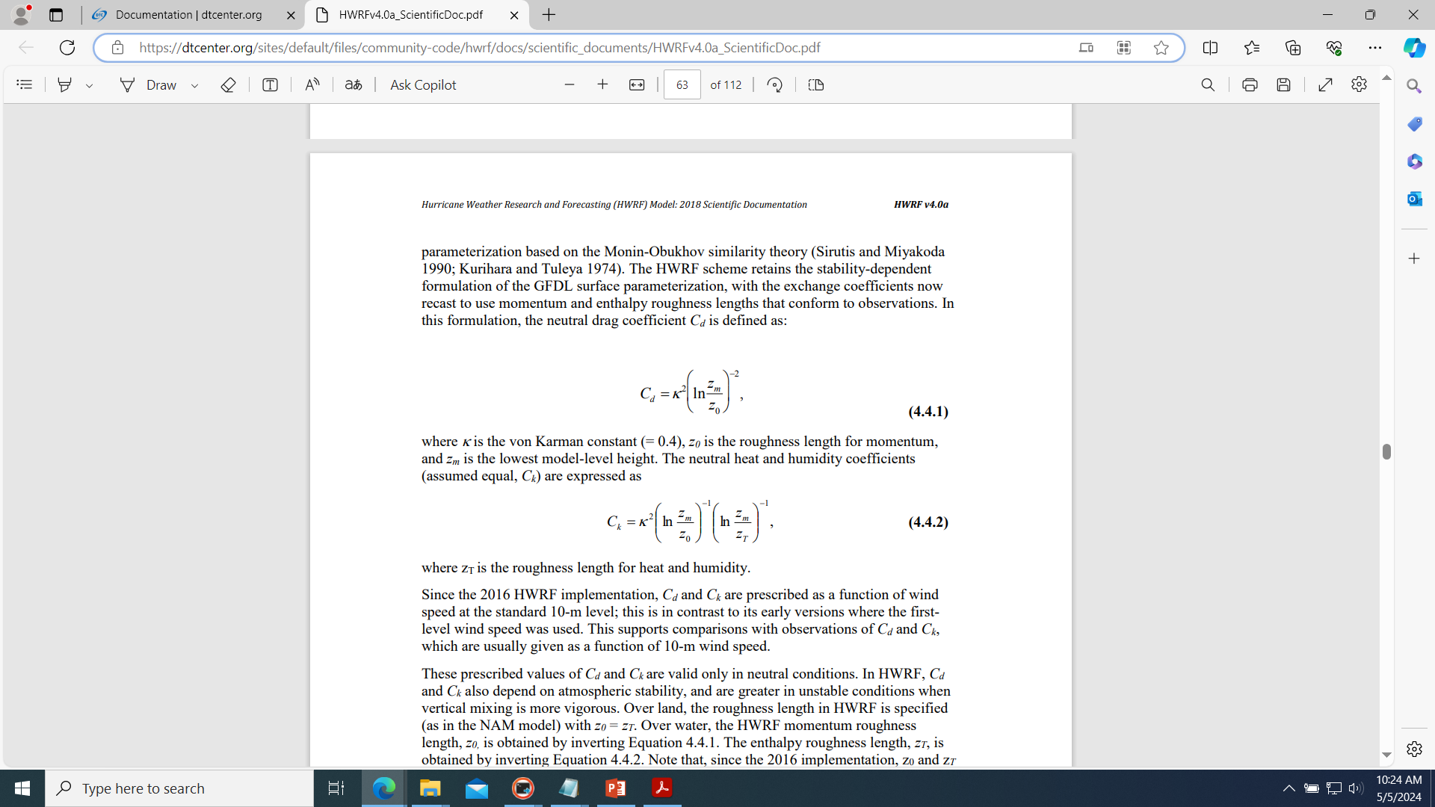
https://dtcenter.org/sites/default/files/community-code/hwrf/docs/scientific_documents/HWRFv4.0a_ScientificDoc.pdf (P53-54)

Slide 21
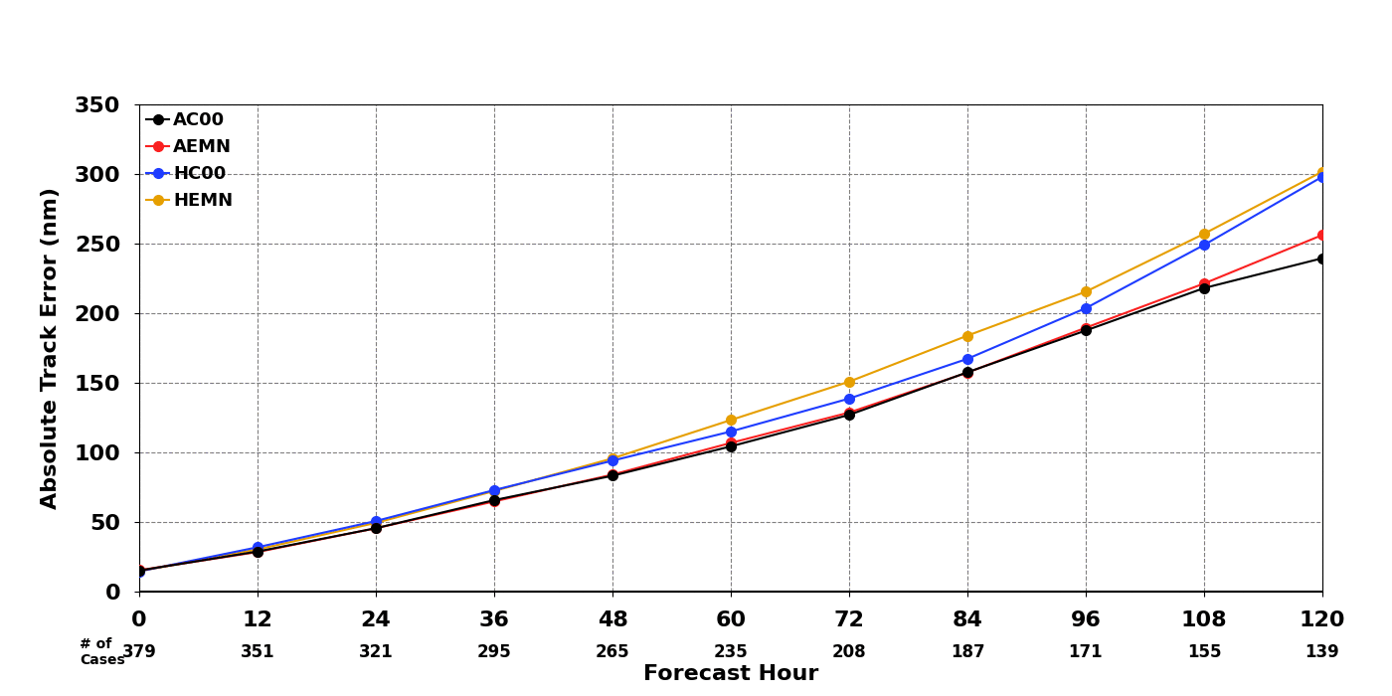
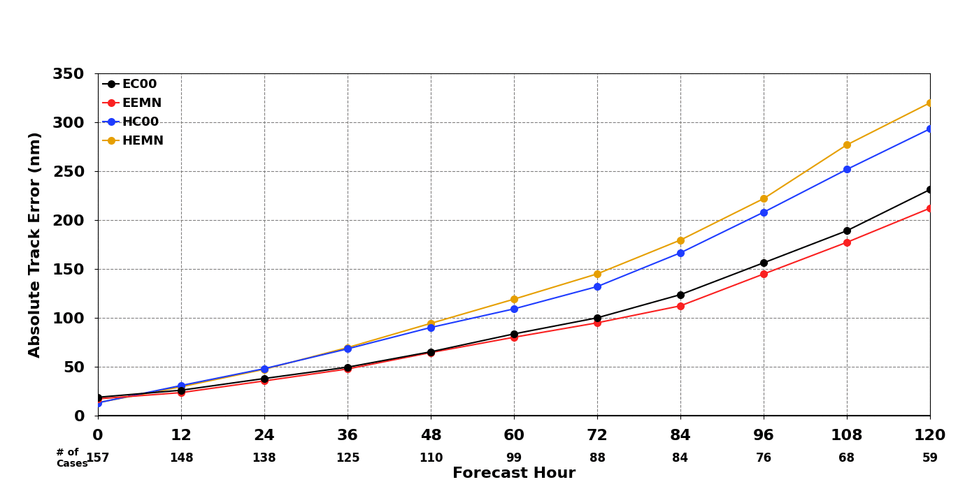
2023 TC Track Error (HAFSens VS. GEFS/EENS)
GEFS control member (AC00)
GEFS 30-member mean (AEMN)
HAFS control member (HC00)
HAFS 20-member mean (HEMN)
ECMWF control member (EC00/9km)
ECMWF 50-member mean (EEMN/9km)
HAFS control member (HC00)
HAFS 20-member mean (HENS)
HAFSens: track error increased, most contributed by “Philippe (AL17-2023)”.

Slide 22
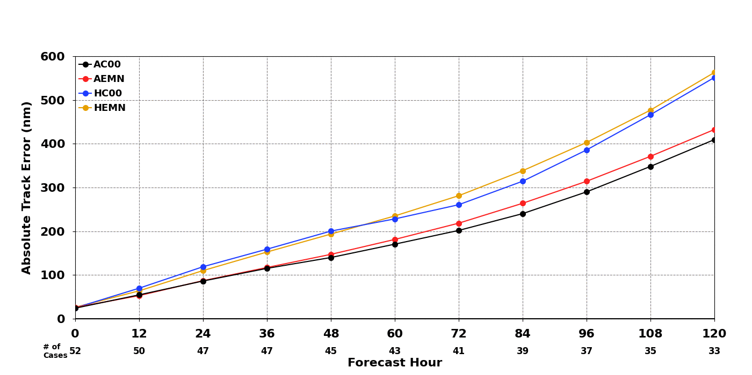
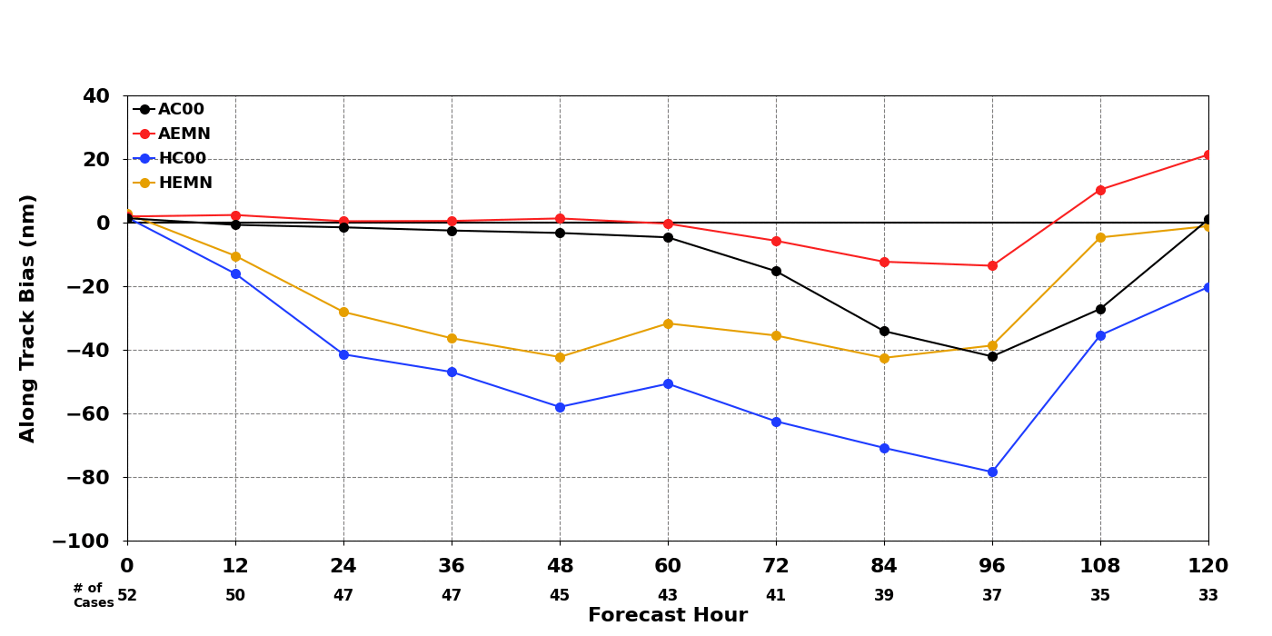
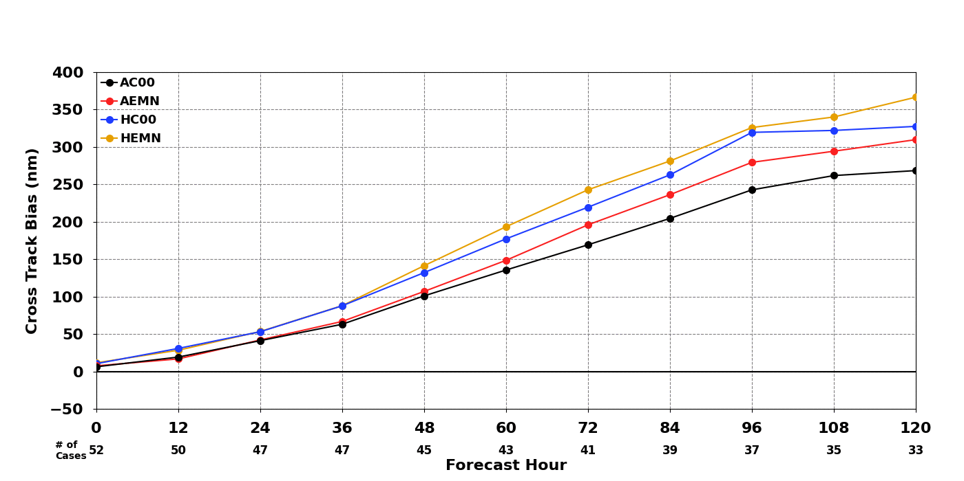
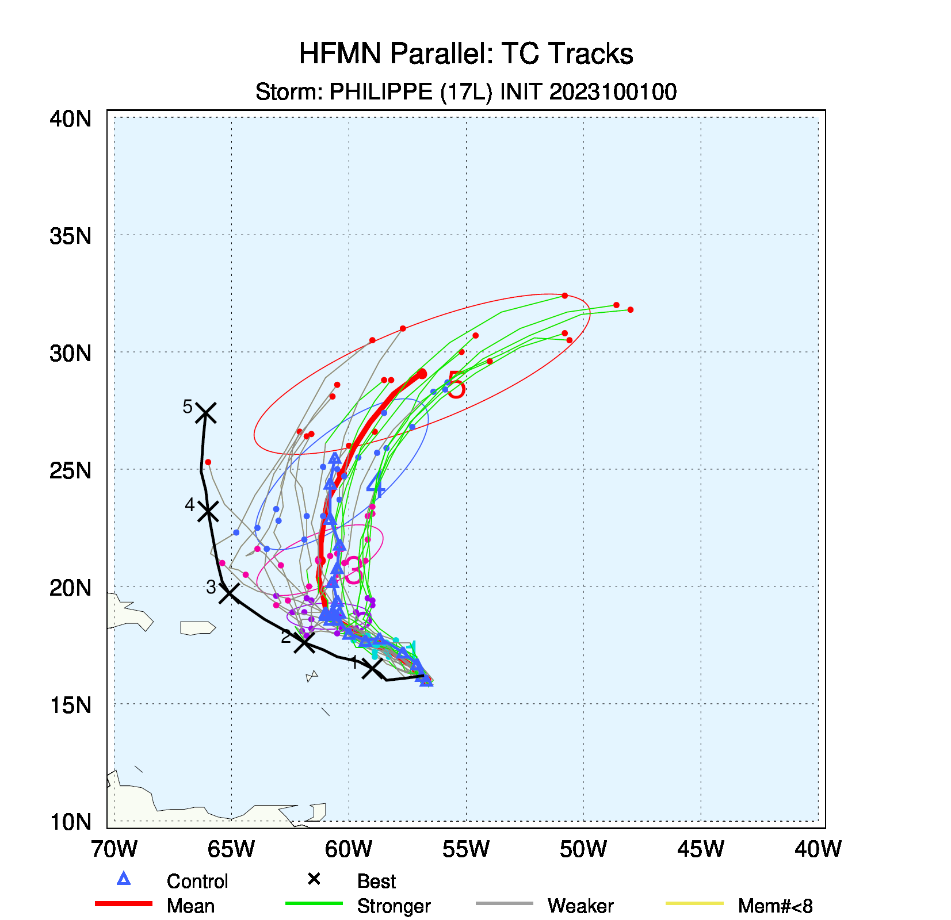
Track error
Along track bias
Cross track bias
HAFS ensemble VS. GEFS ensemble
Fujiwhara Effect: Philippe (AL17) and Rina (AL18)

Slide 23
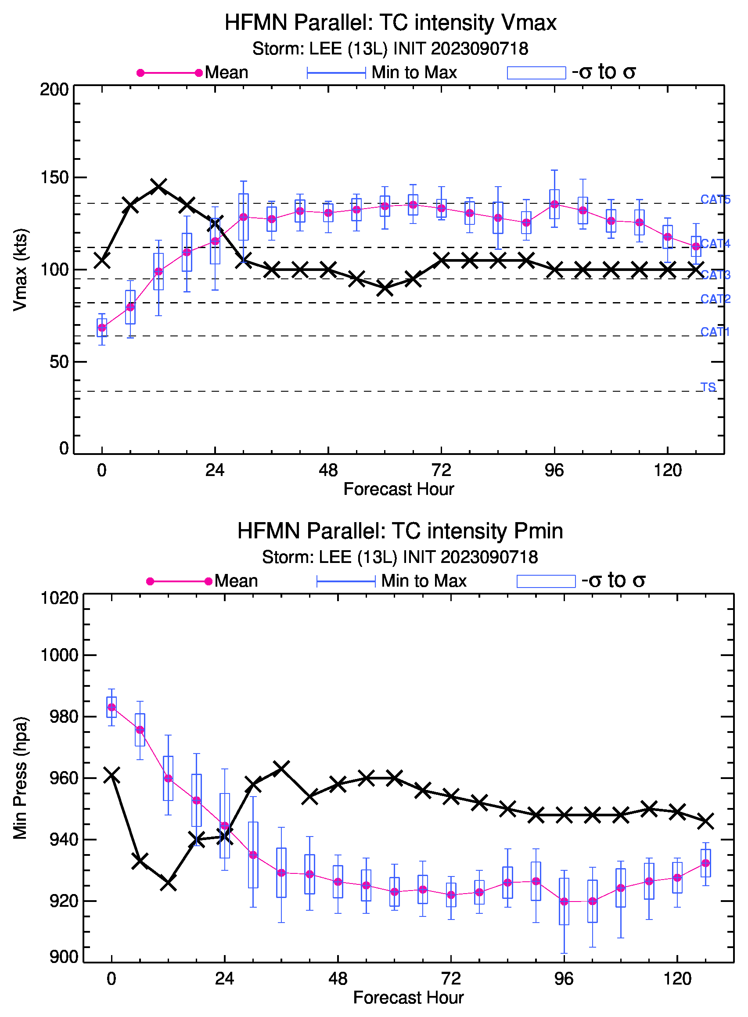
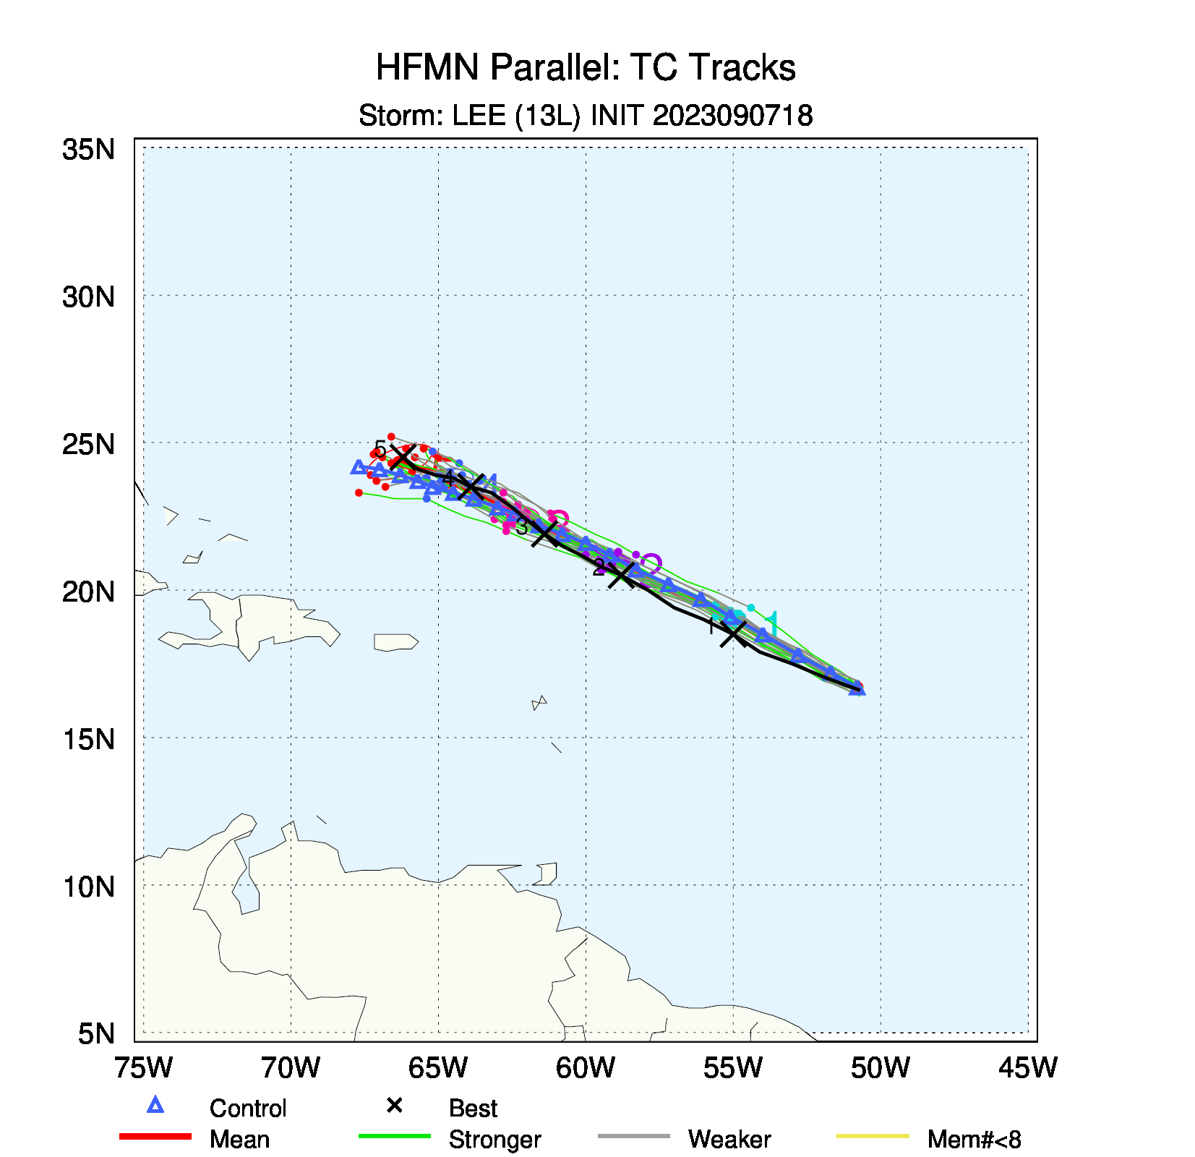
Challenge Storm “Lee”
Initial vortex comes from GEFS (very weak)

