Slide 1
Observing System Simulation Experiments for an Early-Morning-Orbit Meteorological Satellite in the Joint Center for Satellite Data Assimilation
Sean P.F. Casey^{1,2,3,4}, Michiko Masutani^{3,5}, Jack Woollen^{3,5},
Lars Peter Riishojgaard^{2,3} and Tong Zhu^{3,4}
¹Cooperative Institute for Climate and Satellites (CICS)
²Earth System Science Interdisciplinary Center (ESSIC)
³Joint Center for Satellite Data Assimilation (JCSDA)
⁴NOAA/NESDIS/STAR
⁵NOAA/NWS/NCEP/EMC

Slide 2
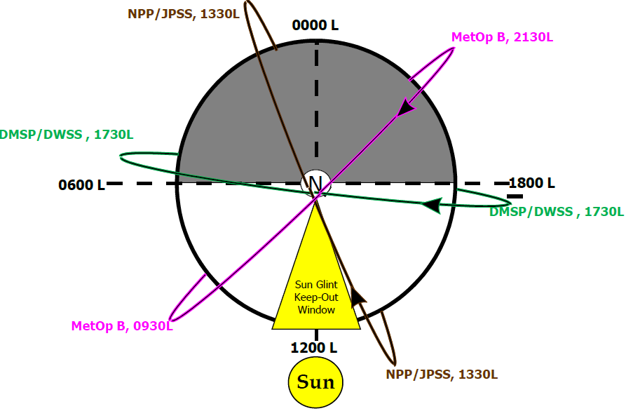
Three polar orbits? Or two?
Following the cancellation of the NPOESS program in February 2010, US plans for sounding coverage in the early morning orbit (~5:30 AM ECT) were put on hold indefinitely. How might the lack of early morning sounding coverage affect medium-range weather forecasts? Which of three suggested replacement satellites would have the greatest forecast impact?
Image Courtesy F. Weng

Slide 3
Joint Observing System Simulation Experiment (OSSE) Structure
OSSE Conceptual Model
Four major components:
Nature run made by ECMWF T511 from 1 May 2005 to 31 May 2006.
Forward models, including CRTM, to generate all satellite radiances and radiosonde observations.
NCEP GSI, to assimilate the observations into initial and boundary conditions.
NCEP GFS, to make the forecasts and perform impacts study with and without a new instrument.
ECMWF: Global model
GSI: Data Assimilation
Nature Run
Initial/Boundary
Conditions
Forward Model: CRTM
GFS:
Global model
Simulated Satellite Observations
Forecasts w/o
New Sensor OBS

Slide 4
Experiments:
A control run, using all available instruments as of May 1st, 2012
Same as 1., but without current early morning orbit coverage [(no Special Sensor Microwave Imager/Sounder (SSMI-S)]
Same as 2., but with Cross-track Infrared Sounder (CrIS) and Advanced Technology Microwave Sounder (ATMS) added in the early morning orbit
Same as 2., but with Visible Infrared Imaging Radiometer Suite (VIIRS) in the early morning orbit (i.e. polar winds)
Same as 2., but with VIIRS and ATMS in the early morning orbit

Slide 5
Simulating new instruments

Slide 6
Model Specifications
Experimental Setup:
NCEP GDAS system based on May 2011 GFS, May 2012 GSI
Horizontal resolution of T-382 (previously used for operations) constrained by
Computational resources
Nature Run resolution (T-511)
Experimental periods:
July/August: 2005 Nature Run, using instruments from 2011 (+ ATMS & CrIS/NPP)
January/February: 2006 Nature Run, using instruments from 2012
2-week spin-up for each time period & experiment, 45 days for forecast impact analysis

Slide 7
Key Questions
How might the lack of early morning sounding coverage affect medium-range weather forecasts?
Experiment 1 (cntrl_sum) vs. Experiment 2 (nossmis_sum)
Which of three suggested replacement satellites would have the greatest forecast impact?
Experiment 2 vs. Experiments 1, 3 (atmscris_sum), 4 (viirs_sum), and 5 (atmsvirs_sum)

Slide 8
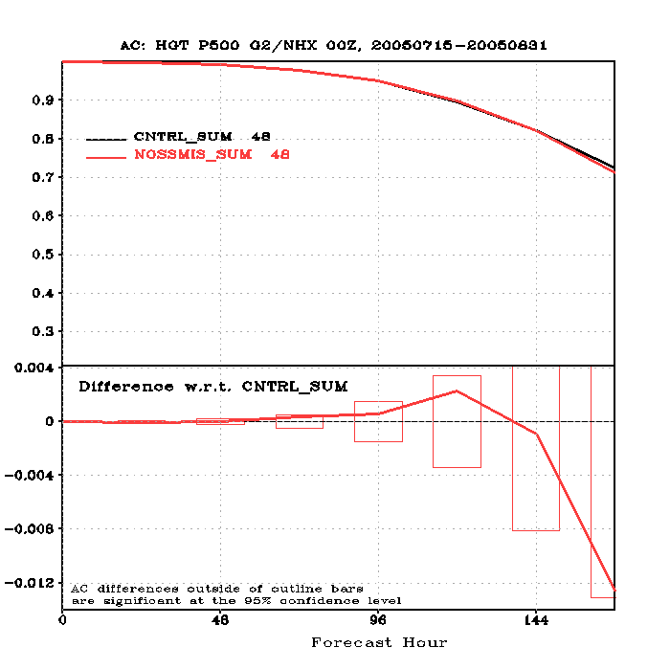
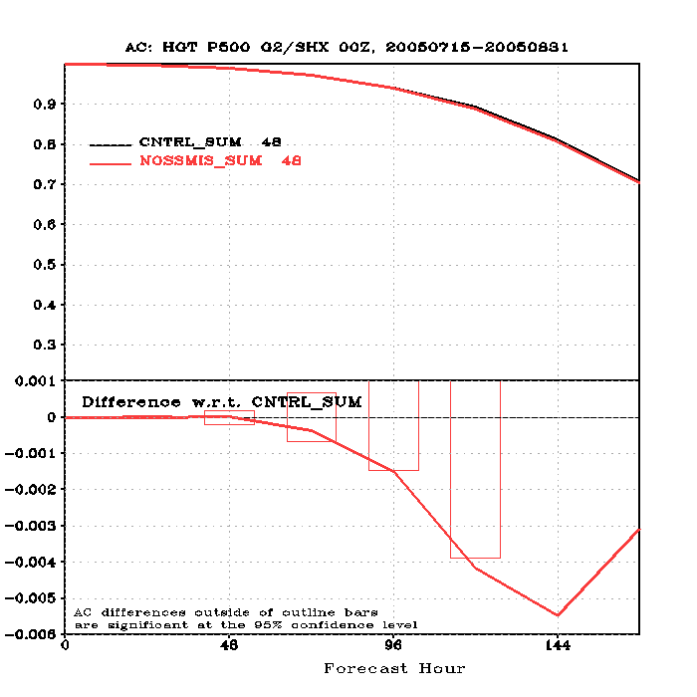
500 hPa Anomaly Correlation Scores
Northern Hemisphere (nonsignificant)
Southern Hemisphere (significant at day 4, 5)

Slide 9
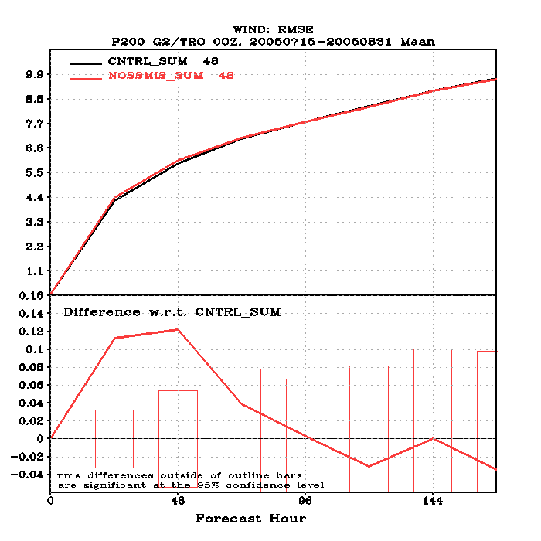
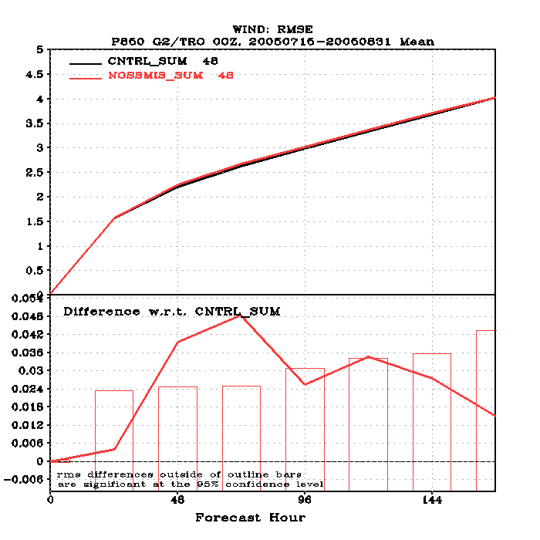
Tropical Wind Speed RMSE
200 hPa
(significant at day 1, 2)
850 hPa
(significant at day 2, 3)

Slide 10
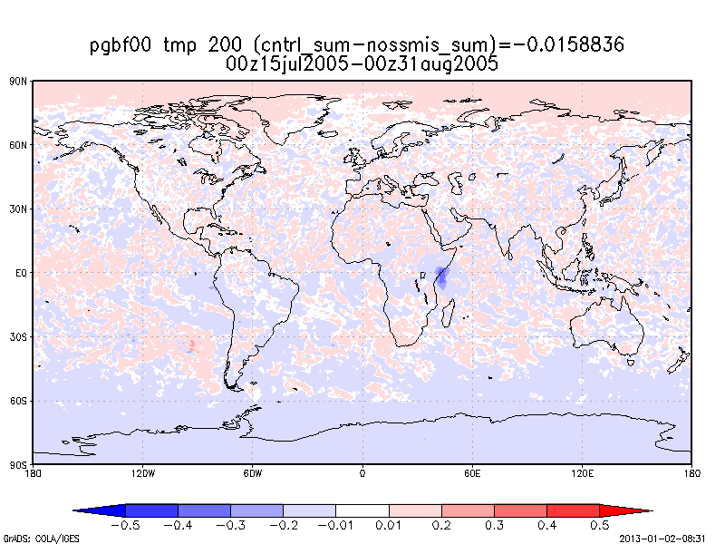
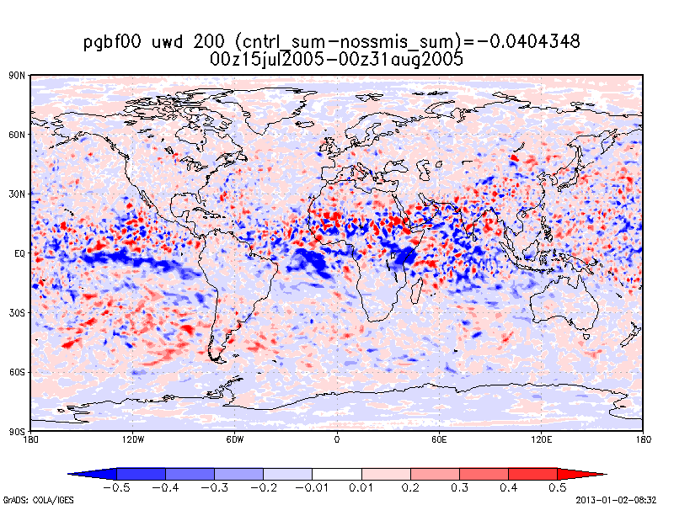
Negative Effects on Analysis
Knowing what “truth” is in the context of an OSSE (i.e., the nature run), we can then compare both experiments to the nature run to see which experiment is closer to “truth” over time.
Pink/Red colors on right are where nossmis is closer to the nature run; Blue is where cntrl is closer to nature run
Removing SSMI/S causes significant analysis biases in 200 hPa temperature (upper right) and zonal wind (lower right)
Temperature effects most pronounced in Southern Hemisphere, wind effects most pronounced in tropics

Slide 11
Key Questions
How might the lack of early morning sounding coverage affect medium-range weather forecasts?
Experiment 1 (cntrl_sum) vs. Experiment 2 (nossmis_sum)
Which of three suggested replacement satellites would have the greatest forecast impact?
Experiment 2 vs. Experiments 1, 3 (atmscris_sum), 4 (viirs_sum), and 5 (atmsvirs_sum)

Slide 12
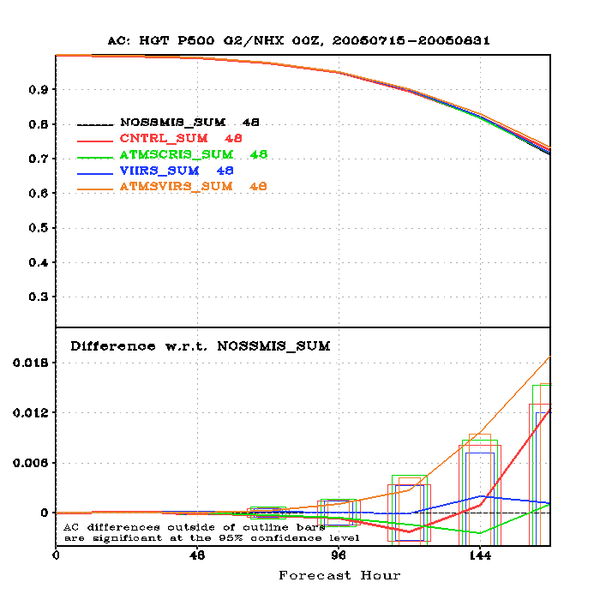
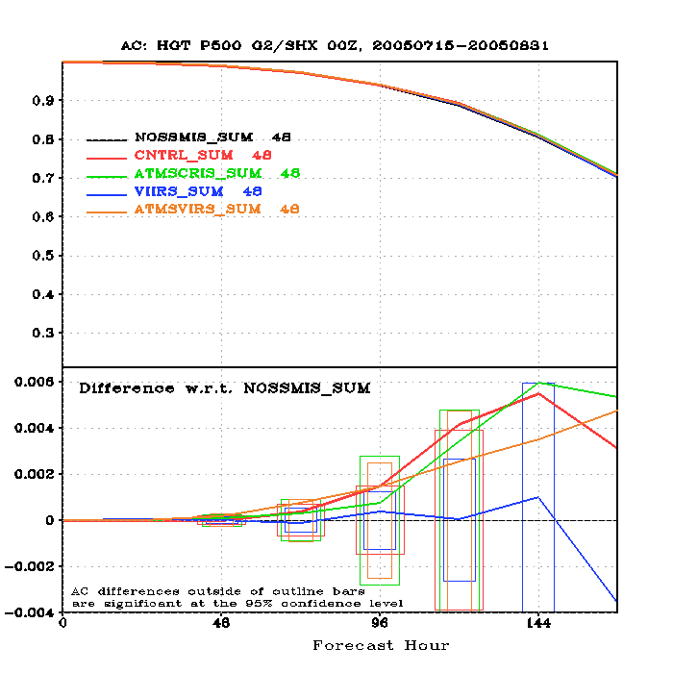
500 hPa Anomaly Correlation Scores
Northern Hemisphere (ATMS/VIIRS significant day 6, 7)
Southern Hemisphere (SSMI/S significant day 4, 5)

Slide 13
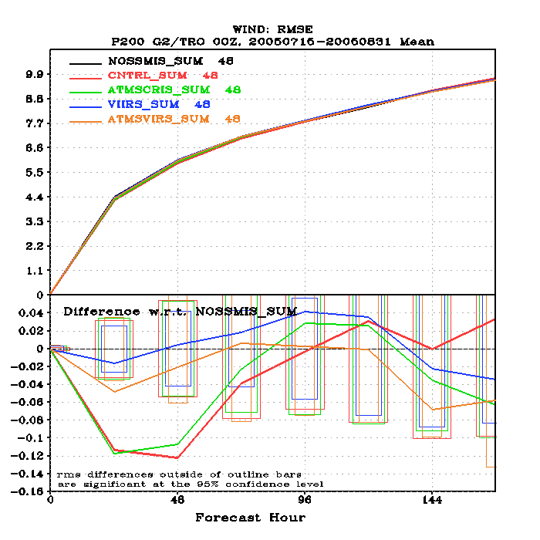
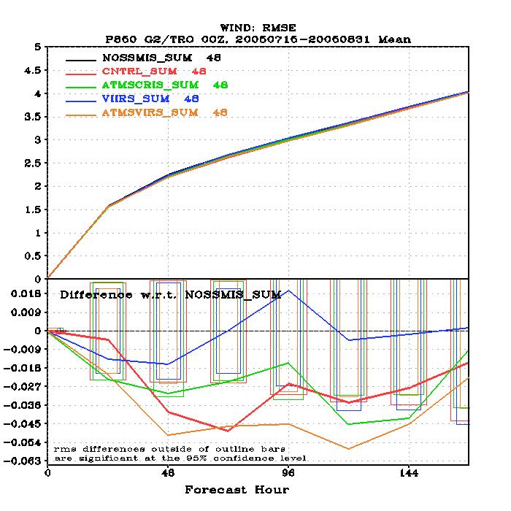
Tropical Wind Speed RMSE
200 hPa (ATMS/CRIS & SSMI/S significant, day 1, 2)
850 hPa (ATMS/VIIRS significant days 2-6)

Slide 14
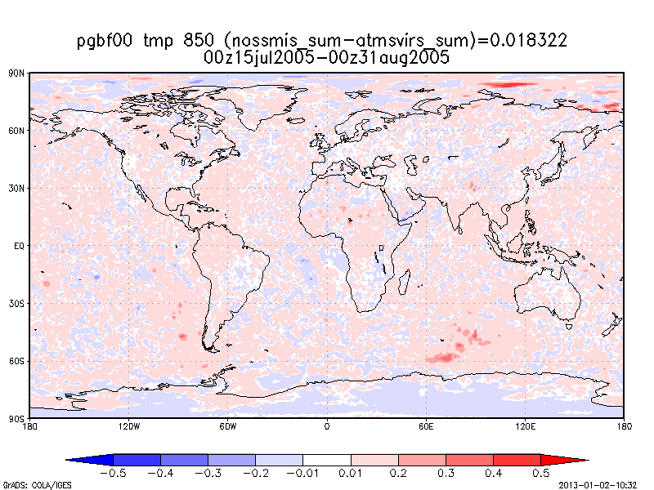
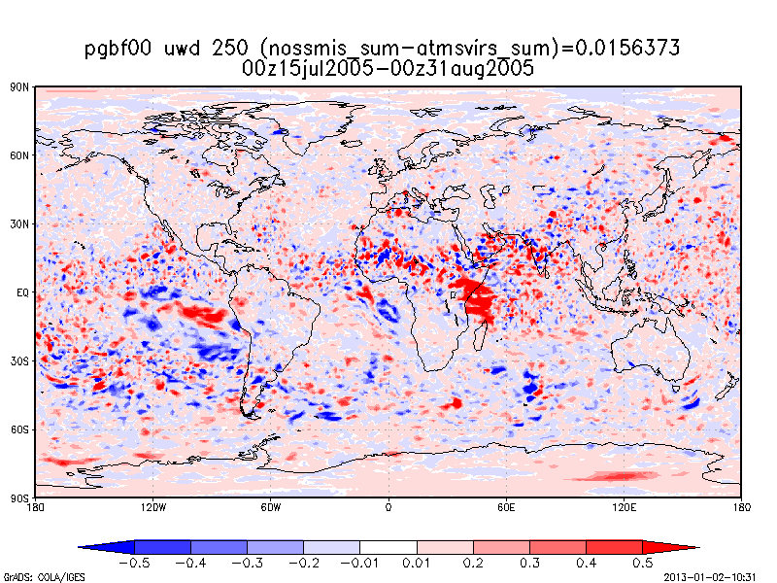
Positive Effects on Analysis
After computing root-mean-square difference (RMSD) between all experiments vs. nossmis, we can then calculate the total difference between 200 & 1000 hPa:
TD_{tot} values for temperature:
TD_{tot}(atmsvirs)=4.81 K
TD_{tot}(atmscris)=4.54 K
TD_{tot}(cntrl)=3.13 K
TD_{tot}(viirs)=0.4 K
Greatest T improvement with atmsvirs is in lower troposphere (850 hPa, upper left)
Greatest zonal wind improvement in upper troposphere (250 hPa, lower left), though there is large lat/lon variation
atmscris does slightly better than atmsvirs in mid-troposphere (600 hPa, not shown); atmscris and atmsvirs yield similar results on model forecast

Slide 15
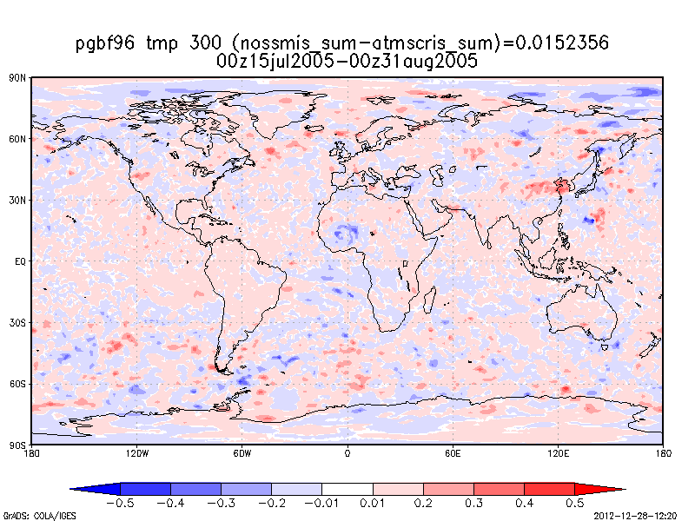
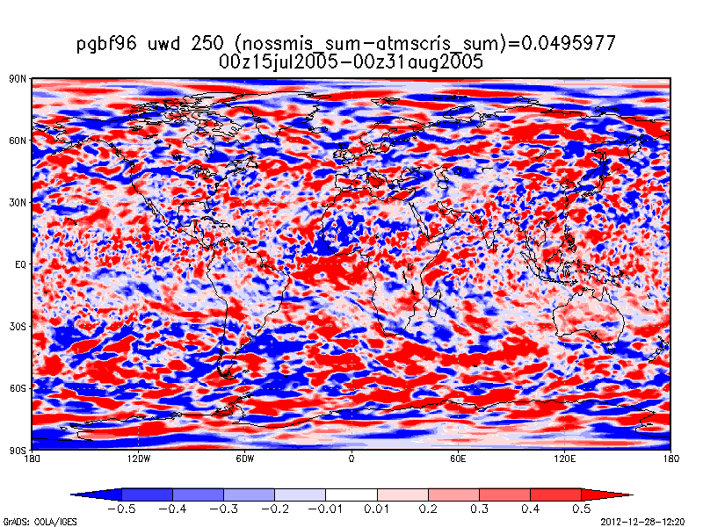
Positive Effects on Forecast
We can also compute TD_{tot} for different analysis times, to see how the different data sources affect the analysis.
TD_{tot} values for temperature forecasts (Day 4):
TD_{tot}(atmscris)=5.17 K
TD_{tot}(atmsvirs)=3.01 K
TD_{tot}(cntrl)=3.13 K
TD_{tot}(viirs)=0.4 K
Greatest T improvement with atmscris is in upper troposphere (300 hPa, upper left)
Greatest zonal wind improvement in upper troposphere (250 hPa, lower left), though large variations are noted
Unsure why atmscris performs better than atmsvirs in forecasts when both were similar in analyses

Slide 16
Conclusions
Current OSSE work demonstrates the importance of a meteorological satellite in the early-morning orbit
Losing SSMI/S causes significant decreases in model analysis and forecast skill, especially in Southern Hemisphere and tropical winds
Best performing replacements for SSMI/S are a combination of ATMS/CrIS or a combination ATMS/VIIRS; VIIRS alone causes little improvement
Future work will include continuing experiment for Jan/Feb, to compare hemispheric seasonal effects

