Slide 1
JCSDA OSSE Capabilities, Status and Plans
Lars Peter Riishojgaard, JCSDA, Michiko Masutani, NCEP/EMC, Sean Casey, JCSDA, Jack Woollen, NCEP/EMC, and Bob Atlas, NOAA/AOML

Slide 2
Overview
JCSDA OSSE history
OSSE system overview
Wind Lidar OSSEs (example)
Future Plans
Summary and conclusions

Slide 3
Joint OSSE history
NASA/NOAA collaboration started in 2007, involving NASA/GSFC, NOAA/NESDIS, NOAA/NWS, NOAA/OAR
Centered around common use of Nature Run provided free of charge by ECMWF
Coordinated through JCSDA
Informal, loosely structured nature, lack of common funding stream has presented challenges
Successful joint validation of ECMWF Nature Run
Some collaboration on simulation and calibration of observations
ADM experiments (GMAO)
GWOS experiments (JCSDA)
UAS experiments (OAR)

Slide 4
Main OSSE system components
Data assimilation system(s)
NCEP/EMC Global Forecast System (T-382)
Nature run
ECMWF T-511, commissioned for Joint OSSE
13 month period (May 2005-June 2006)
Validated extensively through Joint OSSE collaboration
Simulated observations
Reference observations, including satellite radiance data; done in collaboration between NCEP and STAR
Perturbation (“candidate”) observations; done on ad hoc basis
Diagnostics capability
NCEP operational verification system

Slide 5
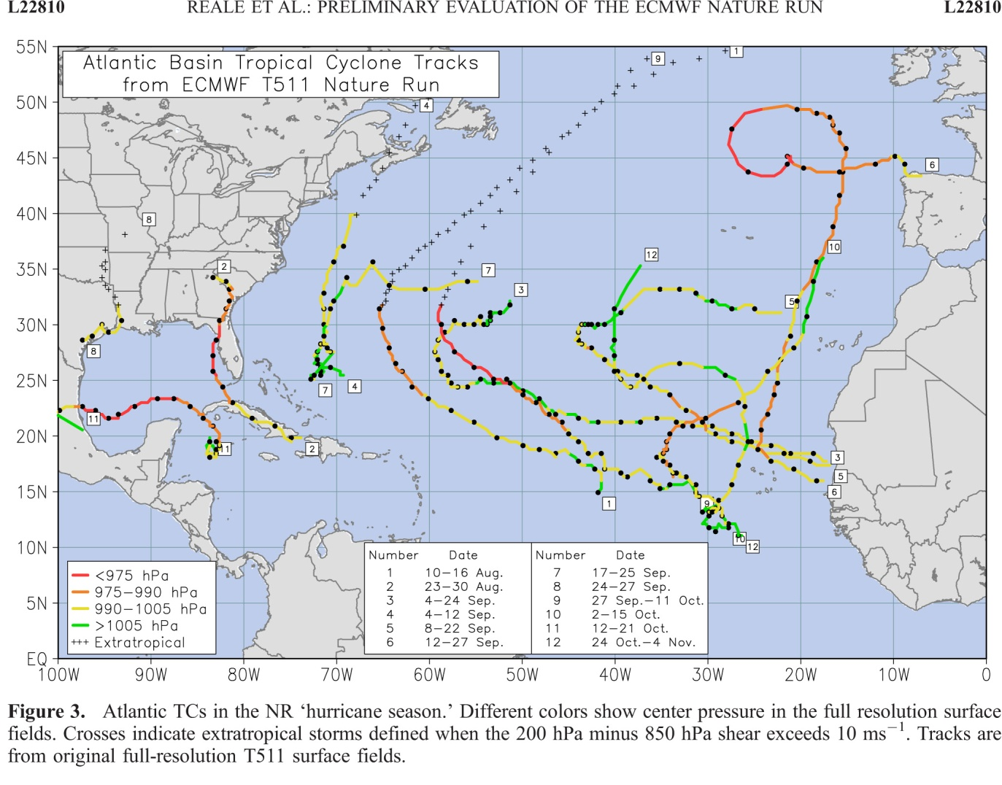
Nature Run validation example: Hurricanes (Reale)

Slide 6
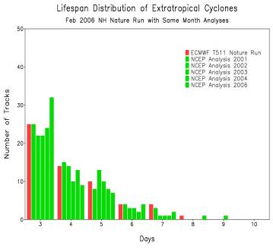
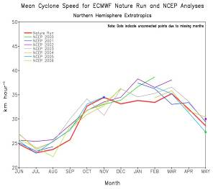
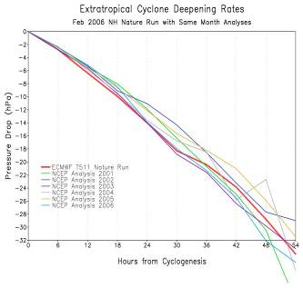
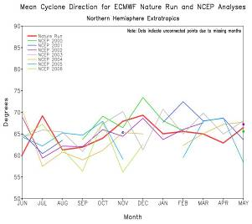
Nature Run validation example: Extratropical cyclones (Terry)

Slide 7
Simulation of reference observations (I), conventional
Conventional observations: “anything other than satellite radiances”
Conceptually simple: Resample NR at observation locations and add error
Problem: For many observation types the locations depend on the atmospheric state:
Radiosondes (drift)
Satellite winds (tracking targets)
Aircraft obs (flight routing)
Ocean surface winds (thresholds and precip)
This is NOT accounted for currently: Actual historical obs locations for 2005 are used
SWA working on more sophisticated approach to scatterometer winds and satellite AMVs

Slide 8
Reference observation simulation (II): Radiances
Satellite radiances dominate both in terms of numbers and of impact
Conceptually: Forward radiative transfer applied to NR input profiles
Problem areas:
Treatment of clouds has substantial impact on availability and quality of observations, and on subsequent QC, thinning and ultimately assimilation results
Desire to avoid “identical twin” Radiative Transfer Models; conceptually one should be use one RTM for simulation and a different RTM for assimilation
NOT yet implemented in Joint OSSE

Slide 9
Types of data simulated
Set A (2005-6 period)
AIRS (Aqua),
AMSU-A (Aqua, NOAA-15, 16, 18),
AMSU-B (NOAA-15, 16, 17),
HIRS2 (NOAA 14),
HIRS-3 (NOAA 15, 16, 17),
HIRS-4 (NOAA-18),
MSU (NOAA-14),
MHS (NOAA-18)
GOES sounder (GOES-10, 12)
All conventional data available in 2005-2006
Set B (2011-12 period)
IASI(METOP-A), AIRS(AQUA), ATMS(NPP), CrIS(NPP)
HIRS-2(NOAA14),
HIRS-3(NOAA 15, 16,17),
HIRS-4(NOAA 18, 19, METOP-A), AMSUA(NOAA 15, 16, 17,18,19, AQUA, METOP-A),
AMSUB(NOAA 15, 16, 17),
MSU(NOAA 14), HSB(AQUA), MHS(METOP-A,NOAA18,19), SSMIS(DMSP F16), SEVIRI(MSG)
GOES sounder (10,12, and 13)
GPSRO
ASCAT
WINDSAT
All conventional data available in 2011-12

Slide 10
Calibration Experiments
Compare impact of removal of RAOB wind in real and simulated experiments
REAL
Simulated

Slide 11
Wind Lidar OSSEs
Impact experiments for GWOS mission concept
NASA Tier-3 Decadal Survey mission concept
Four telescopes, full vector winds on either side of spacecraft
Two technologies, direct and coherent detection
Experiments funded under Wind Lidar Science element of NASA’s ROSES 2007
GWOS observations simulated by Simpson Weather Associates using DLSM

Slide 12
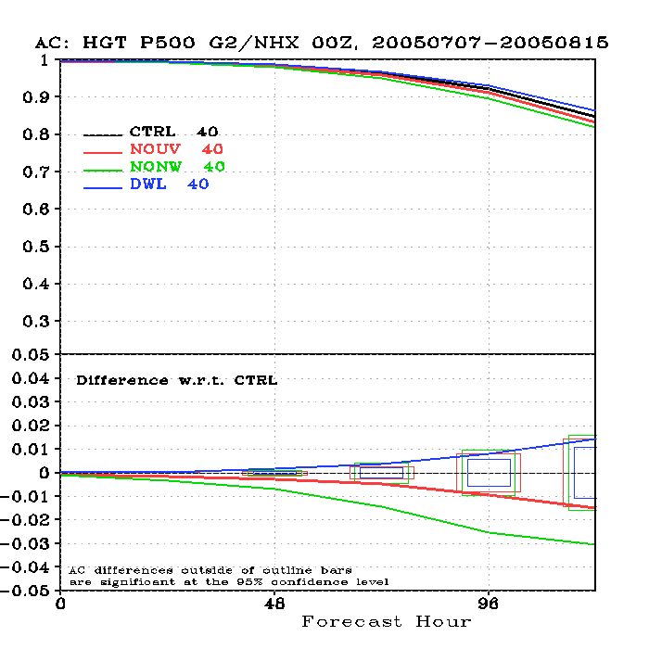
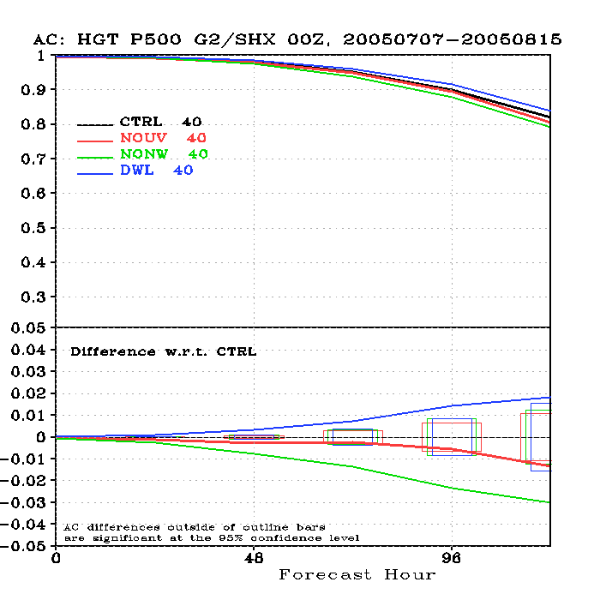
500hPa HGT anomaly correlation coefficients
(T382)
NH
SH
1.2%
1.8%

Slide 13
Beyond initial wind lidar OSSEs
The JCSDA OSSE system is ready for global NWP assessment studies of any new observing system (space-based or otherwise)
OSSEs for JPSS (JPO)
OSSEs for DWSS (DoD); presented in JCSDA Symposium Tuesday
Hyperspectral GEO IR sounder (NOAA)
Other wind lidar technologies (NASA)
GPSRO (DoD)
….
New higher resolution Nature Run
In discussions with ECMWF, GMAO, NOAA/OAR,…

Slide 14
Simulating new instruments
See Poster 709 (Tomorrow, 2:30-4:00, Exhibit Hall 3)
and TJ43.7 (Tomorrow, 5:30, Room 9C) for more information on observation simulation

Slide 15
500 hPa Anomaly Correlation Scores
Northern Hemisphere (ATMS/VIIRS significant day 6, 7)
Southern Hemisphere (SSMI/S significant day 4, 5)

Slide 16
Summary and conclusions
A comprehensive OSSE system has been developed under the Joint OSSE collaboration
This is the first global OSSE system using a modern, satellite radiance-based operational data assimilation system
Example of use of new OSSE system: NASA-funded study of a potential wind lidar system
The JCSDA OSSE system is a valuable national asset and is being used for assessment studies sponsored by NASA, NOAA and DoD

